Slide 1
Underground Natural Gas Storage
American Gas Association
May 2, 2019
Byron Coy PE
Senior Technical Advisor
USDOT / PHMSA

Slide 2
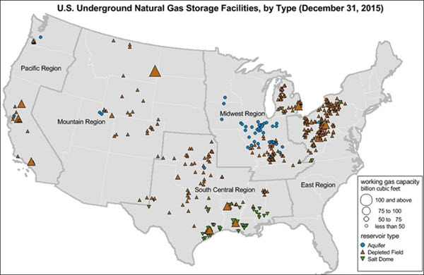

Slide 3
General Statistics
125 Operators
4800 BCF Working Capacity
400 Storage Fields
85% Reservoir-Aquifer, 15% Salt Domes
17000 Wells
Tally based on EIA Information and Annual Reports submitted March 15, 2018
12% increase in PHMSA inspection burden

Slide 4
Interim Final Rule
Docket No. PHMSA-2016-0016
Based on API RP-1170 & 1171
Published December 19, 2016
Effective January 18, 2017
Stay of Enforcement for non-mandatory, June-2017
General Compliance January 18, 2018
Integrity Programs in place January, 2019

Slide 5
States Statistics
---- Top 10 States ----
Number of Storage Facilities
Pennsylvania
Michigan
Texas
Illinois
West Virginia
New York
Kentucky
Ohio
Indiana
Louisiana
Combined Working
Gas Capacity
Michigan
Texas
Louisiana
Pennsylvania
California
Illinois
West Virginia
Ohio
Mississippi
Montana
UGS facilities in 31 States
25 with intrastate assets
6 with only interstate assets

Slide 6
UGS Inspection Program, Initial Conditions
~ 400 facilities requiring inspection
~ 320 facilities currently within federal inspection responsibility
~80 intrastate facilities among participating States
Nationalized inspection Team, no region boundaries
States invited to observe PHMSA inspections
Initial inspection of all facilities within 5 years
Regulations do not interfere with well permitting process

Slide 7
States Participation
State Regulators mostly not the agencies responsible for topside pipelines
Similar, but separate Program, for State Partners
(10) States in 2019 Partnering Program
60105 Certification : State Inspection, State Enforcement
60106 Agreement : State Inspection, PHMSA Enforcement
Other states may join in the future

Slide 8
Number of Facilities by PHMSA Region Based on PHMSA and State Partners in 2019
 | PHMSA Responsibility |  |  |  | States Responsibility
Region | Interstate Facilities | Intrastate Facilities | Total |  | Intrastate Facilities | Agent States 60105 | Agent States 60106
Eastern | 112 | 6 | 118 |  | 8 | PA
Central | 42 | 25 | 67 |  | 42 | MN | IL, IN, KS
Southwest | 22 | 30 | 52 |  | 15 | AR, OK | LA
Western | 19 | 12 | 31 |  | 13 | OR | CA
Southern | 17 | 17 | 34 |  | 0
Totals | 212 | 90 | 302 |  | 78 | 5 | 5

Slide 9
Initial Regulatory Inspections
Initial inspections by PHMSA or States
Based on Interim Final Rule, less Stay of Enfr.
Focus on written procedures and implementation plans
General Compliance Date : January-2018
Inspections started in March-2018
Integrity Programs required in Jan-2019

Slide 10
Inspection Questions
Inspection Set posted on PHMSA Web Site
An inspection :
Would include those questions appropriate for the type and characteristics of the specific facility
May be specialized, focusing on only certain topical areas

Slide 11
Operators demonstrate compliance through inspections
Question set will guide inspection thoroughness in each topical area
Inspections will be a blend of traditional OM&E and integrity programs
Discussion between Inspectors and Operator personnel is expected, but those discussions need to be supported by procedures, documented analysis and activity records
Some time will be spent on field observations

Slide 12
Facilities & Their Wells
 | Number of Facilities | Number of Wells
Facilities to be inspected by PHMSA | 319 | 14,950
Facilities to be Inspected by States | 81 | 2,592
Totals | 400 | 17,542

Slide 13
Inspections : 2018/2019
 | Inspections Completed CY 2018 | Inspections Planned CY 2019
Facilities Inspected by PHMSA | 44 | 36
Construction Inspections by PHMSA |  | 12
Facilities Inspected by State Programs | 21 | 17
Number of Inspections | 65 | 65

Slide 14
Facility Inspections : Well Count
 | Inspections Completed CY 2018 | Inspections Planned CY 2019
Number of Wells at Facilities Inspected by PHMSA | 2,118 | 5,396
Number of Wells at Facilities Inspected by State Programs | 760 | 565
Total Number of Wells at Inspected Facilities | 2,878 | 5,961
Note: Well populations estimated for state inspected facilities, using averages for facilities in states participating in inspection program in 2018 and 2019.

Slide 15
Facility Inspections : 5 Years
Percentage of Facilities Inspected
Wells at Inspected Facilities

Slide 16
PHMSA Facility Inspections 2018

Slide 17
PHMSA Inspections 2018 – Well Count

Slide 18
PHMSA 2019: Std Inspection Plan

Slide 19
PHMSA 2019 Plan – Well Count

Slide 20
New in 2019
2018
Transition from Word Inspection Form to Inspection Assistant
Compliance Cases begin, and are posted
TQ Inspector Training (3 classes)
State invited to participate in PHMSA
2019
Integrity Management requirements kicked in
Construction Inspections
Sustained TQ Inspector Training classes (2 classes)
States invited to participate in PHMSA
Final Rule ?

Slide 21
Final Rule in Development
https://www.transportation.gov/regulations
Interim Final Rule in play until the content and effective date of the Final Rule are issued
Published forecast shows July-2019

Slide 22
Construction Inspections
Inspection Form posted 04-08-2019
https://www.phmsa.dot.gov/forms/pipeline-forms

Slide 23
Frequently Asked Questions
Clarify, explain, and promote better understanding
Often tied to a specific application as an example
Help the public understand how to comply
If an operator’s practice is aligned with the FAQ, then compliance is likely attained
If an opposing course of action is taken, the operator could expect questions during an inspection

Slide 24
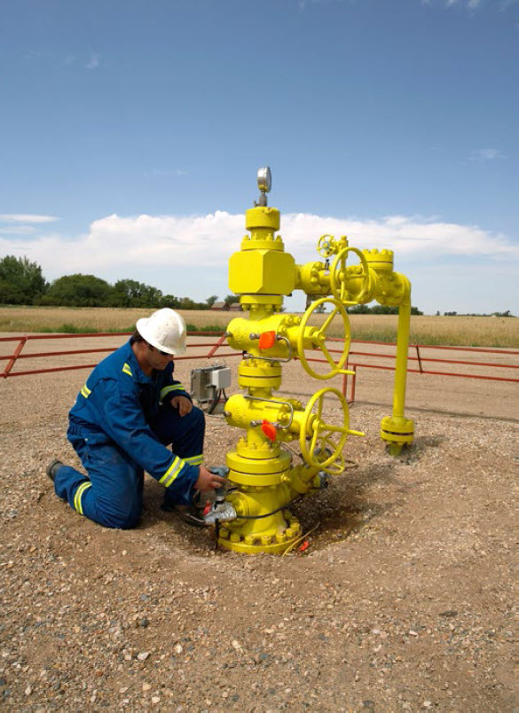
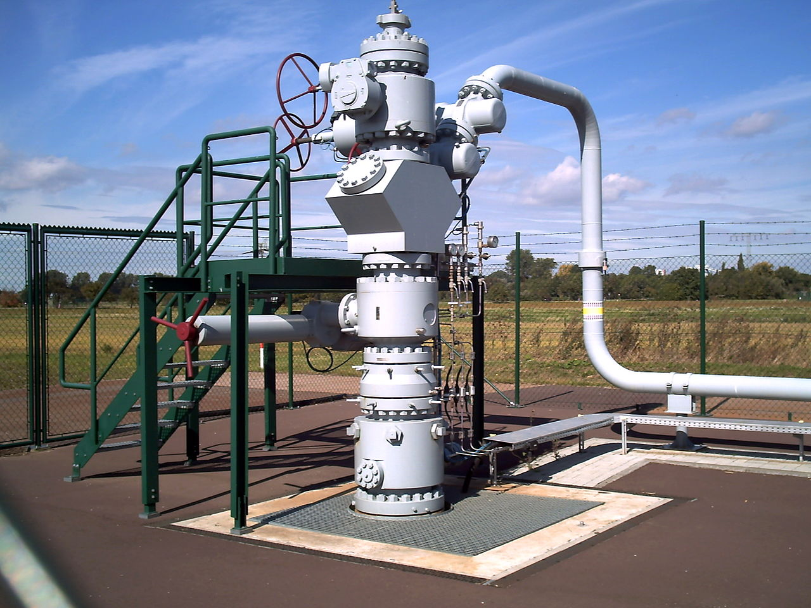
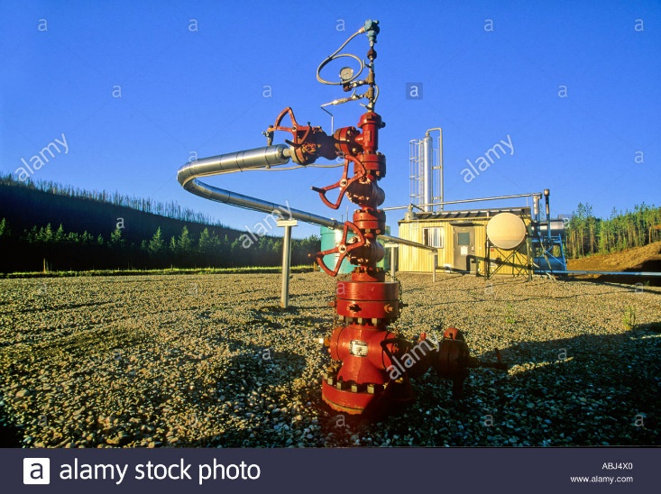
Demarcation …
Wing Valve Assembly

Slide 25
Transition … Development to Operations
Program Development
Transition to Field Operations, set for 10-01-2019
Nationalized Inspection Team, managed by Eastern Region
Program Development to carry Final Rule to completion
Public Workshop
Transform into Annual Conference

Slide 26
After the Final Rule
Revised Inspection Question Set
Revised FAQ’s
Sustained TQ classes
Public Workshop
Initiation of Annual UNGS Conference

Slide 27
PHMSA : Web Links
http://opsweb.phmsa.dot.gov
Operator Notifications
Event Reporting
https://primis.phmsa.dot.gov/ung/index.htm
Major Incidents
Key Documents
FAQs
https://www.transportation.gov/regulations

Slide 28
Contact Information
Byron Coy PE
Senior Technical Advisor
USDOT / PHMSA
byron.coy@dot.gov
609-771-7810

