Slide 1


The “Risk Modeling Work Group” and the Application of Risk Assessment in Integrity Management Programs
Risk Model Work Group
http://primis.phmsa.dot.gov/rmwg/index.htm

Slide 2
Performance Based Regulations
Historically, regulations have been prescriptive, providing tasks that must be completed to meet established, minimum safety requirements
Performance based regulations (such as IM) provide a framework for an operator to continuously improve upon to enhance safety based on their unique operating environment and objectives

Slide 3
Performance Based Regulations
The term “performance-based” refers to:
  Standards that mandate outcomes and give operators flexibility in how to meet them
  Requirements for operators to use management systems consisting of internal plans and practices for promoting safety and reducing risk.
Prescription is added to performance based IM regulations to address inadequacies identified in inspections and lessons learned from failure investigations

Slide 4
Risk Analysis Application in IM
Integrity Management is a Performance based Risk Management Program
Risk Models and Risk Assessments are required to be used throughout the IMP
  Baseline Assessment
  Data Integration / Information Analysis
  Preventive Measures Determinations
  Mitigative Measures Determinations
  Continuing Evaluation and Assessment
- 4 -

Slide 5
Implementation
PHMSA has identified through inspections, failure investigations, NTSB Recommendations, and other feedback that operators need additional guidance and directions on the requirements for using Risk Models and Risk Assessments in their IMPs.
PHMSA has addressed these deficiencies by:
  Issuing Safety Advisory Bulletins
  Updating Inspection Materials (Protocols and Inspection Assistant inspection question set)
  Updating PHMSA Inspector Training Materials
  Proposing New Regulations (e.g., Gas and HL IM NPRMs)
- 5 -

Slide 6
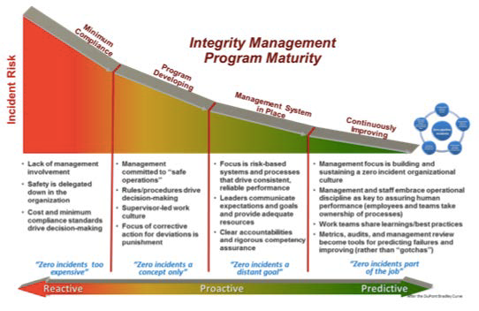
Assessing Maturity
- 6 -

Slide 7
PHMSA Resources
New Regulations http://phmsa.dot.gov/pipeline/regs
Adjustments to Inspection Materials http://www.phmsa.dot.gov/pipeline/library/forms
Safety Advisory Bulletins http://phmsa.dot.gov/pipeline/regs/advisory-bulletin
Public Workshops http://primis.phmsa.dot.gov/meetings/
Risk Modeling Work Group http://primis.phmsa.dot.gov/rmwg/index.htm
- 7 -

Slide 8
NTSB and Others’ Comments
On Risk Methodologies
Industry and PHMSA are in general agreement that risk models need to evolve in such a way as to be more investigative in nature
  As summarized and discussed in past public forums and workshops on pipeline safety (e.g., 2014 Government/Industry Pipeline R&D Forum)
Risk evaluation methods must be sufficiently analytical to be predictive (NTSB Investigations and Safety Study Recommendations)
  Are Threats on a particular line segment increasing or decreasing?
  Consequence potential impacts increasing?
  Interactive threat potential becoming a major issue?

Slide 9
Sufficiently Analytical to be Predictive
Do Results reflect year-to-year changes in risk levels?
  Operational, Environmental, Assessments
Does the overall risk profile adequately match operational experience?
Approaches may need to vary between respective types of threats (time dependent/independent)
More complexity does not necessarily mean better
  Interactive threats may need more sophisticated modeling than threats being evaluated individually

Slide 10
Connection to Decision Making
Risk evaluation results must have a connection to real-life decision making
  Point of risk assessments is not to only do a risk evaluation
  Risk insights must be integrated into routine integrity-related decision making
  Operators should be able to easily demonstrate how risk evaluation results influence work practices and decisions

Slide 11
Public Workshops – Risk Modeling
PHMSA has sponsored 2 Public Workshops focused on Risk Models and their Application in IM Programs
  July 21, 2011 Improving Pipeline Risk Assessments and Recordkeeping (Mtg #70)
  September 9 & 10, 2015 PHMSA Pipeline Risk Modeling Methodologies Public Workshop (Mtg #104)

Slide 12

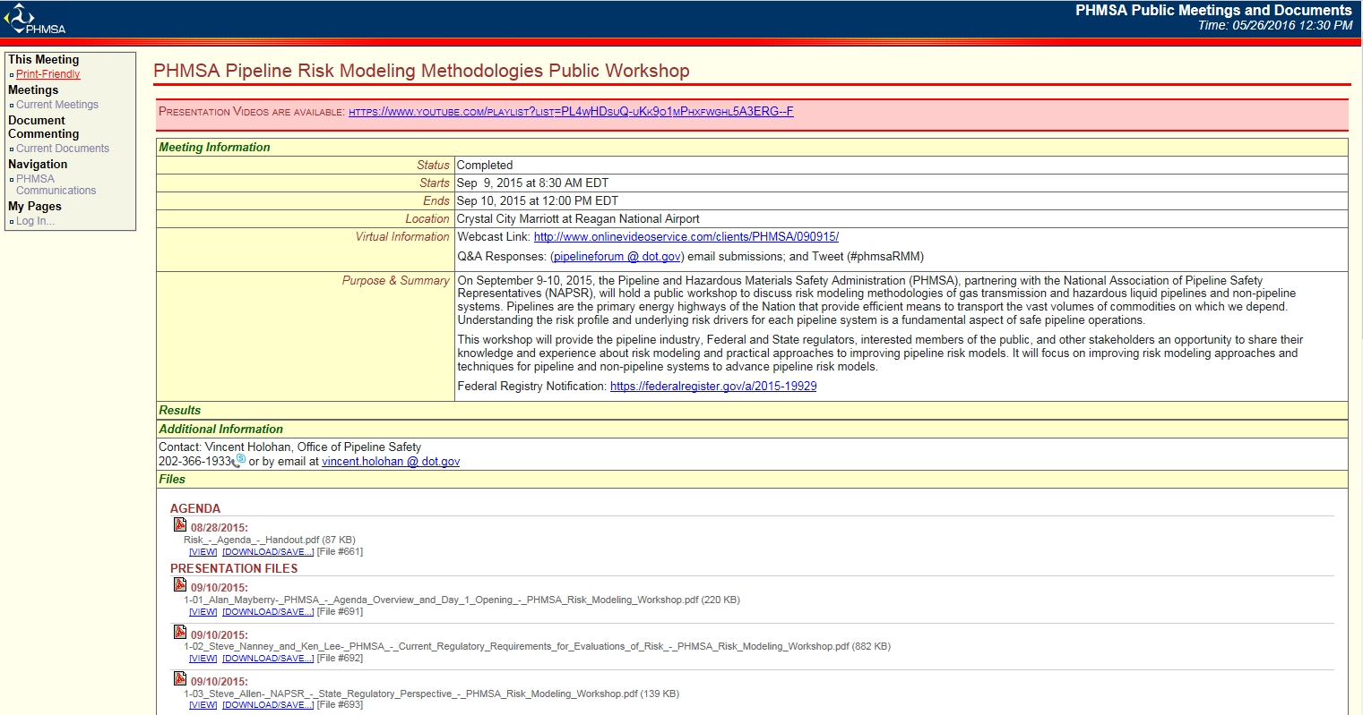
Risk Modeling Meeting website http://primis.phmsa.dot.gov/meetings/

Slide 13
Risk Modeling Work Group (RMWG)
The Risk Modeling Work Group was formed as a follow up to the September 2015 - PHMSA Pipeline Risk Modeling Methodologies Public Workshop
The purpose of the group is to provide technical, integrity management and operational input to PHMSA to aid in the development of a pipeline system risk modeling technical guidance document
http://primis.phmsa.dot.gov/rmwg/index.htm
- 13 -

Slide 14
Risk Modeling Work Group
PHMSA is seeking a wide range of input and consensus as part of the development of this technical guidance, both from within the Regulatory Community and from Pipeline Safety Stakeholders
There are approximately 30 members of the RMWG from the regulatory, operator, and interested party communities
This work group provides a forum to obtain the combined perspective of industry, regulators, public, and risk services providers, and it will also provide a mechanism for eventual public input/comment
- 14 -

Slide 15
RMWG Mission Statement
The mission of the Risk Modeling Work Group (RMWG) is:
  Characterize the state of the art of pipeline risk modeling for gas and liquid transmission pipelines,
  Identify and, if necessary in specific areas, develop a range of state-of-the-art methods and tools capable of addressing the spectrum of pipeline risk management applications, and
  Provide recommendations to PHMSA regarding the use of these methods, tools, and data requirements

Slide 16
Risk Modeling Work Group
RMWG will provide technical guidance on:
  Methods and tools to be used in pipeline risk modeling
  Application of these methods and tools in pipeline risk management.
PHMSA’s technical guidance needs to be based on the state of the art of pipeline risk modeling, as reflected in the views of the technically informed pipeline community

Slide 17
RMWG Guidance Document
Following several RMWG meetings, a Guidance Document will be published in late 2017, covering the following:
Regulatory Requirements for Risk Analysis and Risk Assessment Performance
How Risk Modeling Fits into Overall Pipeline Risk Management
Likelihood Modeling
Consequence Approach Selection
Facility Risk Approach Selection
Risk Modeling Data Needs

Slide 18
Risk Assessment Models
Model Types
Relative Assessment (Index) Models
Scenario-Based Models
Semi-Quantitative Models
Quantitative Models
Probabilistic Models
Facility Risk Models
Discussions on Modeling Consequences
Gas Transmission Consequence Models
Hazardous Liquid Transmission Consequence Models
  Non-HVLs
  HVLs

Slide 19
Likelihood Topics to be Covered
Pipeline Threats
Single Approach or Threat-Specific Approach
Selection of Approach
Human Performance Modeling
Critical Likelihood Parameters
Interactive Threat Modeling
Threshold for Threat Consideration
Validation of Results
Application to Identification of Preventive Measures

Slide 20
Consequence Topics to be Covered
Selection of Approach
Identification of Receptors
Emergency Response
Critical Consequence Parameters
Validation of Results
Application to Identification of Mitigative Measures

Slide 21
Facility Topics to be Covered
Selection of Approach
  Hazard Identification, Bowtie Analysis, Scenarios, etc.
Comparison with Line Pipe Risk
Application to Preventive Measures and Mitigative Measures to reduce risks
Risk Reduction Measures implemented may be similar to integrity assessment methods
  Hydrostatic pressure testing
  Direct Assessment techniques

Slide 22
Data Need Topics to be Covered
Threat-Specific Data
Consequence-Specific Data
Data Validation
Available Industry Data
Available Government Data
Available International Data
Related NTSB Recommendations

Slide 23
RMWG Public Meeting in 2017
PHMSA anticipates hosting a Public Meeting in the Summer, 2017 to present the findings of the RMWG efforts
The Public Meeting would allow for the combined perspectives of industry, regulators, public, and risk services providers to be considered prior to publication of the Guidance Document
- 23 -

Slide 24
Why is RMWG Guidance Important?
PHMSA has identified through inspections, failure investigations, and NTSB Recommendations that operators need additional guidance and directions on developing and maintaining accurate risk models
Risk models should enable the selection of appropriate assessment methods and risk reduction measures that improve pipeline safety
More prescription is being added to current performance based regulations to address these concerns on risk assessment and other pipeline integrity and safety related topics
- 24 -

Slide 25
Thank you for your Participation in Pipeline Safety

