Slide 1
Control Room Management
API Control Room Forum
April - 2019
Byron Coy PE
Sr. Technical Advisor
Pipeline & Hazardous Materials Safety Administration
US Department of Transportation

Slide 2
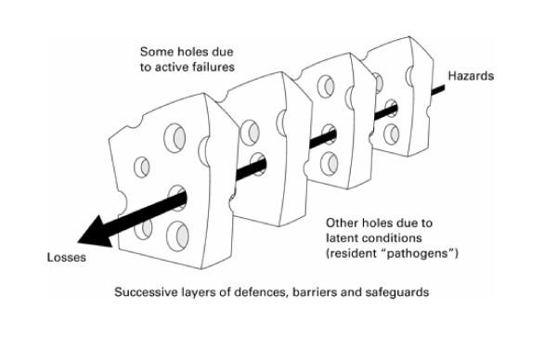
James Reason’s
Swiss Cheese Model
It usually takes several concurrent conditions,
before a serious incident or accident occurs

Slide 3
Swiss Cheese Model
It usually takes several concurrent conditions before a serious incident or accident occurs
If the work you do on Control Room Management removes just one errant condition…
The chance of another event like Bellingham, WA will be reduced
20 Year Anniversary of Bellingham
Where (3) lives were lost : June 10, 1999

Slide 4
Authority to Direct or Supersede
(b)(5), The roles, responsibilities and qualifications of others with the authority to direct or supersede the controller
FAQs, January-2018
  B.07, Procedures to account for occasions when the controller disagrees
  B.08, Qualifications for area of responsibilities
  B.09, Roles & Responsibilities established by the time of implementation
  B.10, Written Policy to allow (or disallow)
FAQ D.02, Hours of service for on-duty time
Web: PHMSA PRIMIS Control Room

Slide 5
Team Training
(h)(6), Control room team training and exercises for controllers and other individuals
FAQs, January-2018
  H.05, Participants, including (b)(5)
  H.06, Content
  H.07, Training Techniques
  H.08, Deadlines & Frequency
  H.09, Controller Participation
Web: PHMSA PRIMIS Control Room

Slide 6
Interstate Control Rooms
Top 10 States
Texas | 83
Oklahoma | 25
Georgia | 14
Colorado | 10
California | 8
Pennsylvania | 7
Florida | 7
Alaska | 6
Utah | 6
Wyoming | 5
There is currently no requirement for Operators to report the number or location of their of Control Rooms
All jurisdictional Control Rooms should be in compliance with the Regulations

Slide 7
More inspections to be scheduled in 2019

Slide 8
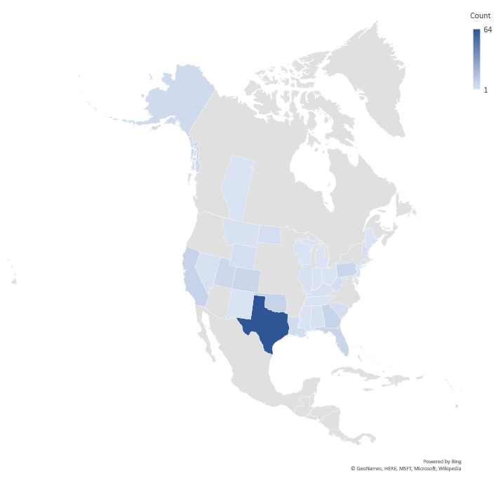
PHMSA
Control Room Inspections
2012-2014
163 Inspections

Slide 9
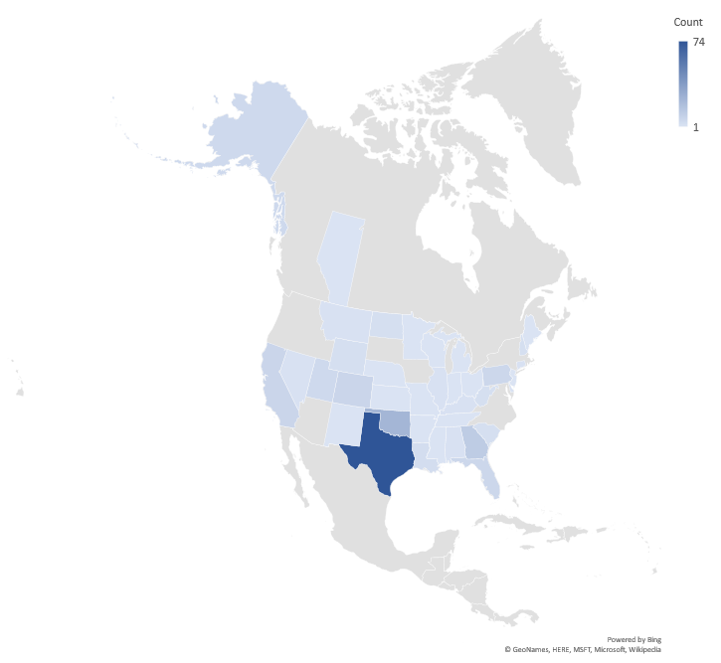
PHMSA
Control Room Inspections
2012-2016
203 Inspections

Slide 10
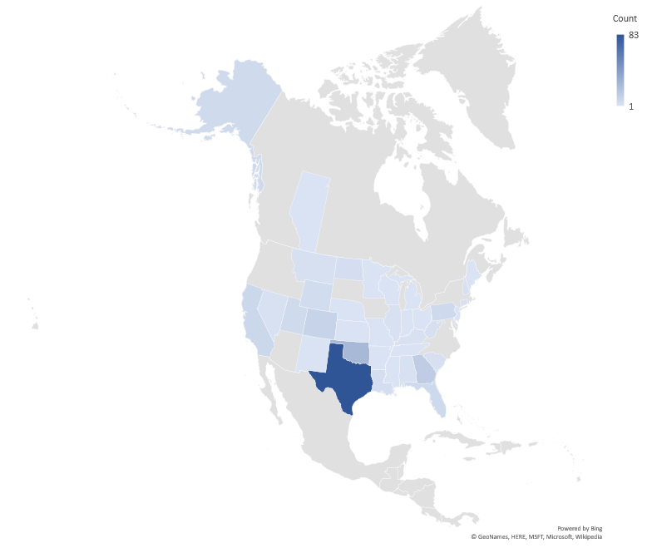
PHMSA
Control Room Inspections
2012-2018
220 Inspections

Slide 11
Compliance Cases from Inspections
Year | Warning Letter | Notice of Amendment | Notice of Probable Violation | Civil Penalty |  | Totals
2012 | 1 | 4 |  |  |  | 5
2013 | 1 | 4 |  |  |  | 5
2014 | 6 | 7 | 3 | 2 |  | 16
2015 | 3 | 5 |  |  |  | 8
2016 | 4 | 7 | 4 | 3 |  | 15
2017 | 2 | 2 | 1 |  |  | 5
2018 | 3 | 2 | 7 |  |  | 12
2019 |  | 3 | 1 |  |  | 4
Totals | 20 | 34 | 16 | 5 |  | 70
Web Search:
cpf 192.631
cpf 195.446

Slide 14
Notice of Amendment Items
Regulation Section | HL | GT | Totals
a - Procedures & Applicability | 25 | 52 | 77
b - Roles | 16 | 10 | 26
c - Adequate Information | 25 | 7 | 32
d - Fatigue Management | 18 | 6 | 24
e - Alarm Management | 24 | 11 | 35
f - Change Management | 8 | 3 | 11
g – Experience | 4 | 3 | 7
h – Training | 13 | 7 | 20
I – Validation | 2 | 3 | 5
j - Deviations | 2 | 3 | 5
Totals | 137 | 105 | 242

Slide 15
Top 5 : Notice of Amendment Items
Regulations | Item Count
(a), Have Procedures | 39
(d)(4), Maximum Hours of Service | 10
(c)(2), Point-to-Point Verification | 9
(e)(1), Alarm Review | 9
(b)(4), Recording Shift Change | 7
(c)(1), Implementing API RP-1165 | 7
(d)(1), Shift Lengths & Schedules | 7
(f)(1), Coordination of Change Management | 7
In 2018, (a) is 3rd highest cited violations in all of 192 & 195

Slide 16
Non-Notice of Amendment Items
Regulation Section | HL | GT | Totals
a - Follow Procedures | 11 | 3 | 14
b - Roles | 2 | 1 | 3
c - Adequate Information | 4 | 2 | 6
d - Fatigue Management | 1 | 1 | 2
e - Alarm Management | 5 | 3 | 8
f - Change Management | 1 |  | 1
g – Experience |  | 1 | 1
h – Training | 9 | 1 | 10
I – Validation
j – Deviations | 4 | 2 | 6
Totals | 37 | 14 | 51
Penalties from Inspections $168,500

Slide 17
Inspection Questions
Original Full-Program Inspection Form
  March 01, 2012, Rev-3
  100+ questions covering all aspects of CRM Regulations
Integrated Inspection
  CRM Screening Questions
  6-10 CRM Overview Questions
Full-Program Inspection Form maintained for targeted use
  Previously uninspected control rooms
  Newly established operator or control room
  Just cause after incident/accident with CRM affiliation

Slide 18
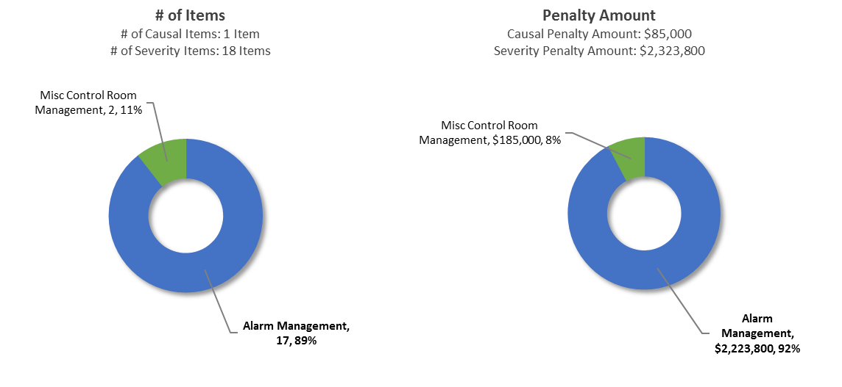
Accident/Incident : Causal & Severity

Slide 19
Alarm Management Problems
Increase Accident/Incident Severity
Violation Description | # of items | Penalty
Failed to notify appropriate Emergency personnel | 4 | $400,000
Failed to take necessary action | 4 | $400,000
Failed to remediate known condition within reasonable time | 3 | $300,000
Inadequate response to unintended shutdown or pressure alarm | 2 | $200,000
Inadequate response to emergency | 1 | $600,000
Failed to respond to creep alarm | 1 | $123,000
Unqualified Controller | 1 | $100,000
Inadequate communications system | 1 | $100,000
Totals | 17 | $2,223,800

Slide 20
NTSB Recommendation P-11-009
Issued September 26, 2011
  Require operators of natural gas transmission and distribution pipelines and hazardous liquid pipelines to ensure that their control room operators immediately and directly notify the 911 emergency call center(s) for the communities and jurisdictions in which those pipelines are located when a possible rupture of any pipeline is indicated.
  Control Room operator or delegated representative
  San Bruno, CA, Natural Gas Incident (9/9/2010)
  Carmichael, MS, Propane Accident (11/1/2007)

Slide 21
NTSB Recommendation P-11-009
PHMSA Advisory Bulletin ADB-12-09
  Communication between pipeline facility operators and local emergency responders
  §§ 192.615, 193.2509 and 195.402
  Promptly notify 9–1–1 emergency call centers, or the local equivalent
  Inquire if there are any other reported indicators of possible pipeline emergencies such as odors, unexplained noises, product releases, explosions, fires, etc.
  Early coordination will facilitate a more timely and effective response

Slide 22
NTSB Recommendation P-11-009
Status : Open – Acceptable Response
PHMSA Rulemaking in progress for 192 & 195
RIN 2137-AF06, Line Segmenting & Rupture Detection
https://www.transportation.gov/regulations/march-2019-significant-rulemakings-report

Slide 23
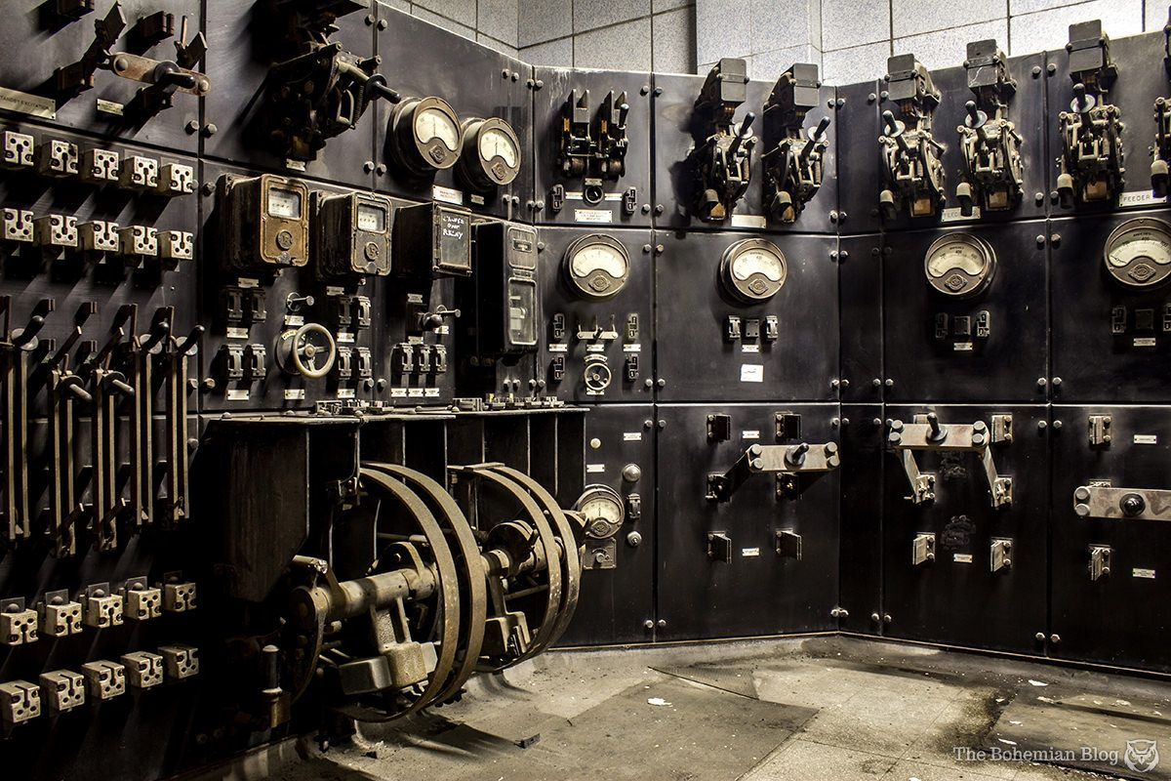

Deploying new technology,
does not guarantee Improvements
Be aware of your system limitations

Slide 24
Byron Coy PE
Sr. Technical Advisor byron.coy@dot.gov
Web Search : PHMSA Primis Control Room
Pipeline & Hazardous Materials Safety Administration
US Department of Transportation

