Slide 1
Welcome to the
U.S. Department of Transportation’s
Office of Hazardous Materials Safety
Research & Development Forum
Month/Year

Slide 2
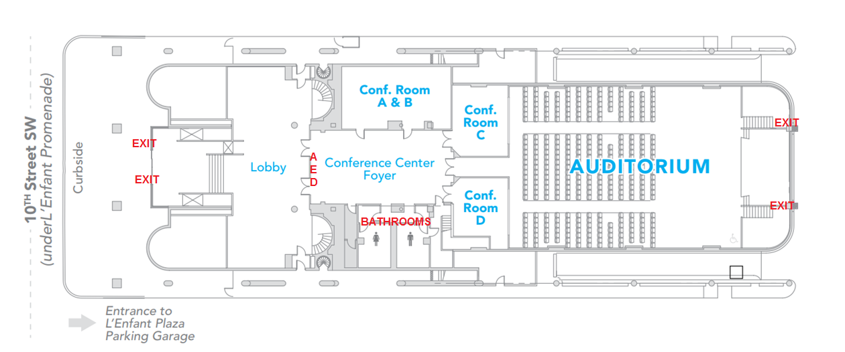
National Transportation Safety Board
420 10th Street SW, Washington DC 20594

Slide 3
Have a Question?
Email: hazmatresearch@dot

Slide 4
Welcome to the
U.S. Department of Transportation’s
Office of Hazardous Materials Safety
Research & Development Forum
Month/Year

Slide 5
U.S. DOT Safety Council LNG Workshop
Bill Stuckey
United States Department of Transportation
Pipeline and Hazardous Materials Safety Administration

Slide 6
Attendees/Presenters
Federal Motor Carrier Safety Administration (FMCSA)
Federal Railroad Administration (FRA)
Federal Transit Administration (FTA)
National Highway Traffic Safety Administration (NHTSA)
Pipeline & Hazardous Material Safety Administration (PHMSA)
Maritime Administration (MARAD)
U.S. Coast Guard (USCG)
Federal Energy Regulatory Commission (FERC)

Slide 7
Workshop objectives
Provide the U.S DOT Safety Council better understanding and address multi-modal transportation, stakeholder issues and risks of the emerging Liquefied Natural Gas (LNG) market.
Identify current issues/concerns/risks by mode within transportation segments of the LNG value chain;
Identify risks/issues for effected stakeholders (transportation operators/employees, the public and first responders) for different segments in the value chain today, and in the foreseeable future and beyond; and
Identify a prioritized list of issues/concerns and associated recommendations and next steps.

Slide 8
How we conducted the workshop
Segment analysis of the LNG value chain
Maritime segment
Roadway segment
Rail segment
Effecting multiple segments
Pipeline segment
Review of key issues/concerns/gaps/risks/etc.

Slide 9
Roles in the Value Chain
Jurisdictions and roles within the LNG Value Chain depend on whether LNG is used for commerce or used as a fuel.
LNG use as a fuel is relatively new in the U.S., the practice is becoming more common in Europe. The market for LNG use as a fuel is primarily driven by price.
Many transportation sectors (ships, trains, trucks, etc.) that have historically relied on traditional fuels (heavy fuel oil, diesel) are looking at LNG or CNG (compressed natural gas) as potential alternatives to save on fuel costs and adhere to emission standards.

Slide 10
Modal Segment Discussions
Discussions were organized by modal segments and related regulating agencies and the following four primary topic areas:
Research and Development
Performance-based Regulatory Challenges
Communication and Outreach
Training

Slide 11
Maritime Segment
Additional research is needed in the areas of risk analysis and remedial response.
Further research is needed in regards to vapor dispersion analysis, water suitability, salvage operations related to underwater leaks, and firefighting procedures.
For example, there is not enough understanding on the conditions and behavior of LNG in the case of a pool fire to successfully and quickly respond to the incident and minimize harm.

Slide 12
Roadway Segment
LNG market research is needed to be informed for industry oversight and standards, improve safety in LNG operations, and protect the public.
Research is needed to prepare for the increase in LNG-related roadway activities and inform incidence reporting and response.
Research to develop guidelines for these new LNG fuel systems, such as fuel system integrity performance requirements, and fuel leak detection.

Slide 13
Rail Segment
Need research on the consequences of LNG release from rail accidents in a tunnel.
Limits and vulnerabilities of tank cars and portable tanks.
Probability of ignition of LNG released from a tank car or tender, and risk analysis of rail transport routes.
Risk-based evaluations of safety in transportation of LNG, as well as a study of the jurisdictional gaps and overlaps related to LNG cargo and fuel in the rail segment.

Slide 14
Other Regulatory Agencies: PHMSA OHMS, NHTSA
Research needed to predict the market drivers, and needs of the industry in the near future, in terms of regulation/infrastructure.
Data analysis on emerging, small scale LNG facilities is needed to protect the general public from any potential LNG-related incidents.
A base-line risk assessment, which will help inform multi-modal standards and regulations.

Slide 15
Pipeline Segment: PHMSA-OPS
Market research in order to understand the potential risks associated of small scale facilities and their implications.
LNG facility and failure data analysis is also lacking. This information is needed to protect the general public from any LNG-related incidents.

Slide 16
Forum Wrap Up and RNS Path Forward
OHMS R&D Forum
May 17th, 2018
Eva Rodezno, R&D, OHMS
Notes:
So thank you bearing with us these two days and giving us your valuable input.
I’m gonna talk briefly about what we do with the ideas suggested for research and then you guys will be on your merry way.

Slide 17
Path Forward
OHMS R&D will review all RNS submitted
Prioritize RNS
Determine best acquisition strategy
Begin acquisition process
Notes:
We here in the R&D branch (myself, Veda and Rick) will review each RNS to make sure it
falls within the realm of PHMSA
our funding amount and type
Depending upon the topic, we then leverage
some of sciences and engineering branches’ expertise for technical input,
other modes for project viability and implementation probability
perhaps even international community.
We then prioritize the RNS based on today’s input, OHMS budget and other factors.
Then we determine which contracting outlet works best with each project

Slide 18
Forum Minutes and Event Posting
Forum presentations and minutes will be posted to PHMSA website¹
Next forum planned for March 2019
Information for next forum will be posted on PHMSA website in next six months¹
1 https://www.phmsa.dot.gov/research-and-development/hazmat/rd-meetings-and-events
Notes:
You can find minutes, transcript of this forum and slides at our website listed at the bottom here.
We hope to have another forum by March 2019, but its contingent upon leadership decision and funds.
We will notify folks about the next forum the same way we did with this forum and also post it to our site.

Slide 19
Thank You!
Notes:
In short, thank you very much for attending. That is everything.

