Slide 1
2019 IIA Phone Conference
Welcome Remarks PHH 33 Chief -Duane Cassidy.
Creating a portal account. Transp. Specialist-Kenneth Clark
Portal Overview/White Paper Overview Senior Transp. Specialist-Neil Benninghoven.
General Correspondence (GC) submission using the Competent Authority portal Transp. Specialist Irwin Pascal
Questions/concerns/comments from participants

Slide 2
Creating a portal account
** Internet Explorer 10 and Above is recommended**
***The Importance of creating an account**
Select hyperlink: https://portal.phmsa.dot.gov/ and go through the screens.
Tutorial accessed via link: https://portal.phmsa.dot.gov/PHMSAPortal2/staticContentRedesign/howto/How_to_Create a_Portal_Hazmat_Account.pdf

Slide 3
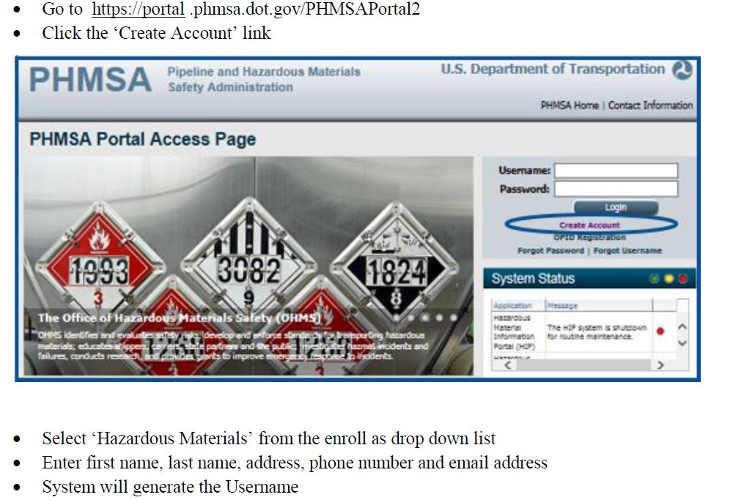
2019 IIA Phone conference
Creating a Portal account

Slide 4
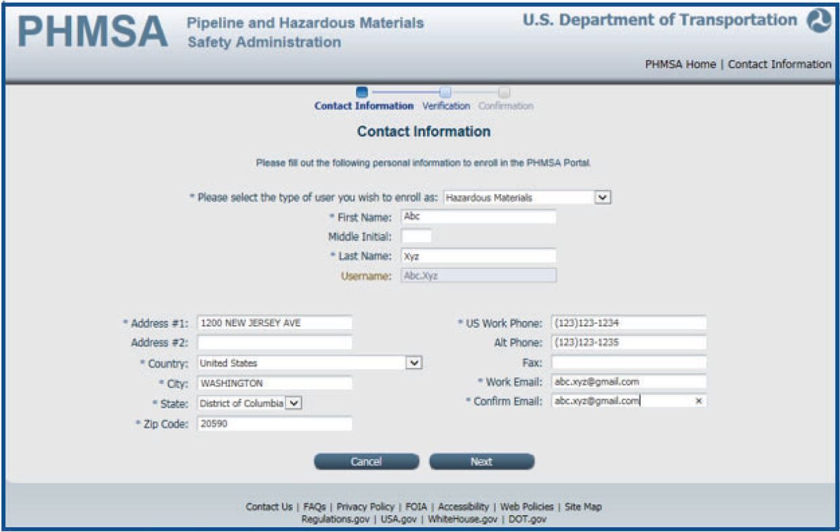
2019 IIA Phone conference
Notes:
”

Slide 5
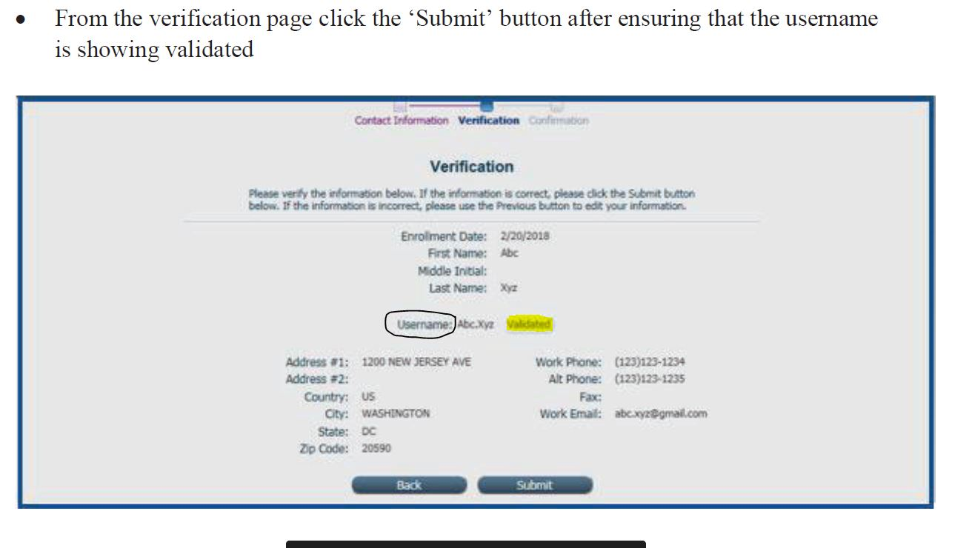
2019 IIA Phone conference

Slide 6
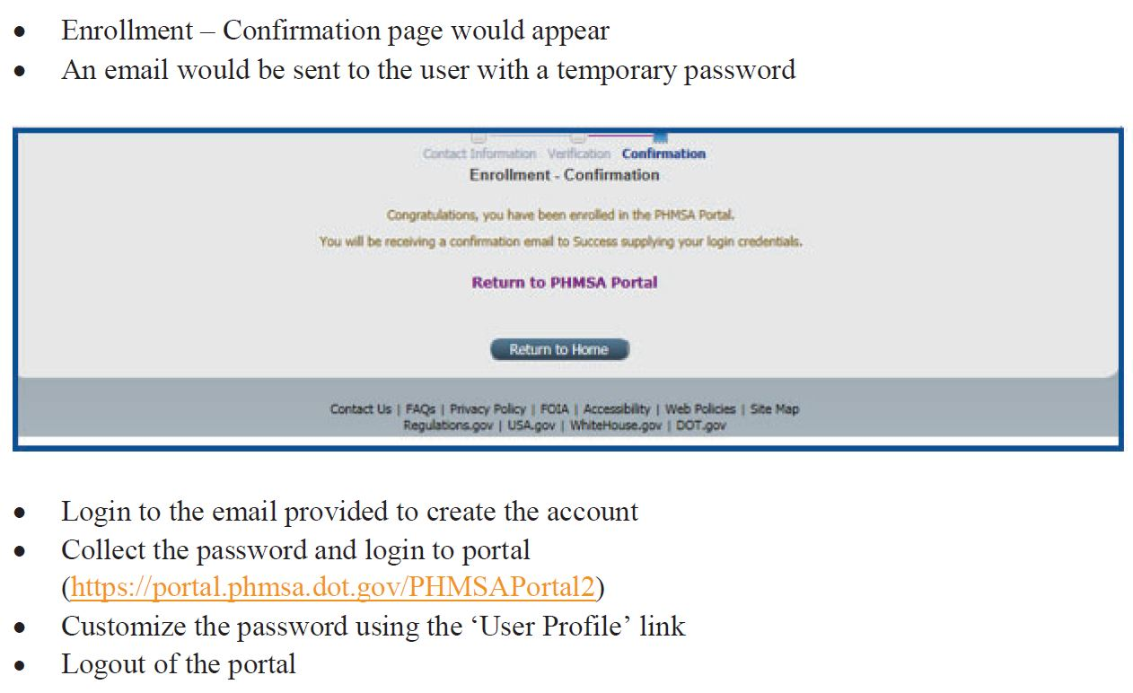
2019 IIA Phone conference

Slide 7
Portal Support
portalsupport@dot.gov

Slide 8
2019 IIA Phone conference
Portal Overview / IIA White Paper
What has changed since it was introduced?
Changing the way that external users interact with approvals.
Automatic email notification from the portal.
White Paper.

Slide 9
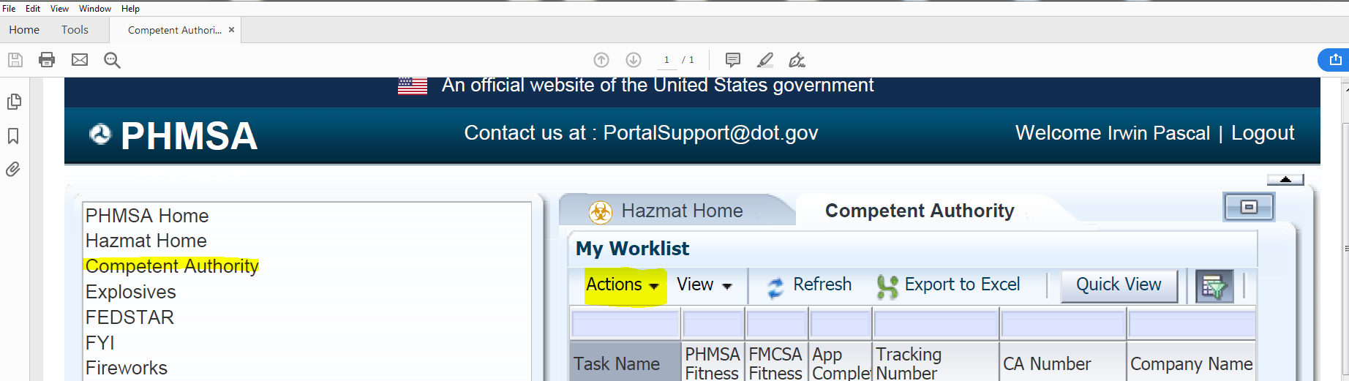
Entering General Correspondence (GC) file-semiannual report
First select the “competent authority” tab then select “actions”

Slide 10
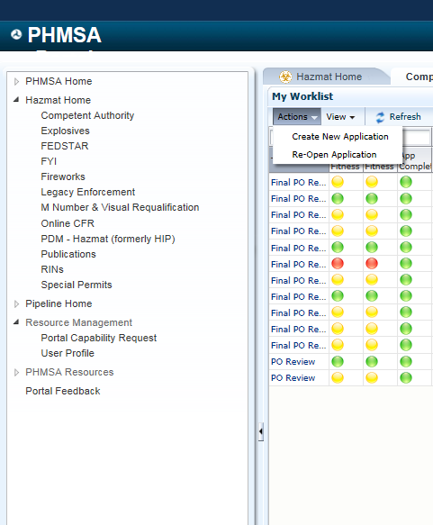
Entering General Correspondence (GC) file-semiannual report
Select – “Create New Application”

Slide 11
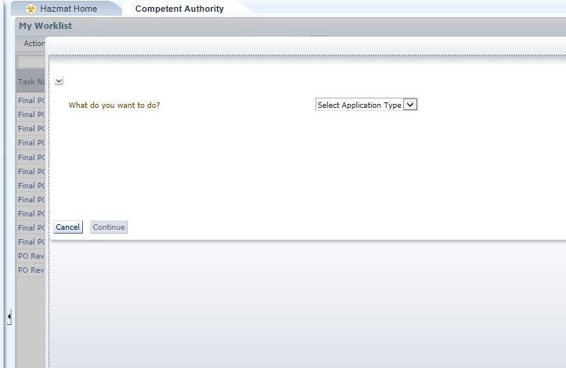
Entering General Correspondence (GC) file-semiannual report

Slide 12
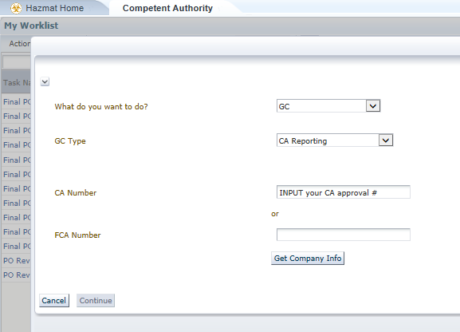
Entering General Correspondence (GC) file-semiannual report
Under GC-type, select CA reporting, then enter your CA number, then select “Get Co. Info”

Slide 13
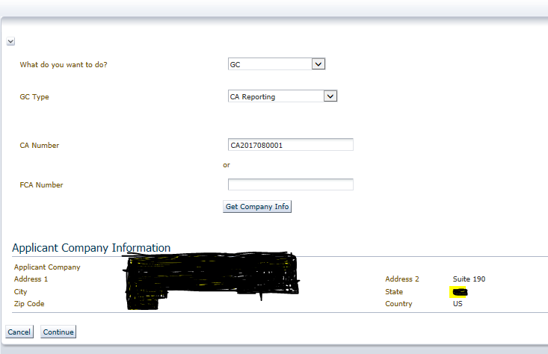
Entering General Correspondence (GC) file-semiannual report

Slide 14
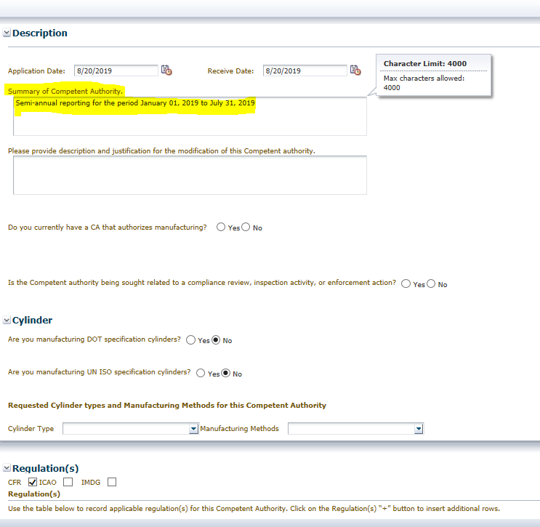
Entering General Correspondence (GC) file-semiannual report
Select “next” - “Description screen” displayed- fill out the “summary of competent authority”

Slide 15
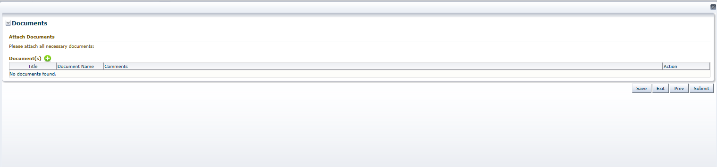
Entering General Correspondence (GC) file-semiannual report
Select “next” – taken to “documents” page. Upload semiannual repots by selecting the green “+”

Slide 16
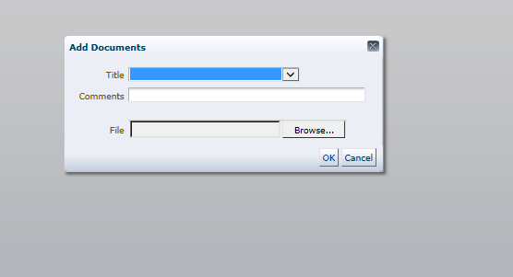
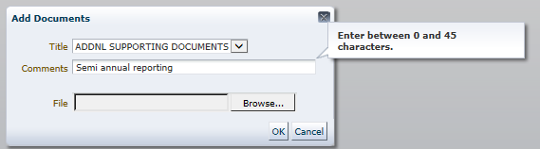
Entering General Correspondence (GC) file-semiannual report
Select file from stored location on your computer

Slide 17
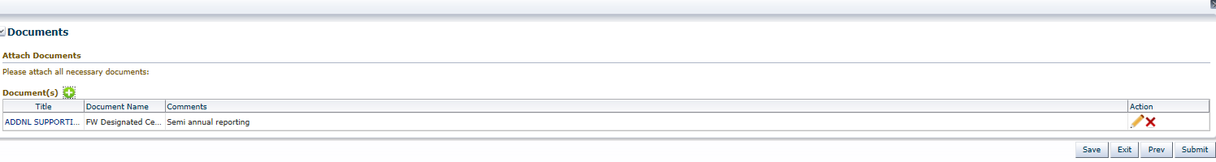
Entering General Correspondence (GC) file-semiannual report
Once All documents are attached select “submit”

Slide 18
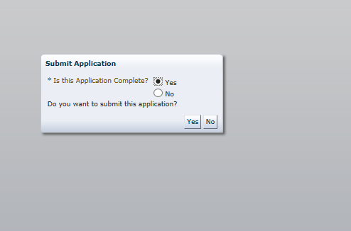
Entering General Correspondence (GC) file-semiannual report
Get a prompt from the system

Slide 19
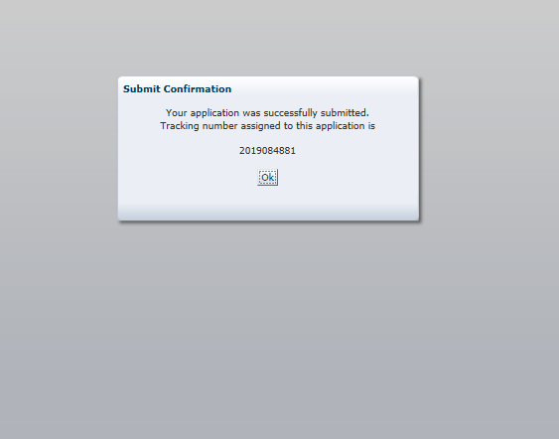
A Tracking Number will be generated if you selected “yes”. This is your “proof” that you have met the semi-annual reporting requirements of your approval. ***shall be done***

Slide 20
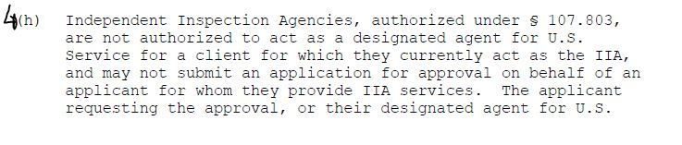
Reminder

Slide 21

Questions

