Slide 1
2019 DAA Phone Conference
Welcome Remarks PHH 33 Chief Duane Cassidy.
Creating a portal account. Transportation Specialist Diane Jones
2019 reporting summary /General Correspondence submission Transportation Specialist Irwin Pascal
Questions/concerns/comments from participants
Notes:
Portal Overview - where we are, where we are going
GC submission – data size accepted by portal, zip files not allowed, **there shall be consequences for non-submission of semiannual reports (showcause)

Slide 2
Creating a portal account
** Internet Explorer 10 and Above is recommended**
***The Importance of creating an account**
Select hyperlink: https://portal.phmsa.dot.gov/ and go through the screens.
Tutorial accessed via link: https://portal.phmsa.dot.gov/PHMSAPortal2/staticContentRedesign/howto/How_to_Create a_Portal_Hazmat_Account.pdf
Notes:
Works on other platforms too but Internet Explorer 10 and above is recommended
Why is it important to create a portal account? Submitting DAA applications, receiving automatic updates (email notification 120-days prior to all expirations; notification for Semi annual reporting)

Slide 3
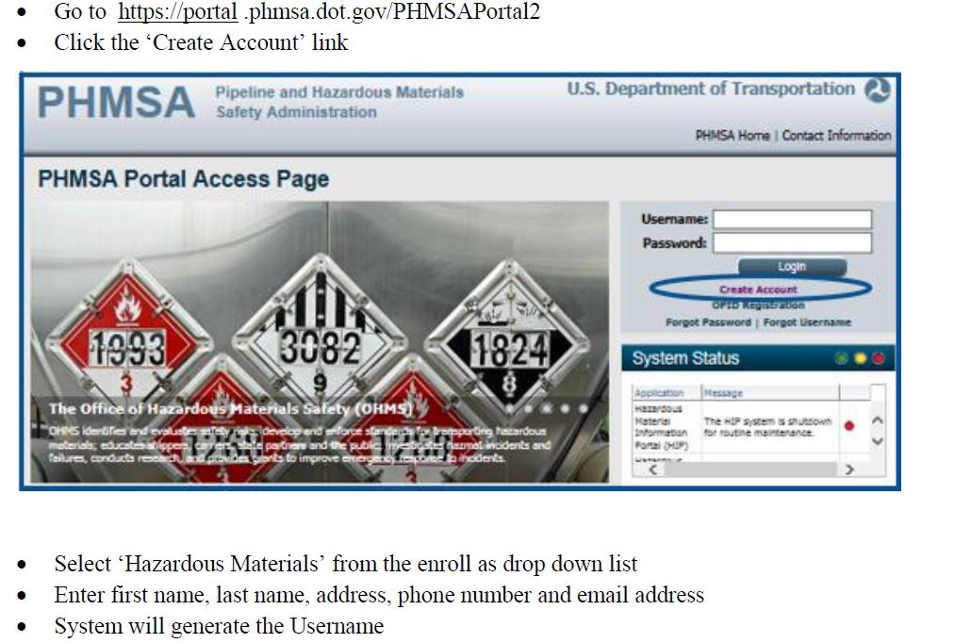
2019 IIA Phone conference
Creating a Portal account

Slide 4
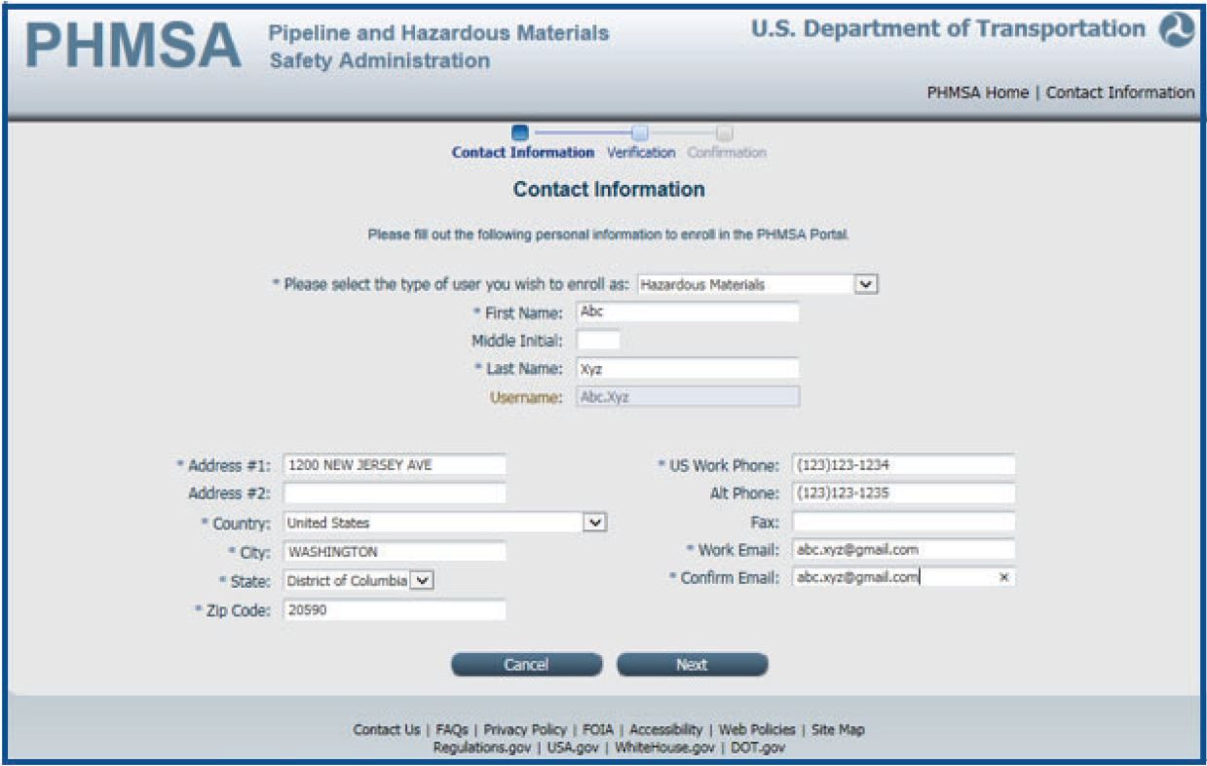
2019 IIA Phone conference
Notes:
After selecting the “NEXT” Button fill out the contact information, then click “next”

Slide 5
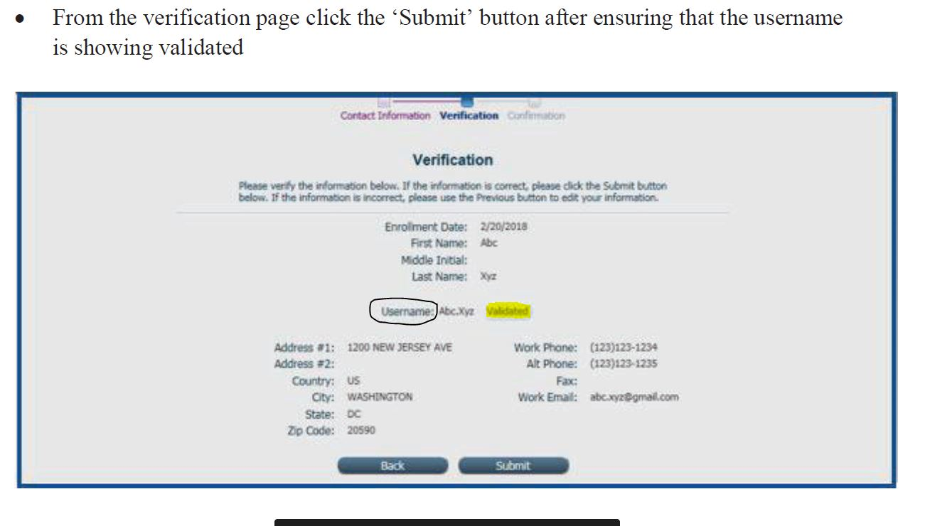
2019 IIA Phone conference
Notes:
Username must say validated

Slide 6
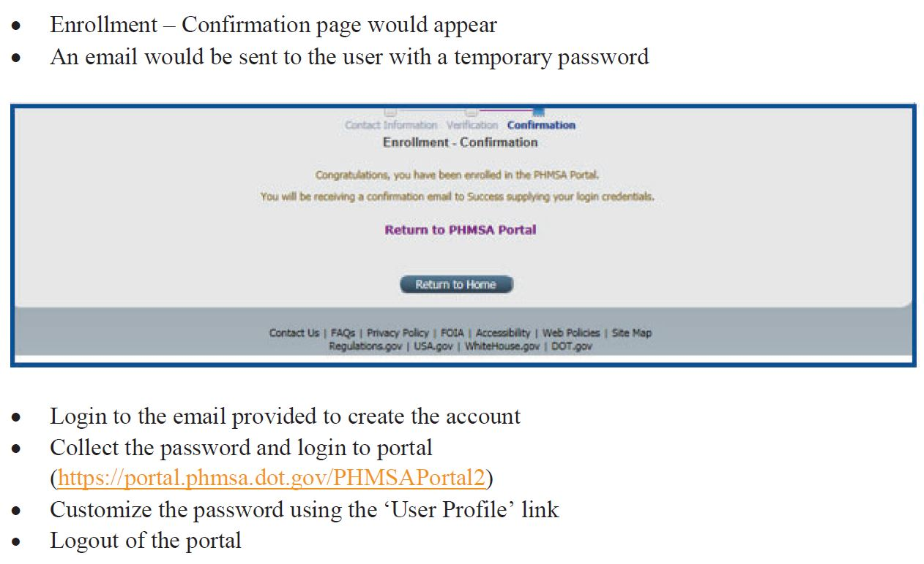
2019 IIA Phone conference

Slide 7
Portal Support
portalsupport@dot.gov
Notes:
Any difficulties encountered while setting up the initial account such as error messages
Check your spam for the temporary password
They can contact us through the usual approvals@dot.gov for general processing applications

Slide 8
2019 DAA Phone conference
Portal Overview
What has changed since it was introduced?
Changing the way that external users interact with approvals.
Automatic email notifications from the portal-(re) approval expiration, semiannual submittal reminders).
Notes:
Email reminders sent out 120 prior to expiration of CAs
Email reminders sent out 30 days prior to the submission-deadlines for semi annual reports
Limit to the file size; No zip files

Slide 9
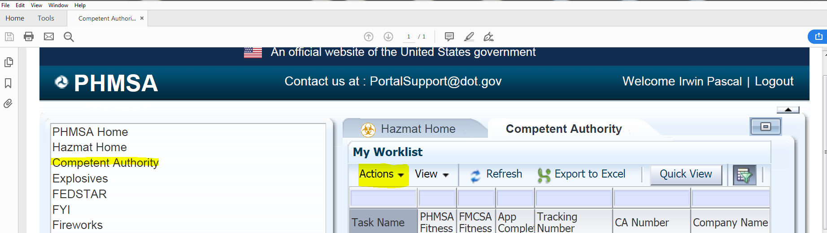
Entering General Correspondence (GC) file-semiannual report
First select the “competent authority” tab then select “actions”
Notes:
General correspondence file is the same as GC

Slide 10
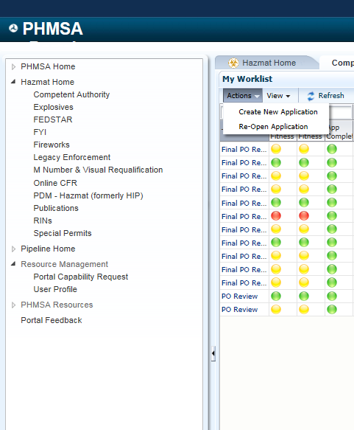
Entering General Correspondence (GC) file-semiannual report
Select – “Create New Application”
Notes:
General correspondence file is the same as GC

Slide 11
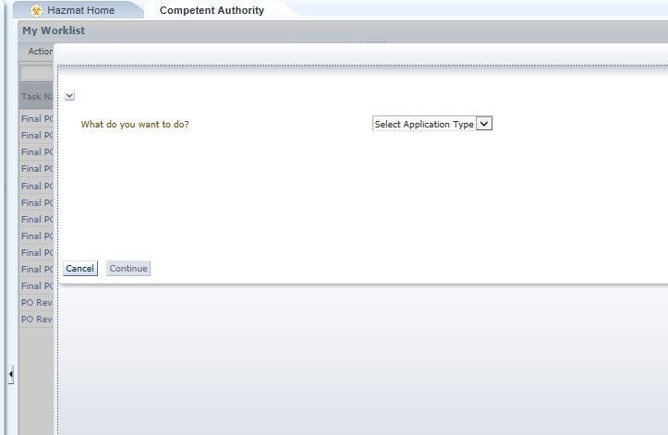
Entering General Correspondence (GC) file-semiannual report
Notes:
Select “application type” the choose “GC” from the drop down menu

Slide 12
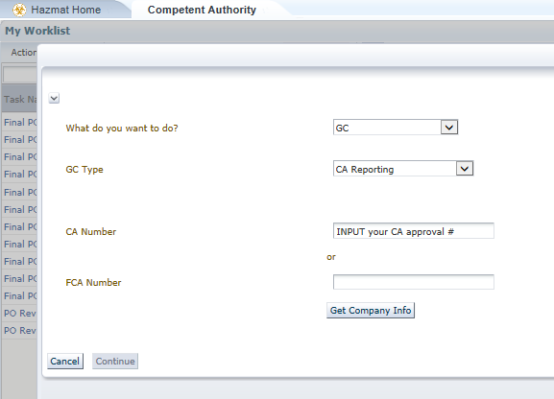
Entering General Correspondence (GC) file-semiannual report
Under GC-type, select CA reporting, then enter your CA number, then select “Get Co. Info”

Slide 13
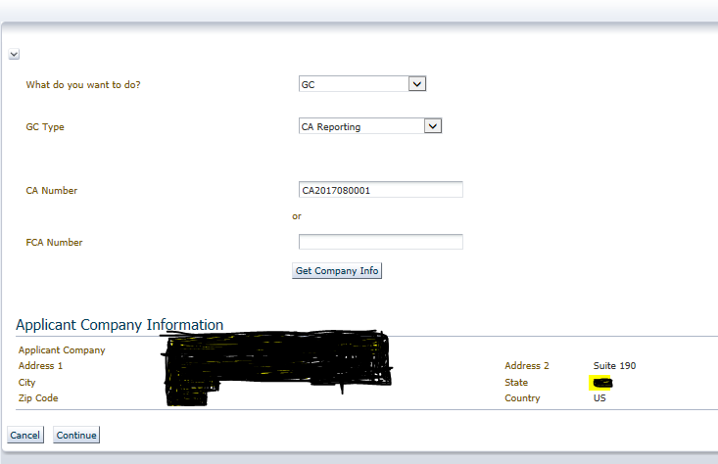
Entering General Correspondence (GC) file-semiannual report
Notes:
Once the company information populates select continue

Slide 14
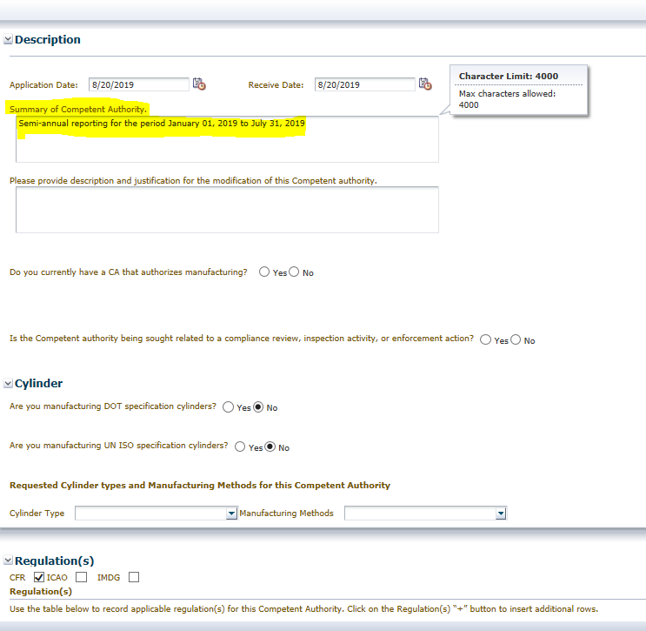
Entering General Correspondence (GC) file-semiannual report
Select “next” - “Description screen” displayed- fill out the “summary of competent authority”
Notes:
Once the company information populates select continue

Slide 15
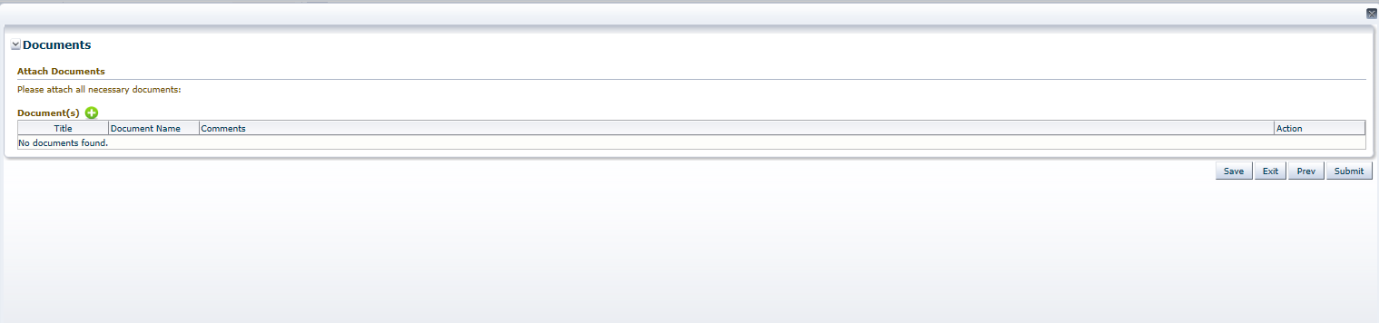
Entering General Correspondence (GC) file-semiannual report
Select “next” – taken to “documents” page. Upload semiannual repots by selecting the green “+”
Notes:
Once the company information populates select continue

Slide 16
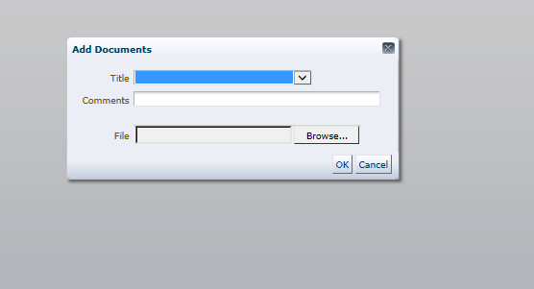
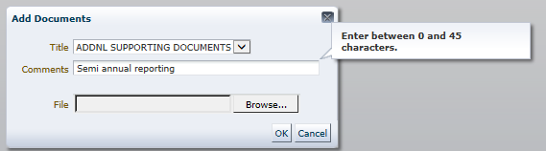
Entering General Correspondence (GC) file-semiannual report
Select file from stored location on your computer
Notes:
Choose Additional supporting docs and in the comments section put “semi annual reporting

Slide 17
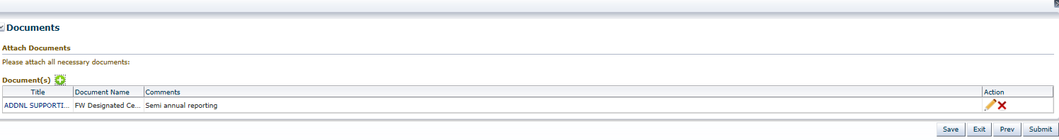
Entering General Correspondence (GC) file-semiannual report
Once All documents are attached select “submit”
Notes:
Choose Additional supporting docs and in the comments section put “semi annual reporting

Slide 18
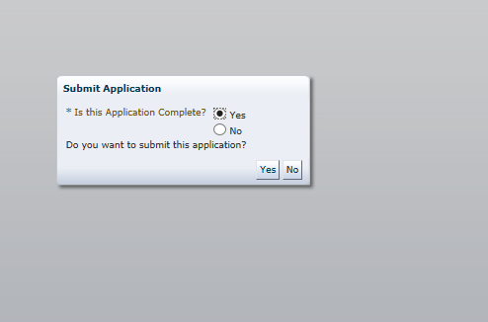
Entering General Correspondence (GC) file-semiannual report
Get a prompt from the system
Notes:
If all the documents have been uploaded select the yes tab. If not then select no and upload any additional documents

Slide 19
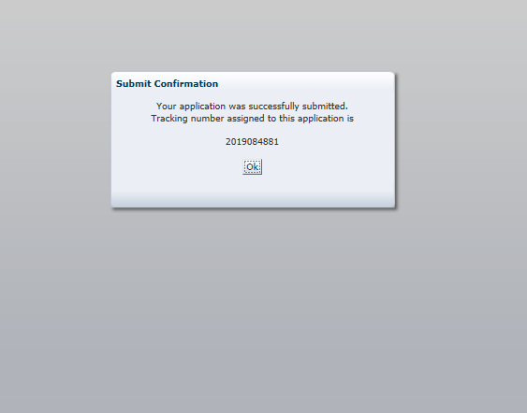
A Tracking Number will be generated if you selected “yes”. This is your “proof” that you have met the semi-annual reporting requirements of your approval. ***shall be done*** you can select “No” and the
Application will
Return to your inbox
To allow for edits and
Submission at a later
time.
Notes:
Applicants will begin to receive showcasuse letters in the event they are not meeting the stipulated reporting requirements as stated in the approval letter

Slide 20
Summary
Semi annual reports – Portal-submission by applicant encouraged.
Renewals and Modification –encourage all applicants to begin submitting their applications (positive control of what is submitted and when, immediate confirmation).
Implemented 120-day reminder for all Renewals. (System send out email notification of pending expiration).
30 day reminder for Semi annual reporting.
Notes:
Strongly Encourages to begin using the Portal.

Slide 21
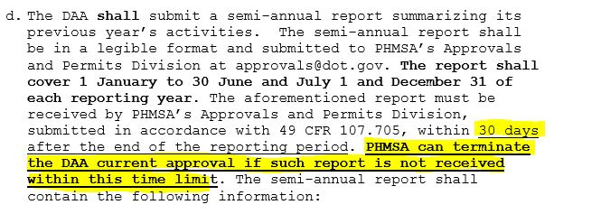
Section 7.d approval letter

Slide 22

Questions

