Slide 1
Termination of
R-Number and M-Number Approvals Without an Expiration
Presented by
Irwin Pascal
PHH-30 Approvals & Permits

Slide 2
Overview
Who is PHMSA?
What are M/R-Numbers?
Why are they being discontinued?
How will this help You/PHMSA?
How was the public notified?
What are the new requirements?
How to request a new approval number?
Deadline: November 17, 2018

Slide 3




Who is PHMSA?
Our mission is to safeguard people, property and the environment from the risks in hazardous materials transportation

Slide 4
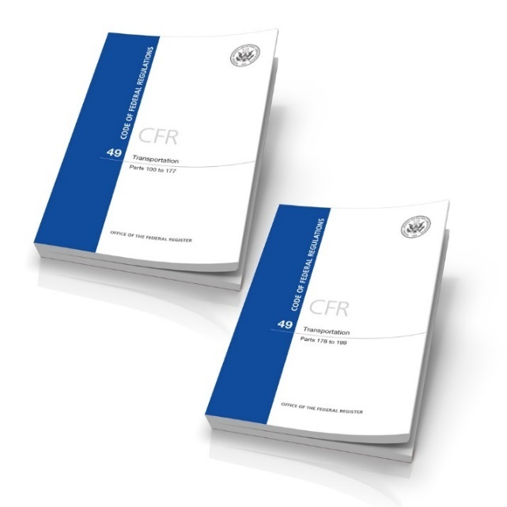
What does PHMSA do?
Regulations
  Rulemakings
  Interpretations
  Hazardous Materials Info Center
Approvals and Special Permits
Education and Compliance Assistance
Emergency Response Guidebook
Grants

Slide 5
PHMSA’s Approvals
Provide written permission from the Associate Administrator to perform a function that requires prior consent under the HMR
PHMSA reviews more than 20,000 approvals annually
  Registration, Classification, Third-Party Inspection, DOT Inspection, Safety Evaluation

Slide 6
R-Number Approvals
Basis for R-numbers was based on 49 CFR § 173.28.
PHMSA previously issued R numbers
No expiration date
PHMSA no longer issues R-numbers
  Transitioned over to M-numbers
  Individuals/companies were allowed to continue using R-numbers

Slide 7
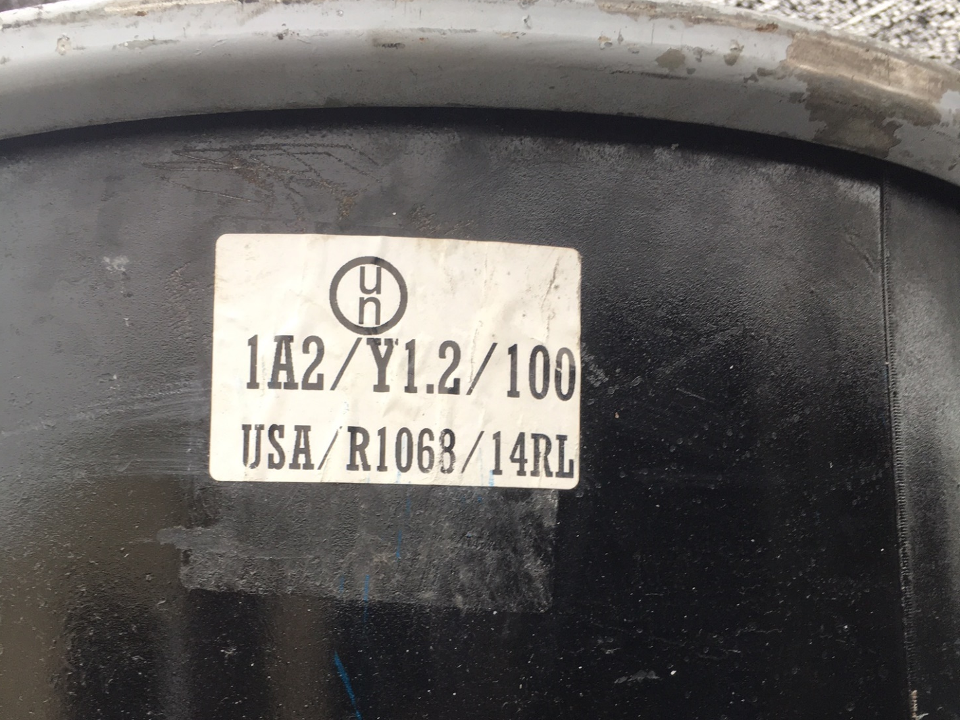
R-Number Approvals

Slide 8
M-Number Approvals
Alpha-numeric identifier
Used to mark all types of packagings
Old M-numbers have no expiration date
M-numbers issued after 2010 have a 5-year expiration date

Slide 9
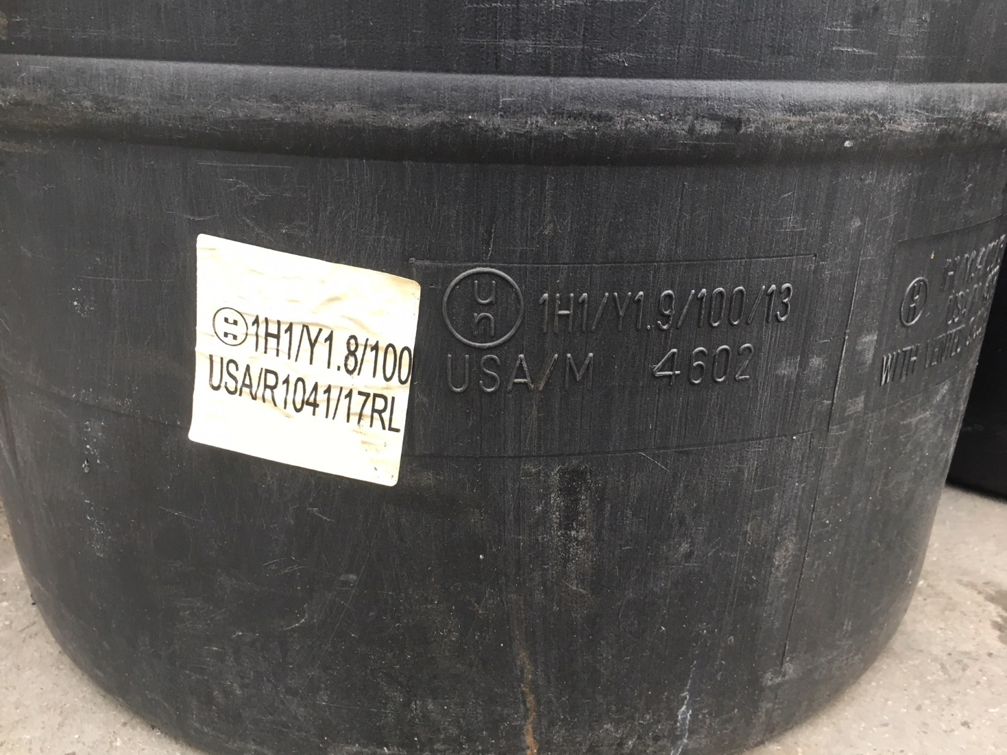
M-Number Approvals

Slide 10
Why are R-numbers being Terminated
PHMSA no longer issues R-numbers
PHMSA transitioned from R-numbers to M numbers.
Investigators cannot locate or verify facilities that would need inspections.
Companies could have potentially moved or changed their status without notifying PHMSA

Slide 11
Why are M-numbers without an expiration being Terminated?
Large quantity of M number approvals issued prior to 2009/2010 without expirations.
All approvals issued now have 5-year expirations
PHMSA is unable to communicate effectively with M-number approval holders without an expiration date
Waste of PHMSA field resources attempting to perform compliance inspection on facilities that cannot be found (changed) location; no longer in operation.

Slide 12
How will this help you?
Ensures applicants are subject to the same renewal timelines/requirements
Assists approval holders, and others, to monitor validity of their approval, renew in a timely manner, and search/determine compliance using the updated listing on PHMSA’s webpage
Allows companies to maintain their public notoriety without disruption during the update process

Slide 13
How will this help PHMSA?
Provides standardization/consistency of PHSMA’s approvals process
Creates a reliable database of M-number approval holders, ensuring both the regulated public and PHMSA’s enforcement team has access to /current/verifiable data
Allows PHMSA to regularly review approval documents/track changes

Slide 14
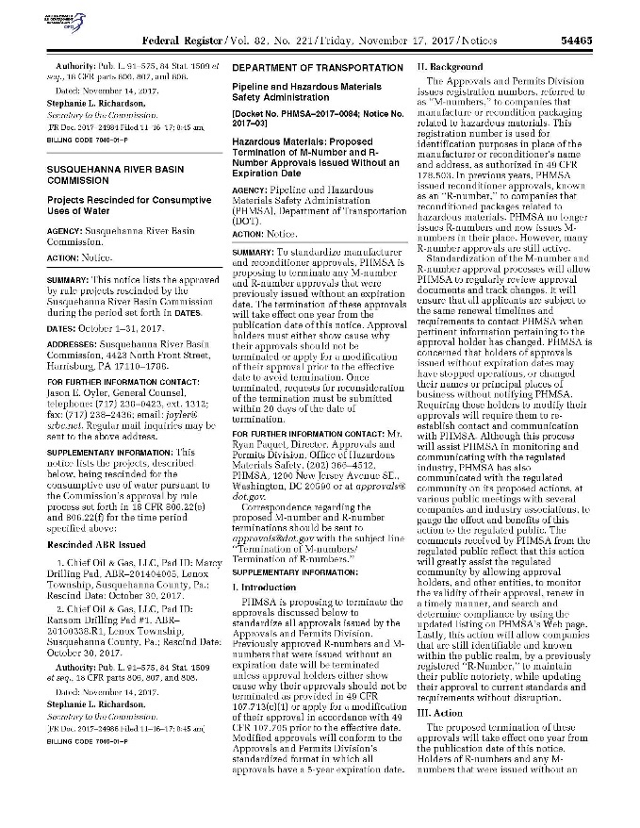
How was the public notified?
Federal Register Notice
  November 17, 2017
  Docket No. PHMSA-2017-0084
  Notice No. 2017-03

Slide 15
What are the New Requirements?
All approval holders have M-numbers valid for 5 years
The deadline to request a new/modified
M-number is November 17, 2018
Any administrative changes or modifications to an approval must be reported to PHMSA

Slide 16
What are the New Requirements?
All R- and M-numbers (without an expiration) will be terminated on November 17, 2018 unless approval holders submit a request to PHMSA for a new/modified M-number with a 5-year expiration

Slide 17
How to Request a New Approval Number?
If you have an R-number, contact PHMSA to request a M-number approval; include your R-number
  You will receive an M-number valid for 5 years
  You may use that newly issued M-number immediately
  Your new M-number will be linked to your R-number
  You may continue to use your R-number as that M-number (with 5-year expiration) is valid/current

Slide 18
How to Request a New Approval Number?
If you have an M-number (without an expiration date), contact PHMSA to modify it
  You will keep the same M-number, which will now have a 5-year expiration.

Slide 19
How to Contact PHMSA
Send an email to Approvals@dot.gov
  Include your name, company name,
  facility address, and telephone number
  Include your R-number (if applicable)
  Include your M-number (if applicable)
Call (202) 366-4535 or (800) 467-4922
Register online: http://portal.phmsa.dot.gov
Visit the link to the online portal

Slide 20
Link to help you in creating and online account and submitting requests online.
https://www.phmsa.dot.gov/hazmat/pressure-vessels-approvals/external-applicant-guide-create-m-number-account

Slide 21
Deadline
On November 17, 2018 PHMSA will issue a new Federal Register Notice to terminate all
R-numbers and M-numbers that do not have an expiration date

Slide 22
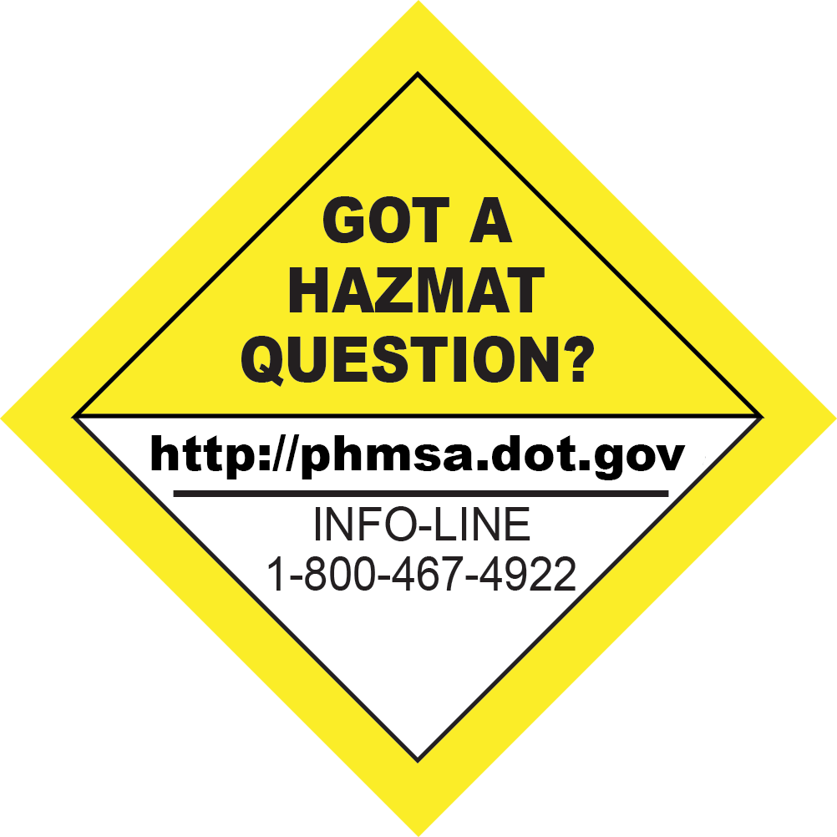
Hazmat InfoCenter
infocntr@dot.gov

