Slide 1
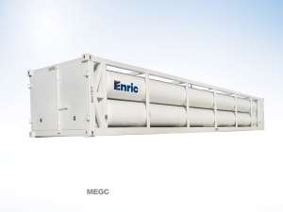
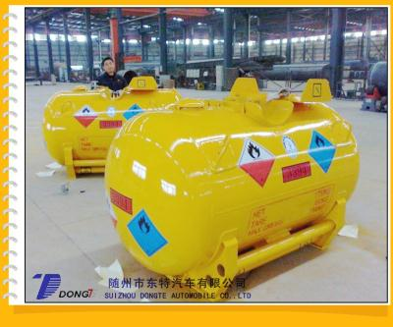
Pipeline and Hazardous Materials Safety Administration (PHMSA)
Designated Approval Agency (DAA) Annual Meeting
DAA Annual Meeting
Washington D.C.
May 17, 2017
Presented by :
PHMSA Staff
Pressure Vessels Division (PHH33)
Pipeline and Hazardous Materials Safety Administration (PHMSA)

Slide 2




Our Mission
015 IT Portfolio
PHMSA's mission is to protect people and the environment by advancing the safe transportation of energy and other hazardous materials that are essential to our daily lives.

Slide 3
Discussion Points FY2015 IT Portfolio
Previous Meeting Question Answer/Review
Approval Letter Update
GAP Analysis

Slide 4
Discussion Points (Cont.)
Review Semi-Annual Reporting Requirements
Application Review by Technical Staff
Field Operation (common findings/inspection process)

Slide 5
Previous Meeting Question Answer/Review
Isreal Mallard

Slide 6
DAA Questions and Concerns
If a DAA notes issues with a portable tank (PT), notifies the owner and the owner fixes the issues, should this be reported on the inspection report? Or noted in the semi-annual report to DOT?
All items should be noted on the inspection report.
Report requirements are noted in the DAA Approval letter.

Slide 7
DAA Questions and Concerns
Is Hattie Mitchell’s letter regarding the schedule for periodic inspection and test of IM and UN Portable Tanks under HMR still a valid PHMSA position?
Ref No: 07-0069
What is PHMSA’s view on the International (IMO-IMDG Code) regulation which allows a plus or minus of three months to perform 2.5 and 5 year visual inspection and test?
PHMSA recommends that industry submit a petition for rulemaking outlining their economic impact.

Slide 8
DAA Questions and Concerns
The U.S. allows the owners to perform the 2.5 year visual inspection on Portable Tank’s. PHMSA issued an interpretation letter which effectively allows anyone to perform the 2.5 year test.
Interpretation Letter-Reference Number: A1-0002

Slide 9
DAA Questions and Concerns
What type of training do Modal inspectors/investigators get and what records are kept showing they know the HMR and technical issues of the manufacturing process?
PHMSA has internal training for Investigators.
PHMSA has inspection activities and procedures.

Slide 10
DAA Questions and Concerns
HM-241, DOT must disagree with the National Board and ASME requirements for UN portable tanks since this adoption will require $2,800.00 worth of training for each inspector in order to perform such inspection as outlined within this rule change if adopted with no safety benefit for having such training.
The Standards and Rulemaking Division are currently taking comments from the public.

Slide 11
DAA Questions and Concerns
How can DAA’s get the link to allow them to get automatic notification on rulemakings by email.
Federal Register Notices
https://www.federalregister.gov/agencies/pipeline-and-hazardous-materials-safety-administration

Slide 12
DAA Questions and Concerns
Europe is discussing requiring DAA to have Quality Assurance training in addition to competent authority approval, will DOT consider this too?
PHMSA’s Engineering and Research Division will discuss this question in detail in their presentation.
Quality Assurance training should be covered in the Standard Operating Procedure (SOP).

Slide 13
DAA Questions and Concerns
What does independent really mean for a DAA? Can a DAA have some interest in a repair shop and still be independent?
49 CFR 107.402 requires an DAA maintain a independent relationship with the manufacturers.
The DAA must remain independent from the manufacturers as noted in the Approval letter.

Slide 14
DAA Questions and Concerns
PHMSA requires that requested documents, either as a result of an investigation or safety review, are received in a timely manner.
Requirement noted in the DAA Approval letter.
Application 30 days IAW- 49 CFR 107.709 (b)
During the inspection – As defined by the Investigator (post inspection)

Slide 15

DAA Questions and Concerns
Any Additional Questions and/or Concerns?
Isreal Mallard
Transportation Specialist
U.S. DOT, PHMSA, OHMS
Approvals and Permits Division
PHH-30
Pressure Vessels Branch
East Building, E21-208
1200 New Jersey Ave., SE
Washington, D.C. 20590-0001
Isreal.mallard@dot.gov

Slide 16
Approval Letter Update
Neil Benninghoven

Slide 17
Approval Letter Update
GAP Analysis
No expiration date Approvals
Contractors

Slide 18
Approval Letter Update (cont.)
Training
Renewal Applications
Semi-Annual Reporting

Slide 19
GAP Analysis
To better define the gaps in the DAA program a GAP Analysis was performed. This analysis will aid in the development of the DAA presentation and redrafting of the DAA Approval Letter. During the GAP Analysis there were several deficiencies noted in the current Approval Letter and also in the 49 CFR § 107.402 and 180.605(c), these “gaps” have been addressed in the new version of the approval letter and with the Standards Branch.

Slide 20
GAP Analysis (cont.)
DAA Approval Letter without expiration dates
Duties of the DAA
DAA Reporting requirements
DAA Statement of independence

Slide 21
Expiration Dates
5 Year expiration date
No expiration date approvals
Grace period

Slide 22
Contractors
Section 5 – Period of Validity and Conditions of Approval:
  5 g – You must report the name(s) and addresses of any contractors who are performing any work for you as the DAA approval holder. This must be done if/when a change is made within 20 days of the change. If no changes in contractors, their information must be submitted in the required Semi-Annual report.

Slide 23
Contractors (cont.)
Section 6 – General Provisions:
  6 a – “A hard copy of this approval must be made available upon request where testing and inspections are conducted. This includes when a third party is performing inspections for the Approval Holder.”
  This means any contractor who performs any of your work (offsite) must display a copy of your approval letter. You (the DAA) are responsible for contractor work and they work under your approval.

Slide 24
Contractors (cont.)
Section 6 – General Provisions:
  6 e - “Any qualified inspectors from another approved DAA or other inspectors acting under contract under the authority of the Approval Holder listed above must be on file with PHMSA prior to marking or certifying packaging listed in paragraph 4.a. above. These individuals/companies must be listed as part of the original approval application or provided in the applicant’s semi-annual report sent to PHMSA prior to conducting inspection activities.” Please note this must be sent to PHMSA prior to any work being completed outside of your physical approval address as listed at the top of the first page.”

Slide 25
Training
Section 6 – General Provisions:
  6 c - “Records of hazardous materials training for all qualified personnel, who perform functions subject to the HMR, in accordance with §§ 172.704(d)”.
  This is one of the most common findings when Field Operations conduct an onsite visit. Make sure you strictly adhere to this regulation to avoid any problems in the future. Copies of the training records can be submitted with applications.

Slide 26
Renewal Applications
Section 6 – General Provisions:
  6 m - “Renewal applications shall be submitted at least 60 days prior to the expiration date listed on the original approval to approvals@dot.gov. If a complete and conforming renewal application is received pursuant to 49 CFR, Parts 450-453 under the provisions of 49 CFR § 107.705 at least 60 days prior to the expiration date, the approval will remain valid and will not expire until final administrative action on the application for renewal has been taken by PHMSA.”

Slide 27
Renewal Applications (cont.)
What this means to you is, if you submit your application at least 60 days prior to the expiration date, your approval does not expire until PHMSA make a determination on your renewal application. If it takes a year to process the application, you are still able to perform your duties under the old approval letter IF your application is received prior to the 60 day mark.

Slide 28
Semi-Annual Reporting
Section 7 – Special Provisions:
  7 c – “The DAA shall submit a semi-annual report summarizing its previous year’s activities, the report shall cover 1 January to 31 June and July 1 and December 31 of each reporting year. The aforementioned report must be received by PHMSA’s Approvals and Permits Division, submitted in accordance with 49 CFR 107.705, within 30 days after the end of the reporting period. PHMSA can terminate the DAA current approval if such report is not received within this time limit.”

Slide 29
Application Review by Technical Staff
Leonard Majors

Slide 30
Certifying the Manufacturing of Portable Tanks
Demonstrated knowledge of all regulations and specifications relevant to the type of manufacturing inspection for which the Approval is requested. For example, the Applicant applying for the certification of DOT, IM and UN specification portable tanks, and Multi-Element Gas Containers (MEGC) must have knowledge of 49 CFR and all referenced standards related to the packaging design, manufacturing and testing (e.g. UN, CSC, ASME, ISO).

Slide 31
Certifying the Manufacturing of Portable Tanks (Cont.)
Standard Operating Procedures (SOPs) and inspection checklists covering aspects of manufacturing, testing, quality control, and reporting. The SOP should include witness points vs. verification points during the manufacturing process.

Slide 32
Certifying the Manufacturing of Portable Tanks (Cont.)
SOPs for personnel performing inspections, including duties and & qualifications, personnel training requirements, continuation of training and certification requirements for all inspectors employed by the approval holder for the specific packaging(s) for which the approval is required.
Copies of all current hazmat employee records of training performing requirements within 49 CFR Parts 100 to 185. Records must meet Section 172.704(d) at the minimum.

Slide 33
Standard Operating Procedures (SOP)
DAA must provide a Standard Operating Procedure for the evaluation to certify manufacturing.
The SOP should outline the procedures used to evaluate designs and manufacturing of the packaging you are certifying and their equipment.

Slide 34
Standard Operating Procedures (SOP) (Cont.)
The SOP should outline the following:
Inspection Checklists covering aspects of manufacturing, testing, quality control, and reporting which clarifies witness points vs. verification points during the manufacturing process.
Personnel performing inspections, including duties and qualifications, personnel training requirements, maintenance of training and certification requirements for all inspectors employed by the approval holder for the specific packagings for which the DAA is applying.

Slide 35
Standard Operating Procedures (SOP) (Cont.)
The SOP will indicate your ability as the DAA to:
  Review and evaluate design drawings, design and stress calculation.
  Knowledge of the appropriate regulations.
  Conduct or monitor and evaluate test procedures and results.
  Review and evaluate the qualifications of materials and fabrication procedures.

Slide 36
Certifying the Requalification of Portable Tanks
Demonstrated knowledge of all regulations pertaining to retesting and inspection of DOT, IM, and UN specification portable tanks or Special Permit portable tanks that are being requalified under the provisions of 49 CFR Part 180.605 or the applicable Special Permit

Slide 37
Certifying the Requalification of Portable Tanks (Cont.)
SOPs for personnel performing inspections, including duties & qualifications, personnel training requirements, maintenance of training and certification requirements for all inspectors employed by the approval holder for the specific packaging(s) for which the approval is required.
Copies of all current hazmat employee records of training performing requirements within 49 CFR Parts 100 to 185. Records must meet Section 172.704(d) at the minimum.

Slide 38
Certifying the Requalification of MEGC’s
After the initial inspection, a MEGC must be inspected at least once every five years, in accordance with the provisions of CFR 180.217.
The 5-year periodic inspection must include an external examination of the structure, the pressure receptacles and the service equipment, as follows:
1) The pressure receptacles are inspected externally for pitting, corrosion, abrasions, dents, distortions, defects in welds or any other conditions, including leakage, that might render the MEGC unsafe for transport.
2) The piping, valves, and gaskets are inspected for corroded areas, defects, and other conditions, including leakage, that might render the MEGC unsafe for filling, discharge or transport. Missing or loose bolts must be tightened/replaced.

Slide 39
Certifying the Requalification of MEGC’s (Cont.)
All emergency devices and valves are free from corrosion, distortion and any damage or defect that could prevent their normal operation. Remote closure devices and self-closing stop valves must be operated to demonstrate proper operation.
Required markings on the MEGC are legible in accordance with the applicable requirements.
The framework, the supports and the arrangements for lifting the MEGC are in satisfactory condition.
The MEGC's pressure receptacles and piping must be periodically requalified as prescribed in §180.207(c), at the interval specified in Table 1 in §180.207.

Slide 40
Training Requirements
The DAA must ensure the applicant has provided the training in the following areas:
  General Awareness Training
  Function-Specific Training
  Safety Training
  Security Awareness Training
  Note: The 49 CFR does not identify training specific courses. Training is base upon the applicant discretion.

Slide 41
Certifying the Manufacture of Multi-Element Gas Containers (MEGC’s)
Specific to MEGC inspection, Approval Agencies are required to ensure that the MEGC conforms to the design type approval.
Witness all tests required for the approval of the MEGC specified in 49 CFR §178.75.
Verify and ensure, through appropriate inspection, that each MEGC is fabricated in all respects in conformance with the approved drawings, calculations, and test data, and regulatory requirements for the framework and attached cylinders.
Determine and ensure that the MEGC is suitable for its intended use and that it conforms to the applicable regulatory requirements.
Apply its name, identifying mark or identifying number, and the date the approval was issued, to the metal identification marking plate attached to the MEGC, upon successful completion of all requirements of 49 CFR Part 178. Any approvals by the Associate Administrator authorizing design or construction alternatives (Alternate Arrangements) of the MEGC (see paragraph (a) of this section) must be indicated on the metal identification plate as specified in §178.75(j).
Prepare an approval certificate for each MEGC or, in the case of a series of identical MEGCs manufactured to a single design type, for each series of MEGCs.
Copies of all current hazmat employee records of training performing requirements within 49 CFR Parts 100 to 185. Records must meet Section 172.704(d) at the minimum.

Slide 42
Certifying the Manufacture of MEGC’s (Cont.)
MEGCs must be designed to withstand, without loss of contents, at least the internal pressure due to the contents, and the static, dynamic and thermal loads during normal conditions of handling and transport.
The design must take into account the effects of fatigue, caused by repeated application of loads through the expected life of the MEGC.
MEGCs and their fastenings must, under the maximum permissible load, be capable of withstanding the following separately applied static forces (for calculation purposes, acceleration due to gravity (g) = 9.81 m/s2):
1) In the direction of travel: 2g (twice the MPGM multiplied by the acceleration due to gravity);
2) Horizontally at right angles to the direction of travel: 1g (the MPGM multiplied by the acceleration due to gravity. When the direction of travel is not clearly determined, the forces must be equal to twice the MPGM);
3) Vertically upwards: 1g (the MPGM multiplied by the acceleration due to gravity);
4) Vertically downwards: 2g (twice the MPGM (total loading including the effect of gravity) multiplied by the acceleration due to gravity.

Slide 43
Summary
The Role of the Designated Approval Agency and the Responsibilities that falls under these duties are extremely essential for PHMSA to authorize approval for the production of tanks.

Slide 44
Questions

Slide 45
Thomas J. Lynch
Investigator, Southwest Region
Field Operations http://phmsa.dot.gov/hazmat
DOT DESIGNATED
APPROVAL AGENCIES
MEETING II
17 May 2017

Slide 46
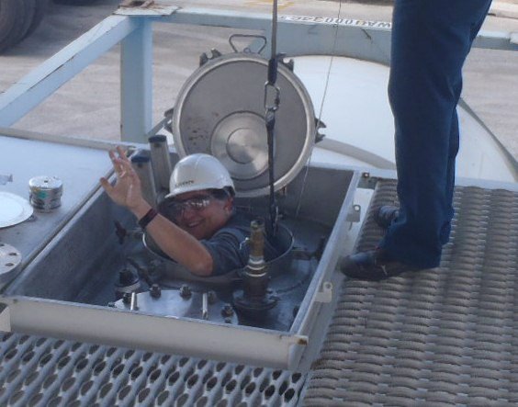
Welcome

Slide 47
Office of Hazardous
Materials Safety (OHMS)
“Protect the nation adequately against the risks to life and property which are inherent in the transportation of hazardous materials (Dangerous Goods) in commerce” [49 U.S.C. 5101]
Ensures and promotes the safety, security and performance of the nations hazardous materials transportation system through its nationwide field operations.
Operational activities that include compliance, incident and accident inspections and investigations; safety, performance and regulatory adequacy and fitness determinations; outreach, education and training activities; and reporting feedback, information and intelligence through its oversight of hazardous materials shippers, carriers and the manufacture, requalification, recondition, maintenance and use of hazardous materials packaging.
To determine the adequacy and clarity of the regulations for which the hazardous material transportation activities are based.
Training and outreach

Slide 48
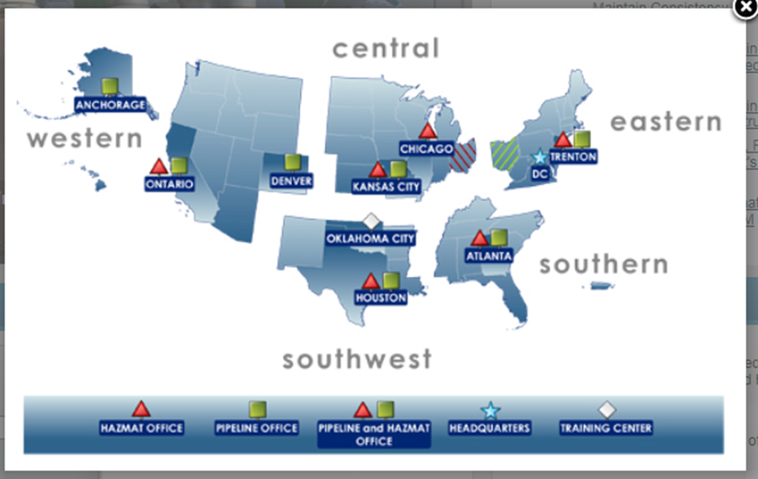
PHMSA Field Operations Regions

Slide 49
Field Operations – A Full Service Operation
Inspections
  Compliance
  Fitness
  International
Investigations
  Accidents / Incidents
  Complaint
  Compliance
  Criminal
Training
  CSB Staff
  HMSAT
  Program Partners
  Modal Partners
Regulatory & Technical
  Regulatory Adequacy Determinations
  Rulemaking Development
  Technical Advisors
  Interpretations
  Subject Matter Experts & Testimony
Outreach/Education
  PHH Inspection Exposure
  Safety Advisories
  Public Presentations
  Awareness Campaigns

Slide 50
Why Us?
Approval Holder
Inspect & Test Packages (High Risk PIH/TIH)
Investigations
Fitness Review
Complaints

Slide 51
The Inspection Process
Introduction
Items Reviewed
Information Gathering
Closing the Inspection
Next Step

Slide 52

The Inspection Process - Introduction
Identification
Purpose of Inspection
General Info Gathering
  Representative
  Subcontractors
  Contact Info
  Tax ID Number
Company Overview
  What do you do?
  Where and how often

Slide 53
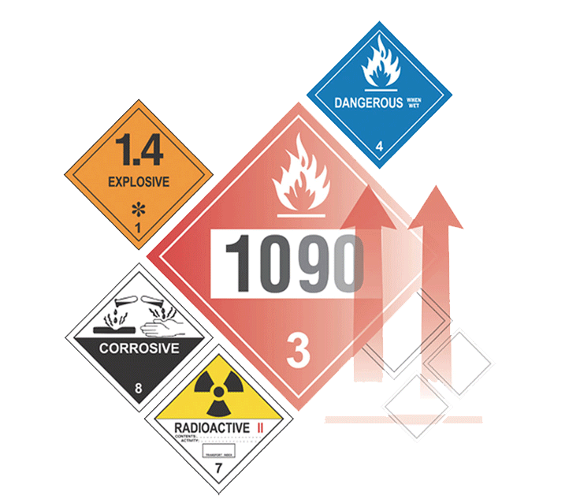
The Inspection Process – Items Reviewed
  Approval documents
  Processes and Procedures (SOP’s)
  Special Permits (holder or inspected)
  Packages Inspected & Tested
  Type of training
  Training records
  Security

Slide 54

The Inspection Process – Information Gathering (Review & collect documents)
Design drawings
Calculations
Inspection procedures
PHMSA observed the inspector
Inspection & test records
Training of Inspector(s)
Records of training
Conflict resolution

Slide 55
The Inspection Process – Information Gathering (Review & collect documents)
Design drawings
Calculations
Inspection procedures
PHMSA observed the inspector
Inspection & test records
Training of Inspector(s)
Records of training
Conflict resolution

Slide 56
The Inspection Process – Information Gathering
Field observations
Visit site where actual work is being performed, or arrange for a demonstration
Observed inspection points during manufacturer
What’s reviewed by inspector
Observe Inspection & tests being performed

Slide 57
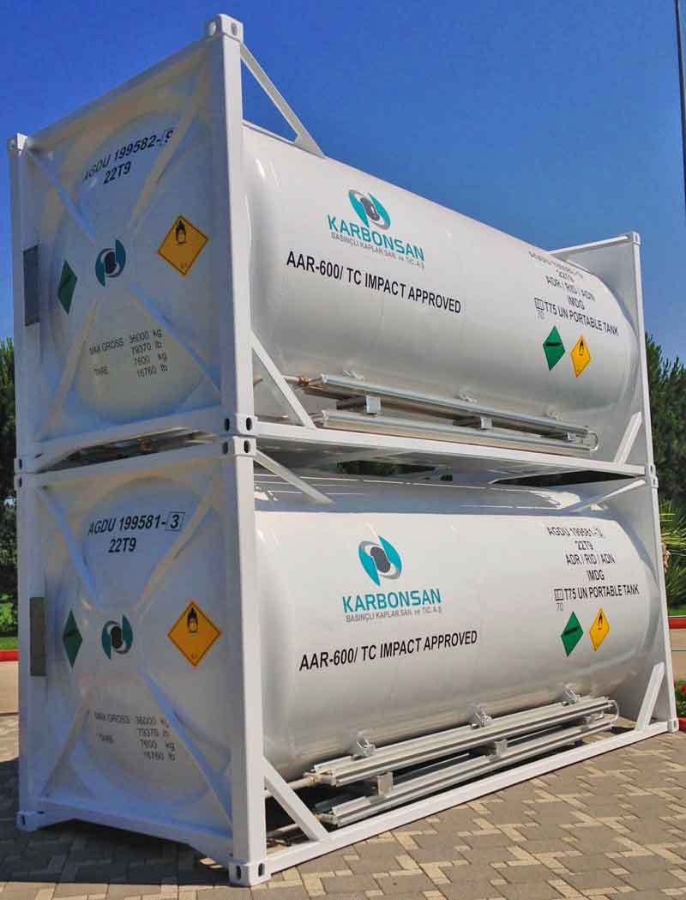
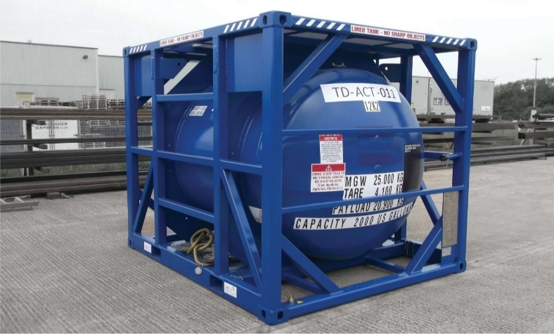
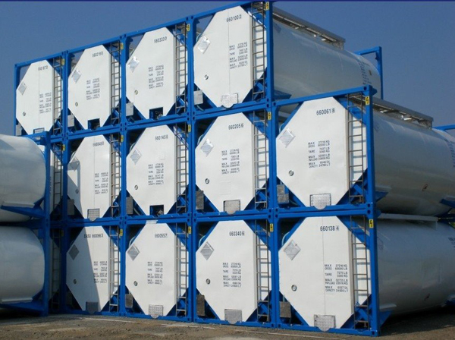
The Inspection Process – Information Gathering
Observations (Photographs)

Slide 58
The Inspection Process – Closing the Inspection
Exit Briefing
  A “Field Report” not a “Final Report”
  Used to summarize the inspection and notate probable violations and 49 CFR references, if any
  Investigator will review document with company official and provide guidance with regard to deficiencies
  Discuss any quality control items noted
  Request corrective action
  Obtain signature(s) and provide copies

Slide 59
The Inspection Process – Next Steps
Investigator returns to regional office to prepare inspection report
  Reviews inspection with Chief Investigator or Region Director
  Formalizes interviews, photos, documentation, etc.
  Documents facts and evidence
Awaiting Corrective Action (within 30 Days)
  Attach to completed report and submits report for approval
Chief Investigator or Region Director will review report for validity and completeness, and determine if corrective actions are sufficient to prevent future occurrences and ensure compliance

Slide 60
Inspection Results/Actions
No Further Action
Warning Letter
Ticket for Non-Compliance
Enforcement Case
  General Council
Criminal Referral
  General Council
  Office of Inspector General (OIG)

Slide 61
Inspection Statistics
Approvals Branch has issued 15 DAA letters
9 of 15 DAA have received Fitness reviews
One has a Conditional Approval

Slide 62
Inspector & Investigator Training
In 2007, the OHMS Investigator Training and Certification
Program began various training classes for Hazardous
Materials Transportation Inspectors and Investigators.
In January 2017, PHMSA (Hazmat) open its new training
Facility in Oklahoma City, OK. Plans are to add course(s)
to perform inspections and investigations on DAA’s using this
new facility.

Slide 63
Contact Information
Thomas J. Lynch
Investigator, Southwest Region
Field Operations
Email: tom.lynch@dot.gov
Phone: 713-272-2820
Notes:
Note: Subpart D Enforcement, Section 107.305 Investigations (a) General only states that The AA encourages voluntary production of documents in accordance with and subject to 105.45….. So no specific time line to comply with request is written here ( may be further up the rules/code

