Slide 1
Pipeline and Hazardous Materials Safety Administration Shakira Mack Pipeline and Hazardous Materials Administration (PHMSA) Chief, Hazardous Materials Grants & Registration October 16, 2018

Slide 2
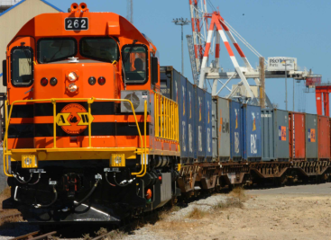
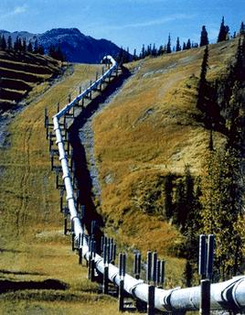
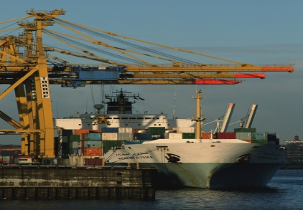
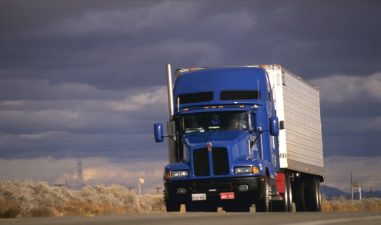
PHMSA’s Vision and Mission
Vision
The most innovative transportation safety organization in world.
Mission
To protect people and the environment by advancing the safe transportation of energy and other hazardous material that are essential to our daily lives.

Slide 3
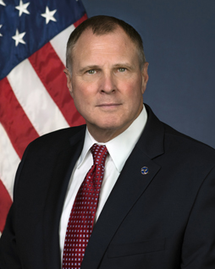
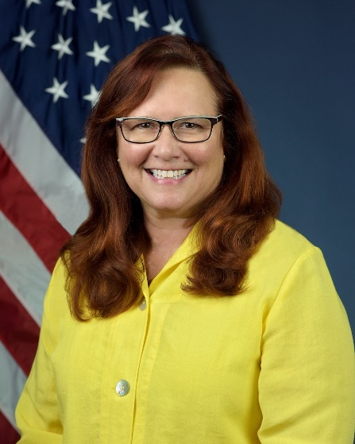
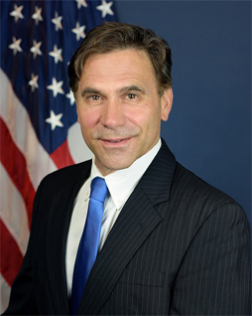
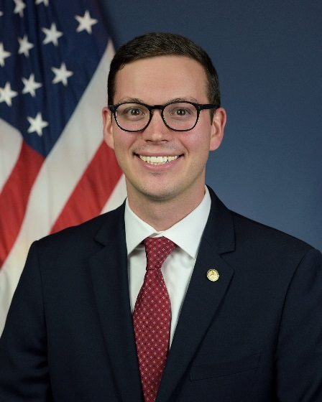
PHMSA Leadership
Deputy Administrator
Drue Pearce
Chief Counsel
Paul Roberti
Director of Governmental, Int’l & Public Affairs
Bobby Fraser
Administrator
Howard “Skip”
Elliott
Notes:
Skip:
Sworn in as PHMSA Administrator on October 30, 2017.
Previously VP of Public Safety, Health, Enforcement, and Security at CSX.
40+ years experience in U.S. freight rail industry.
Strong background in hazardous materials transportation safety.
Drue:
Sworn in as PHMSA Deputy Secretary on August 7, 2017.
Extensive background in Federal transportation policy and pipeline safety.
Served as Senior Advisor to the U.S. Secretary of the Interior.
Served in the Alaska House of Representatives and the Alaska State Senate.
Paul:
Sworn in as PHMSA’s Chief Counsel on March 27, 2018.
Previously Executive Director at Ernst & Young.
Served as Commissioner on Rhode Island Public Utilities Commission.
Served two terms on U.S. Dept. of Energy Electricity Advisory Committee.
Bobby Fraser:
In May 2018, Bobby Fraser was appointed as the Director of Governmental, International, and Public Affairs for the Pipeline and Hazardous Materials Safety Administration (PHMSA). Mr. Fraser joined the U.S. Department of Transportation in 2017, serving as a Senior Governmental Affairs Officer in the Office of the Secretary of Transportation (OST).

Slide 4
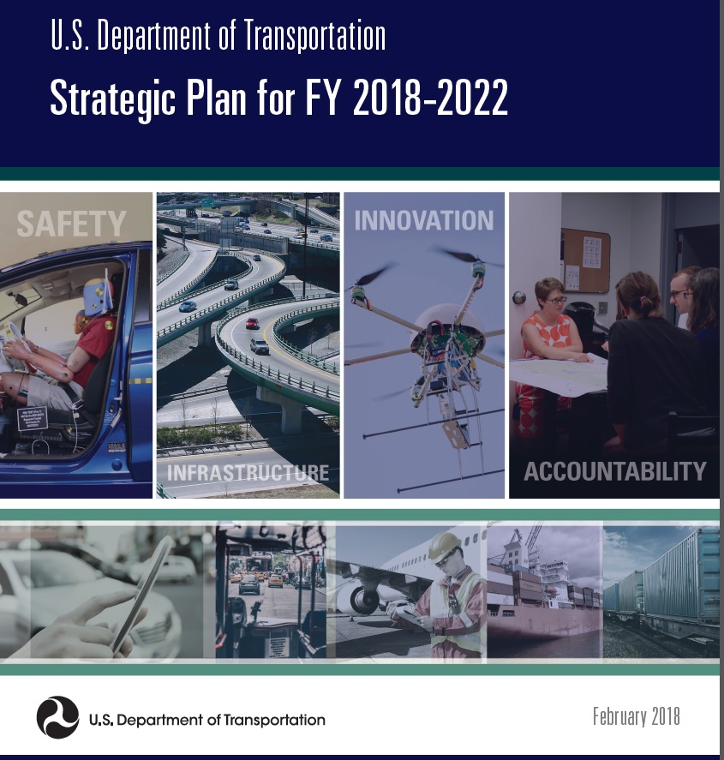
DOT Key Priorities
Safety
Infrastructure
Innovation
Accountability
Notes:
DOT Updates
DOT Strategic Plan 2018-2022 prioritizes the disproportionate transportation safety risks in rural communities
New DOT Grant Review Process
New DOT Grant Review Process

Slide 5
PHMSA Regulatory Reform Efforts
PHMSA is using a systematic (and program-specific) approach to addressing the regulatory reform mandates under EO’s 13771, 13777, and 13783.
PHMSA is reviewing:
Existing regulations
Petitions for rulemaking
Active rulemakings
Special permits
Input from stakeholders
Notes:
EO 13771: Reducing Regulations and Controlling Regulatory Costs - January 30, 2017
EO 13777: Enforcing the Regulatory Reform Agenda - February 24, 2017
EO 13783: Promoting Energy Independence and Economic Growth - March 28, 2017

Slide 6
Is HazMatt hiding in your package?
Certain items like batteries and hairspray may seem harmless, but they can be toxic, corrosive, and even explosive if sent or handled inappropriately.
You can learn more at: ChecktheBox.dot.gov
Remember to CHECK THE BOX and send HazMatt and his friends along safely!
Notes:
Check the Box is a public awareness campaign that seeks to prevent serious incidents by increasing the public’s awareness of everyday items which are considered hazardous materials and require specific classification, packaging, marking, and labeling to ship safely.
The requirements for packaging and marking potentially dangerous goods for transport – as well as the mode of transport – are specific to the type of material being transported.
Flammable aerosols – like hairspray – and dry ice are shipped as undeclared hazmat more than any other commodity.
Ninety-Eight percent of undeclared hazmat incidents are filed by carriers.
Class 3, flammable and combustible liquids, had the most undeclared hazmat incidents with 1,684, followed by class 9, miscellaneous hazardous materials, with 1,555, and class 2, gases, with 1,483.
Approximately 18,000 incidents occur annually. Of those, about 1,500 either involve an undeclared hazardous material, or are the discovery of an undeclared hazardous material. Evacuations occurred in 1,269 of the undeclared hazmat incidents.
Most undeclared hazmat incidents are in the highway mode of transportation.
The percentage of highway undeclared hazmat incidents is increasing year-to-year and the percentage of air incidents is decreasing.

Slide 7
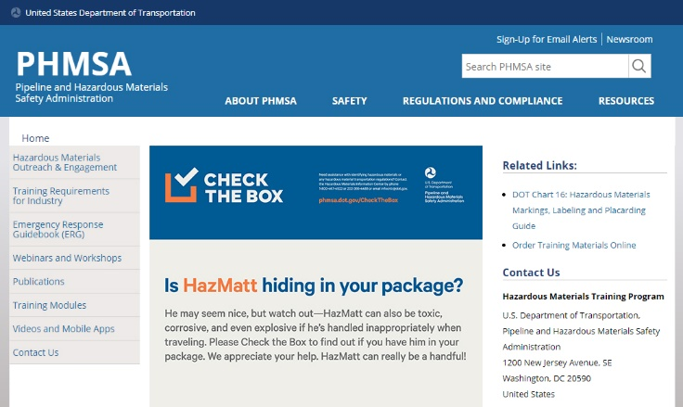
Video

Slide 8
PHMSA Grants
New effort to streamline grant processes for hazmat and pipeline grants
New grants management system enhancing tie-in with agency financial systems (DELPI)
Seek program improvements in next reauthorization bill slated for 2020
Capture stakeholder input for improving emergency response through NFA lead roundtable discussions
Closer focus on measurements of success for grants

Slide 9
Questions?
Please feel free to contact me with any overall program questions or immediate concerns:
Shakira Mack
Shakira.Mack@dot.gov
202-366-5090

