Slide 1
Pipeline & Hazardous Materials Safety Administration HMEP Grant Program
NASTTPO Mid-Year Conference
October 16, 2018

Slide 2
Today’s Topics
Hazmat Grant Program Changes
What’s Coming
Reminders

Slide 3
Grant Program Changes
Grant Specialist Assignments
Andre White – Arkansas through Hawaii, Idaho, Iowa
Andre.White@dot.gov
Flor Valencia – Illinois through Mississippi, Puerto Rico
Flor.Valencia@dot.gov
Suezett Edwards – Montana through Pennsylvania
Suezett.Edwards@dot.gov

Slide 4
Grant Program Changes
Grant Specialist Assignments
Matthew Hufford – Rhode Island through Wyoming
Matthew.Hufford@dot.gov
Lisa Reichenbacher – Territories and Tribal Grantees
Lisa.Reichenbacher@dot.gov
Bonita Brown – Virgin Islands and HMIT, SPST, CS Grantees
Bonita.Brown@dot.gov

Slide 5
Grant Program Changes
Grant Solutions (GS)
No longer used by PHMSA Hazmat Grant Program.
For tribal grantees, grant cycles prior to fiscal year (FY) 2018 grant cycle use GS to closeout.
Submit initial Federal Financial Reports (FFR) and any revised FFRs in GS.
For states and territories, any grant cycles prior to FY2016-2019 grant cycle use GS to closeout.
Submit initial FFRS and any revised FFRs in GS.

Slide 6
Grant Program Changes
Federal Financial Reports (FFR)
As of September 30, 2018, FFRs will be submitted via email to HMEP.grants@dot.gov.
For tribal grantees, grant cycles prior to fiscal year (FY) 2018 grant cycle use GS to closeout.
Submit initial FFRs and any corrected FFRs in GS.
For states and territories, any grant cycles prior to FY2016-2019 grant cycle use GS to closeout.
Submit initial FFRS and any corrected FFRs in GS.

Slide 7
Grant Program Changes
Federal Financial Report
FY 2017 final FFR report for Tribes should be submitted via Grant Solutions.
FY 2017 annual FFR report for States and Territories should be submitted via HMEP.grants@dot.gov.
FY 2018 FFR Report for all HMEP grantees should be submitted via the HMEP.grants@dot.gov.

Slide 8
What’s Coming
FY 2017 Final FFR and Progress Report for Tribes – December 30, 2018
FY 2017 Annual FFR and Progress Report for States and Territories – December 30, 2018
FY 2019 - 2022 HMEP Application Period – February 1 – April 30, 2019 (Tentatively)
FY 2018 Biannual FFR and Progress Report – April 30, 2019
HMEP Conference in Washington DC area – Summer 2019

Slide 9
What’s Coming
Hazardous Materials/WMD Awareness Training Modules
PHMSA and the National Fire Academy have partnered to develop hazmat awareness training modules.
Pilot testing of modules will begin within the next 90 days.
Requesting four volunteers to assist in testing and provide feedback.
Send interest to Carla.Sheppard@dot.gov
Name, email, phone#, state, and job title

Slide 10
What’s Coming
Report to Congress
Annual Report to Congress is being finalized.
Ways to help us with the Report to Congress.
Send any articles, pictures, or testimonies of any recent activities
conducted with HMEP funds.
Send to Bonita.Brown@dot.gov

Slide 11
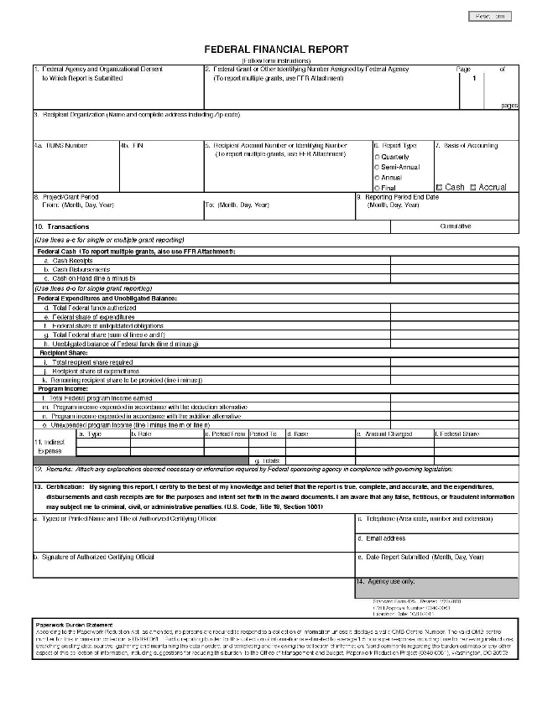
Reminders: States and Territories
Annual FFR (SF-425) Submission
Line d “Total Federal funds authorized” and Line e “Federal share of expenditures”
Must be a cumulative totals of the performance period.
Line i “Total recipient share” and Line j “Recipient share of expenditures”
Must also reflect the cumulative total of the performance period.

Slide 12
Reminders
Hazmat Grants Portal
Activity Request
Submit requests for activities that were not in approved applications.
Contact Change Request
Submit changes of personnel that work on the HMEP grant.
Progress Reports
Complete and submit

Slide 13
HMEP Grant Program Contact Information
General Inquiries: HMEP.Grants@dot.gov
Website: www.phmsa.dot.gov/hazmat/grants
Hazmat Grants Portal: https://hazmatgrants.phmsa.dot.gov/
Team Lead: Carla.Sheppard@dot.gov
General Phone: 202-366-1109

Slide 14
What questions do you have for us?

