Slide 1


Pipeline & Hazardous Materials Safety Administration
HMEP Grant Program
NASTTPO Conference
April 17, 2018

Slide 2

Topics
Welcome
New team members
Application submission updates
Awarding process changes
Federal grant program updates (2 CFR 200)

Slide 3

New Team Members
Financial Grants Specialists
Matthew Hufford – Arkansas through Missouri
    Matthew.Hufford@dot.gov
    202-366-1952
Flor Valencia – Montana through Wyoming
    Flor.Valencia@dot.gov
    202-366-6853

Slide 4

Application Submission Updates:
Continuing, Supplemental, and Tribal Applications

Slide 5

Tentative Timeline
Tribal application webinar – May 3, 2018
Tribal application submission period – May 3-June 4, 2018
Continuing and supplemental (re-allocation) application webinar – May 4, 2018
Continuing and supplemental (re-allocation) application submission period – May 4-June 4, 2018
Awarding of funds – September 30, 2018

Slide 6

Grantee Preparation For Application Review
How can grantees prepare for the open application period?
New activities (grantee and sub-recipient level)
Estimated project costs
Projected number of courses
Projected number to be trained
Estimated activity costs
Projected start and end dates of activities
Contact your grants specialist for additional information

Slide 7

Risk Assessment
Federal agencies and pass-through entities are responsible for assessing risk.
2 CFR 200.331(b) requires pass-through entities to evaluate sub-recipient’s risk of noncompliance with Federal statutes, regulations, and the terms and conditions of the sub-award for purposes of determining appropriate sub-recipient monitoring.

Slide 8
Grants.gov Workspace (Pre-Award)
Available for tribes this year and states and territories next year.
Advantages of the Grants.gov workspace:
    Provides a single place to edit grant documents without emails and attachments.
    Imports forms from previous applications to save time.
    Checks for errors in applications.
    Offers reference information and a link to submit questions.
https://www.grants.gov/web/grants/applicants/workspace-overview.html

Slide 9

Supplemental (Re-allocation) Funding Eligibility
Criteria
All of FY16 (Year 1) funds must have been expended or obligated.
  PHMSA used FY16 (Year 1) annual Federal Financial Reports (FFRs) to validate obligations.
Timely submission of FFRs and performance reports.
Same designated agency from prior year.
On target with timeline in FY16 (Year 1) and FY17 (Year 2) applications.

Slide 10

Awarding Process Changes
Notes:
PHMSA is in the process of streamlining the award process for both hazmat and pipeline grants which will result in some changes

Slide 11

Notice of Grant Agreement
No longer executed via Grant Solutions.
NGAs will be emailed to Authorized Representative (AR).
  Make sure the application includes the person authorized to sign the NGA.
  Please alert your programmatic specialist and cc the HMEP mailbox with any POC changes.
Must be signed and emailed back to the HMEP grants office.

Slide 12



Grant Solutions
Grant Solutions will still be used by the HMEP Program for the following:
  Application submissions/resubmissions
  Federal Financial Reporting
  Correspondence

Slide 13

Federal Grant Program Updates (2 CFR 200)

Slide 14
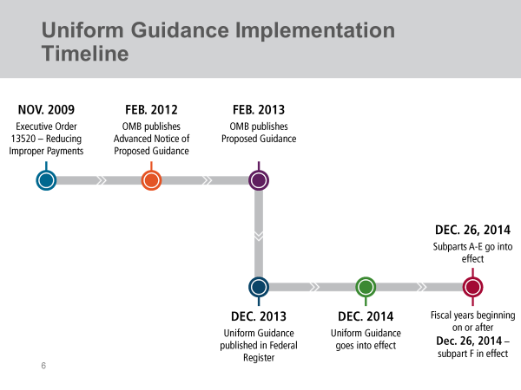
Uniform Guidance Implementation Timeline

Slide 15

Understanding 2 CFR 200’s Impact
on Your Application
Procurement Requirements
Audit Requirements
Internal Controls
Indirect Costs
Personnel Expenses

Slide 16
2017 Procurement Implementation Grace Period
Implementation of the procurement standards for non-federal entities will start with fiscal years beginning on or after December 26, 2017.
OMB has extended a grace period for grantees through May 2018 for implementing the procurement standards in 2 CFR 200, Subpart D.
If you use the grace period then you must document the decision in your internal procurement policies.
Please refer to 2 CFR 200.110(a) for more information.

Slide 17

New Single Audit Requirements
The audit requirements at 2 CFR 200, Subpart F have replaced OMB Circular A-133.
The new audit threshold for non-federal entities is $750,000 or more in the NFE’s fiscal year.
    If you are following Subpart F for the first time, OMB will give you a short term adjustment period.
Tribes and tribal organizations are not required to submit audits to the Federal Audit Clearinghouse.

Slide 18
Federal Awardee Performance
and Integrity Information System (FAPIIS)
What is FAPIIS?
    Publicly accessible online database established to store data about non-federal entities’ qualification to receive awards.
    Became applicable to grants in January 2016.

Slide 19
FAPIIS Applicability to Non-Federal Entities
Federal Agencies:
    Verify applicant qualifications ($150,000)
    May impact Terms and Conditions
Non-Federal Agencies:
  Non-federal entities with a record of poor performance may submit comments to the awardee integrity and performance portal accessible through SAM (currently (CPARS).
  Federal awarding agencies will consider non-Federal entity comments when determining whether the non-Federal entity is qualified for a future Federal award.
Pass Through Agencies:
    May review FAPIIS before making a subaward. This is not a requirement.

Slide 20
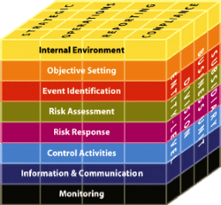
Understanding OMB’s Internal Controls Requirement
OMB clarified 2 CFR 200.61.
Internal controls means a process, implemented by a non-federal entity, designed to provide reasonable assurance regarding the achievement of objectives in the following categories:
  Effectiveness and efficiency of operations;
  Reliability of reporting for internal and external use; and
  Compliance with applicable laws and regulations.

Slide 21
Understanding your Indirect Cost Rate
Must have a current agreement. If your agreement is expired you have three options.
    1. Negotiate a new rate;
    2. Apply for a one time extension of the current rate;
    3. If eligible, adopt the 10% de minimis rate.
Review your agreement to identify the list of direct costs included in your ICRA. Any exclusions should not be applied.
Some examples of excluded items are: equipment, capital expenditures, rental costs, and any other items not approved by the cognizant agency for indirect cost.

Slide 22

Additional Guidance for Personnel Expenses
Standards for Documentation of Personnel Expenses
    Personnel expenses charged to federal awards must be based on accurate documentation.
    If the recipient uses an employee’s compensation toward cost share or matching, must use the same documentation standards as personnel expenses charged directly to the grant.
    Some recipients may use alternative cost allocation methods if approved by their cognizant agency.
    Please refer to 2 CFR 200.430(i) for more information.

Slide 23
Uniform Guidance Resources
Online Resources:
    http://www.ecfr.gov
    https://cfo.gov/grants
    https://www.whitehouse.gov/sites/whitehouse.gov/files/omb/circulars/A133/2017/Compliance_Supplement_2017.pdf
Check individual agency websites for specific implementation information.

Slide 24
HMEP Grant Program Contact Information
General Inquiries: HMEP.Grants@dot.gov
Website: www.phmsa.dot.gov/hazmat/grants
Phone: 202-366-1109

Slide 25
Pipeline Grants
PHMSA provides grant opportunities designed to improve damage prevention, develop new technologies, and improve pipeline safety. PHMSA’s pipeline safety grant programs has helped to foster partnerships with local communities, and universities to promote pipeline awareness campaigns, development of pipeline resources and information, and the implementation of best practices regarding pipeline safety nationwide. These comprehensive programs include:
Technical Assistance Grants (TAG)
State Pipeline Safety Base Grants
One Call
State Damage Prevention

Slide 26

What questions do you have for us?

