Slide 1

Pipeline & Hazardous Materials Safety Administration
HMEP Grant Program
Federally Recognized Tribes
Grant Application Development Webinar
February 14, 2019

Slide 2






Hazmat Grant Program Office
Chief, Grants and Registration
Team Lead, Senior Grants Specialist
––
Matthew Hufford
HMEP Tribal Grants Specialist
Backup HMEP Tribal Grants Specialist
Kenetha Hillman
Rose Achieng
Admin. Assistant (CTR)
Business Analyst (CTR)

Slide 3

Agenda
Grants Chief Announcements
  Grant Management Process Changes
  Renewed Customer Service Initiatives
HMEP Grant Award Overview
HMEP Grant Application
Questions & Answers
HMEP Grant Application References
Notes:
During the HMEP application webinar, we will discuss…

Slide 4
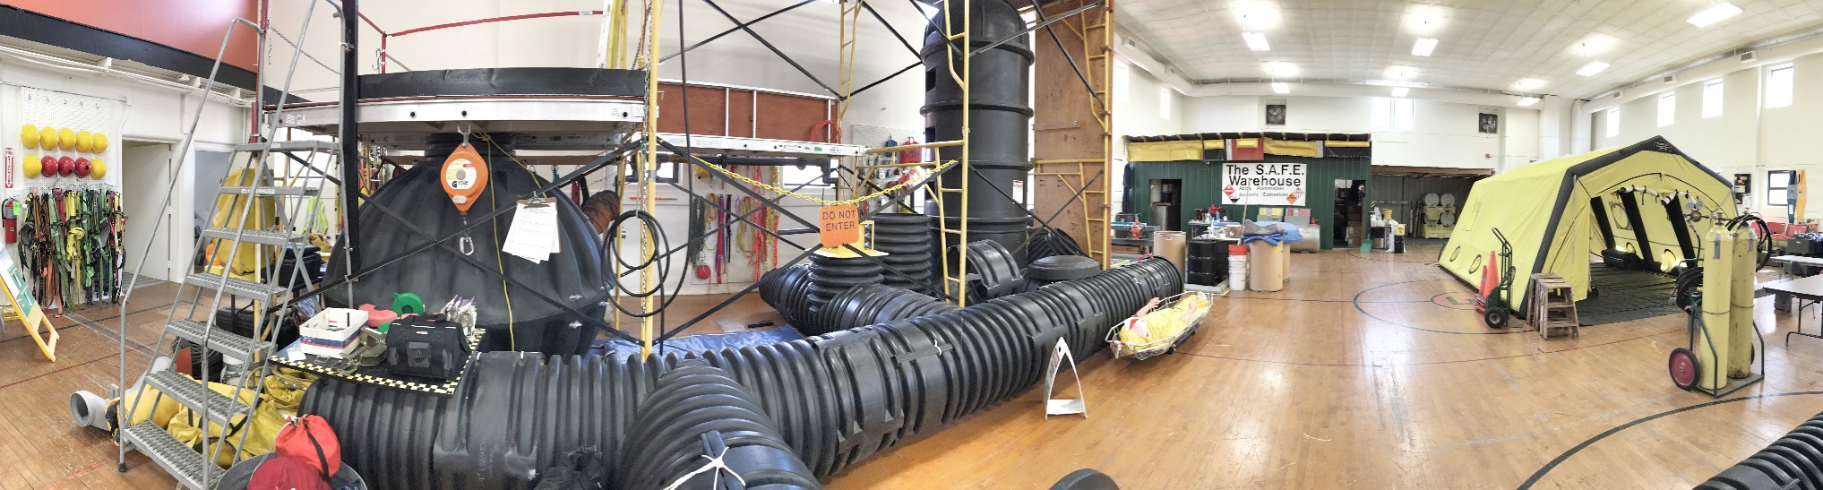
HMEP Grant Award Overview
The HMEP grant is funded by registration fees collected from hazardous materials (HAZMAT) shippers and carriers who offer for transportation or transport certain hazmat in intrastate, interstate, or foreign commerce in accordance with 49 CFR Part 107, Subpart G.
HMEP grants support federally recognized tribes with transportation-related hazardous materials emergencies and the implementation of the Emergency Planning and Community Right-to-Know Act (EPCRA) of 1986.
  Learn more about EPCRA here: https://www.epa.gov/epcra/what-epcra

Slide 5
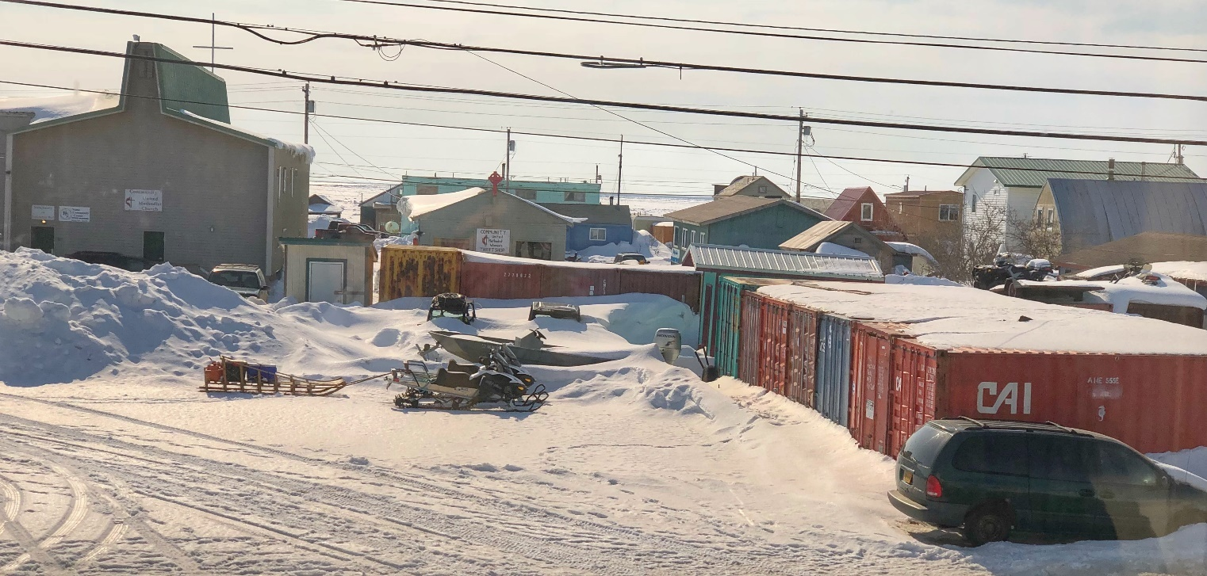
HMEP Grant Award Overview
Diversity among American Indians and Alaska Natives is wide and expansive so the need for each federally-recognized tribe is different.
That’s where you come in:
  What is that need?
  How is it determined?
  Has there been a recent incident?
This grant supports HAZMAT in transportation needs. Since that need varies, this grant is flexible.
Notes:
The components for the HMEP planning grant are…

Slide 6
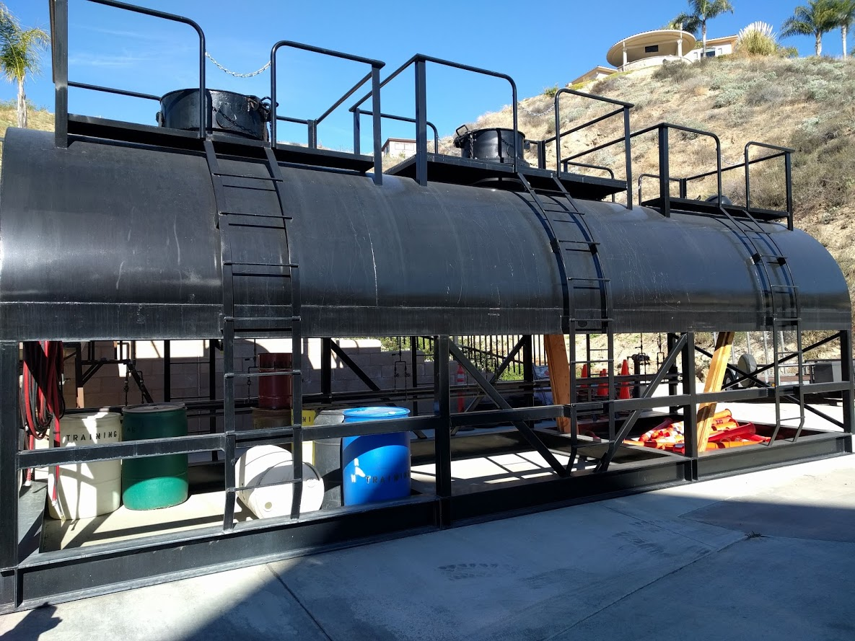
HMEP Grant Award Overview
Eligible activities include (but are not limited to):
  Commodity Flow Studies (what HAZMAT is flowing through your community?)
  HAZMAT Awareness Training (provides foundation on how to respond to an incident involving HAZMAT)
  Table Top Exercises
  Purchase of Training Props
  Grants Management Training
  HAZMAT Conference Attendance (pre-approval required)
HMEP Expenditures Guide: https://www.phmsa.dot.gov/sites/phmsa.dot.gov/files/docs/about-phmsa/grants/hazmat/2956/2017-hmep-expenditures-guide-071317.pdf
Notes:
The components for the HMEP planning grant are…

Slide 7
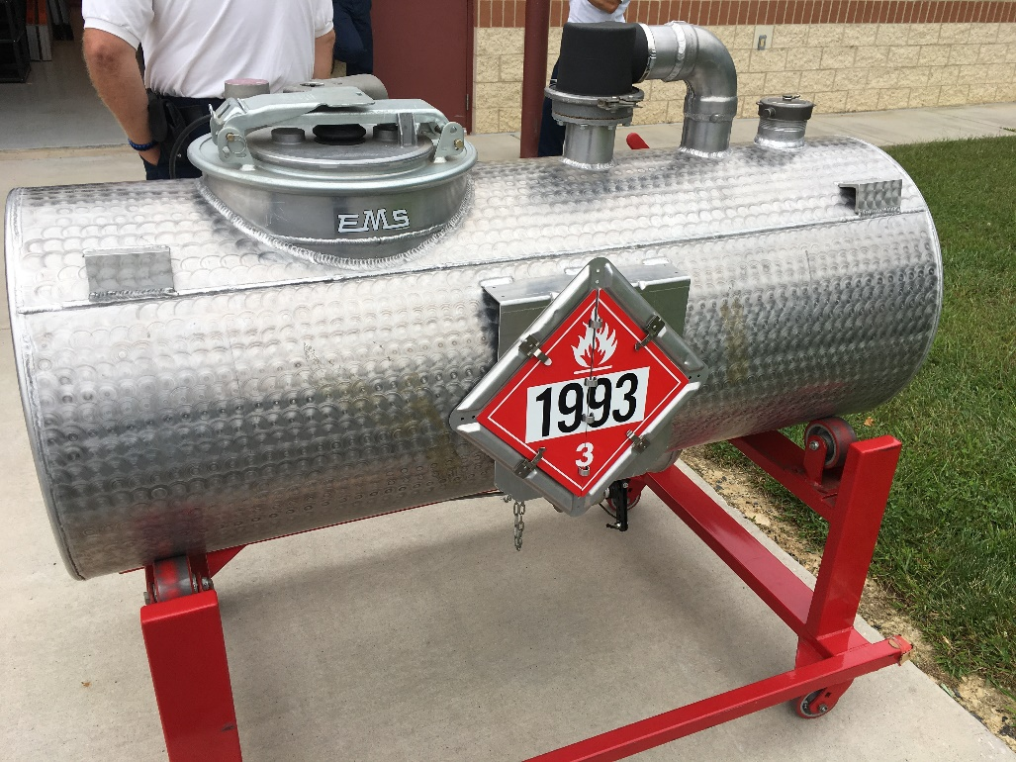
HMEP Grant Award Overview
Eligibility
Applicants are limited to federally recognized tribal governments and intertribal consortiums.
Verify that your tribe is federally recognized at the link below: https://www.bia.gov/sites/bia.gov/libraries/maps/tld_map.html
Notes:
The components for the HMEP planning grant are…

Slide 8
HMEP Grant Award Overview
Tentative FY19 HMEP Application Timeline
March 1, 2019 (tentatively) – Notice of Funding Opportunity (NOFO) posts to Grants.gov and notice sent to potential applicants via email.
April 30, 2019 (tentatively) – Grant application deadline.
June 2019 – PHMSA completes review of applications.
September 30, 2019 – Notice of Grant Agreement (NGA) issued to grantees. Period of performance from 09/30/2019 to 09/30/2020.
Any questions concerning your application should be submitted to hmep.grants@dot.gov.

Slide 9
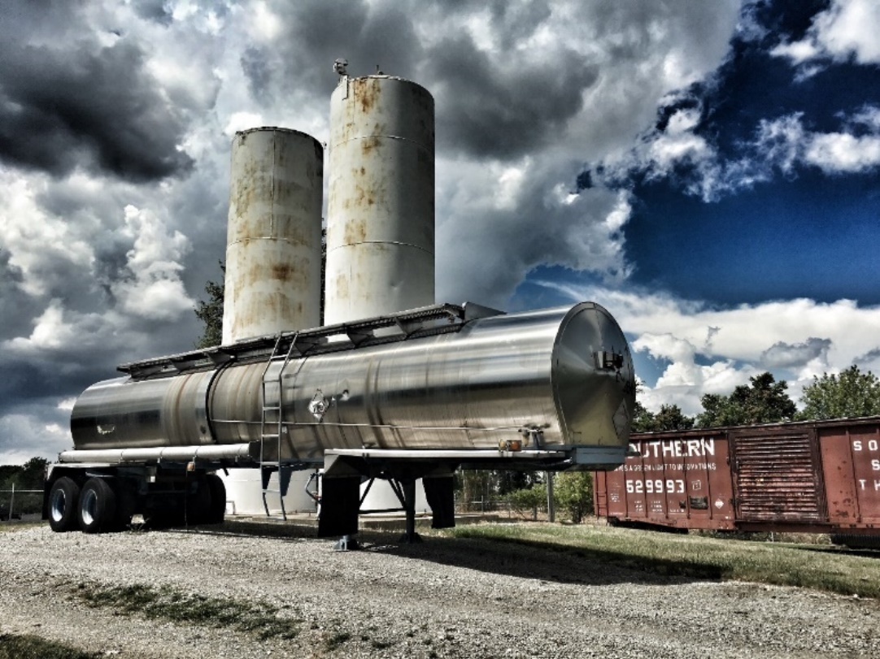
HMEP Grant Award Overview
Submitting a Grant Application
The HMEP grant program no longer utilizes Grant Solutions.
Applications will be submitted via grants.gov.
Search by CFDA number and enter 20.703 to locate the HMEP grant application.
Applicants must register with FedConnect prior to submitting an application.
FedConnect instructions are available here: https://www.fedconnect.net/FedConnect/Marketing/Documents/FedConnect_Ready_Set_Go.pdf

Slide 10
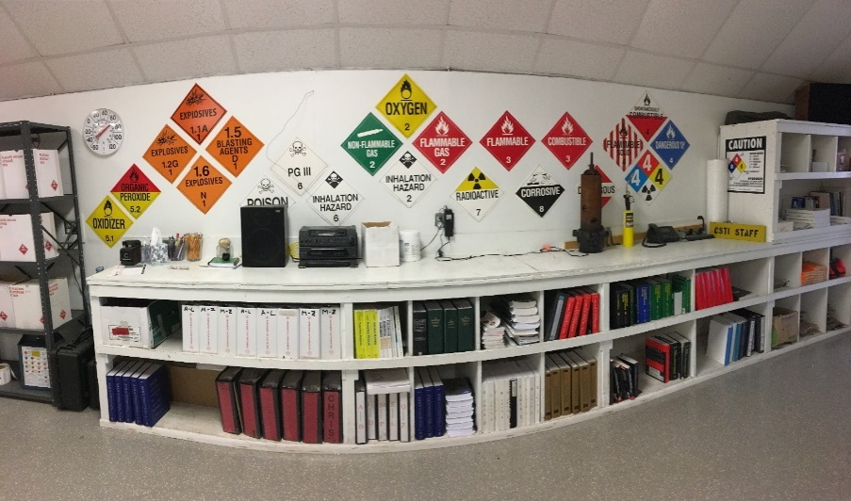
HMEP Grant Application
  TERC Designation Letter
  Standard Forms – Please have authorized representative sign.
    SF-424 Application for Federal Assistance
    SF-424A Budget Information - Non-Construction Programs
    ED-80-0013 Certification Regarding Lobbying
    Standard Title VI Assurance and Non-Discrimination Provisions
  Application Parts
  Part A: Grantee Information
  Part B: Transportation Fees
  Part C: Statement of Work
  Part D: Budget Narrative
  Part E: Certifications
Notes:
The components for the HMEP planning grant are…

Slide 11
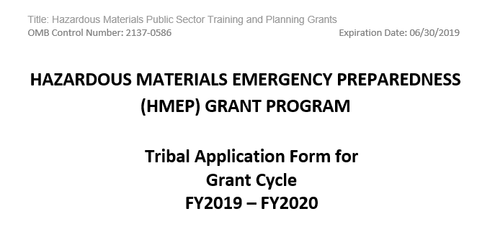
HMEP Grant Application

Slide 12
HMEP Grant Application
  Part A: Grantee Information
  Designated Agency Name
  Contact Information: Authorized Representative, Program Manager, Finance Manager
  Organizational Information
  Part B: Transportation Fees
  Are transportation fees assessed and collected?
    If yes, answer the following:
      How much in transportation fees was collected in the last year?
      What percentage of the fees collected is used solely for the purpose related to the transportation of hazardous materials?
Notes:
The components for the HMEP planning grant are…

Slide 13
HMEP Grant Application
  Part C: Statement of Work – Needs Assessment
  A systematic process to acquire an accurate, thorough picture of a community’s strengths and weaknesses, needs, resources, and readiness that can be used in identifying the right target group for the right program within the constraints of time, scope and resources.
    Provides supportive evidence and objective direction for programs, projects, and activities.
    Allows staff to determine priorities and gaps, understand barriers, and allocate resources.
    Creates cohesions through the alignment of goals, strategies, professional development, and desired outcomes.
    Enables benchmarking, transferability of best practices, and monitoring of implementation and impact.
    Assists with continuous improvement activities.
Notes:
The components for the HMEP planning grant are…

Slide 14
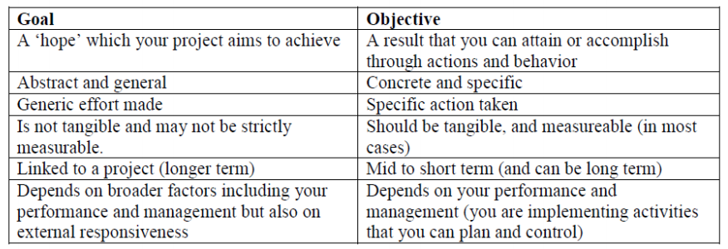
HMEP Grant Application
  Part C: Statement of Work – Goals and Objectives
  What are you hoping to achieve from this project?
    Goals are statements of hoped and desired change that serve the purpose of the project.
  What are you expecting to do to achieve that?
    Objectives are statements of the expected results (ends) to accomplish the goals.
Notes:
The components for the HMEP planning grant are…

Slide 15
HMEP Grant Application
  Part C: Statement of Work – Activities Supporting Program Goals
    Preparedness activities under section 303 of the Emergency Planning and Community Right-To-Know Act (EPCRA).
      Commodity flow studies
      National Association of SARA Title III Program Officials (NASTTPO) conference
    Training activities under the NFPA 472 core competencies or OSHA 29 CFR § 1910.120(q).
      Hazmat awareness, operations, technician, specialist, and refresher courses
      Confined space rescue courses
      Hazmat IQ training
      CAMEO training
Notes:
The components for the HMEP planning grant are…

Slide 16
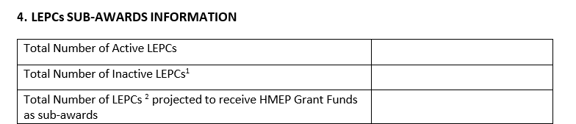
HMEP Grant Application
  Part C: Statement of Work – Sub-Award Information
Notes:
The components for the HMEP planning grant are…

Slide 17
HMEP Grant Application
  Part C: Statement of Work – Sub-Grantee Activity Information
Notes:
The components for the HMEP planning grant are…

Slide 18
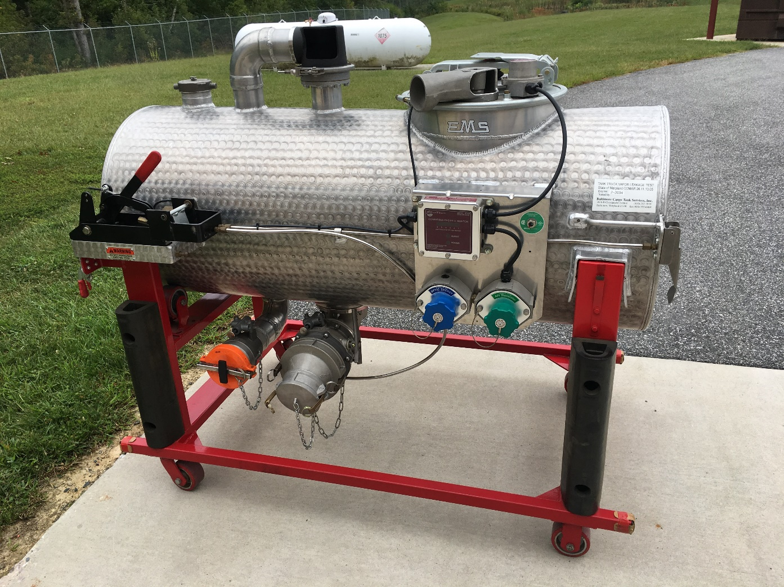
HMEP Grant Application
  Part C: Statement of Work – HMEP Monitoring
  Provide a description of the monitoring and evaluation of the activities that will be conducted to ensure that the grant activities are successfully carried out according to the activity timeline.
  Include an explanation of quality control measures, including but not limited to random examinations, inspections, and audits of planning activities, to maximize the cost effectiveness and impact of the program.
Notes:
The components for the HMEP planning grant are…

Slide 19

HMEP Grant Application
  Part C: Statement of Work Reminders
  Provide activity descriptions, not just the activity’s name. Include training curriculum (if available), conference agenda, and details of the activity’s relation to transportation if not listed as an approved activity in the HMEP Expenditures Guide.
  Correlate activities to needs, goals, and objectives outlined in the application.
  Provide approximate total cost of each activity.
  Provide the projected start and end date for each activity.
  Do not copy and paste your project narrative from previous grant years.
Notes:
The components for the HMEP planning grant are…

Slide 20

HMEP Grant Application
Part D: Budget Narrative
Applicants must include a budget and budget narrative that details the costs required during the performance of the project.
The budget provides an overview of costs organized by object class category.
The budget narrative explains these costs in detail and how they are calculated.
Together, the budget and budget narrative provide a forecast of expenditures to measure against the applicant’s actual financial operations.

Slide 21

HMEP Grant Application
Part D: Budget Narrative Reminders
At least 75% of HMEP funds must be for programmatic activities. This may include:
  Developing, improving, and implementing emergency plans.
  Conducting commodity flow studies.
  Conducting exercises.
  Training public sector employees.
Up to 25% of HMEP funds may be used for management and administration (“M&A”) for tribal state employees. This may include:
  Personnel and fringe costs involved with oversight of grant, such as travel and supplies associated with monitoring sub-grantees.
  Indirect costs.

Slide 22
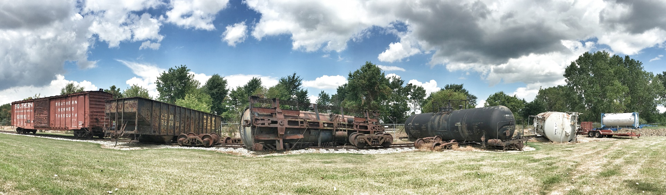
HMEP Grant Application
Part D: Budget Narrative Reminders
Every SF-424A line-item should have a corresponding explanation as to how it was calculated in the budget narrative. Submitting a well-written budget narrative results in a faster review!
Explain how the 20% matching contribution will be met in the budget narrative.
Attach the indirect cost rate agreement if claiming indirect costs.
Double check all computations.

Slide 23
HMEP Grant Application
Part D: Budget Narrative Reminders
An applicant’s budget request is reviewed for compliance with the governing cost principles and other requirements and policies applicable to the type of recipient and the type of award.
The cost principles address four tests that PHMSA follows in determining cost eligibility. Costs must be:
  Allowable (2 CFR part 200, FOA, federal statute)
  Allocable (2 CFR § 200.405)
  Necessary(2 CFR § 200.403)
  Reasonable and consistently applied (2 CFR § 200.403)
Notes:
The components for the HMEP planning grant are…

Slide 24
HMEP Grant Application
Part E: Certification
Statement of aggregate expenditures
Statement of consistency with NFPA 472 or OSHA 29 § 1910.120 competencies
Statement of compliance with Section 301 and 303 of EPCRA (42 U.S.C. 11001, 11003)
Statement of 75% programmatic requirement
Statement of National Incident Management System (SIMS) compliance
Statement of auditable accounting system
Tribal Emergency Response Commission (TERC) review of grant application
Application Certification
Please have the authorized representative sign.

Slide 25
HMEP Grant Program Contact Information
General Inquiries: HMEP.Grants@dot.gov
Website: www.phmsa.dot.gov/hazmat/grants
Phone: 202-366-1109

Slide 26
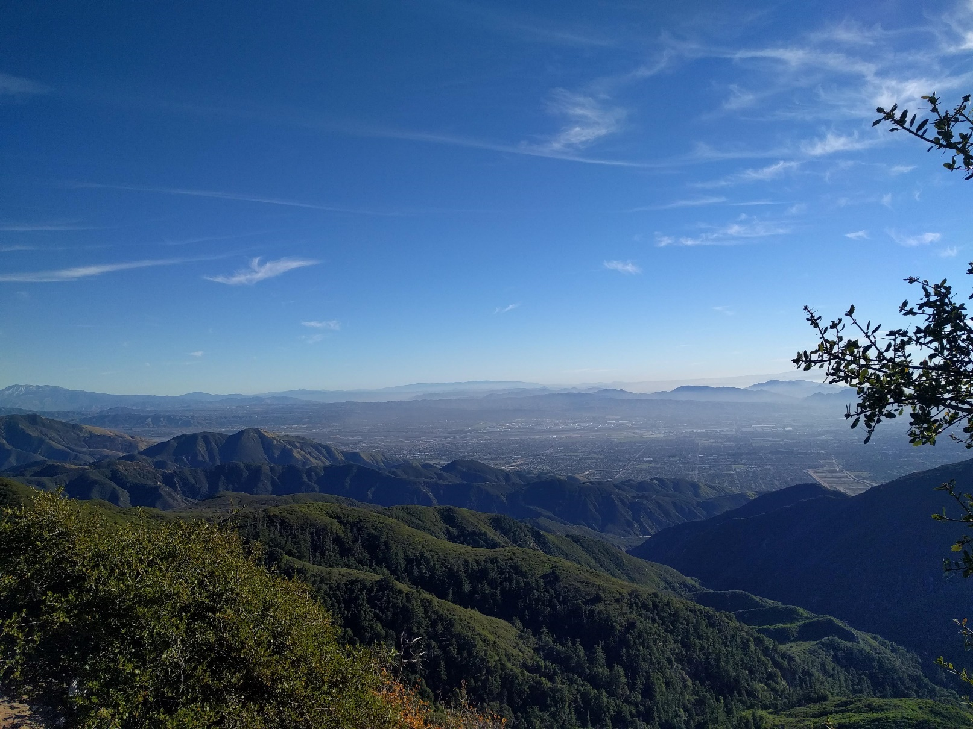
What questions do you have for us?

Slide 27
References
1) Regulations, Statutes, and Policies
2) Budget & Budget Narrative SF-424A
3) Line Item Details
4) HMEP Tribal Application Guidance Handout (Word document sent via email)

Slide 28

1) Regulations, Statute, and Policies
49 USC § 5116
49 CFR § 110
Notice of Funding Opportunity (forthcoming)
NFPA Standard 472
OSHA 29 CFR §1910.120(q)
2 CFR part 200
HMEP Grant Program Expenditure Guide for guidance for proposed activities at https://www.phmsa.dot.gov/sites/phmsa.dot.gov/files/docs/about-phmsa/grants/hazmat/2956/2017-hmep-expenditures-guide-071317.pdf

Slide 29

2) Budget & Budget Narrative SF-424A

Slide 30
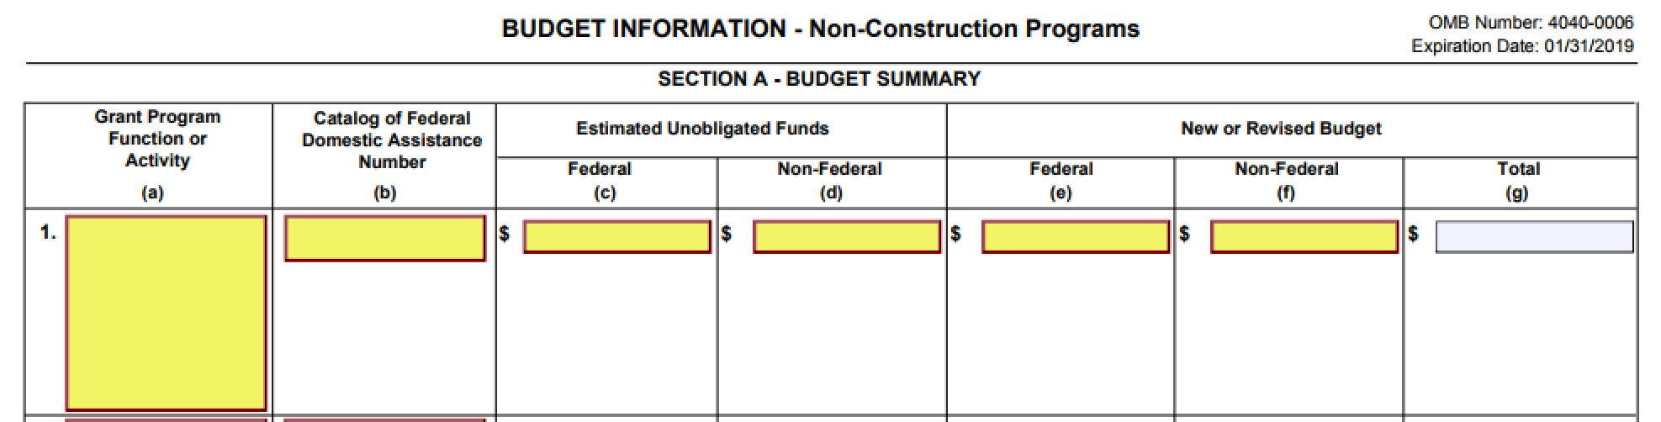
2) Budget & Budget Narrative SF-424A Section A
Enter the federal and non-Federal match amounts in their respective columns under New or Revised Budget. The Total in Column G should auto-populate.

Slide 31
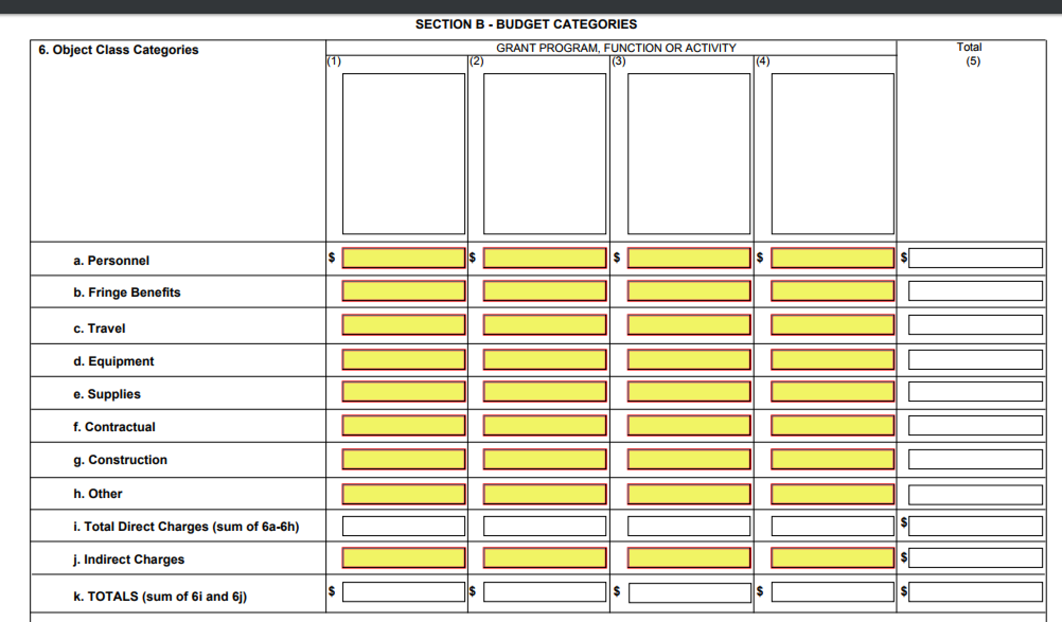
2) Budget & Budget Narrative SF-424A Section B
Enter federal costs only. Please do not separate planning and training.
Please do not include matching amounts in this section. Instead, please utilize the budget narrative to explain how matching will be met (if applicable).

Slide 32
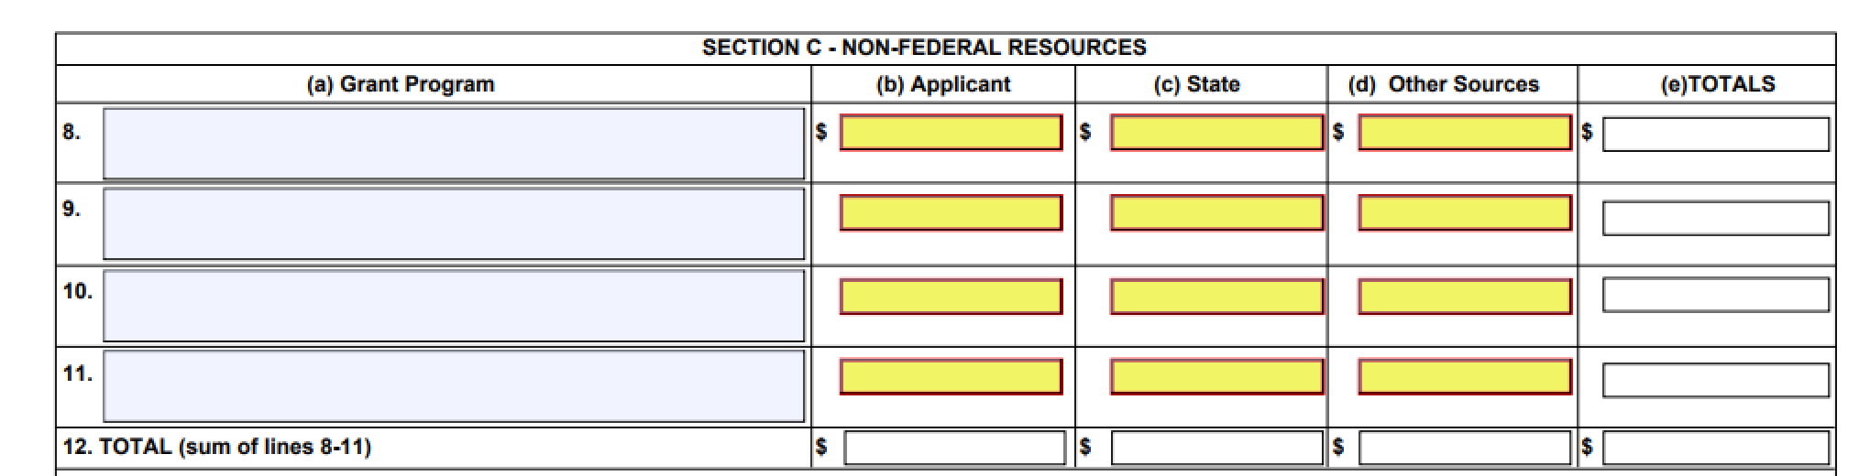
2) Budget & Budget Narrative SF-424A Section C
Enter the matching costs only.
Section D (Forecasted Cash Needs) is not required.

Slide 33
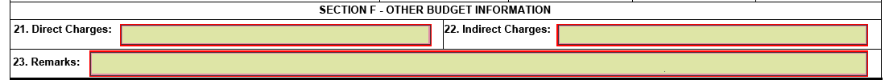
2) Budget & Budget Narrative SF-424A Section F
Section F includes the total for direct charges and indirect charges.
Please fill out indirect charges and attach the indirect cost rate agreement if claiming indirect costs.

Slide 34
3) Line Item Details

Slide 35
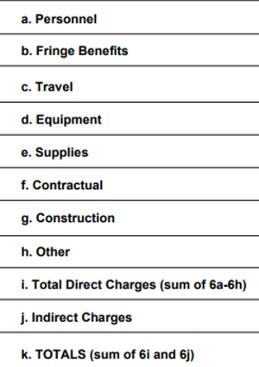
3) Line Item Details
This section provides a definition and tips for correctly filling out each object class category in the SF-424A and the application budget narrative.

Slide 36

3) Line Item: Personnel Costs (2 CFR 200.430)
This line item refers to the cost of wages and salaries paid to employees of the applicant who are directly involved in grant implementation. Generally, personnel are issued a W-2 by the applicant.
Utilize the budget narrative to give the position title, position description, employee status (full or part-time), hourly wage or salary, percentage of time dedicated to the grant, and total cost to the grant.
Show your computational work and any assumptions made.
Consultant or subgrantee costs should not be included in the Personnel line item.

Slide 37

3) Line Item: Fringe Benefits (2 CFR 200.431)
This line item refers to the cost of benefits paid to personnel as compensation in addition to their regular salaries and wages, including the cost of the applicant’s share of FICA, health insurance, workers’ compensation, and vacation.
Utilize the budget narrative to include a description of specific benefits charged to the project and at what percentage. Fringe benefits are only allowable for the percentage of time devoted to the grant.
Please show your computational work and any assumptions made.
While personnel should have a corresponding fringe cost (and vice versa), personnel and fringe costs must be separated into their respective line-item categories. Please do not combine these costs together.

Slide 38

3) Line Item: Travel (2 CFR 200.474)
This line item refers to the travel costs of personnel that are reasonable and necessary to effectively manage and carry out grant activities, provide oversight, and measure program effectiveness.
Please utilize the budget narrative to explain travel costs. Include the travel purpose, method of travel, number of people traveling, the number of days, and an estimated cost for each trip. Please provide an explanation of what activities the travel will cover.
Please show your computational work and any assumptions made. Estimates are acceptable if you provide a basis for determining the estimated amount requested.

Slide 39
3) Line Item: Equipment (2 CFR 200.439)
This line item refers to non-expendable personal property having a useful life of more than one year and a per-unit cost of $5,000 or more per unit.
Utilize the budget narrative to include a description, quantity, and per-unit price for all equipment and how the equipment will be used on grant activities.
Show your computational work and any assumptions made.
If the expense is under the usual threshold of $5,000 per item, it belongs under supplies. However, if the applicant’s equipment threshold is below $5,000, please utilize the budget narrative to provide an explanation and state the policy citation.

Slide 40

3) Line Item: Supplies (2 CFR 200.453)
This line item refers to tangible materials costing less than $5,000 per unit, such as copy paper, pens and pencils, and computers.
Please utilize the budget narrative to provide the quantity and per-unit cost for supplies and how the supplies will be used on grant activities.
Please show your computational work and any assumptions made.

Slide 41

3) Line Item: Contractual (2 CFR 200.330)
This line item refers to the cost of any contract or sub-award agreement.
A sub-award is provided by a pass-through entity to a sub-recipient in order to carry out part of the pass-through entity’s federal award. Sub-recipients are responsible for programmatic decision-making.
A contract is a legal instrument implemented by grant recipients to purchase property or acquire services in order to carry out a project. The property or services acquired are not directly involved in programmatic activities.
Utilize the budget narrative to identify your sub-awards and contracts and explain how contractual costs were derived for each.
Show your computational work, any assumptions made, and how each contract or sub-award relates to grant activities.

Slide 42

3) Line Item: Other
This line item refers to direct costs that do not fit any of the aforementioned categories, such as rent for buildings used to conduct grant activities, utilities, leased equipment, child care, transportation expenses, employee training, tuition, etc.
Please utilize the budget narrative to itemize “other” direct costs and provide a reasonable explanation.
Please show your computational work, any assumptions made, and how “other” direct costs relate to grant activities.
Notes:
If this is the case, when your agency procurement policy requires you to treat sub-recipients as sub-grants, please denote this in your budget narrative.
At PHMSA we request that any sub-award costs are provided under the Other line-item, unless you’re agency’s procurement policy specifically/explicitly requests sub-awards be categorized as sub-contracts.

Slide 43

3) Line Item: Indirect Costs (2 CFR 200.416)
This line item refers to costs incurred for common or joint objectives that benefit more than one project.
If the applicant has a current and fully executed indirect cost rate, a copy of the indirect cost agreement signed by the cognizant Federal agency must be included with the application.
If the indirect cost rate agreement is in the renewal process and will not be approved by the continuing application due date, attach the letter of renewal or letter of request sent to your cognizant agency.

Slide 44
3) Line Item: Matching (2 CFR 200.306)
This line item refers to costs not paid by Federal funds. This amount is 20% for HMEP grants (although some exclusions apply).
On the SF-424A line-item budget please enter match in Section A and Section C only. The application will be returned if match is listed in Section B.
Please utilize the budget narrative to clearly explain how matching costs will be met.
Identify the type of match, explain the amount to be matched, and how this amount was determined.
Matching should be described in the same level of detail as Federal dollars, including a breakdown by object class category.
Please show your computational work and any assumptions made.

