Slide 1


Hazardous Materials Emergency Preparedness
Grant Program
States & Territories
Grant Application Development Webinar
Performance Period: 2019 - 2022
Notes:
During the HMEP application webinar, we will discuss…

Slide 2
Agenda
Grants Chief Welcome
HMEP Application Form
Common Application Errors
HMEP Grant Milestones
Questions/Comments
Notes:
During the HMEP application webinar, we will discuss…

Slide 3
Hazmat Grants Team
Director
Aaron Mitchell
Chief
Shakira Mack
Senior Grants Management Specialist
Carla Sheppard
Acting Senior Program Analyst
Andre White
Grants Management Specialists
Bonita Brown, Flor Valencia, Lisa Reichenbacher, Matthew Hufford, Nalita Viney, Suezett Edwards
Program Support
Rose Achieng – Business Analyst
Kenetha Hillman – Administrative Assistant
- 3 -

Slide 4
HMEP Formula Allocation Updates
New allocations will be based on updated risk-based data from PHMSA’s Incident database (2014-2017). Grantees should expect to receive allocations for Year 1 as well as estimates for Year 2 and 3 during the week of February 18.
Allocation factors include (1) Incident frequency; (2) Average cost of incidents by transport mode (rail, water, air, highway); and (3) 2010 US Census state-level population density data.
To learn more about PHMSA’s Incident Data collection, please visit: https://www.phmsa.dot.gov/hazmat-program-management-data-and-statistics/data-operations/incident-statistics

Slide 5
Components of the HMEP Grant Application

Slide 6
Components of the HMP Grant Application Initial (Year One) Application
Your grant proposal must include the following:
Initial Application
  Standard Forms
    SF 424
    SF 424A
    Title VI
    ED-80-0013 Certifications Regarding Lobbying; Debarment, Suspension etc.
  HMEP Application Form
    Part A: Grantee Information
    Part B: Transportation Fees
    Part C: Statement of Work
    Part D: Budget Narrative
    Part E: Certifications

Slide 7
Components of the HMEP Grant Application Continuing Applications (Y2 & Y3)
Note:
A continuing application is an application that provides updated information that was not provided in the initial application
No certification forms, Governor’s letters, statements, etc. are required unless the designated agency has changed. Application should be much shorter!

Slide 8
Planning & Preparation
Needs Assessment

Slide 9
Planning & Preparation
Needs Assessment
Why do we need a Needs Assessment?
Needs Assessments play an active role in the accomplishment of organizational goals.
They are used to identify strategic priorities, define results to be accomplished, guide decisions related to appropriate actions to be taken, establish evaluation criteria for making judgments of success, and inform the continual improvement of activities within organizations.

Slide 10
Planning & Preparation
Hazmat Transport Needs Assessment
Things to consider
Allow sufficient time to perform the needs assessment
Involve all parties needed
Determine if needs are feasible
Determine if needs coincide with the goals for your agency
Prioritize needs according to level of importance

Slide 11
Planning & Preparation
Hazmat Transport Needs Assessment

Slide 12
Planning & Preparation
Hazmat Transport Needs Assessment

Slide 13
Planning & Preparation
Hazmat Transport Needs Assessment

Slide 14
Components of the HMEP Grant Application
Project Plan

Slide 15
Components of the Grant Application
Overview
There are 3 components to the HMEP Application:
Standard Forms
  Application forms (SF-424, SF-424A and Assurances)
Project Narrative (Project Plan)
  Organization information (key contacts), needs assessment, goals and objectives, proposed activities to include the projected output and outcome of each, performance period timeline and a monitoring plan.
Budget Narrative
  Describes and explains the costs listed in the SF-424A, and demonstrates how match will be met.
Notes:
The components for the HMEP planning grant are…

Slide 16

Components of the Grant Application
Projecting Goals, Outputs & Outcomes
An objective goal is an overarching principle that guides decision making for the organization.
Specific
Measurable
Achievable
Realistic
Timely
An output is the specific, measurable activity that will take place in the grant project. For example – completed 2 commodity flow studies.
An outcome is a measurement and evaluation of an activity’s result against its intended or projected result. An example would be: the completion of 2 commodity flow studies identified several vulnerabilities in transport routes near a local college.

Slide 17

Components of the Grant Application
Listing Activities
When listing activities in your project narrative, it is very important to remember the:
Who –Who will be performing the task or activity?
What –What task or activity is being performed?
Why –Why is the task or activity being performed?
Where –Where will the task or activity take place?
When –When is the task or activity projected to be performed?
How Many – What is the projected number participants involved in the task or activity?
How Much – What is the projected cost of the task or activity?

Slide 18
Components of the Grant Application
Project Plan Activities
The activities listed in the project plan speaks to the goals for the performance period and how you plan to implement and achieve them.
Example:
Tula County, a Sub-applicant of the State of Calisota is proposing to conduct a Hazmat Refresher course as a number of responders are now due for training.
Training will be conducted at Tula Hazardous Materials College in Tula County.
Tula County is projecting to conduct a Hazmat Refresher course during the third quarter of the first year for maximum participation.
57 participants are projected to attend this training course. The projected cost for this training course, to include travel, supplies, facility rental, and registration costs is $27,571.00.

Slide 19

Components of the Grant Application
Project Narrative – Timeline
  A timeline is a metric which uses milestones upon which the grantee can monitor themselves for progress, as well as monitoring from PHMSA.
  Project narratives must have timelines that indicate when activities will take place.

Slide 20
Components of the Grant Application
Project Narrative: Guidance and Reminders
Review the HMEP funding announcement.
Do not copy and paste your project narrative from previous grant applications.
The project narrative must fully describe the proposed activities. “Subgrant process, TBD” is no longer valid. Applications that cannot describe how funds will be spent will be subject to Special Terms and Conditions.
Initial application should contain projections covering the 3-year performance period.
Any revisions to the initial application can be made via a post award modification (activity request) or during the continuing application period.

Slide 21
Components of the HMEP Grant Application
Budget & Budget Narrative

Slide 22
Components of the Grant Application
Application Budget (SF-424A)
A grant application must include a budget that details the costs required during the performance of the project.
The purpose of the line-item budget and budget narrative is to provide a forecast of expenditures and enable the actual financial operation of the organization to be measured against the forecast.

Slide 23
Components of the Grant Application
Testing Your Budget
An applicant’s budget request is reviewed for compliance with the governing cost principles, other requirements and policies applicable to the type of recipient and the type of award.
The cost principles address four tests that PHMSA follows in determining cost eligibility. Costs charged to awards must be:
Allowable (2 CFR part 200, FOA, federal statute)
Allocable (2 CFR § 200.405)
Necessary(2 CFR § 200.403)
Reasonable and consistently applied (2 CFR § 200.403)

Slide 24
Components of the Grant Application
Budget Narrative, In-depth…
The budget provides an overview of costs. The budget narrative is written to give a fuller explanation of the cost, and how it was calculated.
The budget narrative of a grant proposal is important, as it provides:
Transparency for proposed costs listed in the SF-424A Budget.
Justification for proposed costs that may appear questionable to the granting agency.
Details how and where the applicant will satisfy cost-sharing requirements (matching).

Slide 25
Components of the Grant Application
Budget and Budget Narrative Guidance and Reminders
There is no 75% “pass-through” requirement, however, there remains a 75% programmatic requirement. At least 75% of the funds must be for programmatic activities, this includes:
Developing, improving, and implementing emergency plans
Conducting commodity flow studies
Conducting exercises
Training public sector employees

Slide 26
Proposal Budget and Budget Narrative
Up to 25% may be used for management and administration (“M&A”) of the HMEP grant such as monitoring and evaluating the program.
Other examples include: personnel and fringe costs for state employees involved with oversight of the grant, travel and supplies costs associated with monitoring the grant, and indirect costs.

Slide 27
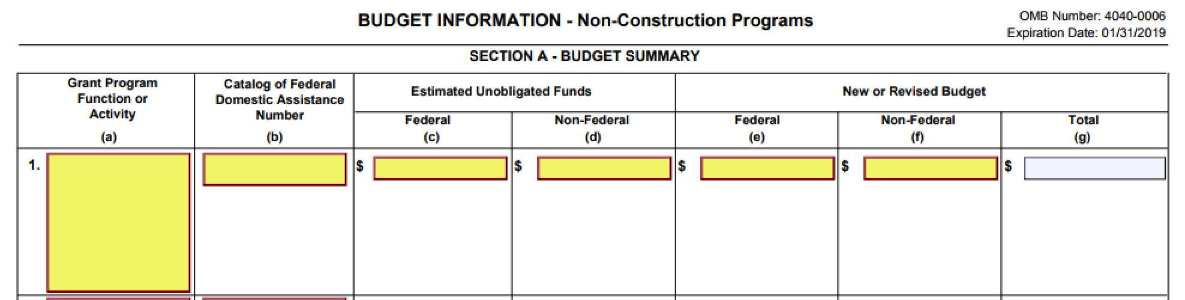
Components of the Budget Narrative
Budget & Budget Narrative SF-424A Section A
Enter the Federal and Non-Federal match amounts in their respective columns under New or Revised Budget. Column G should auto-populate.

Slide 28
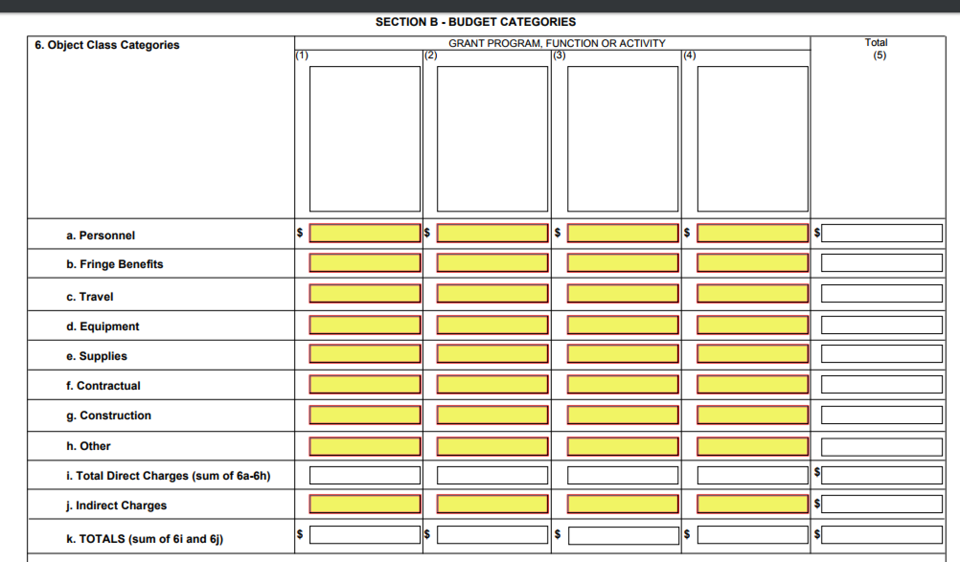
Components of the Budget Narrative
Budget & Budget Narrative SF-424A Section B
Enter the federal costs only. Planning and training should not be separated. Include matching amounts in this section (unless exempt). The budget narrative should be used to explain how matching will be met (if applicable).

Slide 29
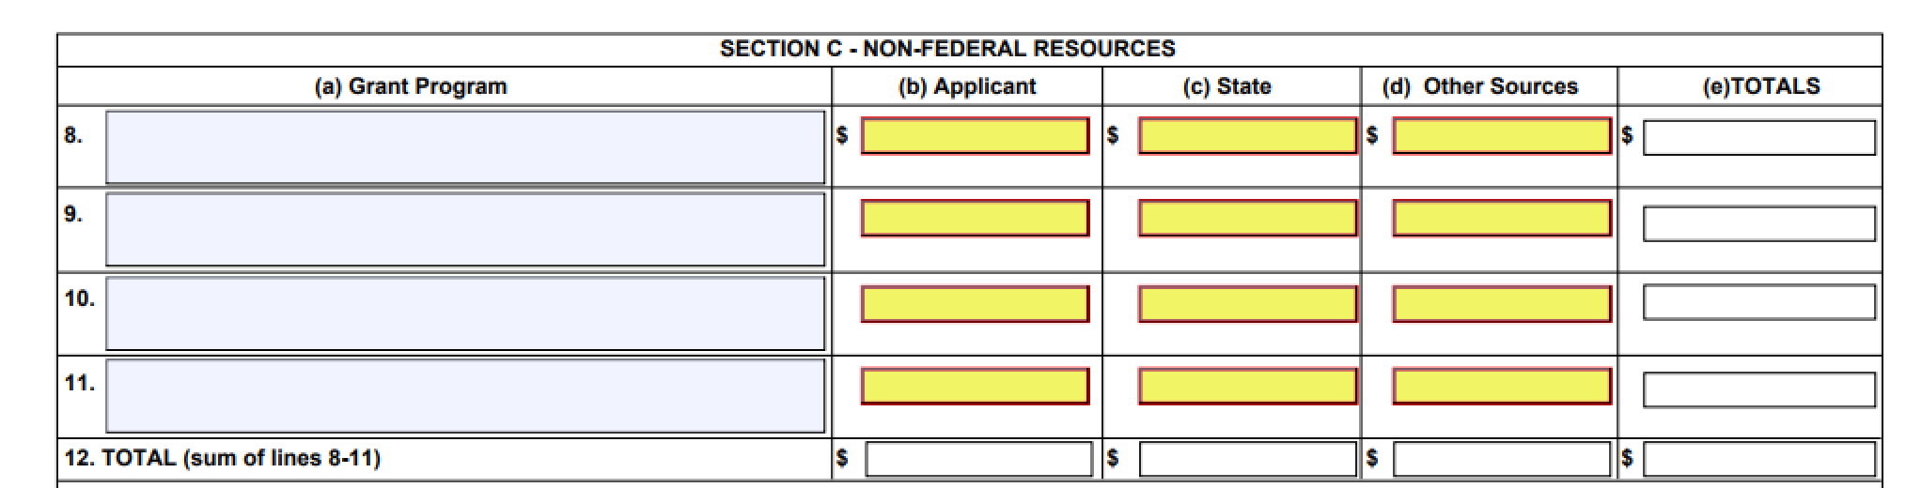
Components of the Budget Narrative
Budget & Budget Narrative SF-424A Section C
Enter the matching costs only.

Slide 30
Components of the Budget Narrative
Budget & Budget Narrative SF-424A Section D & E
We encourage you to complete section D and E.

Slide 31
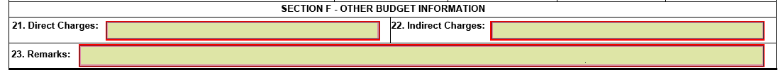
Components of the Budget Narrative
Budget & Budget Narrative SF-424A Section F
Section F is required if requesting indirect costs.

Slide 32
Components of the Grant Application
Budget Line Items Explained
Personnel (2 CFR § 200.430)
Employee salaries working directly on the grant project. Include the number, type of personnel, the percentage of time dedicated to the project, hourly wage, and total cost.
This category is limited to ONLY persons employed by your organization. Contractual and consultant costs should not be listed in the Personnel line item.

Slide 33
Components of the Grant Application
Budget Line Items Explained
Fringe Benefits (2 CFR § 200.431)
The allowances and services provided to employees as compensation in addition to regular salaries and wages. Include how the fringe benefit amount is calculated, a description of specific benefits charged to a project, and the benefit percentage.
Personnel and Fringe costs must be separated into their respective line-item categories. Do not combine these costs together!

Slide 34
Components of the Grant Application
Budget Line Items Explained
Travel (2 CFR § 200.474)
Those costs requested for field work or for travel to professional meetings. Provide the purpose, method of travel, number of persons traveling, number of days, and estimated cost for each trip.
If details of each trip are not known at the time of application submission, provide the basis for determining the amount requested.
Be sure not to exceed the Federal standard for rates of travel. Exceptions will be considered by PHMSA grant staff on the basis reasonableness and necessity. Federal rates of travel can be found on https://www.gsa.gov/travel/plan-book/per-diem-rates

Slide 35
Components of the Grant Application
Budget Line Items Explained
Equipment (2 CFR § 200.439)
Includes those items which are tangible, nonexpendable, personal property having a useful life of more than one year and an acquisition cost of $5,000 or more per unit (unless the state threshold is lower).
Include a description, quantity and unit price for all equipment.
If the expense is under the usual threshold of $5,000 per item, it belongs under “Supplies.” However, if your equipment threshold is below $5,000, provide an explanation and state policy citation.
PHMSA recommends applicants have a plan in place to track and dispose equipment items acquired using HMEP grant funding in accordance with § 200.313 (d)(e).
.

Slide 36
Components of the Grant Application
Budget Line Items Explained
Supplies (2 CFR § 200.453)
Tangible property other than equipment. Include the type of supply item in general terms.
It is not necessary to document office supplies in great detail (for example: reams of paper, boxes of paperclips, etc.). A good way to document office supplies is to indicate the approximate expenditure of the unit as a whole.
However, applicants should include a quantity and unit cost for larger cost supply items such as computers and printers

Slide 37
Components of the Grant Application
Budget Line Items Explained
Contractual (2 CFR § 200.22)
Contractual costs are those services carried out by an individual or organization, other than the applicant, in the form of a procurement relationship. There are two ways to capture costs in this category: subgrants and contracts.
What is a subgrant? (2 CFR § 200.92; 2 CFR § 200.330)
An award provided by a pass-through entity to a subrecipient to carry out part of a Federal award received by the pass-through entity.
  1. Has its performance measured in relation to whether objectives of a Federal program were met.
  2. Responsibility for programmatic decision-making.

Slide 38
Components of the Grant Application
Budget Line Items Explained
What is a contract? (2 CFR § 200.22)
A contract is a legal instrument by which a Prime Grantee Recipient purchases property or services needed to carry out the project or program under an award.
Sub-awards and Contracts must be listed in the Contractual line-item category. In the budget narrative, they must be correctly identified as a sub-award or a contract.

Slide 39
Components of the Grant Application
Budget Line Items Explained
Other
“Other” direct costs do not fit any of the aforementioned categories, such as rent for buildings used to conduct project activities, printing, utilities and/or leased equipment, employee training, tuition, etc.
“Other” direct costs should be itemized and the methodology explained in the budget narrative.

Slide 40
Components of the Grant Application
Budget Line Items Explained
Indirect Costs (2 CFR § 200.416)
Are incurred for common or joint objectives that benefit more than one project. The applicant must include a current and fully executed agreement in the application if claiming indirect costs.
Make sure the rate is applied to the appropriate base in the approved agreement.
If the rate will not be approved by the application due date, attach the letter of renewal or letter of request that you sent to your cognizant agency to your application.
Applicant may use the 10% DeMinis

Slide 41
Non-Federal Share
Cost Sharing/Matching
Cost sharing or matching is the portion of project costs not paid by Federal funds. For planning and training grants, this amount is 20%, if applicable.
On the 424A budget, enter match in Section A, B, and C. In Section B, place the match in column 2.
Match must be fully described in the budget narrative in a clearly marked section for match. Explain the amount and how it will be met in the same manner you would for a federal share cost item.

Slide 42

Overall Budget Narrative: Reminders
Submitting a well-written budget narrative results in a faster review by PHMSA and a lower administrative burden to applicants.
Please check for computational errors!
Every number listed in the SF-424A line-item budget should have a corresponding explanation as to how it was calculated in the budget narrative.

Slide 43
Things to Consider
Recommendations
Applicants should endeavor to have the entire 3-year activities detailed in the first year application. Continuation applications may simply be an update, or a statement that nothing has changed.
Start early! Identify sub-awards prior to application submission. Year’s 2 & 3 estimated funding is already known.
Steady progress throughout the grant period. Waiting until year 3 to complete activities is unacceptable and may result in a loss of funding.

Slide 44
Notice of Funding Opportunity (NOFO)
The NOFO will provide the requirements for the continuing application submission (where to submit, format, etc.).

Slide 45
Common Application Errors
Did I Do That?

Slide 46

Most Common Application Errors
Standard Forms
SF-424 – Application for Federal Assistance
  Authorized Representative's Signature
  Listing Performance Period (3 Years for States/Territories)
SF-424A – Budget Information
  Failure to list only year 1 allocation amount
  Mathematical errors
  Failure to calculate budget items under the correct Object Class
Missing, Incomplete, or Unsigned These Required Forms
  ED-80-0013 – Certifications Regarding Lobbying; Debarment, Suspension, Drug-Free Workplace etc.
  Standard Title VI/Non-Discrimination Assurances – Civil Rights Assurances

Slide 47
Most Common Application Errors
Project Narrative
Failure to identify Goals, Objectives, Outputs and Outcomes
Planning and Training Needs Assessment
  Lack of identifying numerical data and substantiation for needed resource
Lack of clear outputs and outcomes
Exceeding 25% M&A threshold

Slide 48
Most Common Application Errors
Project Narrative Cont.
Planning and Training Activities
  Failure to align activities with budget narrative
  Failure to provide a brief activity description with proposed output numbers and start/end dates
  Failure to include estimated activity costs
  Failure to correlate activities to goals, objectives and needs listed in the application

Slide 49
Most Common Application Errors
Budget Narrative
SF-424A budget failure to align with the budget narrative
Lack of detailed explanation of how the agency will make its 20% match contribution (if applicable)
Incorrect object class categorization enables mishandling of expenses or may cause post-award audit triggers
Personnel/Fringe Benefit costs incorrectly charged
Incorrect allocation of Indirect costs
Identifying pass through indirect cost to the program
Lack of indirect cost agreement/lack of clarity on inclusions causing duplicate expenses (direct vs. indirect)

Slide 50
HMEP Grant Milestones
Mark Your Calendar!

Slide 51

HMEP Grant Milestones
Application
FY16-19 Performance period ends: 09/30/2019
Application Period begins: March 2019
Application Due Date: April 30 (tentative)
Application Award Date: 09/30/2019
Period of Performance: 09/30/2019 – 09/30/2022

Slide 52
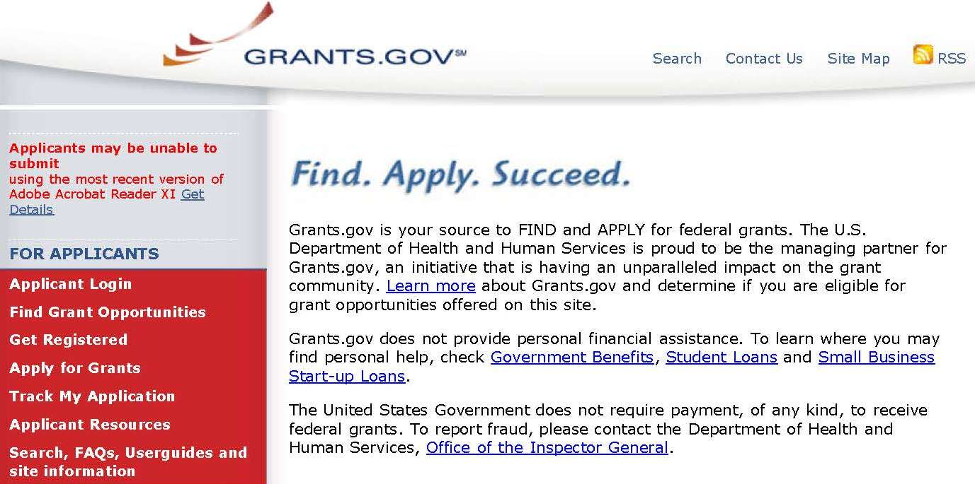

Invitation to Apply
PHMSA encourages all States and Territories to apply for the HMEP grant via www.grants.gov.

Slide 53

Invitation to Apply
Additional Requirements
Additionally, applicants must register with FedConnect for an account before submitting an application.
Your organization’s Marketing Partner ID number (MPIN), which can be retrieved from the System for Award Management (SAM), is required to create an account.
For instructions on how to register in FedConnect and how to use the portal, view the FedConnect: Ready, Set, Go! Tutorial under the Need Help? section on the FedConnect home page.
https://www.fedconnect.net/FedConnect/Marketing/Documents/FedConnect_Ready_Set_Go.pdf FedConnect Instructions
https://www.fedconnect.net Fedconnect
https://www.sam.gov/SAM/ SAM

Slide 54
Hazmat Grant Program
Contact Information
General Grant Inquiries
HMEP.Grants@dot.gov
  Website:
  www.phmsa.dot.gov/hazmat/grants
  Phone:
  (202)366-1109

Slide 55

Questions?

Slide 56
Q & A
Does PHMSA know the allocation amounts for all three years of the performance period?
Yes, PHMSA will provide all three years in the allocation email to the designated agency. Please be aware that the years two and three may vary slightly based on the sequestration. Also the allocation amount for year three may change if you receive an offset due lack of obligating all of your funds for year one.
Is there a way to receive additional funding?
Yes, through the offset process PHMSA used in FY16-19, a grantee could potentially be eligible to apply for supplemental funding for year three of the performance period.

Slide 57
Q & A
3. How do you know that you can claim indirect costs?
An applicant can claim indirect cost as long as the applicant has a valid Indirect Cost Rate Agreement (ICRA) from a Federal Agency.
4. Are subrecipients allowed to claim indirect costs?
Yes, as long as the subrecipient has a valid ICRA from a Federal Agency.
When will the information of supplemental funding available be provided?
PHMSA will provide information on supplemental funding during year three continuing application period so that those grantee that are eligible may apply for the additional funding.

Slide 58
Q & A
How does someone get on PHMSA Hazmat Grants mailing list?
To be added to our mailing list, please send an email requesting to be added to our distribution list. In your request make sure you provide the following information: name, job title, agency and state name, email, and phone number.
Are there any significant changes to the 2019 Expenditures Guide versus the 2017 version?
Yes, the food is no longer a conditionally allowable; it is unallowable. Also we have changed the Tier II Chemical Inventory Reports and Tier II Databases from unallowable to conditionally allowable. The Fire Rescue International (FRI) conference has changed from conditionally allowable to unallowable.

