Slide 1


Pipeline & Hazardous Materials Safety Administration
HMEP Tribal Grant Program
Grant Application Development Webinar
Program Year 2018
May 8, 2018

Slide 2









Hazmat Grant Program Office
Acting Chief, Grants and Registration
Team Lead, Senior Grants Specialist
––
Rose Achieng
Programmatic Grants Specialist
Financial Grants Specialist
Business Analyst (CTR)
––
Flor Valencia
Kenetha Hillman
Programmatic Grants Specialist
Financial Grants Specialist
Admin. Assistant (CTR)
––
Matthew Hufford
Programmatic Grants Specialist
Financial Grants Specialist

Slide 3

Agenda
Program Overview
PHMSA Grant Schedule
Developing the Grant Application
  Components of the Project Narrative
  Components of the Budget and Budget Narrative
Guidance on the HMEP Application Sections
Questions/Comments
Notes:
During the HMEP application webinar, we will discuss…

Slide 4
About PHMSA
Mission To protect people and the environment by advancing the safe transportation of energy and other hazardous materials that are essential to our daily lives.
Vision Our vision is to make PHMSA the most innovative transportation safety organization in the world.
Goals Promote continuous improvement in safety performance, invest in safety innovations and partnerships, and build greater public and stakeholder trust.

Slide 5

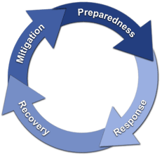
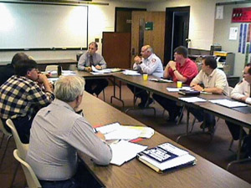
Hazmat Grant Program Purpose
To support State, Territorial, Tribal, and local communities to deal with hazardous materials emergencies, particularly those involving transportation, and to enhance the implementation of the Emergency Planning and Community Right-to-Know Act (EPCRA) of 1986.

Slide 6

Eligibility Screening
Applicants are limited to federally recognized tribal governments, which are defined as any Indian tribe, band, nation, or other organized group or community (including Native villages).
Intertribal consortium is defined as a partnership between two or more tribes that is authorized by the governing bodies of those tribes to apply for and receive grant funding. In addition, an ineligible entity can partner with an eligible entity.
Notes:
The components for the HMEP planning grant are…

Slide 7

FY 18 Grant Cycle Timeline
Early May 2018 (tentative): Notice of Funding Opportunity (NOFO) posted to Grants.gov. NOFO email sent out to potential applicants. Any questions concerning your application should be submitted to hmep.grants@dot.gov.
Early June 2018 (tentative): Deadline for applications.
June-July 2018: Application Review completed by PHMSA.
September 2018: Notice of Grant Agreement (NGA) issued with period of performance 9/30/18-9/30/19.

Slide 8

Regulations, Statute, and Policies
49 USC § 5116
49 CFR § 110
Notice of Funding Opportunity (forthcoming)
NFPA Standard 472 and other training curriculum
2 CFR part 200
Notes:
Regulations governing this webinar are…

Slide 9

Developing the Grant Application
Components of the Project Narrative

Slide 10
Components of the HMEP Grant Application
  Standard Forms
    Application forms (SF-424, SF-424A, SF424B, and Assurances)
Application Parts
  Projective Narrative (HMEP Application form)
  Title VI Form
  Budget (SF-424A)
  Budget Narrative (HMEP Application form)
Notes:
The components for the HMEP planning grant are…

Slide 11
Components of the Project Narrative
  Cover Letter from the Tribal Authority designating the entity to receive Federal funds
  Organization information
  TERC review of grant application
  Statement of auditable accounting system
  Description of how applicant will monitor and evaluate activities that will be conducted
  Identify whether the Tribe assesses and collects transportation fees
Notes:
The components for the HMEP planning grant are…

Slide 12
Components of the Project Narrative
  Planning and Training Needs Assessment.
  List the program goals and objectives for the HMEP grant funds.
  List and describe the proposed HMEP project activities.
  Provide a statement certifying the Tribe’s aggregate expenditures.
  Provide a statement certifying that 75% of grant funding will be used for HMEP programmatic activities and no more than 25% of Federal funding will be used for maintenance and administration costs (M&A).
Notes:
The components for the HMEP planning grant are…

Slide 13
Pre-Application
Before you write your proposal, perform a needs assessment.
What is a Needs Assessment?
  It is a clear and well-supported statement based on a systematic process for determining and addressing needs, or “gaps,” between current conditions and desired conditions, or “wants.”
  DESIRED PROGRAM - ACTUAL PROGRAM = PROGRAM NEED
  It is important to differentiate between program needs and program wants.

Slide 14
Project Narrative: Needs Assessment Considerations
Allow sufficient time to develop the needs assessment.
Involve all parties needed to perform an accurate needs assessment.
Determine if needs are feasible, meet the HMEP grant purpose, and are related to hazardous materials transportation.
Determine if needs coincide with the Hazmat preparedness planning and training goals for your agency.
Prioritize needs according to level of importance and cost.
Include regional data analysis.
Notes:
The components for the HMEP planning grant are…

Slide 15
Project Narrative: Goals and Objectives
Goals are the desired end result. Whether they are included in an agency’s strategic plan, a sub-recipient project plan, or some other organizational plan, goals always indicate the desired final product.
Objectives are intermediate steps leading to the goals.
When including your goals and objectives in the grant application, ensure they are SMART:
Specific, Measurable, Achievable, Realistic, and Timely (“SMART”)
Notes:
The components for the HMEP planning grant are…

Slide 16

Project Narrative: Activities
Provide Activity Description. Listing the name of the activity is not adequate. Include training curriculum (if available), conference agenda, and details of the activity’s relation to transportation if not already an approved activity in the HMEP Activity Guide.
Correlate the activity to needs, goals, objectives, and outcomes outlined in the application.
Provide approximate total cost of project with each activity.
Provide the projected start and end date for each activity.
Notes:
The components for the HMEP planning grant are…

Slide 17

Project Narrative: Reminders
Review the FY18 HMEP Notice of Funding Opportunity (NOFO). The funding announcement will clearly outline the elements of the application that need to be completed.
If you are a current grantee, do not copy and paste your project narrative from last year. The requirements in FY18 are different and the new HMEP application form has changed the process.

Slide 18
Project Narrative: Reminders Continued
“Subgrant process, TBD” is no longer valid for applicants that will make sub-awards. Applications that do not provide sub-award activity information on how funds will be spent will not be issued an award in FY18. Applicants are not required to make sub-awards.
Use the HMEP Grant Program Expenditure Guide for guidance for proposed activities. https://www.phmsa.dot.gov/grants/hazmat/hmep-expenditures-guide-pdf.

Slide 19
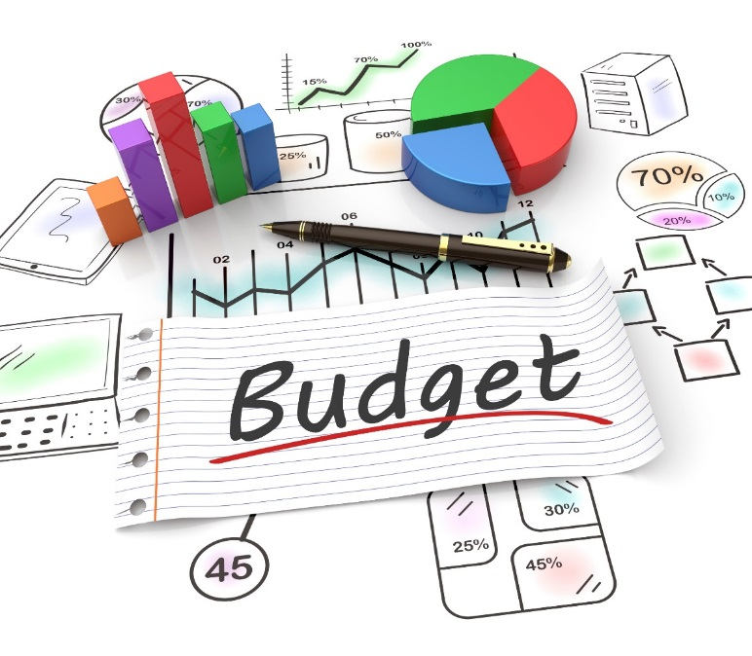
Developing the Grant Application
Components of the Budget and Budget Narrative

Slide 20
Budget Narrative: In-depth
The budget provides an overview of costs. The budget narrative is written to give a fuller explanation of the cost, and how it was calculated.
The budget narrative of a grant proposal is important, as it provides:
Transparency for proposed costs listed in the SF-424A Budget.
Justification for proposed costs that may appear questionable to the granting agency.
Details how and where the applicant will satisfy cost-sharing requirements (matching).
Notes:
The components for the HMEP planning grant are…

Slide 21
Budget Narrative: Required Forms
SF-424 Application for Federal Assistance
Fill out correctly. Make sure you have the correct authorized official and contact information listed. The SF-424 period of performance must be 09/30/2018-09/30/2019.
SF-424A (budget)
Section A Budget Summary – Enter the Federal and Match Amounts in their respective columns.
Section B Budget Categories – Do not separate planning and training. Enter the Federal Costs only! Match is to be explained in budget narrative only.
Notes:
The components for the HMEP planning grant are…

Slide 22

Budget Narrative: Required Forms Continued
SF-424A (budget)
Section C – Enter amount for non-Federal Resources (match) for the year.
Attached Assurances
Do not forget to fill out and submit the lobbying and Title VI forms.
Notes:
The components for the HMEP planning grant are…

Slide 23
Budget Narrative
Application Budget (SF-424A)
  A grant application must include a budget that details the costs required during the performance of the project.
  The purpose of the line-item budget and budget narrative: Provides a forecast of expenditures; enable the actual financial operation of the organization to be measured against the forecast.
Notes:
The components for the HMEP planning grant are…

Slide 24
Budget Narrative Continued
Budget Narrative
  Describes and explains the costs listed in the SF-424A, and demonstrates how match and 75% programmatic requirement must be met.
  25% or less may be used for management and administration (“M&A”) of the grant (i.e. state employees managing the grant, travel, and supplies cost associated with monitoring the grant, and indirect costs).
Notes:
The components for the HMEP planning grant are…

Slide 25
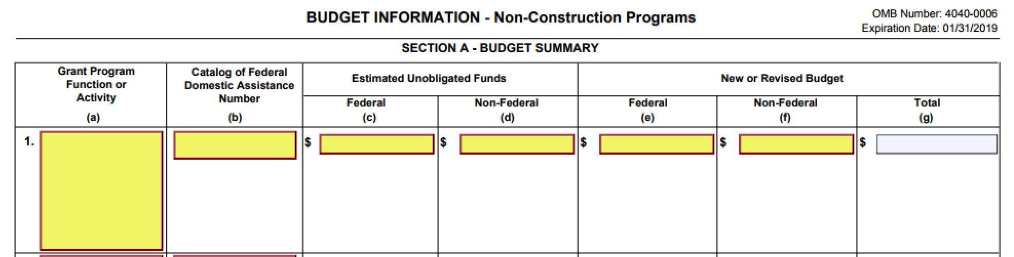
Budget & Budget Narrative SF-424A Section A
Enter the FY18 Federal and Non-Federal match amounts in their respective columns under New or Revised Budget. Column G should auto-populate.

Slide 26
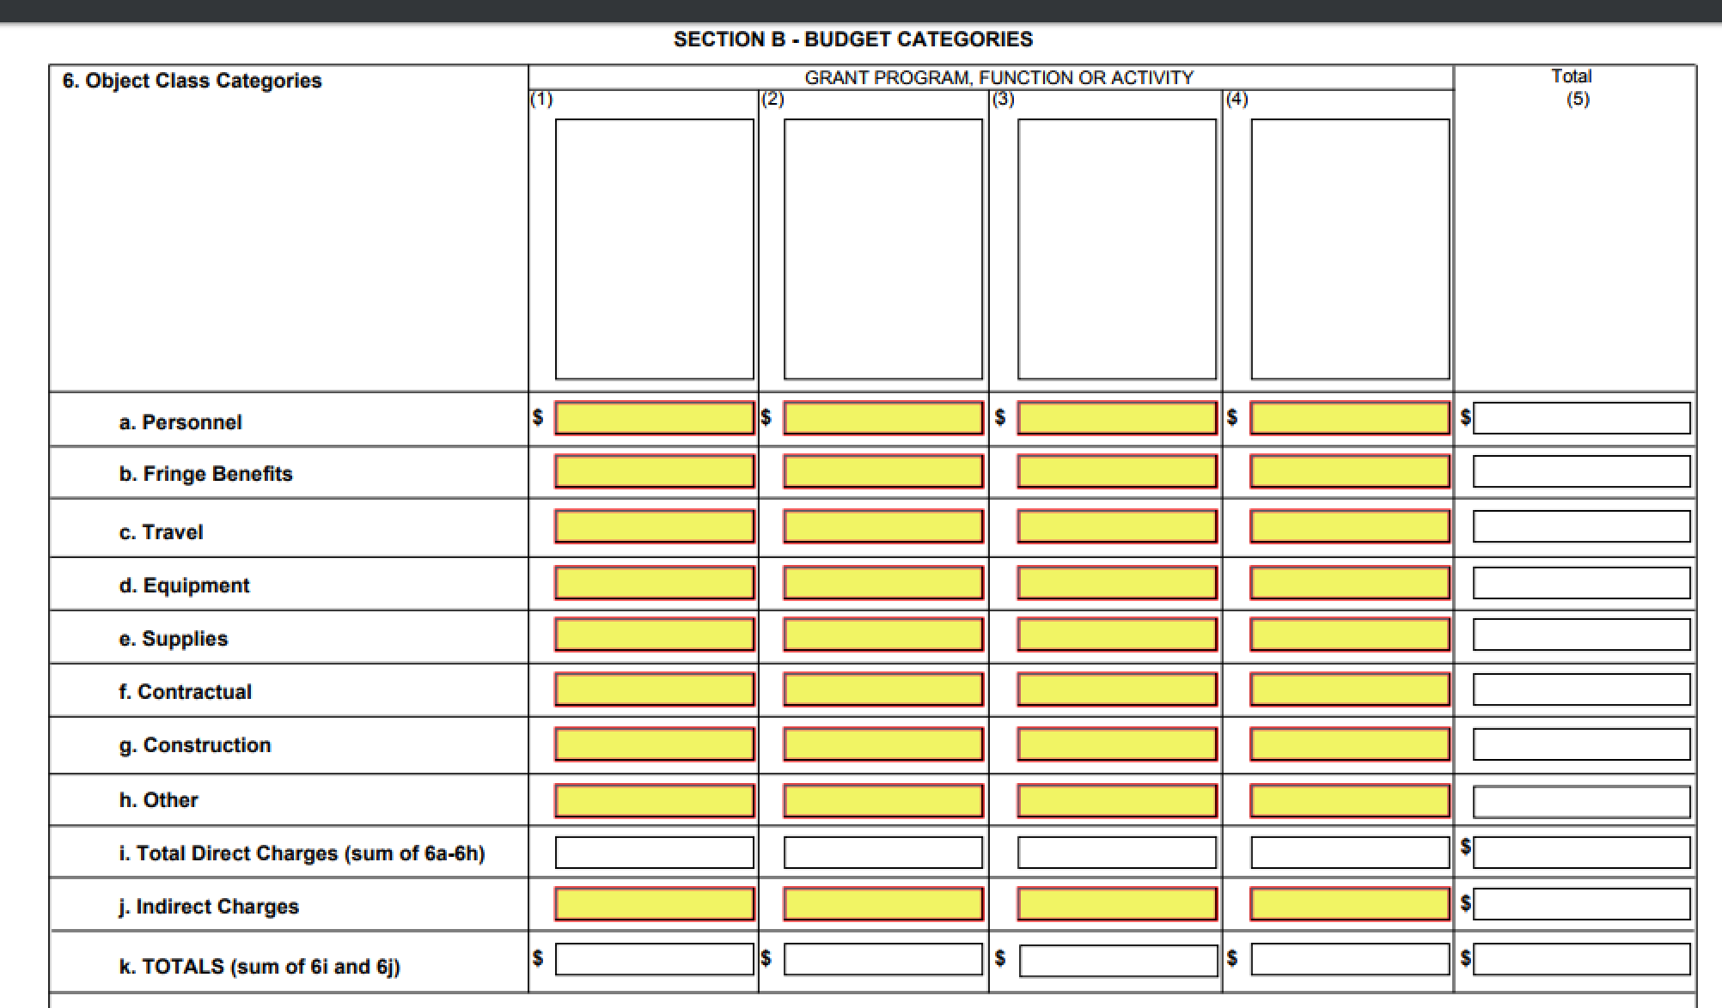
Budget & Budget Narrative SF-424A Section B
Enter the federal costs only. Please do not separate planning and training. Please do not include matching amounts in this section. Please utilize the budget narrative to explain how matching will be met (if applicable).

Slide 27
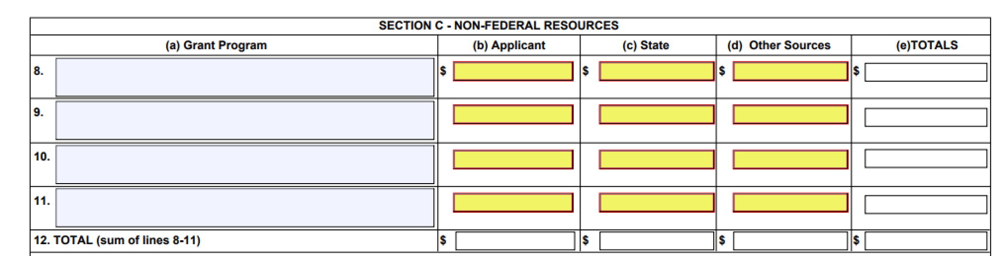
Budget & Budget Narrative SF-424A Section C
Enter the matching costs only.
Section D and Section E are not required for the FY18 Continuing Application.

Slide 28
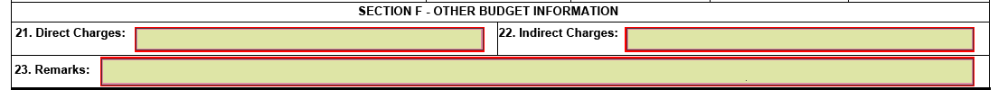
Budget & Budget Narrative SF-424A Section F
Section F is required if requesting indirect costs.

Slide 29
Budget Narrative: Cost Principles
An applicant’s budget request is reviewed for compliance with the governing cost principles and other requirements and policies applicable to the type of recipient and the type of award.
The cost principles address four tests that PHMSA follows in determining cost eligibility. Costs charged to awards must be:
Allowable (2 CFR part 200, FOA, federal statute)
Allocable (2 CFR § 200.405)
Necessary(2 CFR § 200.403)
Reasonable and consistently applied (2 CFR § 200.403)
Notes:
The components for the HMEP planning grant are…

Slide 30
Budget and Budget Narrative: Reminders
Submitting a well-written budget narrative results in a faster review by PHMSA and a lower administrative burden to applicants.
Please check for computational errors!
Every number listed in the SF-424A line-item budget should have a corresponding explanation as to how it was calculated in the budget narrative.
Notes:
The components for the HMEP planning grant are…

Slide 31
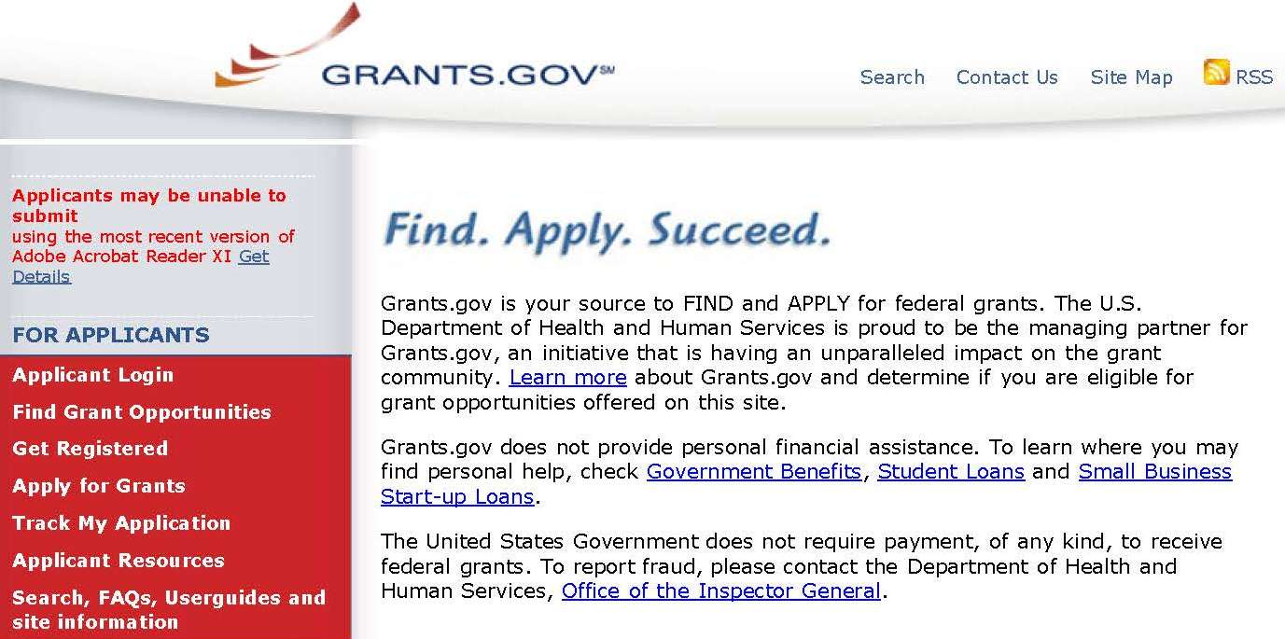

Invitation to Apply
PHMSA encourages Federally Recognized Tribes to apply for the HMEP grant via www.grants.gov.

Slide 32
HMEP Grant Program Contact Information
General Inquiries: HMEP.Grants@dot.gov
Website: www.phmsa.dot.gov/hazmat/grants
Phone: 202-366-1109

Slide 33

What questions do you have for us?

