Slide 1


Pipeline & Hazardous Materials Safety Administration
HMEP Grant Program
States & Territories
Continuing Application Webinar
May 10, 2018

Slide 2









Hazmat Grant Program Office
Acting Chief, Grants and Registration
Team Lead, Senior Grants Specialist
––
Rose Achieng
Programmatic Grants Specialist
Financial Grants Specialist
Business Analyst (CTR)
––
Flor Valencia
Kenetha Hillman
Programmatic Grants Specialist
Financial Grants Specialist
Admin. Assistant (CTR)
––
Matthew Hufford
Programmatic Grants Specialist
Financial Grants Specialist

Slide 3
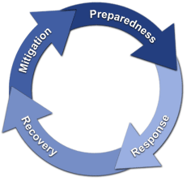
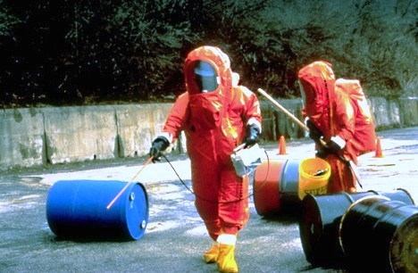
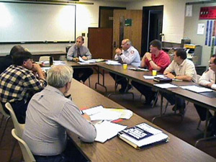
Hazmat Grant Program Purpose
Support State, Territorial, Tribal, and local communities with hazardous materials emergencies inherent to its transportation in addition to the implementation of the Emergency Planning and Community Right-to-Know Act (EPCRA) of 1986.

Slide 4
FY 18 Grant Cycle Timeline
Continuing and Supplemental Applications
May 2018 (tentative) – Applicants will receive funding allocations via email.
May 2018 (tentative) – Applicants eligible to apply for supplemental funding will receive an email invitation to apply with instructions.
Early June 2018 (tentative) - Deadline for applications.
June-July 2018 - Application Review completed by PHMSA.
September 2018 - Notice of Grant Agreement (NGA) issued. Period of performance is 09/30/2018 – 09/30/2019.
Any questions concerning your application should be submitted to hmep.grants@dot.gov.

Slide 5

Objective & Agenda
Objective: To provide applicants with key information for preparing successful continuing applications.
Agenda:
Developing the Grant Application
  Components of the Project Narrative
  Components of the Budget and Budget Narrative
Questions/Comments
Notes:
During the HMEP application webinar, we will discuss…

Slide 6
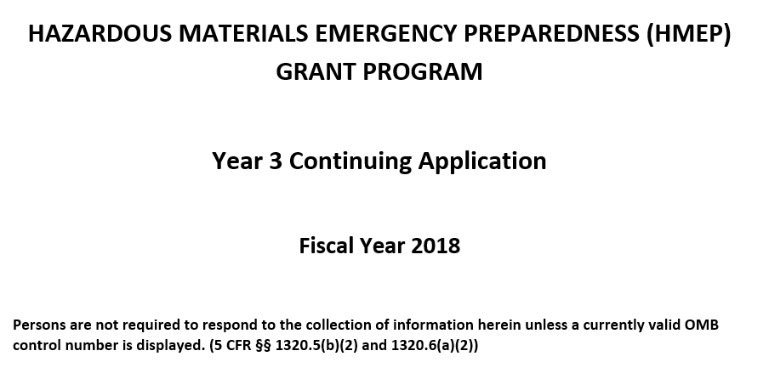
Components of the HMEP Grant Application Form

Slide 7
Components of the HMEP Grant Application Form
  Standard Forms
    Application forms
      SF-424 -Application for Federal Assistance
      SF-424A -Budget Information - Non-Construction Programs
Application Parts
  FY 2018 HMEP Grant Application Form
    Project Narrative
    Budget Narrative
  Supporting/Continuation Documents
  No certification forms, Governor’s letters, statements, etc., are required. This was done in (Year 1) and considered valid for the entire project period unless applicant provides notification of a change.
Notes:
The components for the HMEP planning grant are…

Slide 8
Completing the HMEP Grant Application Form – Project Narrative

Slide 9
Completing the HMEP Grant Application Form – Project Narrative
  A project narrative includes:
  Organization information (key contacts)
  Needs assessment-A statement that indicates the HMEP planning and training needs of your jurisdiction
  Goals and Objectives
  Activities Supporting Program Goals
  Proposed activities to include the projected output and outcome of each
  Approximate total cost of project with each activity
  Projected start and end date for each activity
  Performance period timeline and a monitoring plan
Notes:
The components for the HMEP planning grant are…

Slide 10
Completing the HMEP Grant Application Form – Project Narrative
  Grantee Information
    Designated Agency Name
    Contact Information
      Authorized Representative
      Program Manager
      Finance Manager
  Needs Assessment -It is a clear and well-supported statement based on a systematic process for determining and addressing needs, or "gaps" between current conditions and desired conditions
  DESIRED PROGRAM - ACTUAL PROGRAM = PROGRAM NEED
    Conduct a Planning and Training Needs Assessment.
    Differentiate between program needs & wants.
    Prioritize according to level of importance.
Notes:
The components for the HMEP planning grant are…

Slide 11
HMEP Grant Application Form – Project Narrative
  Goals and Objectives
  Goals are:
      A projected outcome that include general, intangible, and abstract factors.
  Objectives are:
      A projected output that includes a precise statement that is tangible, concrete, and measurable.
      When including your goals and objectives in the grant application, ensure they are SMART:
Specific, Measurable, Achievable, Realistic, and Timely (“SMART”)
Notes:
The components for the HMEP planning grant are…

Slide 12
HMEP Grant Application Form – Project Narrative
  4. Activities Supporting Program Goals
    Preparedness Activities – Are activities planned under section 303 of the Emergency Planning and Community Right-To-Know Act (EPCRA).
    Response Activities - Are trainings that fall under the NFPA 472 core competencies or OSHA 29 CFR § 1910.120(q) you plan to carry out with HMEP funds.
    Activities must be:
      Allowable - (2 CFR part 200, FOA, Federal Statute) – Mandated by OMB and granting agency guidelines
      Factors Affecting Allowability (2 CFR § 200.403) –Necessary, Reasonable, Consistently Applied, Adequately documented, etc.
      Reasonable (2 CFR § 200.404) – Ordinary and necessary for the proper and efficient performance of the grant award
      Allocable (2 CFR § 200.405) – Goods or services that are chargeable or assignable to the grant award
Notes:
The components for the HMEP planning grant are…

Slide 13
HMEP Grant Application Form – Project Narrative
  Annotating the Grantee Activity Information Section
  Grantee Activity Information
  Sub-grantee Activity Information
Notes:
The components for the HMEP planning grant are…

Slide 14

HMEP Grant Application Form – Project Narrative
  Reminders
  Provide Activity Description. Listing the name of the activity is not adequate. Include training curriculum (if available), conference agenda, and details of the activity’s relation to transportation if not already an approved activity in the HMEP Activity Guide.
  Correlate Activity to needs, goals, objectives, and outcomes outlined in application.
  Provide approximate total cost of project with each activity.
  Provide the projected start and end date for each activity.
  Do not copy and paste your project narrative from years 1 and 2 unless the activities are part of the current proposal.
  Evaluate your proposal for Year 3 to validate the usage of 75% of grant funding for HMEP Programmatic activities and no more than 25% for federal funding for maintenance and administration costs (M&A).
Notes:
The components for the HMEP planning grant are…

Slide 15
HMEP Grant Application Form – Project Narrative
  Reminders
  “Subgrant process, TBD” is no longer valid for applicants that will make subawards. Applications that do not provide sub-award activity information on how funds will be spent are required to submit the proposals to the programmatic specialist for review and approval before the awarding and execution of the sub-awards.
  Remember activities that are not included in the approved application require the submission of an activity request for consideration and approval.
Notes:
The components for the HMEP planning grant are…

Slide 16

Completing the HMEP Grant Continuing Application Form
Budget and Budget Narrative

Slide 17

Budget & Budget Narrative Overview
Applicants must include a budget and budget narrative that details the costs required during the performance of the project.
The budget provides an overview of costs organized by object class category.
The budget narrative explains these costs in detail and how they are calculated.
Together, the budget and budget narrative provide a forecast of expenditures to measure against the applicant’s actual financial operations.

Slide 18
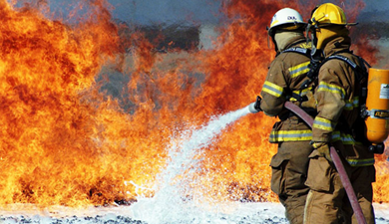
Budget & Budget Narrative Reminders
At least 75% of HMEP funds must be for programmatic activities. This may include:
Developing, improving, and implementing emergency plans.
Conducting commodity flow studies.
Conducting exercises.
Training public sector employees.
Up to 25% of HMEP funds may be used for management and administration (“M&A”) for state employees. This may include:
Personnel and fringe costs involved with oversight of grant, such as travel and supplies associated with monitoring sub-grantees;
Indirect costs.

Slide 19
Budget & Budget Narrative Reminders
Explain every SF-424A line-item should have a corresponding explanation as to how it was calculated in the budget narrative. Submitting a well-written budget narrative results in a faster review!
The applicant must:
Explain how they will meet the 20% matching contribution in the budget narrative.
Attach the indirect cost rate agreement if claiming indirect costs.
Double check all computations.

Slide 20
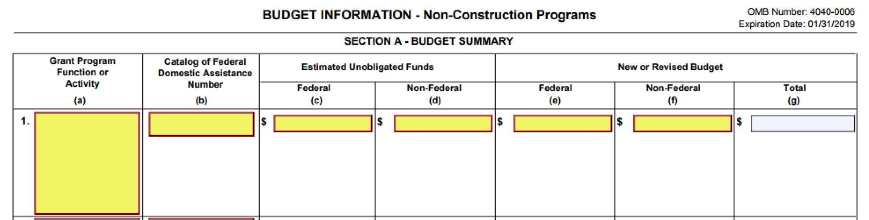
Budget & Budget Narrative SF-424A Section A
Enter the Year-3 (FY18) Federal and Non-Federal match amounts in their respective columns under New or Revised Budget. The Total in Column G should auto-populate.

Slide 21
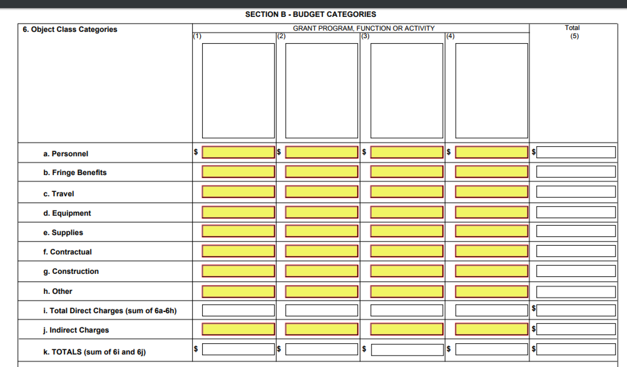
Budget & Budget Narrative SF-424A Section B
Enter federal costs only. Please do not separate planning and training.
Please do not include matching amounts in this section. Instead, please utilize the budget narrative to explain how matching will be met (if applicable).

Slide 22
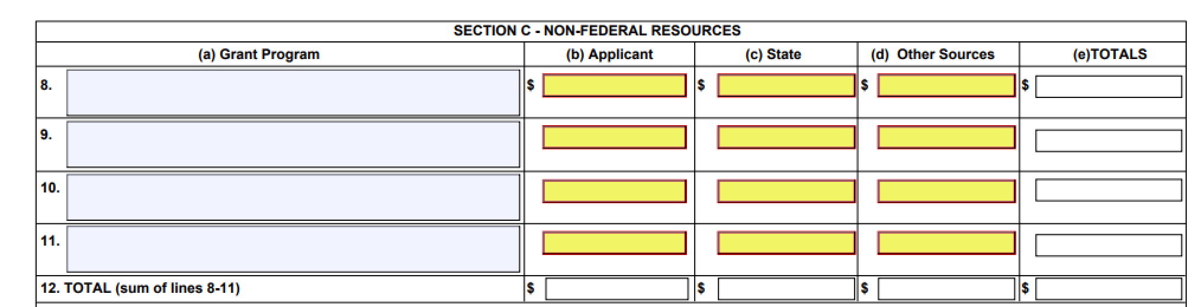
Budget & Budget Narrative SF-424A Section C
Enter the matching costs only.
Section D (Forecasted Cash Needs) and Section E (Budget Estimates of Federal Funds Needed for Balance of the Project) are not required for the FY18 Continuing Application.

Slide 23
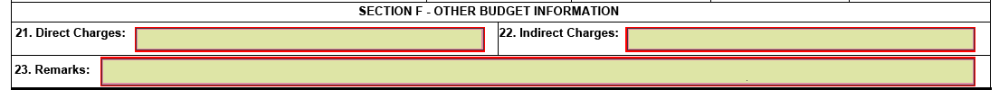
Budget & Budget Narrative SF-424A Section F
Section F includes the grand total of the budget for direct and indirect charges.
Please fill out indirect charges and attach the indirect cost rate agreement if claiming indirect costs.

Slide 24
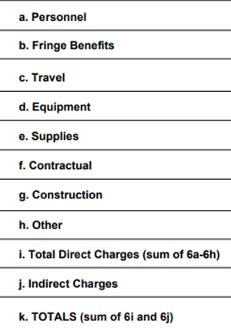
Line Item Details
This section provides a definition and tips for filling correctly filling out each object class category in the SF-424A and the application budget narrative.

Slide 25

Personnel Costs (2 CFR 200.430)
This line item refers to the cost of wages and salaries paid to employees of the applicant who are directly involved in grant implementation. Generally, personnel are issued a W-2 by the applicant.
Utilize the budget narrative to give the position title, position description, employee status (full or part-time), hourly wage or salary, percentage of time dedicated to the grant, and total cost to the grant.
Show your computational work and any assumptions made.
Consultant or subgrantee costs should not be included in the Personnel line item.

Slide 26

Fringe Benefits (2 CFR 200.431)
This line item refers to the cost of benefits paid to personnel as compensation in addition to their regular salaries and wages, including the cost of the applicant’s share of FICA, health insurance, workers’ compensation, and vacation.
Utilize the budget narrative to include a description of specific benefits charged to the project and at what percentage. Fringe benefits are only allowable for the percentage of time devoted to the grant.
Please show your computational work and any assumptions made.
While personnel should have a corresponding fringe cost (and vice versa), personnel and fringe costs must be separated into their respective line-item categories. Please do not combine these costs together.

Slide 27
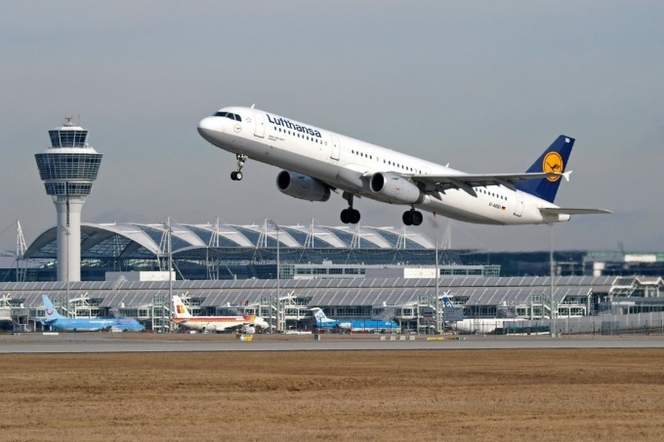
Travel (2 CFR 200.474)
This line item refers to the travel costs of personnel that are reasonable and necessary to effectively manage and carry out grant activities, provide oversight, and measure program effectiveness.
Please utilize the budget narrative to explain travel costs. Include the travel purpose, method of travel, number of people traveling, the number of days, and an estimated cost for each trip. Please provide an explanation of what activities the travel will cover.
Please show your computational work and any assumptions made. Estimates are acceptable if you provide a basis for determining the estimated amount requested.

Slide 28
Equipment (2 CFR 200.439)
This line item refers to non-expendable personal property having a useful life of more than one year and a per-unit cost of $5,000 or more per unit.
Utilize the budget narrative to include a description, quantity, and per-unit price for all equipment and how the equipment will be used on grant activities.
Show your computational work and any assumptions made.
If the expense is under the usual threshold of $5,000 per item, it belongs under supplies. However, if the applicant’s equipment threshold is below $5,000, please utilize the budget narrative to provide an explanation and state the policy citation.

Slide 29

Supplies (2 CFR 200.453)
This line item refers to tangible materials costing less than $5,000 per unit, such as copy paper, pens and pencils, and computers.
Please utilize the budget narrative to provide the quantity and per-unit cost for supplies and how the supplies will be used on grant activities.
Please show your computational work and any assumptions made.

Slide 30

Contractual (2 CFR 200.330)
This line item refers to the cost of any contract or sub-award agreement.
A contract is a legal instrument implemented by grant recipients to purchase property or acquire services in order to carry out a project. The property or services acquired are not directly involved in programmatic activities.
Utilize the budget narrative to identify your sub-awards and contracts and explain how contractual costs were derived for each.
Show your computational work, any assumptions made, and how each contract or sub-award relates to grant activities.

Slide 31
Flexibility in Categorizing Sub-awards
A sub-award is provided by a pass-through entity to a sub-recipient in order to carry out part of the pass-through entity’s federal award. Sub-recipients are responsible for programmatic decision-making.
Sub-awards are generally placed under the Contractual section; however, applicants may opt to categorize sub-awards under Other.
A sub-award may be provided through any form of legal agreement, including an agreement that the pass-through entity considers a contract.
Notes:
If this is the case, when your agency procurement policy requires you to treat sub-recipients as sub-grants, please denote this in your budget narrative.
At PHMSA we request that any sub-award costs are provided under the Other line-item, unless you’re agency’s procurement policy specifically/explicitly requests sub-awards be categorized as sub-contracts.

Slide 32

Other
This line item refers to direct costs that do not fit any of the aforementioned categories, such as rent for buildings used to conduct grant activities, utilities, leased equipment, child care, transportation expenses, employee training, tuition, etc.
Please utilize the budget narrative to itemize “other” direct costs and provide a reasonable explanation.
Please show your computational work, any assumptions made, and how “other” direct costs relate to grant activities.
Notes:
If this is the case, when your agency procurement policy requires you to treat sub-recipients as sub-grants, please denote this in your budget narrative.
At PHMSA we request that any sub-award costs are provided under the Other line-item, unless you’re agency’s procurement policy specifically/explicitly requests sub-awards be categorized as sub-contracts.

Slide 33

Indirect Costs (2 CFR 200.416)
This line item refers to costs incurred for common or joint objectives that benefit more than one project.
If the applicant has a current and fully executed indirect cost rate, a copy of the indirect cost agreement signed by the cognizant Federal agency must be included with the application.
If the indirect cost rate agreement is in the renewal process and will not be approved by the continuing application due date, attach the letter of renewal or letter of request sent to your cognizant agency.

Slide 34
Matching (2 CFR 200.306)
This line item refers to costs not paid by Federal funds. This amount is 20% for HMEP grants (some territories are exempt).
On the SF-424A line-item budget please enter match in Section A and Section C only. The application will be returned if match is listed in Section B.
Please utilize the budget narrative to clearly explain how matching costs will be met.
Identify the type of match, explain the amount to be matched, and how this amount was determined.
Matching should be described in the same level of detail as Federal dollars, including a breakdown by object class category.
Please show your computational work and any assumptions made.

Slide 35
HMEP Grant Program Contact Information
General Inquiries: HMEP.Grants@dot.gov
Website: www.phmsa.dot.gov/hazmat/grants
HMEP Grant Program Expenditure Guide for proposed activities: https://www.phmsa.dot.gov/grants/hazmat/hmep-expenditures-guide-pdf.
Phone: 202-366-1109

Slide 36

What questions do you have for us?

Slide 37
Q & A
When can we expect the application to become available?
  PHMSA anticipates opening the Continuing Application submission period within the next 1 to 2 weeks.
For territories who are not required to match, what should be entered on the 424A?
  Leave the Non-Federal column blank or you may enter $0
Once the application is sent you, how long will we have to complete?
  PHMSA will provide applicants with 30 days to submit Continuing Applications.

Slide 38
Q & A
Will the application be submitted via snail mail or email?
Applications will be submitted via Grant Solutions, PHMSA will provide more guidance in the near future.
Under your budget narrative where you have personnel and fringe benefits, should we provide only the federal personnel information or do you add the match information as well in the narrative?
  Applicants should utilize the Match section of the application to explain how the match will be met. Provide an explanation as to the amount to be matched and how it was determined. Matching funds should be described in the same manner as if they were the Federal share of costs. List all staff positions by title. Give annual salary exclusive of fringe benefits, job title, role in the HMEP grant (this may differ from the organizational job title), percentage of time assigned to the HMEP grant, and total cost for the budget period. Base the allocation of salaries for individuals that have responsibilities in both the planning and training areas on realistic estimates of where the time is actually spent. Include only those positions directly funded by the HMEP grant (in whole or in part) or that are part of required matching. For the salaries used as third‐party in‐ kind contributions (“soft match”), explain the methodology and assumptions used.

