Slide 1
Pipeline and Hazardous Materials Safety Administration HMEP Grant Program
Performance Report Webinar
Notes:
During the HMEP online performance reporting webinar, we will discuss how to submit an online performance report using PHMSA’s new online process.

Slide 2
Hazmat Grant Program Office
Kenetha Hillman
Administrative Assistant
 | Aaron Mitchell Director
 | Lisa O’Donnell Chief, Grants and Registration
Carla Sheppard Sr Grants Management Specialist | Rose Achieng Business Analyst | Shakira Mack Sr Program Analyst
Bonita Brown Grants Management Specialist | Suezett Edwards Grants Management Specialist | Andre’ White Grants Management Specialist
Lisa Reichenbacher Grants Management Specialist | Flor Valencia Grants Management Specialist | Matthew Hufford Grants Management Specialist
Notes:
I’m…and this is our hazmat grants program office team.

Slide 3
Agenda
PHMSA Grant Schedule
Performance Reporting Guidance
Questions/Comments

Slide 4
Grant Cycle Timeline
FY 2018
Dec. 29, 2017 – Annual FFR Report due
January 30, 2018 – Annual Progress Report due
January 2018 – Continuing Application Webinar
February 1, 2018 – Continuing/Supplemental Application Submission Period Opens (Date Tentative)
April 30, 2018 – Year 2 Semi-annual Progress Report and FFR due
Notes:
Here is the FY 18 grant cycle timeline.

Slide 5
Performance Reporting
Guidance:
Use the web performance reporting link provided by PHMSA for all performance reporting.
Mid-year reports must provide information on activities occurring during the first half of the grant year cycle ending March 31. Due no later than April 30.
Annual reports must provide information on activities that have occurred during the grant year cycle ending September 30. Due no later than December 29.
Final progress reporting must provide information on activities occurring during the entire 3-year grant cycle ending September 30. Due no later than December 29.

Slide 6
A’s FY2015 IT Portfolio
Performance Reporting (cont.)
New Performance Report link will be on the HazMat Grants Forms page
6 of 15

Slide 7
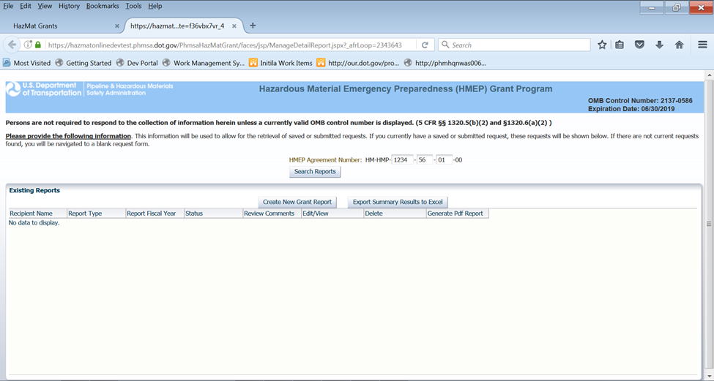
Performance Reporting (cont.)
1. Enter HMEP Grant Agreement # found on NGA
2. Create new report by clicking “Create New Grant Report”
7 of 15

Slide 8
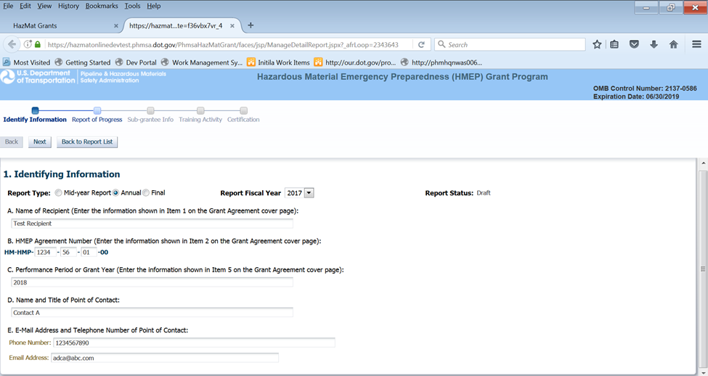
Performance Reporting (cont.)
3. Enter identifying information
8 of 15

Slide 9
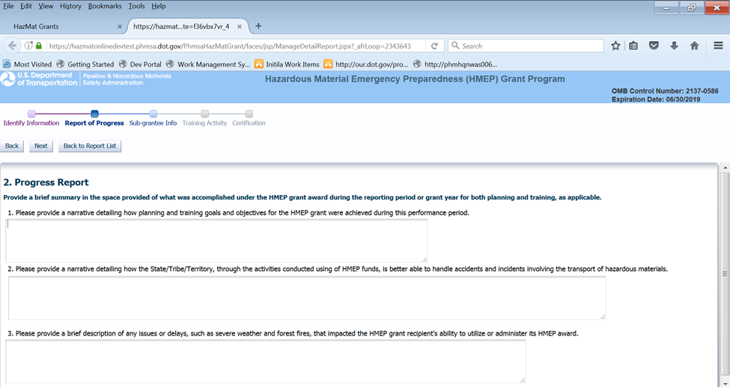
Performance Reporting (cont.)
4. Provide responses to questions 1-3.
9 of 15

Slide 10
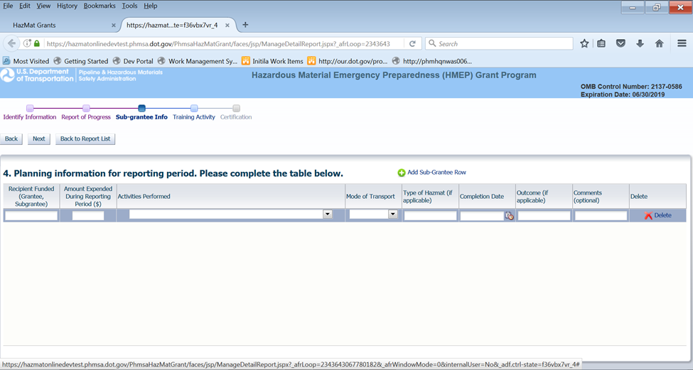
Performance Reporting (cont.)
5. To enter rows, click “Add Sub-Grantee Row”
6. Enter data in appropriate columns
10 of 15

Slide 11
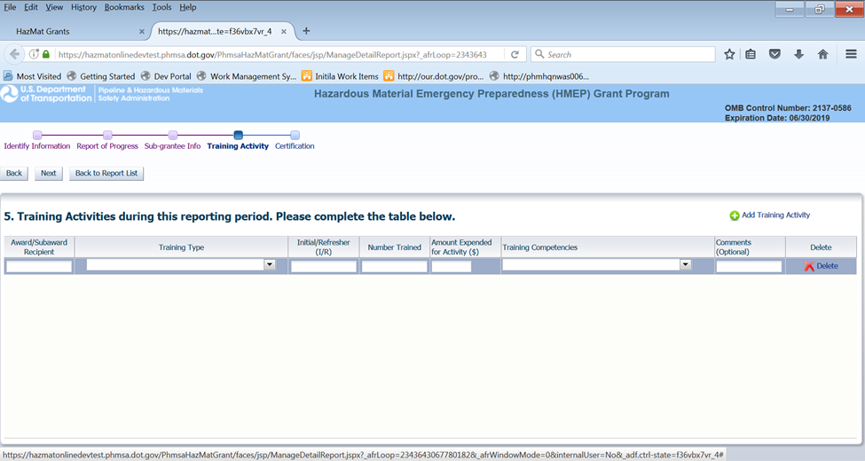
Performance Reporting (cont.)
7. To enter rows, click “Add Training Activity”
8. Enter data in appropriate columns
11 of 15

Slide 12
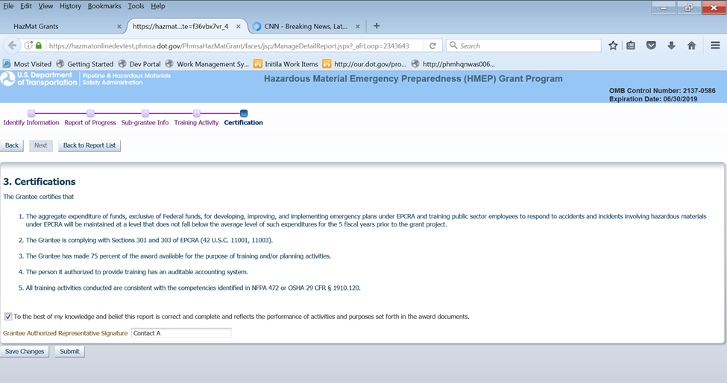
Performance Reporting (cont.)
9. Check box to indicate that to the best of your knowledge and belief, the report is correct and complete and reflects the performance of activities and purposes set forth in the award documents.
10. If ready to send, click “submit,” if not click “save changes.”
12 of 15

Slide 13
Performance Reporting (concluded)
Online Report Capabilities
Auto saves as you move from page-to-page
You can save work and come back to complete
There are no edit capabilities once you submit, until PHMSA returns form to you for corrections
You can search by grant number and retrieve old reports
You can export reports as pdf files
13 of 15

Slide 14
Hazmat Grant Program Contact Information
General Grant Inquiries
HMEP.Grants@dot.gov
Website:
www.phmsa.dot.gov/hazmat/grants
Phone:
(202)366-1109
14 of 15

Slide 15
Questions?
15 of 15

