Slide 1
2024
PIPELINE AND HAZARDOUS MATERIALS SAFETY ADMINISTRATION (PHMSA)
Independent Inspection Agencies Meeting (Virtual)
Presented by Kenneth Clark and Diane Jones

Slide 2
PHMSA
OUR MISSION
To protect people and the environment by advancing the safe transportation of energy products and hazardous materials essential to our daily lives.

Slide 3
AGENDA
1. PHMSA PRESSURE VESSELS – NEIL BENNINGHOVEN
Welcome/Opening Remarks
2. PHMSA STANDARDS & RULEMAKING – EAMONN PATRICK
Hazardous Materials Regulations Updates - Cylinders
3. PHMSA FIELD INVESTIGATOR – KATELIN MAITS
International Cylinder Inspections
4. PHMSA TECHNICAL – REFAAT SHAFKEY
Technical Review of Applications for Approvals
5. PHMSA PRESSURE VESSELS – KENNETH CLARK
CA Approval (Chemical Analysis)
2 ½ Conditional Approval
Special Permits Addition
6. IIA’s Questions
Response to General Questions Submitted by IIA’s
7. Closing Remarks

Slide 4

Rulemakings with the
Office of Hazardous Materials Safety
Recent Revisions to Cylinder Manufacture, Use, and Requalification Requirements (HM-234, HM-219C, HM-219D, HM-215Q)
Eamonn Patrick
Office of Hazardous Materials Safety - Standards and Rulemaking Division
Notes:
Good morning/afternoon, thank you for your interest in final rule HM-234, Miscellaneous Amendments Pertaining to DOT-Specification Cylinders. Today I will provide a briefing on the purpose, scope, history, and highlights of HM-234.

Slide 5
Overview
Overview
Purpose of rulemakings
  Update requirements for manufacturing, testing, marking, filling, and requalifying cylinders
  Increase level of safety, international harmonization, and transportation efficiency
  Address errors, inconsistencies, and outdated requirements

Slide 6
HM-234 (Published December 2020; effective December 2021)
New Incorporation by Reference (IBR) - CGA C–1, Methods for Pressure Testing Compressed Gas Cylinders(2016; Eleventh edition).
  IBR applies to pressure tests at time of both manufacture and requalification
IBR Updates
  CGA C–3, Standards for Welding on Thin-Walled Steel Cylinders (2005, Reaffirmed 2011; Seventh edition)
  CGA C–6, Standards for Visual Inspection of Steel Compressed Gas Cylinders (2013; Eleventh edition)
  CGA C–14, Procedures for Fire Testing of DOT Cylinder Pressure Relief Device Systems (2005, Reaffirmed 2010; Fourth edition)
  CGA S–1.1, Pressure Relief Device Standards—Part 1—Cylinders for Compressed Gases (2011; Fourteenth edition)

Slide 7
HM-234 (continued)
HM-234 (continued)
Expand the applicability of the fire extinguisher exception to include cylinders intended for installation in a fire extinguishing system;
Expand the authorized use of salvage cylinders to include Class 4 and Class 5 materials;
Re-impose of 75 cubic inch size limit for DOT 39 cylinders containing certain flammable liquefied gases;
Update requirements for 4-series welded cylinder construction;
Require tare weight marking for cylinders used in liquified gas service;
Clarify filling requirements for multi-element gas containers (MEGCs) filled by weight;
Align pressure relief requirements for DOT 39 cylinders containing oxidizing gas transported by air with CGA requirements;
Update water pump tank system requirements;
Revisions to requalification recordkeeping requirements – addition of gas service and year of manufacture;
Revision to cylinder repair marking requirements – “R” stamp to indicate grinding and ultrasonic thickness exam; and
RIN marking for export cylinders with “EX” stamp

Slide 8
HM-219C (Published Nov 2020; effective December 2020)
Updated IBRs
  CGA C-6.3 “‘Standard for Visual Inspection of Low Pressure Aluminum Alloy Cylinders 2013, Third Edition”
  CGA S–7, ‘‘Method for Selecting Pressure Relief Devices for Compressed Gas Mixtures in Cylinders, 2013, Fifth Edition’’
  CGA C–11, ‘‘Practices for Inspection of Compressed Gas Cylinders at Time of Manufacture, 2013, Fifth Edition’’
  CGA C–6.1–2013, ‘‘Standards for Visual Inspection of High Pressure Aluminum Compressed Gas Cylinders, 2013, Fifth Edition”
Authorization for import/export of foreign pi-marked cylinders

Slide 9
HM-219D (Published March 2024; effective April 2024)
Updated IBRs
  CGA publication C–7–2020, “Guide to Classification and Labeling of Compressed Gases,” Eleventh Edition.
New IBRs
  CGA C–20–2014, “Requalification Standard for Metallic, DOT and TC 3-series Gas Cylinders and Tubes Using Ultrasonic Examination,” Second Edition
    This IBR will eliminate the need for some existing DOT special permits and allow alternative methods for the requalification of cylinders. This revision would eliminate the need for special permit applications and renewals.
  CGA publication C–27–2019, “Standard Procedure to Derate the Service Pressure of DOT 3-Series Seamless Steel Tubes, First Edition.”
  CGA publication CGA C–29–2019, “Standard for Design Requirements for Tube Trailers and Tube Modules, First Edition.”
Authorization for external rethreading or threading of a DOT 3AX, 3AAX, or 3T cylinder manufactured w/out threads, under IIA supervision
Authorization for UN seamless stainless steel cylinders in Compressed Natural Gas service
Authorization for 10% overfill and associated “+” mark for DOT 3A, 3AX, 3AA, and 3AAX cylinders containing hydrogen and mixtures of hydrogen with helium, argon or nitrogen

Slide 10
HM-215Q (Published April 2024; effective May 2024)
Updated IBRs
  ISO 9809-1,-2, and -3 2019(E) for manufacture of seamless steel cylinders
  ISO 10462:2013/Amd 1:2019(E), “Gas cylinders—Acetylene cylinders—Periodic inspection and maintenance—Amendment 1,”
  ISO 11117:2019(E), “Gas cylinders—Valve protection caps and guards—Design, construction and tests,”
  ISO 11118:2015/Amd 1:2019(E), “Gas cylinders—Non-refillable metallic gas cylinders—Specification and test methods—Amendment 1,”
  ISO 11513:2019, “Gas cylinders—Refillable welded steel cylinders containing materials for sub-atmospheric gas packaging (excluding acetylene)—Design, construction, testing, use and periodic inspection,”
  ISO 16111:2018, “Transportable gas storage devices—Hydrogen absorbed in reversible metal hydride,”
  ISO 17871:2020(E), “Gas cylinders—Quick-release cylinder valves—Specification and type testing,”
  ISO 21172-1:2015/Amd 1:2018, “Gas cylinders—Welded steel pressure drums up to 3000 liters capacity for the transport of gases—Design and construction—Part 1: Capacities up to 1000 liters—Amendment 1,”
New IBRs
  ISO 23088:2020, “Gas cylinders—Periodic inspection and testing of welded steel pressure drums—Capacities up to 1000 l,”
Adding TC-8WM and TC-8WAM specifications to the table of corresponding DOT specifications in § 171.12(a)(4)(iii) as comparable cylinders to DOT-8 and DOT-8AL, respectively;
Revision to the pi-marked cylinder authorization in 171.23 to clearly indicate that the authorization applies only to cylinders with a water capacity not exceeding 150 L, not all pressure receptacle types

Slide 11
Any Questions?
Contact Information
Eamonn.Patrick@dot.gov
(202) 366-4410
Notes:
Thank you very much for your time. Are there any questions?

Slide 12
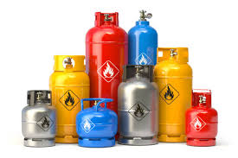
Dr. Katelin Maits
Investigator, Eastern Region
PHMSA IIA Meeting
International Cylinder Inspections
May 14, 2024

Slide 13
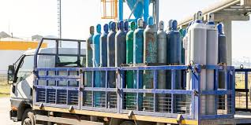
Inspection Planning FY2024
Team began meeting in February 2023
Lists were released to the regional leadership in October 2023
China trips were added back in for FY 2024
IIAs assisted in data collection (Thank you!)
13

Slide 14

FY 2024 Inspections
Field Operations was slotted with 35 Inspections FY 2024, 2 have since been cancelled by the companies. There are 22 inspections remaining.
These inspections are based on renewal of approvals, modifications, and new approvals.
The countries: China (19), India (5), Germany (2), UAE (1), Thailand (1), France (1), Czech Republic (1), Turkey (2), S. Korea (2), and England (1).
There are 25 Investigators involved in the inspections.

Slide 15
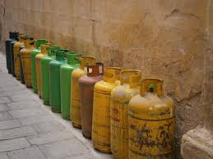
Individual Trip Planning
2 Facets to Planning
-Inspection Planning
-Approval/ Documentation
for Travel Abroad

Slide 16
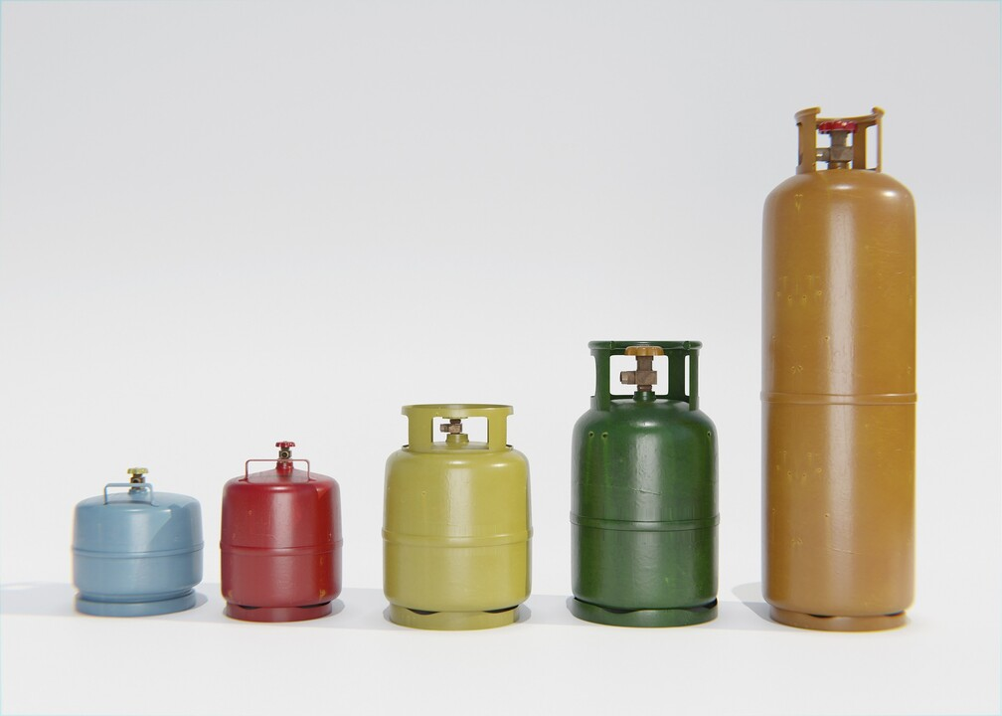
Future Year Planning
-Team has started meeting
and planning for FY2025.
-The goal is for the list to be
finalized by September each year.
-Moving forward a modification
or approval will happen in the
next fiscal year.

Slide 17
Thank You!
Questions?
Katelin.Maits@dot.gov

Slide 18
Pipeline and Hazardous Materials Safety Administration (PHMSA)
Technical Review of Approvals Applications
Refaat Shafkey

Slide 19
What do we Need in an Application?
Cover letter explaining the request. Title every document and Include list of attachments
Complete design drawing - a fully dimensioned sketch including minimum wall thickness, service and test pressure, cylinder volume and weight, the method of manufacture, heat treatment, material chemistry, guaranteed mechanical properties, batch test requirements, design calculations and marking etc. If some of this info is on separate documents, they should be referenced on the main drawing.
Summary sheet for all the test results: (Use consistent units of measurements)
  Batch and Design qualification test results
  Hydraulic pressure test, Hardness test reports etc.
  Dimensional checks and UE examination results/reports
  Include pictures of tensile/bend/flattening test and cycle burst tests as relevant.
Drawings and test reports must be stamped by the IIA and use consistent units. Note: All scanned documents should be legible and scanned in uniform direction. Number all pages in the report.

Slide 20
Design Drawing
Must include the following:
Reference to specification to which the design complies.
A fully dimensioned cylinder drawing covering all dimensions as required in the reference standard. Marking drawing is also required.
Service and Test pressures, Min volume and Empty cylinder weight
Method of manufacture, Material chemistry, Heat treatment
Mechanical and Physical properties (Tensile, Bend/Flattening, Charpy and Hardness test requirements etc.) Note: Use consistent units of measurements throughout the report. Do not mix imperial and metric units on different docs.
Performance tests required on batch basis (Burst, Cycle, Flaw tests etc.). Provide photographic evidence of test results where possible.
Sidewall thickness calculations as required in the specification or standard.
Proper title for the drawing clearly indicating the scope and any limitations applicable to the design.

Slide 21
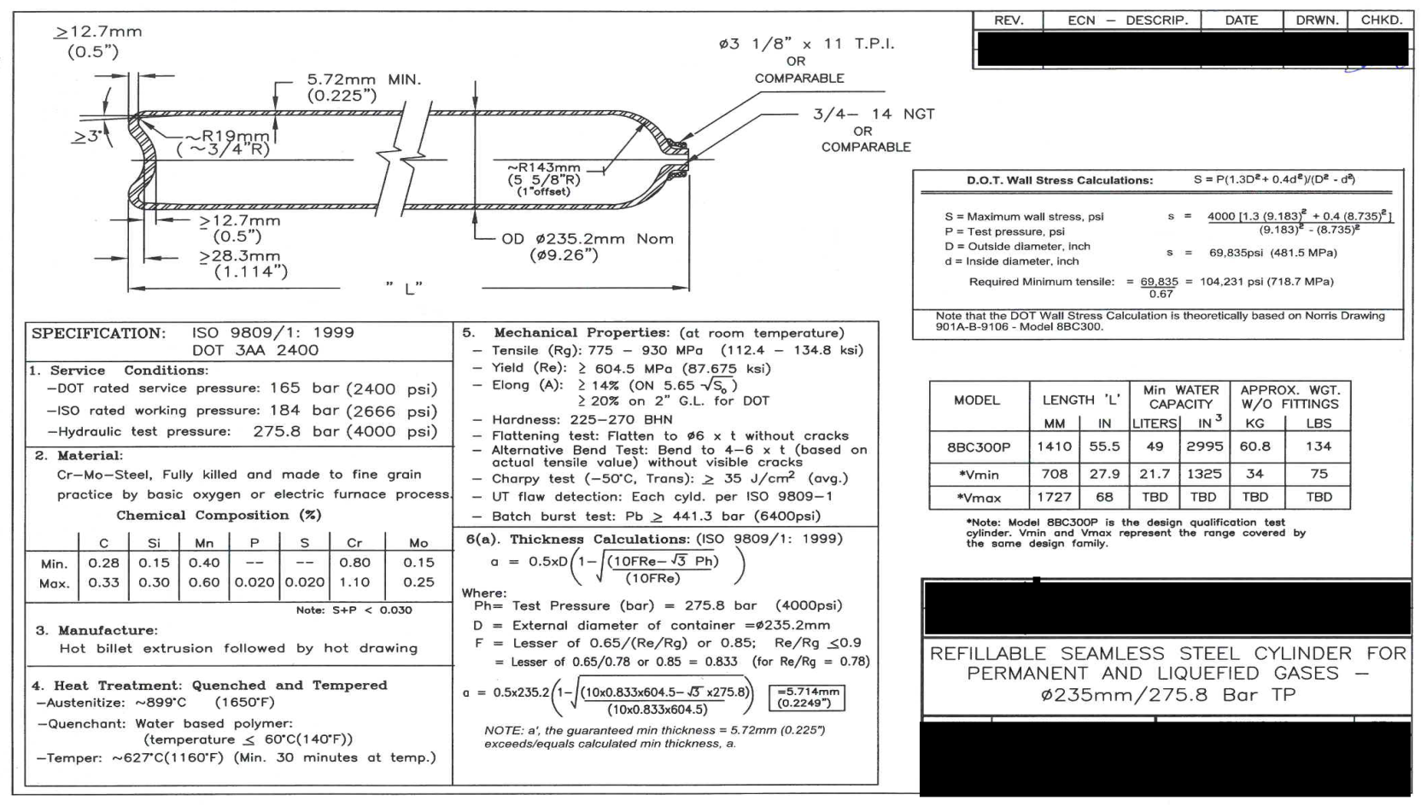
Sample Design Drawing

Slide 22
Sample Summary Sheet for Approvals Application
Item | Test | Cylds required | ISO 9809-1: 2010 sec/clause refr. | Measurement location | Requirement | Report Page No. | Results
1 | Cylinder Drawing | N/A | 7.9 | N/A | fully dimensioned drawing with material specification | 3 | Dwg # -----
2 | Cylinder Stamping Drawing | N/A | 13 | N/A | Document | 4-7 | Dwg # ----
3 | Manufacturer's Declaration of Conformity | N/A | N/A | N/A | Document | 8 | Complete
4 | Material chemistry check | N/A | 6.2 | Check analysis or mill cert. for steel chemistry | Meet requirements of clause 6.2. Note S, P and S+P do not exceed clause 6.2.2 limits. | 9-10 | OK
5 | Heat Treat Summary Sheet | Per A.I | 6.4 | Austenitize and temper temp chart records |  | 11 | OK
6 | Thickness Report / Hardness Test | All | 11.3 | Cyld section near shoulder and base | Specify hardness range BHN. | 12 | PASS
7 | UT flaw | All | 8.4, Annex B | Cylinder wall | Per ISO 9809-1, Annex B | 13 | PASS
8 | Out-of-roundness | Per A.I. | 8.5 | Top, mid and bottom sections | <2% of actual dia (approx < 0.186") | 14 | PASS: (values obtained?)
9 | Mean diameter (pi-tape) | Per A.I. | 8.6 | Top, mid and botm sections (< +/- 1% of nom dia) | Specify min / max vlaues | 14 | PASS:
10 | Straightness (banana) | Per A.I. | 8.7 | ( < 3mm/m of cylindrical length) | Specify max value | 14 | PASS: List values obtained
11 | Verticality (lean) | Per A.I. | 8.8 | ( <10mm/m of cylindrical length) | Specify min value | 14 | PASS List values obtained
12 | Thread Inspection | Per A.I. | 8.9 |  |  | 15 | PASS
13 | Hydrotest | All | 11.2 | Volumetric expansion test | Test pressure: ? Perm expn < 10% of TE | 16 | PASS
14 | Mechanical tests | 2 |  | Results Summary Sheet |  | 17 | PASS
14a | Tensile | " | 10.2 | ISO coupon for 2-ISO cylds. | Rg and Re values %E values guaranteed on the drawing (ISO-Prop rectangular bar) | 17 | List values obtained in tests.
14b | Charpy (-50 deg C, Trans) | " | 10.4 | One set each from two ISO cylds | avg of 3 tests>35J/cm^2 w/ no single <28 (test to be done per ISO 148) | 18-19 | List actual values obtained
14c | Thickness check for sidewall, base and head (on cylds taken for mechanical tests) | 2 (ISO mech test cylds.) | 9.2.2(a), hash 2 | Measurements to be taken on three transverse sections of the cyld part and on a longitudinal section of the base and head. | Meet design drawing | 20-24 | PASS
14d | Bend Test | " | 10.3 | Both mechanical test cylds | to 5 x tnom w/o cracks | 17 | PASS
15 | Base Check (on Cycle Test cylds.) | 2 | 9.2.3 | Bottom thickness, standing circle | within 15% of design min | 25-27 | PASS: Bottoms within 15% of design
16 | Hydraulic Burst Test Summary | 2 | 10.1.2 & 10.5 | Cylds must have representative markings | Pb & Py to meet requirement of ISO 9809/1 | 28-29 | List values obtained in the tests
17 | Cycle Test Summary | 3 | 9.2.2 | Cylds must have representative markings | 12,000 cycles min. After cycle test, section bases and measure base thickness . | 30 | Show that base thickness in within 15% of tb on drawing.
18 | Neck ring Test | Per A.I | When fitted(7.6) | Axail load to remove NR > 10xempty cyld wgt. Torque to turn NR > 74 ft-lbf | Specify axial and torque load required values | 31 | Actual values obtained
19 | Internal/external surface check | Per A.I | 8.3 &9.2.19a) &Annex-A | Inspect internal and external surfaces. | Free of injurious defects | 32 | PASS

Slide 23
Summary of Items in an Approvals Application
Start with the drawing and thickness calculations. The drawing must include, among other things like service conditions, a fully dimensioned sketched, the method of manufacture, material chemistry and heat treatment info.
Calculations: The IIA’s must pay attention to calculations for min thickness. It has been noticed that occasionally they have been incorrect.
Summary spreadsheet: Follow the requirements of the specification or standard clause by clause to list requirements, the results obtained and, where (provide page number) the actual result can be found in the application.
Tittle all documents and number all pages in the report. This helps ease of reference in case of questions.
Units of measurement: Stay consistent throughout the application.
Photos: Include clear pictures of tensile/bend/flattening tests and cycle and burst tests.
Scanned documents: The direction of the scanned pages should be uniform – keep the top of the page the same throughout .
Multiple language – Include English equivalent words or sentences where test report is in foreign language.
Cover letter: The request should include a cover letter clearly stating what is being requested: modification (provide drawing on which modification is based), new design, new approval etc.
Stamp: IIA should stamp all test results and other documents reviewed.

Slide 24
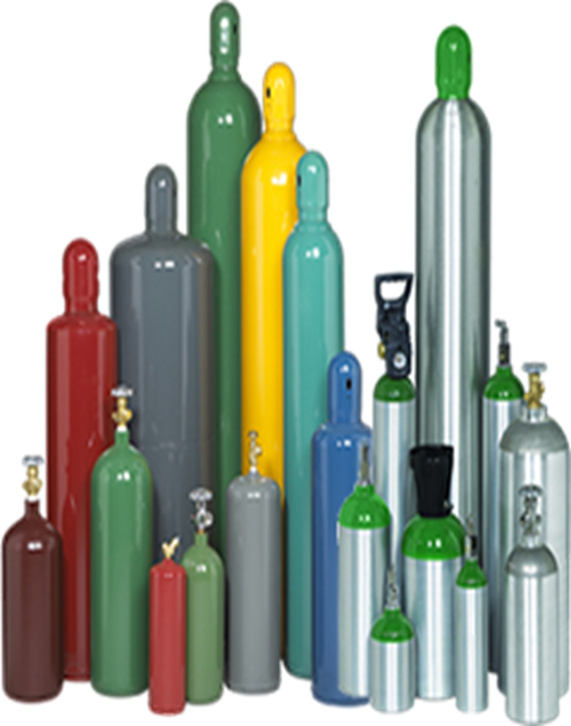

Questions
refaat.shafkey@dot.gov
Ph: 571.837.0005

Slide 25
Pressure Vessels Updates
Kenneth Clark
Pressure Vessels
PHH-25
Notes:
Renewal applications shall be submitted at least 60 days prior to the expiration date listed on the original approval to approvals@dot.gov. If a complete and conforming renewal application is received pursuant to 49 CFR, Parts 450-453 under the provisions of 49 CFR § 107.705 at least 60 days prior to the expiration date, the approval will remain valid and will not expire until final administrative action on the application for renewal has been taken by PHMSA.

Slide 26
Pressure Vessels Updates
Competent Authority Approval
  Addition of Chemical Analysis
  2 ½ -year Conditional Approval Policy
  Addition Manufacturer and IIA approval numbers added to Competent Authority Approval letters
Requalification (RIN) Approvals
    Special Permit is corresponding with the RIN Test Method and approved cylinder specification(s).
    Expired Special Permits
Notes:
Renewal applications shall be submitted at least 60 days prior to the expiration date listed on the original approval to approvals@dot.gov. If a complete and conforming renewal application is received pursuant to 49 CFR, Parts 450-453 under the provisions of 49 CFR § 107.705 at least 60 days prior to the expiration date, the approval will remain valid and will not expire until final administrative action on the application for renewal has been taken by PHMSA.

Slide 27
Pressure Vessels Updates
Competent Authority Approval Update
  Chemical Analysis will be added to the Competent Authority Approval.
    (49 CFR section 107.807)
Notes:
There will be updates

Slide 28
Pressure Vessels Updates
CA Approval Sample
Notes:
Revising current provisions in accordance with new 49 CFR Regulations
Adding new provisions to incorporate new policies
Eliminating outdated provisions for accuracy

Slide 29
Pressure Vessels Updates
Conditional Approval
  2 ½ -year Conditional Approval
    PHMSA’s policy is that no new designs will be issued to a cylinder manufacturing facility while on a 2 ½ -year conditional approval.
    An on-site fitness inspection must be conducted prior to the addition of any new designs not originally authorized to manufacturer.
    New cylinder designs will be added to full term 5-year CA Approvals. (Completion of On-Site)
Notes:
Conditional Approvals were issued 2 ½ year approvals to give PHMSA time to go and perform onsite inspections and allow the industry to safely continue production until an onsite inspection is scheduled.
While operating on a Conditional Approval or Timely filing letter, you cannot add additional cylinder designs until PHMSA has complete their review and/or inspection.

Slide 30
Pressure Vessels Updates
Manufacturer and IIA CA Approval
  Manufacturer’s CA Approval will now contain their IIA’s CA Approval Number.
  IIA’s Approval will also contain the Manufacturer they are contracted to CA Approval Number.
Notes:
Pressure Vessels branch will work with Technical and Field Operations staff to complete renewal process
PHMSA currently developing an action plan to ensure timely renewals of all IIA applications
Ensure application package is complete to avoid any delays in the process (IAW 49 CFR 107.705 & 107.803)

Slide 31
Pressure Vessels Updates
Manufacturer and IIA CA Approval
Example of Manufacturer’s CA Letter
5. PERIOD OF VALIDITY AND CONDITIONS OF APPROVAL: This approval does not provide relief from any requirements of the Hazardous Materials Regulations except as stated herein. This approval is valid until the posted expiration date or until terminated by the Associate Administrator for Hazardous Materials Safety.
a. Approved Authority: The holder of this approval is
authorized to Manufacture and Mark the following DOT & UN
ISO specification cylinders under the supervision of an
independent inspection agency approved for that purpose in accordance with 49 CFR §107.803.
DOT Cylinders - Manufactured in accordance with §§ 178.35
Only designs on file with the department may be manufactured and marked under the terms of this approval.
b. Approved Independent Inspector (IIA): Only the following IIA is currently authorized to conduct onsite inspections at your manufacturing facility:
Independent Inspection Agency,(CA2024000000)
Washington, DC

Slide 32
Pressure Vessels Updates
Requalification Updates
Special Permits Addition
Special Permits are equivalent to RIN’s Test Methods.
Special Permits that are being requested are in accordance with the approved Cylinder Specifications.
Special Permits are current.
Questions relating to Special Permits: specialpermits@dot.gov

Slide 33

Questions

Slide 34
“Thank You”

