Slide 1

Pipeline & Hazardous Materials Safety Administration:
Hazardous Materials Emergency Preparedness (HMEP) Grant
Continuing Application Webinar
States & Territories
February 1, 2024

Slide 2

Agenda
PHMSA Introduction and Overview
Tentative deadlines
Developing the Continuing Application
  Project Narrative
  Budget SF-424A form & Budget Narrative
Questions/Comments
Contact Information
Notes:
The presenter should provide detailed information in presenter notes

Slide 3
PHMSA Hazmat Grants Team
Director
Aaron Mitchell
Chief
Carla Sheppard
Senior Grants Management Specialist
Flor Valencia
Grants Management Specialists
Bonita Brown, Lisa Reichenbacher, Suezett Edwards and Andre White
Program Support
Shamia Nixon – Administrative Assistant
Emma Salinas- Program Analyst
Mahelia Whittier – Business Analyst
Notes:
6x6 rule: each of your six lines or bullets should have no more than six words. You don't need to use complete sentences and can minimize your use of pronouns, connective words and prepositions.
Slides per minute rule: A good rule of thumb for total number of slides is to have no more than one slide per minute of presentation time. Thus, for your pre-defense, you should try to limit your total number of slides.

Slide 4
Tentative Deadlines
February 1 – April 1, 2024: Year 3 Continuing application submissions.
April – May 2024: Continuing application review by PHMSA.
August 2024 (tentative): Modified Notice of Grant Agreement (NGA) issued. Period of performance is 10/01/2022 – 09/30/2025.
Any questions concerning your application should be submitted to hmep.grants@dot.gov.
Notes:
6x6 rule: each of your six lines or bullets should have no more than six words. You don't need to use complete sentences and can minimize your use of pronouns, connective words and prepositions.
Slides per minute rule: A good rule of thumb for total number of slides is to have no more than one slide per minute of presentation time. Thus, for your pre-defense, you should try to limit your total number of slides.

Slide 5

HMEP Grant:
Continuing Application Information
Notes:
This slide should always be blue

Slide 6
Continuing Application Form Items
  Standard Form:
    Budget Information (SF-424A)
Application Forms:
  Project Narrative
  Budget Narrative
  Indirect Cost Agreement (if applicable)
  HMEP Sample Application : OMB Form 424A (dot.gov)
No certification forms, Governor’s letters, statements, etc., are required. This was done in Year 1 and considered valid for the entire project period unless applicant provides notification of a change.
Notes:
The presenter should provide detailed information in presenter notes

Slide 7
Completing Project Narrative (Sections: A & C)
Notes:
This slide should always be blue

Slide 8
Project Narrative Overview
Part A: Project narrative includes Grantee Information
  1. Designated Agency (Name, address and web page)
  2. Contact Information:
    Authorized Representative (signs your agency Notice of Grant Award).
    Program Manager (is responsible for completing your agency Performance progress reports, submits activity request and provides programmatic activities status for your agency).
    Finance Program Manager or Equivalent (is responsible for completing your agency SF425 form (Federal Financial Report), SF424A form, submits DELPHI drawdown and provides financial update status for your agency).
    Other Point of Contact for Grant (Anyone else who works on the HMEP grant you deem necessary to be included in HMEP distribution emails).
Notes:
The presenter should provide detailed information in presenter notes

Slide 9
Project Narrative Overview
Part A: Project narrative includes Grantee Information
3. Organizational Information:
Provide information about your organization. This should include:
  Organization Mission
  Organizational Structure
  Organization experience and capacity to manage Federal grant programs.
  If you are a new designated agency for the HMEP grant you must complete this section.
Notes:
The presenter should provide detailed information in presenter notes

Slide 10
Project Narrative Overview
Part C: Statement of work:
Provide information for each sub-grant, contract or agreement. This includes:
  Needs Assessment that indicates the HMEP planning and training needs.
  If there are no updates/changes to the Needs Assessment indicate this by entering “no changes” in the section.
  Goals & Objectives
  If there are no updates/changes to the Goals and Objectives indicate this by entering “no changes” in the section.
Notes:
The presenter should provide detailed information in presenter notes

Slide 11
Part C: Needs Assessment
A clear and well-supported statement that identifies and addresses instances where needs are or not met.
DESIRED PROGRAM - ACTUAL PROGRAM = PROGRAM NEED
It’s important to differentiate between program needs and program wants.
  Note: If you have previously included all activities covering the entire 3-year performance period in your year1 application and there are no changes, please annotate “no changes” in this section.
Notes:
6x6 rule: each of your six lines or bullets should have no more than six words. You don't need to use complete sentences and can minimize your use of pronouns, connective words and prepositions.
Slides per minute rule: A good rule of thumb for total number of slides is to have no more than one slide per minute of presentation time. Thus, for your pre-defense, you should try to limit your total number of slides.

Slide 12
Activities Supporting Program Goals
    Planning activities fall under section 303 of the Emergency Planning and Community Right-To-Know Act (EPCRA), e.g., commodity flow studies, hazard risk analyses, emergency plans to be written, emergency plans to be updated, and emergency plans to be exercised.
    Training activities fall under the NFPA 472 core competencies or OSHA 29 CFR § 1910.120(q). Provide training type, training activity description, number of courses to be held, and the projected number of individuals to be trained.
    Note: If you have previously included all activities covering the entire 3-year performance period in your year1 application and there are no changes, please annotate “no changes” in this section.
Notes:
6x6 rule: each of your six lines or bullets should have no more than six words. You don't need to use complete sentences and can minimize your use of pronouns, connective words and prepositions.
Slides per minute rule: A good rule of thumb for total number of slides is to have no more than one slide per minute of presentation time. Thus, for your pre-defense, you should try to limit your total number of slides.

Slide 13

Part C:Activities Supporting Program Goals
Part C: Statement of work:
  All activities must be allowable, allocable, reasonable, and necessary (2 CFR 200).
  Grantee should complete the Activity Information and Sub-Grantee Activity Information table.
    Do not leave blank.
    Do not skip over.
    If it does not apply insert, N/A.
  HMEP Sample Application : OMB Form 424A (dot.gov)
  HMEP Grant Guide
Notes:
The presenter should provide detailed information in presenter notes

Slide 14

Project Narrative Reminders (Part 1)
  The HMEP Grant Guide provides direct examples of allowable, generally unallowable, and conditionally allowable activities. These examples are for reference only. HMEP Grant Guide
  No more than 25% of the grant can fund maintenance and administration costs (M&A).
  Grantees are highly encouraged to include sub-grantee information in the grant application. However, if not included, grantees will be required to submit an activity request form.
Notes:
6x6 rule: each of your six lines or bullets should have no more than six words. You don't need to use complete sentences and can minimize your use of pronouns, connective words and prepositions.
Slides per minute rule: A good rule of thumb for total number of slides is to have no more than one slide per minute of presentation time. Thus, for your pre-defense, you should try to limit your total number of slides.

Slide 15

Project Narrative Reminders (Part 2)
  Ensure grantee and sub-grantee activity information grid is complete with a brief synopsis under the description column. If a section is not applicable, please indicate N/A.
  If there are multiple activity requests post-award, an updated application may be required.
  Reminder: If you have previously included all activities covering the entire 3-year performance period and there are no changes, please annotate “no changes” in this section.
Notes:
6x6 rule: each of your six lines or bullets should have no more than six words. You don't need to use complete sentences and can minimize your use of pronouns, connective words and prepositions.
Slides per minute rule: A good rule of thumb for total number of slides is to have no more than one slide per minute of presentation time. Thus, for your pre-defense, you should try to limit your total number of slides.

Slide 16
Completing the Budget and Budget Narrative
Notes:
This slide should always be blue

Slide 17
Completing the Budget and Budget Narrative
This section provides step by step instructions on how to correctly complete sections A through F within the budget SF-424A form and application budget narrative overview information.
HMEP Sample Application : OMB Form 424A (dot.gov)
Notes:
The presenter should provide detailed information in presenter notes

Slide 18
Budget Narrative Overview
Applicants must include a budget (SF424A form) and budget narrative as a part of the continuing grant application. The budget and budget narrative provide cost detail on activities and projected purchases listed in the project narrative.
  The budget provides an overview of costs organized by object class category.
  The budget narrative explains costs in detail and how they are calculated.
Together, the budget and budget narrative provide a forecast of expenditures to measure against the applicant’s actual financial operations.
Notes:
6x6 rule: each of your six lines or bullets should have no more than six words. You don't need to use complete sentences and can minimize your use of pronouns, connective words and prepositions.
Slides per minute rule: A good rule of thumb for total number of slides is to have no more than one slide per minute of presentation time. Thus, for your pre-defense, you should try to limit your total number of slides.

Slide 19
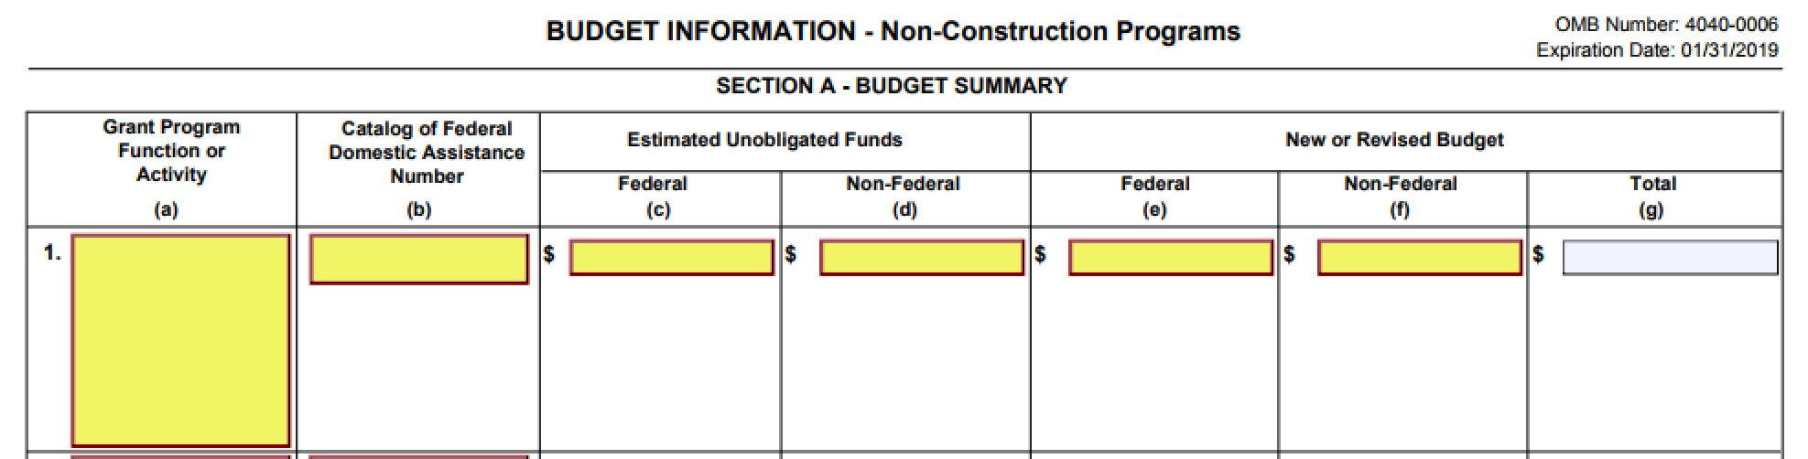


SF-424A form: Section A
HMEP Year 3 Continuing Application
Enter the Year-3 (FY24) Federal and Non-Federal amounts in their respective columns under the New or Revised Budget heading. Column G will calculate the total automatically.
Notes:
If you are using the SF-424A provided by us
See the Year 2 allocation email sent last week.

Slide 20
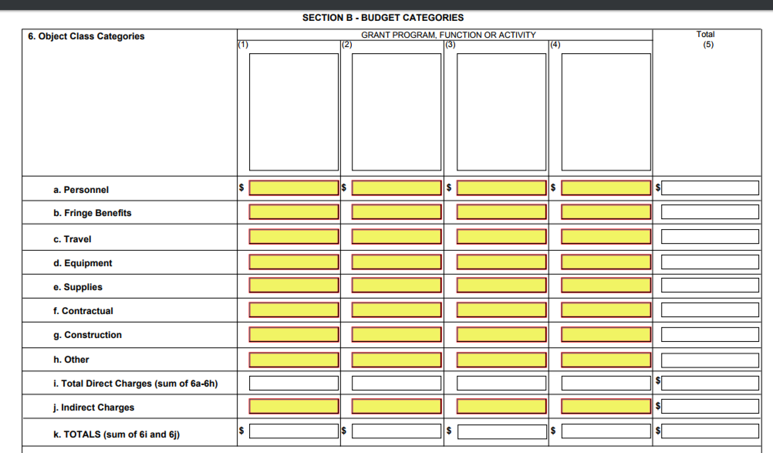
SF-424A form: Section B
Enter federal costs only in column (1).
If identifying cost share amounts, enter in column (2).
HMEP Year 3 Continuing Application
Match/Cost Share

Slide 21
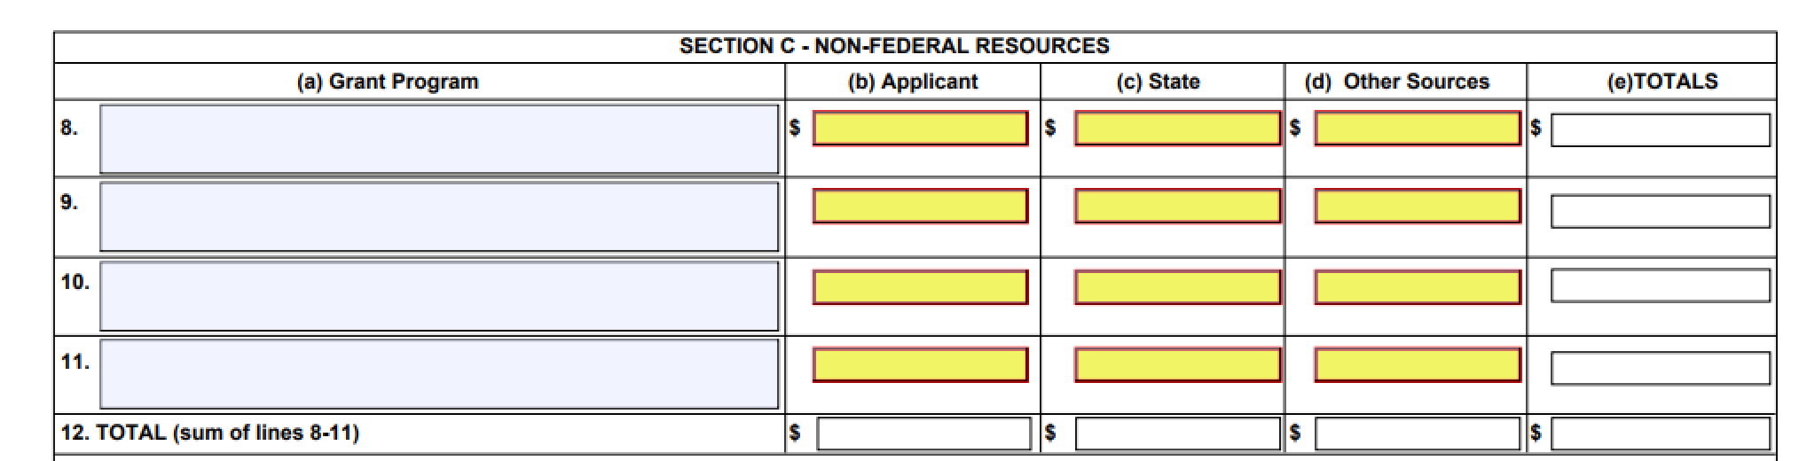
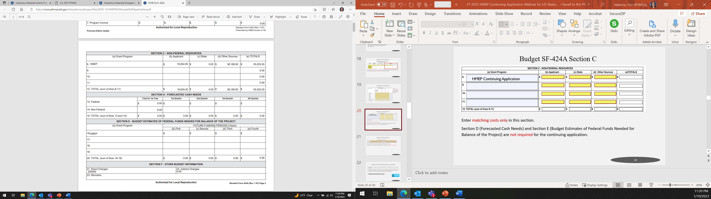
SF-424A form: Section C, D & E
Section C:
Enter cost share only in this section.
Sections D and E: Are not required for the continuing application.
HMEP Year 3 Continuing Application

Slide 22
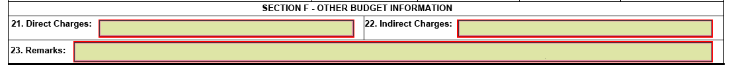
SF-424A form: Section F
Section F includes the grand total of the budget for direct and indirect charges. Cost share should not be included in the total for direct charges.
If claiming Indirect Costs, fill out Indirect Charges section and attach the Indirect Cost Rate Agreement.

Slide 23
Application Budget Narrative Line Items
Notes:
This slide should always be blue

Slide 24
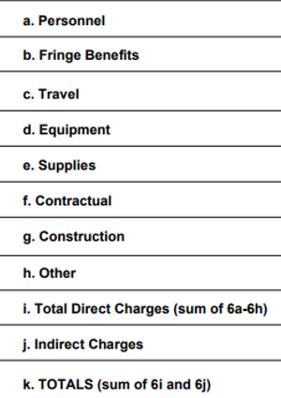
Application Budget Narrative Line Items
This section provides the definition as well as tips for correctly filling out each line item in your application budget narrative (Section D).
HMEP Sample Application : OMB Form 424A (dot.gov)
Notes:
6x6 rule: each of your six lines or bullets should have no more than six words. You don't need to use complete sentences and can minimize your use of pronouns, connective words and prepositions.
Slides per minute rule: A good rule of thumb for total number of slides is to have no more than one slide per minute of presentation time. Thus, for your pre-defense, you should try to limit your total number of slides.

Slide 25

Application Budget Narrative:
Personnel Costs (2 CFR 200.430) Part 1
This line item refers to the cost of wages and salaries paid to employees of the applicant who are directly involved in grant implementation. Generally, personnel are issued a W-2 by the applicant.

Slide 26
Application Budget Narrative:
Personnel Costs (2 CFR 200.430) Part 2
Utilize the budget narrative to give the position title, position description, employee status (full or part-time), hourly wage or salary, percentage of time dedicated to the grant, and total cost to the grant.
Show your computational work and any assumptions made.
Consultant or sub-grantee costs should not be included.

Slide 27
Application Budget Narrative:
Fringe Benefits (2 CFR 200.431) Part 1
This line item refers to the cost of benefits paid to personnel as compensation in addition to their regular salaries and wages, including the cost of the applicant’s share of FICA, health insurance, workers’ compensation, and vacation.

Slide 28
Application Budget Narrative:
Fringe Benefits (2 CFR 200.431) Part 2
Utilize the budget narrative to include a description of specific benefits charged to the project and at what percentage. Fringe benefits are only allowable for the percentage of time devoted to the grant.
Please show your computational work and any assumptions made.
While personnel should have a corresponding fringe cost (and vice versa), personnel and fringe costs must be separated into their respective line-item categories. Please do not combine these costs together.

Slide 29

Application Budget Narrative:
Travel (2 CFR 200.474) Part 1
This line item refers to the travel costs of personnel that are reasonable and necessary to effectively manage and carry out grant activities, provide oversight, and measure program effectiveness.

Slide 30
Application Budget Narrative:
Travel (2 CFR 200.474) Part 2
Utilize the budget narrative to explain travel costs. Include the travel purpose, method of travel, number of people traveling, the number of days, and an estimated cost for each trip. Please provide an explanation of what activities the travel will cover.
Show your computational work and any assumptions made. Estimates are acceptable if you provide a basis for determining the estimated amount requested.

Slide 31
Application Budget Narrative: Equipment (2 CFR 200.439) Part 1
This line item refers to non-expendable personal property having a useful life of three or more years and a per-unit cost of $5,000 or more per unit.

Slide 32
Application Budget Narrative: Equipment (2 CFR 200.439) Part 2
Utilize the budget narrative to include a description, quantity, and per-unit price for all equipment and how the equipment will be used on grant activities.
Show your computational work and any assumptions made.
If the expense is under the usual threshold of $5,000 per item, it belongs under supplies. However, if the applicant’s equipment threshold is below $5,000, please utilize the budget narrative to provide an explanation and state the policy citation.

Slide 33

Application Budget Narrative:
Supplies (2 CFR 200.453) Part 1
This line item refers to tangible materials costing less than $5,000 per unit, such as copy paper, pens and pencils, and computers.

Slide 34
Application Budget Narrative:
Supplies (2 CFR 200.453) Part 2
Please utilize the budget narrative to provide the quantity and per-unit cost for supplies and how the supplies will be used on grant activities.
Please show your computational work and any assumptions made.
The costs for supplies should be reasonable and PHMSA will consider past requests that appear to be similar, such as laptops.

Slide 35

Application Budget Narrative: Contractual (2 CFR 200.330) Part 1
This line item refers to the cost of any contract agreement.
Notes:
Follow state and federal (2 CFR 200) procurement requirements…

Slide 36
Application Budget Narrative: Contractual (2 CFR 200.330) Part 2
A contract is a legal instrument implemented by grant recipients to purchase property or acquire services usually in order to carry out a project. The property or services acquired are not directly involved in programmatic activities.
Utilize the budget narrative to identify your contracts and explain how costs were derived for each.
Show your computational work, any assumptions made, and how each contract relates to grant activities.
Notes:
Follow state and federal (2 CFR 200) procurement requirements…

Slide 37
Application Budget Narrative:
Other -Part 1
This line item refers to direct costs that do not fit any of the aforementioned categories, such as sub-awards, rent for buildings used to conduct grant activities, utilities, leased equipment, childcare, transportation expenses, employee training, tuition, etc.
Backfill, overtime, and volunteers' stipends should be identified under the Other line-item.
Notes:
If this is the case, when your agency procurement policy requires you to treat sub-recipients as sub-grants, please denote this in your budget narrative.
At PHMSA we request that any sub-award costs are provided under the Other line-item, unless you’re agency’s procurement policy specifically/explicitly requests sub-awards be categorized as sub-contracts.

Slide 38
Application Budget Narrative:
Other- Part 2
For sub-award, please follow your agency’s procurement policy when it comes to classifying sub-grantees as contractual or “other” costs.
At PHMSA we request that any sub-award costs are provided under the Other line-item, unless your agency’s procurement policy categorizes sub-awards as sub-contracts.
Utilize the budget narrative to itemize “other” direct costs and provide a reasonable explanation.
Show your computational work, any assumptions made, and how “other” direct costs relate to grant activities.
Notes:
If this is the case, when your agency procurement policy requires you to treat sub-recipients as sub-grants, please denote this in your budget narrative.
At PHMSA we request that any sub-award costs are provided under the Other line-item, unless you’re agency’s procurement policy specifically/explicitly requests sub-awards be categorized as sub-contracts.

Slide 39

Application Budget Narrative:
Indirect Costs
(2 CFR 200.414) &(2 CFR 200.416) Part 1
This line item refers to costs incurred for common or joint objectives that benefit more than one project.

Slide 40
Application Budget Narrative:
Indirect Costs
(2 CFR 200.414) &(2 CFR 200.416)Part 2
If the applicant has a current and fully executed indirect cost rate, a copy of the indirect cost agreement signed by the cognizant Federal agency must be included with the application.
If the indirect cost rate agreement is in the renewal process and will not be approved by the continuing application due date, attach the letter of renewal or letter of request sent to your cognizant agency.

Slide 41
Application Budget Narrative: Matching (2 CFR 200.306) Part 1
This line item refers to costs not paid by Federal funds. This amount is 20% for HMEP grants).
On the SF-424A line-item budget, please ensure to enter the match in Section A and Section C.

Slide 42
Application Budget Narrative:
Matching (2 CFR 200.306) Part 2
Cost Sharing/Matching
Cost sharing or matching is the portion of project costs not paid by Federal funds. For planning and training grants, this amount is 20%, if applicable. On the 424A budget, enter match in Section A and C. Match must be fully described in the budget narrative in a clearly marked section for match. Explain the amount and how it will be met in the same manner you would for a federal share cost item. You can do a soft or a hard (cash) match. | HMEP grant grant award. Match can be calculated by using the federal share (award) divided by the percentage of Total Project Cost minus federal share. Match can also be calculated by multiplying Federal share by 25%. Example: With a match of 20%, and federal share of 80%, a $250,000 federal share: • $250,000 divided by 80% = $312,500 •$312,500 minus $250,000 = $62,500 •The 20% cost share is $62,500.
 | Example: $25,000 of Federal share request: $25,000 * 25% =$62,500 match required

Slide 43
Application Budget Narrative: Matching (2 CFR 200.306) Part 2
Utilize the budget narrative to clearly explain how matching costs will be met.
Identify the type of match (i.e. soft, in-kind, cash, or combination match).
Matching should be described in the same level of detail as Federal dollars, including a breakdown by object class category.
Show your computational work and any assumptions made.

Slide 44
Budget SF-424A form & Application Budget Narrative Common Errors
SF-424A Section B: Federal and Non-Federal are listed and often combined. Remember to identify Federal funds in column (1) and nonfederal in column (2) in this section of the SF-424A.
Applicant will identify indirect cost on SF-424A and budget narrative but does not submit a valid indirect cost rate agreement.
No detail information provided on how the applicant will meet the match requirement. Remember to identify how the match will be met (in-kind, soft match, cash/hard match) and where the match will come from. (i.e. personnel, participant time spent in training).
Notes:
6x6 rule: each of your six lines or bullets should have no more than six words. You don't need to use complete sentences and can minimize your use of pronouns, connective words and prepositions.
Slides per minute rule: A good rule of thumb for total number of slides is to have no more than one slide per minute of presentation time. Thus, for your pre-defense, you should try to limit your total number of slides.

Slide 45

Budget SF-424A form & Application Budget Narrative Reminders
SF-424A line items should have a corresponding explanation in the budget narrative as to how it was calculated.
The applicant must explain how they will meet the 20% matching contribution in the budget narrative.
The applicant must submit an Indirect Cost Rate Agreement (ICRA) if claiming indirect costs. If the ICRA has expired, please reach out to your cognizant agency to establish an updated rate.
Notes:
6x6 rule: each of your six lines or bullets should have no more than six words. You don't need to use complete sentences and can minimize your use of pronouns, connective words and prepositions.
Slides per minute rule: A good rule of thumb for total number of slides is to have no more than one slide per minute of presentation time. Thus, for your pre-defense, you should try to limit your total number of slides.

Slide 46



Slide 47

Hazmat Grant Program Contact Information:
General Inquiries E-mail: HMEP.Grants@dot.gov
General Inquiries Telephone number: 202-366-1109
Hazardous Materials Grants Program Website: http://www.phmsa.dot.gov/hazmat/grants
HMEP Resources: https://www.phmsa.dot.gov/grants/hazmat/hmep-resources
Notes:
The presenter should provide detailed information in presenter notes

Slide 48
FAQs: Part 1:
Will an HMEP conference be held in early fall that we need to budget for?
  The Hazmat Grant Conference will take place in early September 2024. We will provide more information as we solidify the exact dates and location.
Will the webinar presentation be available for download?
  Yes. The webinar presentation will be available on the PHMSA hazmat grant website.
Notes:
The presenter should provide detailed information in presenter notes

Slide 49
FAQs: Part 2:
Any restrictions on operable second hand or used equipment purchases?
Purchase of operable second hand or used equipment is allowable as long as the equipment viable life cycle. The equipment must have at least five years or more in its life cycle.
Is there a new link on the PHMSA website to submit Activity Requests that support the new UEI number vs the outdated DUNS number?
  The website for Activity Request (AR) has not been updated to show the new UEI requirement. We are working with our IT department to make updates to the site. If you are submitting an AR, enter the UEI number in the DUNS box.
  AR are currently being submitted through the HMEP mailbox.
Notes:
The presenter should provide detailed information in presenter notes

Slide 50
FAQs: Part 3:
On the allocation email it is said that you use Census, incident frequency, and average cost of incident by transport mode. Where do you get the number of incidents from?
The Hazardous Materials Regulations (HMR) require certain types of hazmat incidents be reported to PHMSA via an incident report form 5800.1. PHMSA collects the information into our system. PHMSA grants program uses this information as part of the allocation formula. For more information on PHMSA’s incident reporting click this link Incident Reporting | PHMSA (dot.gov).
Can we put funding for CUPA conference, a regional Hazmat Response plan contract and Continuing Challenge funding as contractual in the budget and budget narrative?
Grantees should follow their agency/state procurement policy. If your policy dictates that these are considered contract, then you would provide the information on them under contractual.
Notes:
The presenter should provide detailed information in presenter notes

