Slide 1


PHMSA Field Operations
Presented by Investigator Joe Vega

Slide 2
Disclaimer: These slides are
informational and reference generalities, not strict practices or policies.
Notes:
This slide should always be blue

Slide 3
Overview
PHMSA Office of Hazardous Materials Safety (OHMS) Field Operations Overview
PHMSA Site Visits
Trends
Takeaways
Notes:
The presenter should provide detailed information in presenter notes
xxx

Slide 4


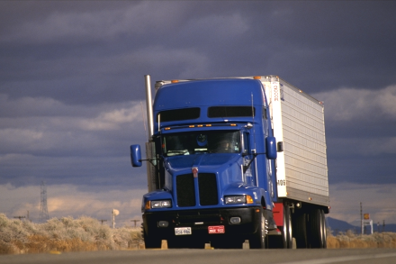

Our Mission
PHMSA's mission is to protect people and the environment by advancing the safe transportation of energy and other hazardous materials that are essential to our daily lives.
4
Notes:
The presenter should provide detailed information in presenter notes
xxx

Slide 5
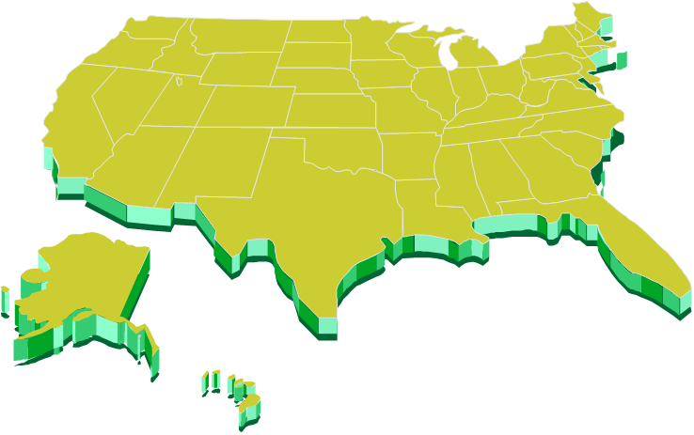
Hazmat Shipments
1 million daily shipments
1.6 billion tons shipped annually by all modes
Notes:
6x6 rule: each of your six lines or bullets should have no more than six words. You don't need to use complete sentences and can minimize your use of pronouns, connective words and prepositions.
Slides per minute rule: A good rule of thumb for total number of slides is to have no more than one slide per minute of presentation time. Thus, for your pre-defense, you should try to limit your total number of slides.

Slide 6
PHMSA OHMS Field Operations
Promote the safe and secure shipment of hazardous materials in transportation
Activities Include:
Compliance Inspections/Investigations
Incident Investigations
Fitness Reviews
Outreach and Training Activities

Slide 7



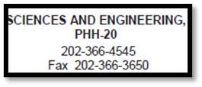
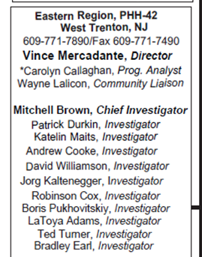
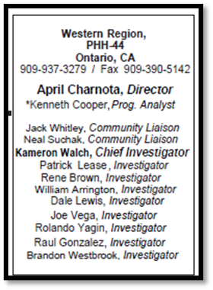
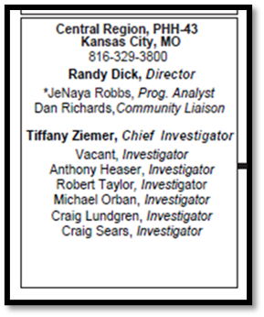
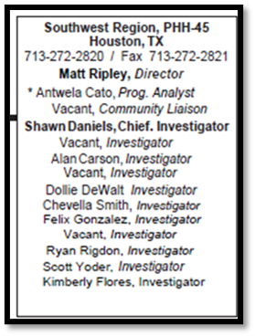
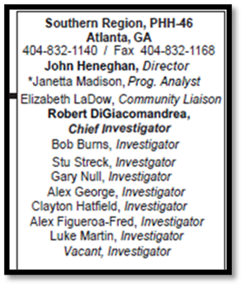
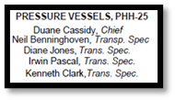
PHMSA OHMS (truncated)

Slide 8
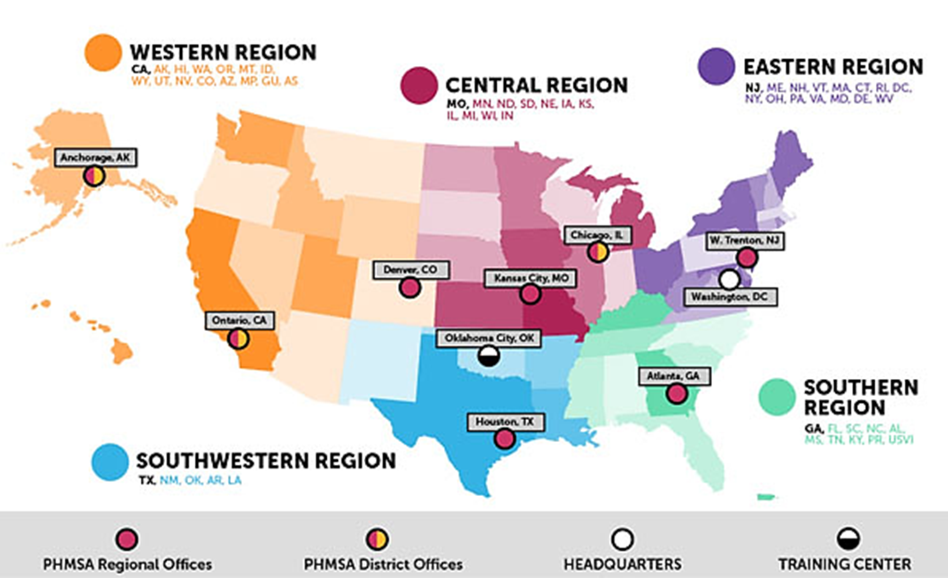
Regional Offices

Slide 9
What does PHMSA regulate?
Shippers/Carriers
  Class 1-9
  Waste
Package Certifiers
Freight Forwarders
Third-Party Labs
Special Permit Holders
Independent Inspection Agencies
Designated Approval Agencies
Aerosol Fillers/Shippers
Agriculture Industry
  Nurse Tanks
Packaging Manufacturers, Testers, & Retesters
  Drums, IBCs, Pressure Vessels (Cylinders, Portable Tanks), Boxes, etc…
Distributors/Brokers
Cylinder Requalifiers
High Hazard Entities

Slide 10
Site Visit Differences
Inspection/Investigation
General operations
Initiated by PHMSA (Random or targeted)
Unannounced
Enforcement actions (WL, TKT, ENF)
Fitness Review
Attaining or maintaining approval
Response to application
Scheduled
Fitness Recommendation (FIT/UNFIT)
Notes:
6x6 rule: each of your six lines or bullets should have no more than six words. You don't need to use complete sentences and can minimize your use of pronouns, connective words and prepositions.
Slides per minute rule: A good rule of thumb for total number of slides is to have no more than one slide per minute of presentation time. Thus, for your pre-defense, you should try to limit your total number of slides.

Slide 11
Site Visit Process
Entrance Briefing
Walkthrough
  Facility and testing procedures
Documentation Review
Exit Briefing
Goal: Understand on-site operations to compare to HMR, Approvals, and Special Permits
Notes:
The presenter should provide detailed information in presenter notes

Slide 12
Entrance Briefing
Introduction
General info gathering
What types of tests are conducted?
How often?
Size of facility
Employees
Other regulated activities
Notes:
6x6 rule: each of your six lines or bullets should have no more than six words. You don't need to use complete sentences and can minimize your use of pronouns, connective words and prepositions.
Slides per minute rule: A good rule of thumb for total number of slides is to have no more than one slide per minute of presentation time. Thus, for your pre-defense, you should try to limit your total number of slides.

Slide 13
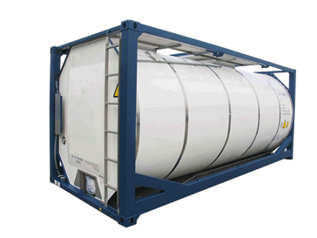
Facility Walkthrough
Testing locations
Interviews with testing personnel
Testing procedures
  Demonstration preferred
Equipment
Calibration demonstration
Containers on-site
Notes:
6x6 rule: each of your six lines or bullets should have no more than six words. You don't need to use complete sentences and can minimize your use of pronouns, connective words and prepositions.
Slides per minute rule: A good rule of thumb for total number of slides is to have no more than one slide per minute of presentation time. Thus, for your pre-defense, you should try to limit your total number of slides.

Slide 14

Documentation Review
Approvals and Special Permits
Standard Operating Procedures (SOP)
Calculations
Design Drawings
Test Reports
Calibration Records
Semi-Annual Reports
Training Records
Notes:
6x6 rule: each of your six lines or bullets should have no more than six words. You don't need to use complete sentences and can minimize your use of pronouns, connective words and prepositions.
Slides per minute rule: A good rule of thumb for total number of slides is to have no more than one slide per minute of presentation time. Thus, for your pre-defense, you should try to limit your total number of slides.

Slide 15
Exit Briefing
An informal notification of what was observed during the site visit or as a result of the documentation review
Not a “Final Report”
Note probable violations
Discuss corrective actions
Notes:
6x6 rule: each of your six lines or bullets should have no more than six words. You don't need to use complete sentences and can minimize your use of pronouns, connective words and prepositions.
Slides per minute rule: A good rule of thumb for total number of slides is to have no more than one slide per minute of presentation time. Thus, for your pre-defense, you should try to limit your total number of slides.

Slide 16
After the Exit Briefing
Report creation
  Obtain corrective action, as applicable
  Investigator compiles all information gathered along with the Exit Briefing
  Verify probable violations; add/remove period
Report review by Region Chief
Fitness recommendation (if applicable)
  Not final fitness determination
Notes:
6x6 rule: each of your six lines or bullets should have no more than six words. You don't need to use complete sentences and can minimize your use of pronouns, connective words and prepositions.
Slides per minute rule: A good rule of thumb for total number of slides is to have no more than one slide per minute of presentation time. Thus, for your pre-defense, you should try to limit your total number of slides.

Slide 17

Violation Trends
Administrative
  Incomplete training records
    Function-specific training (testing procedures, approvals, special permits)
    Records not maintained per 49 CFR 172.704(d)
  SOPs not corresponding to actual operations
    Not up-to-date with HMR and CA Approval
  Incomplete semi-annual reports
    Missing specification, special permit info, etc.
Notes:
The presenter should provide detailed information in presenter notes

Slide 18
Violation Trends
Technical
  Testing at incorrect pressures
    Different portable tanks may have different test pressures
  Using expired special permits
    Manufacture special permit
    Party status-grantee authorization
    Status
  Incorrect markings
    Data plate markings for modifications
Notes:
The presenter should provide detailed information in presenter notes

Slide 19
Overall Takeaways
Review HMR and CA Approval to current operations and records
Review uncommon procedures and tanks
  Requirements may be different from the usual
  View each specification packaging separately
Notes:
6x6 rule: each of your six lines or bullets should have no more than six words. You don't need to use complete sentences and can minimize your use of pronouns, connective words and prepositions.
Slides per minute rule: A good rule of thumb for total number of slides is to have no more than one slide per minute of presentation time. Thus, for your pre-defense, you should try to limit your total number of slides.

Slide 20
?
QUESTIONS

Slide 21
Thank you
WE Region
Joe Vega Investigator
Joe.vega@dot.gov
Notes:
My name again is ______________________________ and you can find my contact information on this slide. Beneath my email address you can find the states covered by my Regional Office.
All of my peers around the country are also listed here in case you find that your state is covered by another region. Please feel free to reach out to any one of us because – we are the corps group called the Hazardous Material Safety Action Team.
Our main objective is to help you understand the 49 CFR as it relates to the shipment of hazardous materials in transportation.
Thank you for listening to this presentation, we will now start the Q&A portion of this webinar. We have representatives from PHMSA and FMCSA ready to answer your questions. If you have any questions, please use the chat box to type your question or raise your hand using the hand icon in the bar on your screen and we will call on you to unmute and ask your question.
This Q&A session will last for 10 minutes. To make sure we get to everyone’s question, we will also provide time during lunch and after the last webinar at 430pm for questions that need more time answering. We will also have representatives available for side bar conversations.
With that said, I’ll turn it over to our facilitator today to ask or call on the first question.

