Slide 1
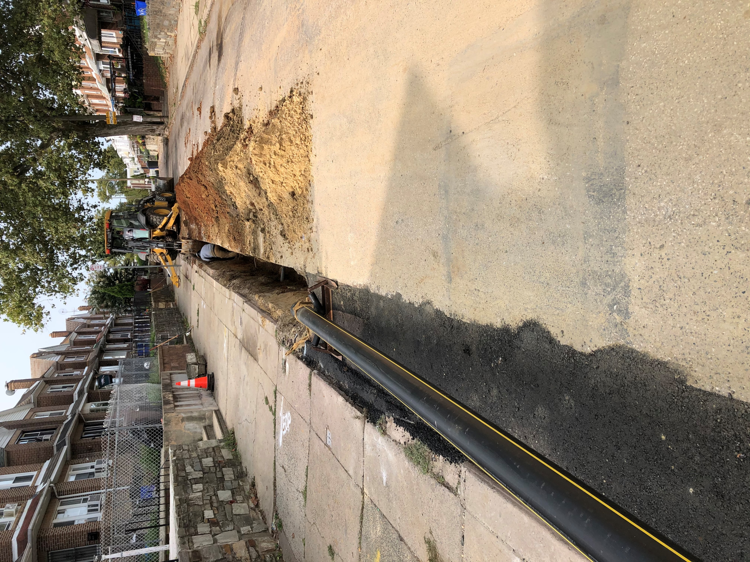
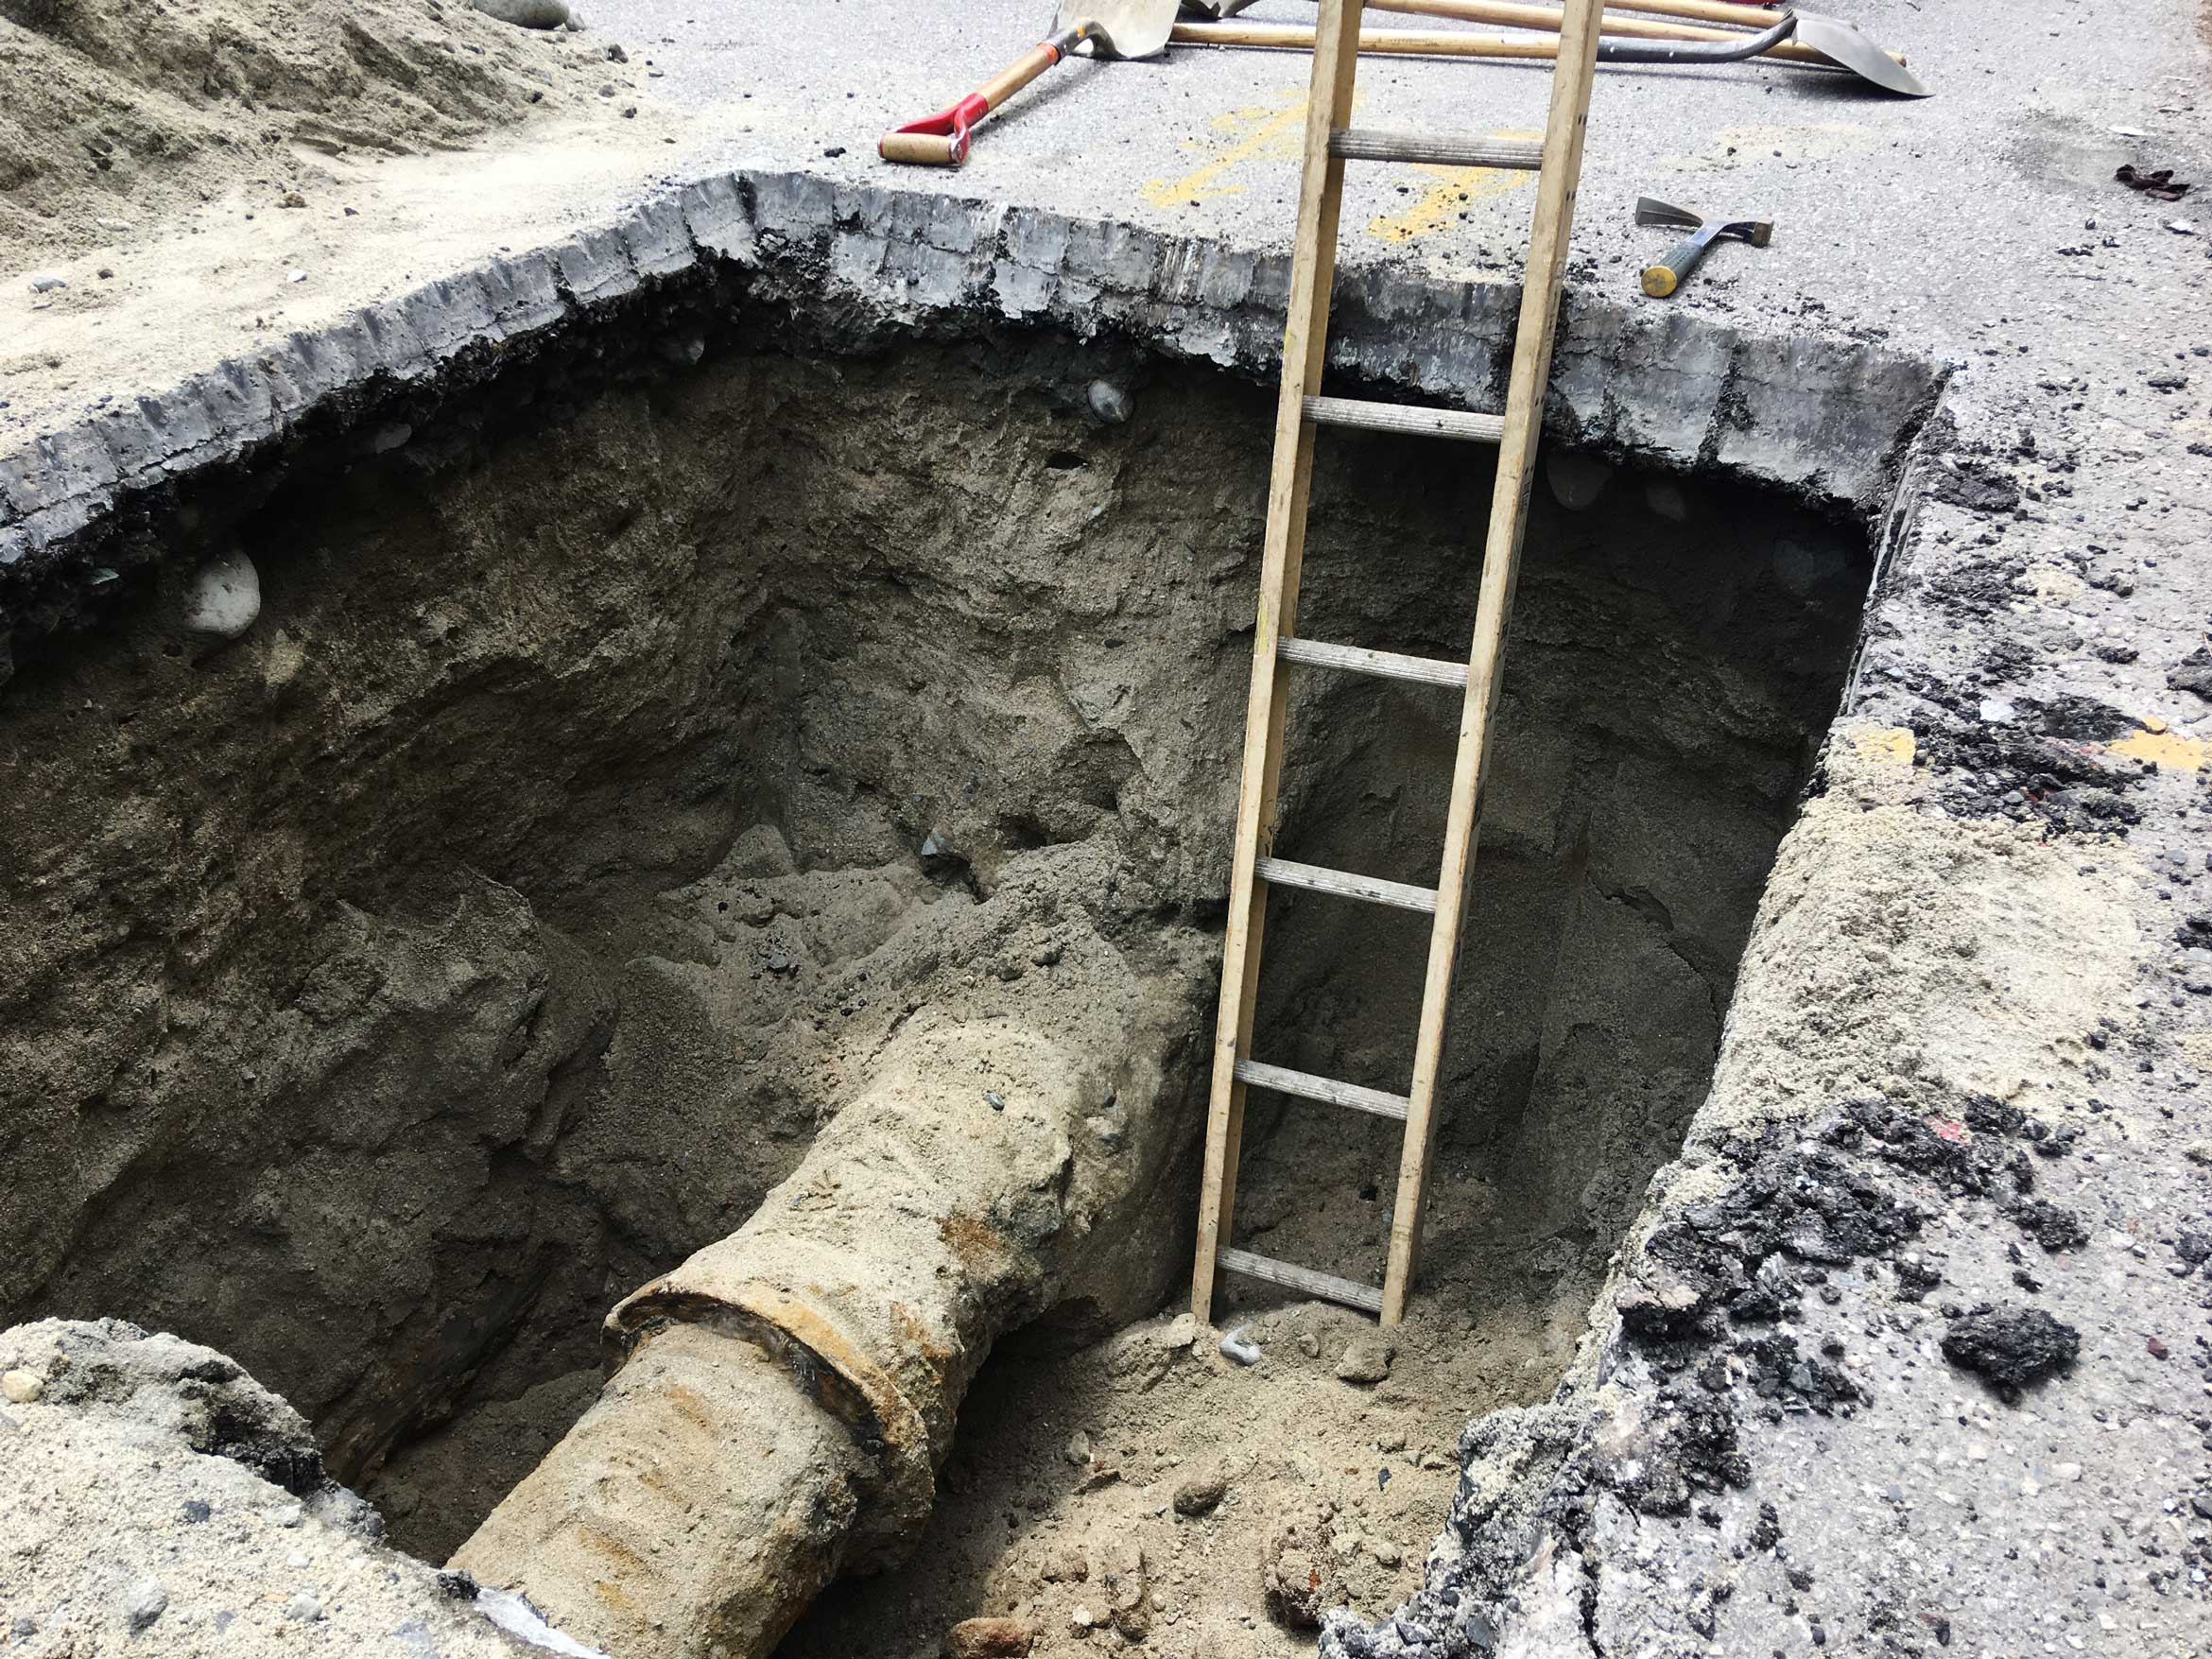
Pipeline and Hazardous Materials Safety Administration
Office of Pipeline Safety
Natural Gas Distribution Infrastructure Safety and Modernization (NGDISM) Grant Program
APGA Webinar May 31, 2022

Slide 2
Eligibility & Purpose
Eligibility: Available to a municipality or community owned utility (not including for-profit entities)
Purpose: To repair, rehabilitate, or replace gas distribution pipelines, or to acquire equipment to:
  1) Reduce incidents and fatalities and
  2) Avoid economic losses

Slide 3
Award Considerations
  PHMSA will prioritize projects that will: (1) reduce the risk of leakage, (2) help protect the environment, (3) create jobs, provide positive economic impact and growth, and (4) benefit disadvantaged rural and urban communities.
  Final award selections will consider the quality and number of applications received, and the dollar amounts requested.

Slide 4
Administration Priorities
Climate/Environmental Resilience: Project outcomes will protect our environment and reduce climate impacts by remediating aged and failing pipelines and pipe prone to leakage.
Providing Good-Paying Jobs: Jobs created through this grant program should aim to pay above the average labor rates in the respective locality.

Slide 5
Administration Priorities Continued
3. Disadvantaged Communities: (1) the project is in a location identified in the Transportation Disadvantaged Community tool; or (2) the project is located on Tribal land; or (3) the project is in any territory or possession of the United States.
4. Buy America: Commitment to maximize the use of goods, products, and materials produced in, and services offered in the United States.
5. Improving Cybersecurity for Critical Infrastructure Control Systems: Projects should aim to strengthen the security and resilience of the critical infrastructure against both physical and cyber threats.

Slide 6
Funding Available for FY 2022
$200 Million
Two percent of available funds will be utilized for PHMSA administrative costs
No single operator can receive more than 12.5 percent of the available funds

Slide 7
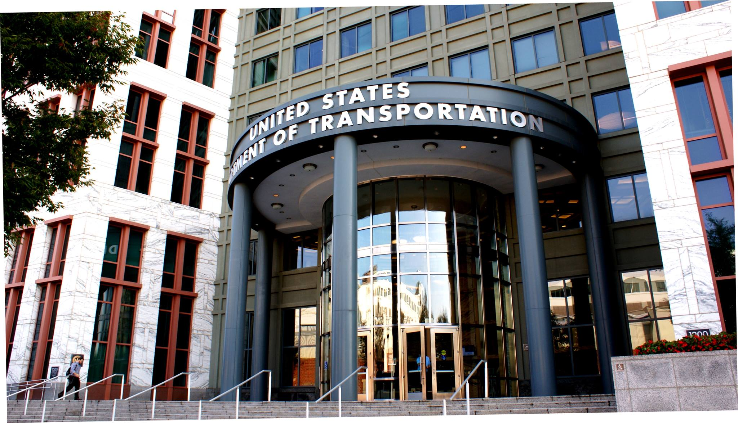
NOFO and Award Timeline
Notice of Funding Opportunity (NOFO) published on May 24, 2022.
NOFO and attachments are available on Grants.gov
Application Deadline: July 25, 2022
Awards must be made no later than 270 days after the NOFO is published (February 17, 2023).

Slide 8
PHMSA’s Ongoing Technical Assistance Commitment
PHMSA is committed to providing technical assistance to applicants throughout this grant application process. Below are some of the dedicated initiatives to help applicants.
Prompt updates to FAQ document on grants.gov and PHMSA’s NGDISM website.
Development of a Sample NGDISM Application that will be posted on grants.gov and PHMSA’s NGDISM website.
Direct technical assistance to applicants for the Environmental Review and Title VI/Environmental Justice process.

Slide 9
Applying for the NGDISM Grant

Slide 10
Applicant Responsibilities Prior to Applying
Unique Entity Identifier (UEI). New entities can get their Unique Entity ID at SAM.gov and, if required, complete an entity registration.
Grants.gov. For new users, go to http://www.grants.gov/ and select “Register.” New user registrations can take up to two weeks to be complete the approval process.
FedConnect. This is a PHMSA grants system that interfaces with grants.gov. Applicants must register with FedConnect at https://www.fedconnect.net for an account before submitting an application.

Slide 11
Application Steps
Register for a UEI number in SAM.gov
Create account in grants.gov
Create an account in FedConnect.net (PHMSA Grants System)
Complete all mandatory Standard Forms (SF):
  SF-424 Application for Federal Assistance
  SF-424C Budget Information for Construction Programs
  SF-424D – Assurances for Construction Program

Slide 12
Application Steps Continued
Upload Budget Narrative Attachment
Upload Project Narrative Attachment
Sign and upload Certification Regarding Lobbying Form
Sign and upload Standard Title VI/Non-Discrimination Assurances – Civil Rights Assurances
Submit application on grants.gov

Slide 13
Indirect Costs
Indirect costs are costs that are not readily chargeable to a particular program or function, but benefit all programs and functions operated by the non-Federal entity.
An example of an indirect cost might be the salary and related fringe benefits paid to the applicant’s accounting staff and/or the executive director. Generally, these kinds of costs are identified, pooled, and charged against individual programs or funding sources using a rate designed to recover the costs.
Applicants can use an existing Indirect Cost Rate Agreement (ICRA), negotiate an ICRA with PHMSA, or utilize the 10% de minimis rate.
Once elected, the 10 percent de minimis rate must be used consistently for all Federal awards received by the non-Federal entity.

Slide 14
Environmental Compliance Process

Slide 15
NEPA and Environmental Compliance
Nationwide Tier 1
PHMSA is currently preparing a Nationwide Tier 1 Environmental Assessment. This document will discuss the safety and environmental benefits and impacts of the grant program.
The Nationwide Tier 1 will also discuss the actions that project proponents (PPs) will be required to take to minimize environmental impacts and comply with environmental laws. PPs are applicants who are provisionally selected for awards.
PHMSA will announce the availability of the Tier 1 in the Federal Register and on the PHMSA grant website. Anyone can submit a comment on the Tier 1 in the Regulations.gov docket that will be provided. PHMSA will consider these comments in developing environmental requirements for PPs.

Slide 16
NEPA and Environmental Compliance
Tier 2- Site Specific Environmental Questionnaire
After a PP is provisionally selected for funding, PHMSA will provide the PP with the Tier 2 Environmental Questionnaire for completion.
The Tier 2 will solicit environmental information and detail mitigation actions that PPs must agree to perform during design and construction.
PHMSA will provide assistance to PPs with completion of the Tier 2 and environmental compliance.

Slide 17
NEPA and Environmental Compliance
Tier 2- Site Specific Environmental Questionnaire
As detailed in the NOFO, we expect that the Tier 2 will solicit the following site information from PPs:
  Project Description and Location (i.e., Maps)
  Property Changes based on design (i.e., amount and location of land to be cleared, excavated, or disturbed)
  Brownfields
  Water Resources
  Waterway Crossings, Wetlands, Floodplains, Coastal Zones
  Threatened and Endangered Species
  Historic Properties and Cultural Resources
  Environmental Justice data

Slide 18
NEPA and Environmental Compliance
Tier 2- Site Specific Environmental Questionnaire
PHMSA will help with any consultation with U.S. Fish and Wildlife, Army Corps of Engineers, State Historic Preservation Offices, etc., if needed.
Once PPs submit their completed Tier 2s to PHMSA, PHMSA may request further information/clarification, if needed.
Upon review of the completed Tier 2s, PHMSA will determine whether the project could result in unanticipated environmental impacts.
If there are no unanticipated impacts, NEPA and environmental compliance for that site is complete. PHMSA will add language to the completed Tier 2 making a Finding of No Significant Impact (FONSI).

Slide 19
NEPA and Environmental Compliance
Tier 2- Site Specific Environmental Questionnaire
For completed Tier 2s that indicate unanticipated environmental impacts, PHMSA will work with the PP to develop further mitigation actions or consultation with resource agencies.
PHMSA may solicit public comment on these additional mitigation actions.
PHMSA will review any comments, finalize additional mitigation actions, and if appropriate, make a FONSI.
If significant environmental impacts are anticipated and cannot be mitigated, PHMSA will evaluate whether to conduct further environmental review.

Slide 20
Budgeting for Environmental Compliance
Although PPs do not need to provide environmental information until after they are provisionally selected for funding, each PP should consider time and expense of environmental compliance actions in preparing their budget.
In estimating these costs, the PP should consider whether sensitive resources, as listed in Slide 17, exist on its site.
PHMSA anticipates that most projects will not require mitigation beyond what is describe in the Tier 2 document. PHMSA reminds PPs that it will provide assistance during this process when needed.

Slide 21
Resource Slides

Slide 22

Unique Entity ID (UEI) Video Walkthrough

Slide 23

Intro to Grants.gov - How to Register with Grants.gov

Slide 24

Learning Workspace - Completing Forms in a Grants.gov Workspace

Slide 25

Learning Workspace - Completing Forms in a Grants.gov Workspace

Slide 26
FedConnect Customer Service
Need help?
Check Registration Status
Password Reset
Contact Your Organization's FedConnect Administrator
Contact FedConnect Support
Email: fcsupport@unisonglobal.com
Phone 1-800-899-6665
(Monday – Friday, 8-8 EDT)

Slide 27
Contact Information
PHMSAPipelineBILGrant@dot.gov
202-366-7652
PHMSA will collect questions by email or phone and respond via grants.gov.

