Slide 1


Hazardous Materials Emergency Preparedness Grant Program Tribes
Grant Application Development Webinar for FY 2022
Performance Period: October 1, 2022 – September 30, 2023

Slide 2
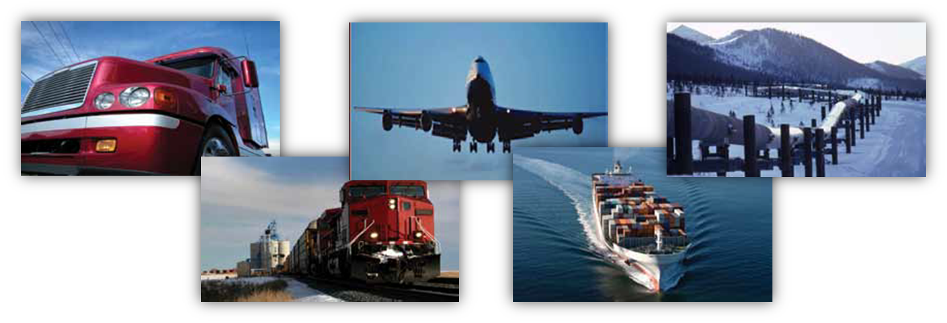
PHMSA Mission
PHMSA's mission is to protect people and the environment by advancing the safe transportation of energy and other hazardous materials that are essential to our daily lives. To do this, the agency establishes national policy, sets and enforces standards, educates, and conducts research to prevent incidents. We also prepare the public and first responders to reduce consequences if an incident does occur.

Slide 3
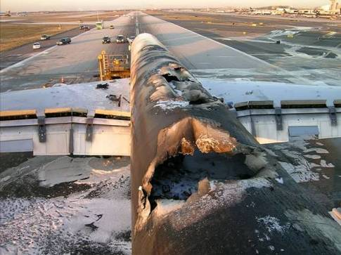
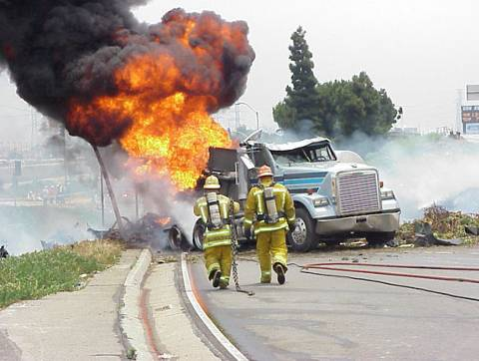
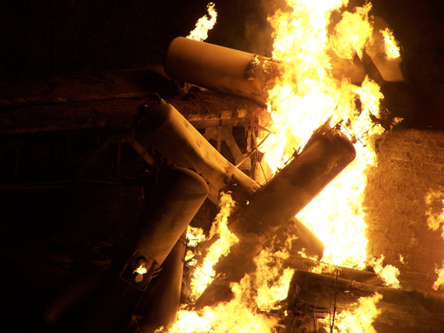
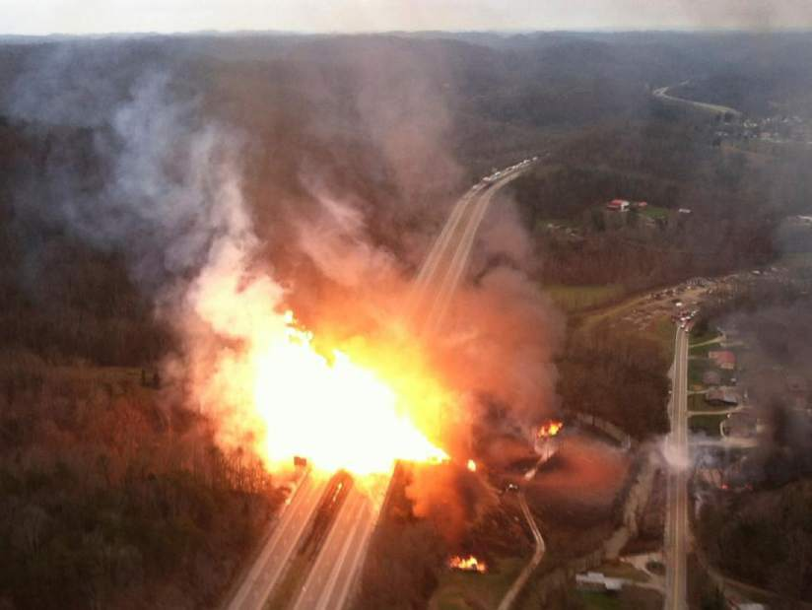
What We Work to Prevent: Transportation Related Hazmat Accidents and Incidents

Slide 4
Hazmat Grants Team
Director
Aaron Mitchell
Chief
Shakira Mack
Senior Grants Management Specialist
Carla Sheppard
Grants Management Specialists
Andre White, Bonita Brown, Flor Valencia, Lisa Reichenbacher, Matthew Hufford, Suezett Edwards
Program Support
Mahelia Whittier– Business Analyst
Shannon Logan– Administrative Assistant

Slide 5
Today’s Agenda
HMEP Program Overview
U.S. DOT/PHMSA Priorities
Conducting a Needs Assessment
HMEP Application Components
Cost Share (Matching)
Common Application Errors
HMEP Grant Milestones
Questions/Comments
Notes:
During the HMEP application webinar, we will discuss…

Slide 6
HMEP Grant Overview

Slide 7
HMEP Grant Award Overview
The HMEP grant is funded by registration fees collected from hazardous materials (HAZMAT) shippers and carriers who offer for transportation or transport certain hazmat in intrastate, interstate, or foreign commerce in accordance with 49 CFR Part 107, Subpart G.
HMEP supports federally recognized Tribes and Tribal Organizations with transportation-related hazardous materials emergencies and the implementation of sections 301 and 303 the Emergency Planning and Community Right-to-Know Act (EPCRA) of 1986. Learn more about EPCRA here: https://www.epa.gov/epcra/what-epcra
Approximately $1 million is made available for federally recognized Tribes and Tribal Organizations, annually.

Slide 8
HMEP GRANT common activities
Eligible activities include (but are not limited to):
Commodity Flow Studies (what HAZMAT is flowing through your community?)
HAZMAT Training (awareness, technician, operations, specialist)
Table-Top Exercises
Purchase of Training Props
Development of Emergency Response Plans
Backfill/Overtime/Stipends for volunteer firefighters
HAZMAT Conference Attendance
Hazardous Waste Operations and Emergency Response (HAZWOPER) Training

Slide 9
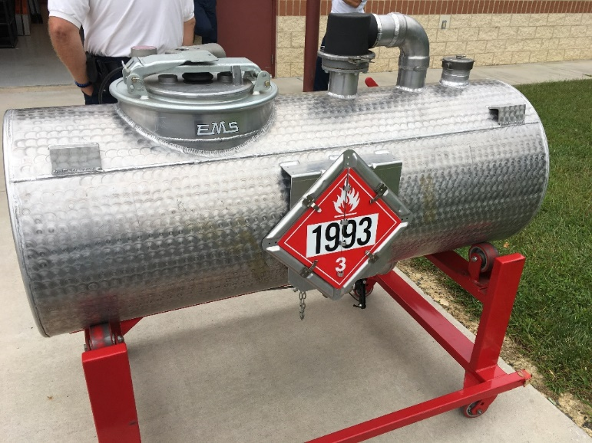
HMEP Grant Award Overview
Eligibility
Applicants are limited to federally recognized Tribal Governments and Intertribal Consortiums.
Notes:
The components for the HMEP planning grant are…

Slide 10
U.S. DOT/PHMSA Priorities
Executive Order 13985: Advancing Racial Equity and Support for Underserved Communities Through the Federal Government.
PHMSA’s FY 2022 priority is directed towards ensuring that underserved communities (UCs) are prepared and trained to respond to hazmat transportation emergencies.
The term “underserved communities” refers to populations sharing a particular characteristic, as well as geographic communities, that have been systematically denied the full opportunity to participate in aspects of economic, social, and civic life.

Slide 11
Components of the HMEP Grant Application

Slide 12
Components of the HMEP Grant Application Initial Application
Your grant proposal must include the following:
Initial Application
Standard Forms
SF 424
SF 424A
Title VI
SF-LLL: Disclosure of Lobbying Activities
HMEP Application Form
Part A: Grantee Information
Part B: Transportation Fees
Part C: Statement of Work
Part D: Budget Narrative
Part E: Certifications

Slide 13
HMEP Grant Application
Part A: Grantee Information
Tribal Government or Organization Name and Address
Contact Information: Authorized Representative, Program Manager, Finance Manager
Organizational Information
Part B: Transportation Fees
Are transportation fees assessed and collected?
If yes, answer the following:
How much in transportation fees was collected in the last year?
What percentage of the fees collected is used solely for the purpose related to the transportation of hazardous materials?

Slide 14
HMEP Grant Application
Part C: Statement of Work – Needs Assessment
A systematic process for determining and addressing needs, or gaps between current conditions and desired conditions or “wants.” The discrepancy between the current condition and wanted condition must be measured to identify the needs.
Provides supportive evidence and objective direction for programs, projects, and activities.
Allows staff to determine priorities and gaps, understand barriers, and allocate resources.
Creates cohesions through the alignment of goals, strategies, professional development, and desired outcomes.
Enables benchmarking, transferability of best practices, and monitoring of implementation and impact.
Assists with continuous improvement activities.

Slide 15
Planning & Preparation Hazmat Transport Needs Assessment
Questions to Consider when Preparing Your Needs Assessment
Identify hazmat in your jurisdiction
Are your first responders trained to respond to hazmat incidents?
Do you have emergency response plans? Are they updated?
Have your first responders completed emergency response drills that align with your emergency response plans?

Slide 16
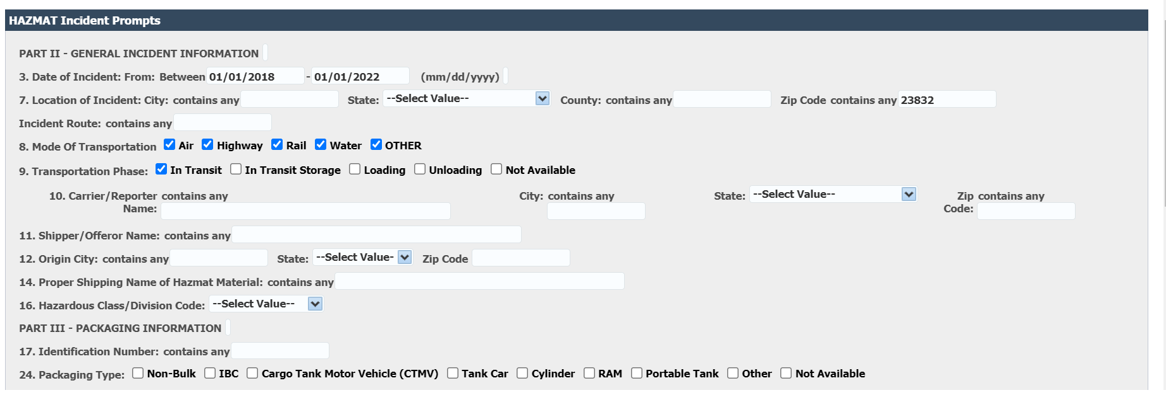
Reviewing Past Incident data in your jurisdiction
Link to PHMSA’s Incident Database

Slide 17

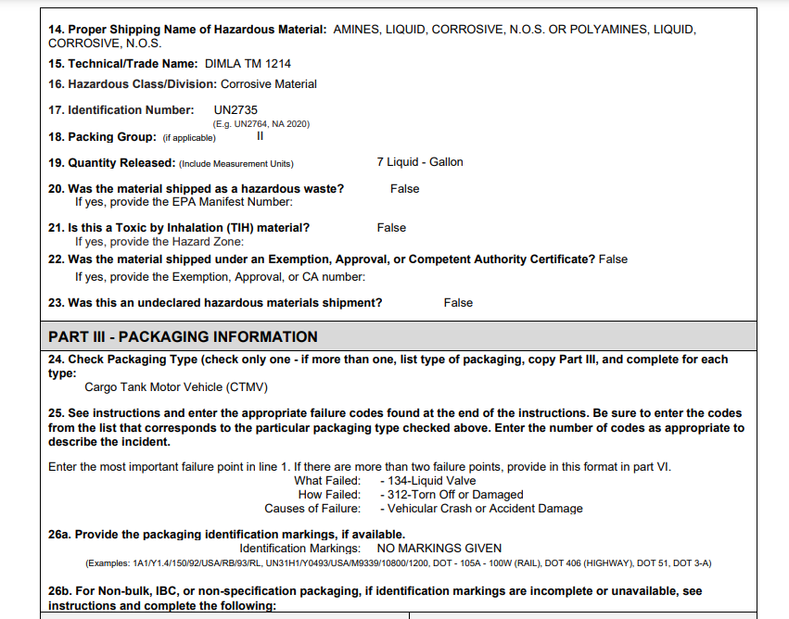
Reviewing Past Incident data in your jurisdiction

Slide 18
Sample needs assessment
Calisota has 1 major interstate, 2 major navigable rivers, approx. 32 miles of rail lines and 1 major pipeline that transport hazardous materials throughout the state. This material is comprised of all nine classes as defined by USDOT, 49 CFR. The primary cause of hazmat responses is due to transportation related incidents. Currently 24 emergency responders require hazmat awareness and hazmat technician training to ensure Calisota can properly respond to a hazmat transportation incident. Additionally, the existing emergency response plan needs to be updated to include new hazmat currently flowing through the state and 2 new chemical facilities.

Slide 19
HMEP Grant Application
Part C: Statement of Work – Goals and Objectives
What are you hoping to achieve from this project? Goals are statements of hoped and desired change that serve the purpose of the project.
What are you expecting to do to achieve that? Objectives are statements of the expected results (ends) to accomplish the goals.
What specific outputs will be completed? Outputs are the specific, measurable activities
that will take place in the grant project. For example – completed 2 commodity flow
studies.
What was the result? An Outcome is a measurement and evaluation of an activity’s result against its intended or projected result.

Slide 20
HMEP Grant Application
Part C: Statement of Work – Activities Supporting Program Goals
Preparedness activities under section 301 and 303 of the Emergency Planning and Community Right-To-Know Act (EPCRA).
Commodity flow studies
National Association of SARA Title III Program Officials (NASTTPO) conference
Update or write emergency plans.
Training activities under the NFPA 472 core competencies or OSHA 29 CFR § 1910.120(q).
Hazmat awareness, operations, technician, specialist, and refresher courses
Confined space rescue courses
Hazmat IQ training
CAMEO training

Slide 21
HMEP Grant Application
Part C: Statement of Work –Grantee Activity Information
GRANTEE ACTIVITY INFORMATION
Location | Planning or Training? | Activity Description | Projected # of Courses to be held (if applicable) | Projected number to be trained | Estimated Activity Costs | Projected Activity Start and End Date

Slide 22

Components of the Grant Application
Listing Activities
When listing activities in your project narrative, it is very important to remember the:
Who –Who will be performing the task or activity?
What –What task or activity is being performed?
Why –Why is the task or activity being performed?
Where –Where will the task or activity take place?
When –When is the task or activity projected to be performed?
How Many – What is the projected number participants involved in the task or activity?
How Much – What is the projected cost of the task or activity?

Slide 23
Components of the Grant Application
Project Plan Activities
The activities listed in the project plan speaks to the goals for the performance period and how you plan to implement and achieve them.
Example:
Calisota is proposing to conduct a Hazmat Refresher course as a number of responders are now due for training.
Training will be conducted at Tula Hazardous Materials College in Tula County.
Tula County is projecting to conduct a Hazmat Refresher course during the third quarter of the year for maximum participation.
57 participants are projected to attend this training course. The projected cost for this training course, to include travel, supplies, and facility rental is $27,571.00.

Slide 24

Components of the Grant Application
Project Narrative – Timeline
A timeline is a metric which uses milestones upon which the grantee can monitor themselves for progress, as well as monitoring from PHMSA.
Project narratives must have timelines that indicate when activities will take place.

Slide 25
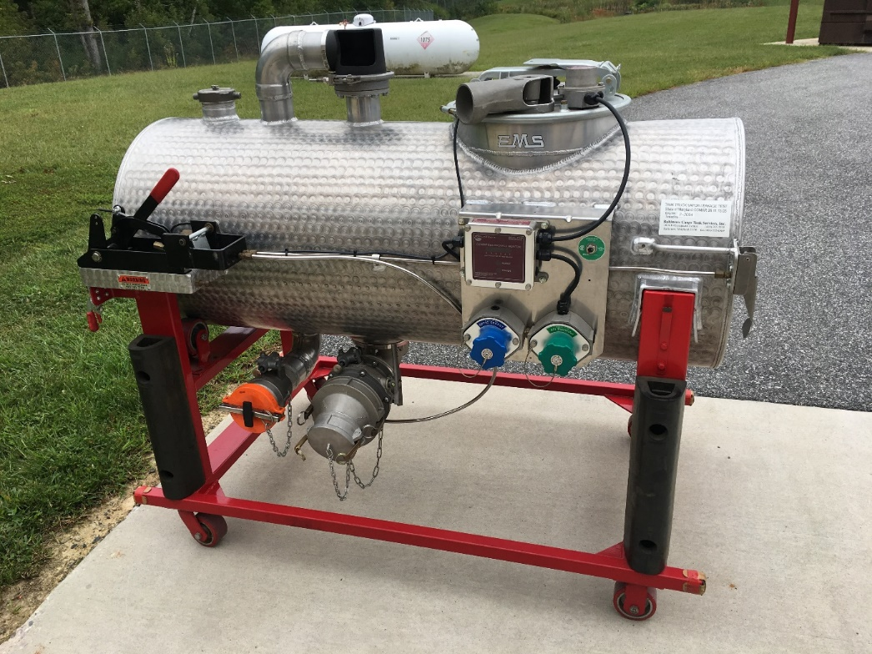
HMEP Grant Application
Part C: Statement of Work – HMEP Monitoring
Provide a description of the monitoring and evaluation of the activities that will be conducted to ensure that the grant activities are successfully carried out according to the activity timeline.
Include an explanation of quality control measures, including but not limited to random examinations, inspections, and audits of planning activities, to maximize the cost effectiveness and impact of the program.

Slide 26
HMEP Grant Application
Part E: Certification – Authorized Representatives should initial next to each statement below to indicate that your agency understands and agrees with each certification.
Statement of aggregate expenditures
Statement of consistency with NFPA 472 or OSHA 29 § 1910.120 competencies
Statement of compliance with Section 301 and 303 of EPCRA (42 U.S.C. 11001, 11003)
Statement of 75% programmatic requirement
Statement of National Incident Management System (SIMS) compliance
Statement of auditable accounting system
Tribal Emergency Response Commission (TERC) was provided an opportunity to review grant application
Application Certification
Please have the authorized representative sign.
Notes:
Carla ends.

Slide 27
Components of the Grant Application
Project Narrative: Guidance and Reminders
Review the HMEP Tribal funding announcement.
Use the HMEP Application form. (Any applications submitted not using the form will be returned to applicant to be redone on the application form)

Slide 28

HMEP Grant Application
Part C: Statement of Work Reminders
Provide activity descriptions, not just the activity’s name. Include training curriculum (if available), conference agenda, and details of the activity’s relation to transportation if not listed as an approved activity in the HMEP Expenditures Guide.
Correlate activities to needs, goals, and objectives outlined in the application.
Provide approximate total cost of each activity.
Provide the projected start and end date for each activity.
Do not copy and paste your project narrative from previous grant years.
Notes:
Lisa ends.

Slide 29
Most Common Application Errors
Project Narrative
Failure to identify Goals, Objectives, Outputs and Outcomes
Planning and Training Needs Assessment
Lack of identifying numerical data and substantiation for needed resource
Lack of clear outputs and outcomes
Exceeding 25% M&A threshold

Slide 30

Programmatic Questions?

Slide 31
Components of the HMEP Grant Application
Budget & Budget Narrative
Notes:
Carla starts

Slide 32
Components of the Grant Application
Application Budget (SF-424A)
A grant application must include a budget that details the costs required during the performance of the project.
The purpose of the line-item budget and budget narrative is to provide a forecast of expenditures and enable the actual financial operation of the organization to be measured against the forecast.

Slide 33
Components of the Grant Application
Testing Your Budget
An applicant’s budget request is reviewed for compliance with the governing cost principles, other requirements and policies applicable to the type of recipient and the type of award.
The cost principles address four tests that PHMSA follows in determining cost eligibility. Costs charged to awards must be:
Allowable (2 CFR part 200, NOFO, federal statute)
Allocable (2 CFR § 200.405)
Necessary(2 CFR § 200.403)
Reasonable and consistently applied (2 CFR § 200.403)

Slide 34
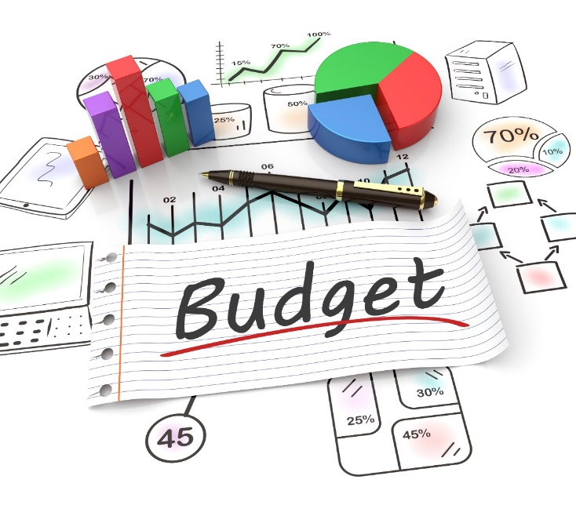
HMEP Grant Application
Part D: Budget Narrative
Applicants must include a budget and budget narrative that details the costs required during the performance of the project.
The budget provides an overview of costs organized by object class category.
The budget narrative explains these costs in detail and how they are calculated.
Together, the budget and budget narrative provide a forecast of expenditures to measure against the applicant’s actual financial operations.

Slide 35
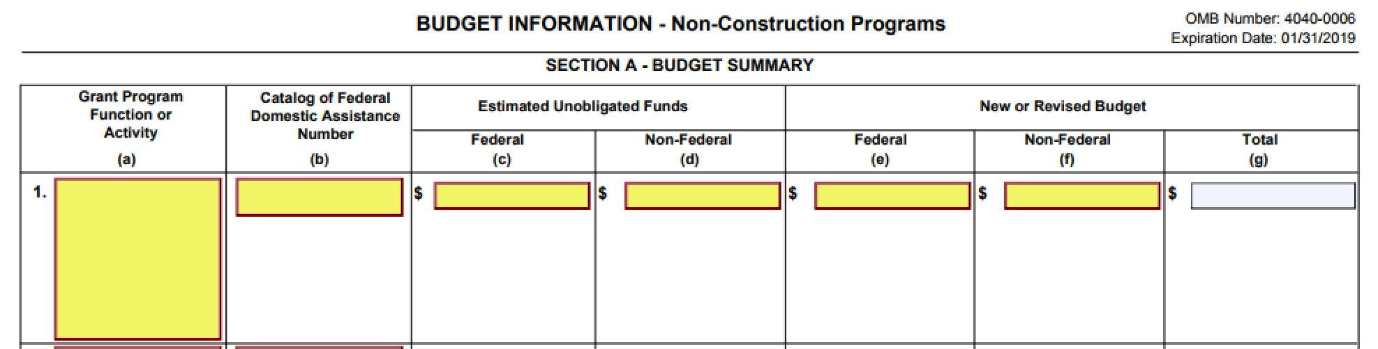
Components of the Budget Narrative
Budget & Budget Narrative SF-424A Section A
Enter the Federal and Non-Federal match amounts in their respective columns under New or Revised Budget. Column G should auto-populate.

Slide 36
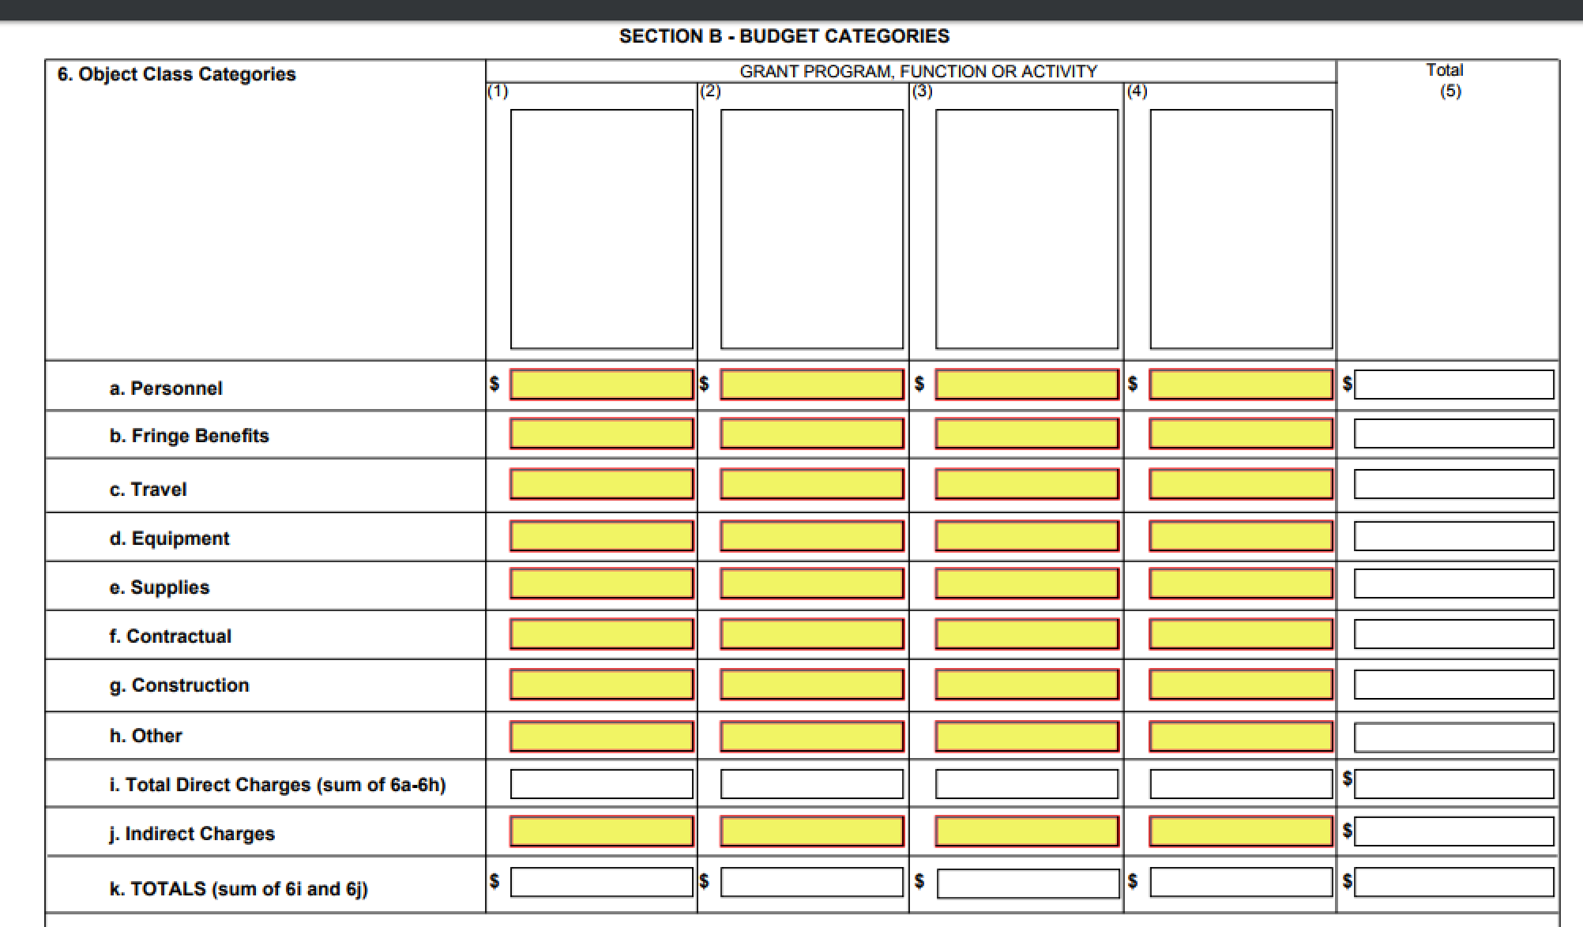
Components of the Budget Narrative
Budget & Budget Narrative SF-424A Section B
Enter the federal costs only. Include matching amounts in this section (unless exempt). The budget narrative should be used to explain how matching will be met (if applicable).

Slide 37
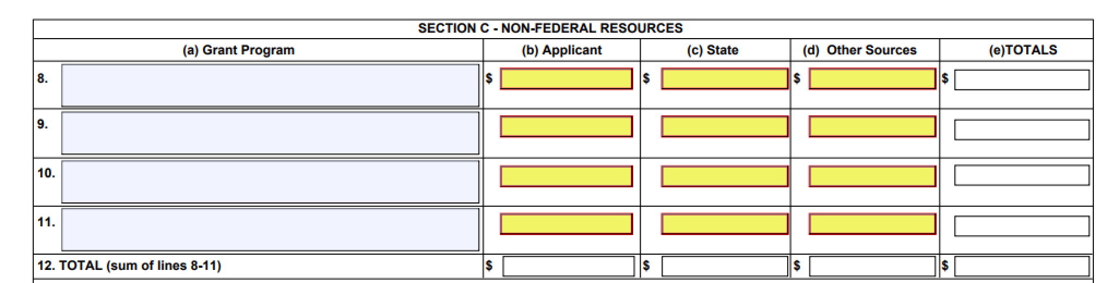
Components of the Budget Narrative
Budget & Budget Narrative SF-424A Section C
Enter the matching costs only.

Slide 38
Components of the Budget Narrative
Budget & Budget Narrative SF-424A Section D & E
We encourage you to complete section D and E.

Slide 39
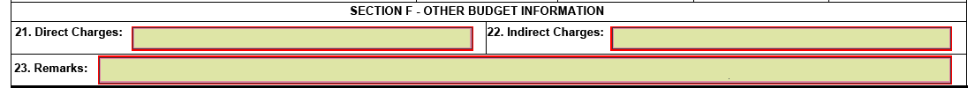
Components of the Budget Narrative
Budget & Budget Narrative SF-424A Section F
Section F is required if requesting indirect costs.

Slide 40
Components of the Grant Application
Budget Line Items Explained
Personnel (2 CFR § 200.430)
Employee salaries working directly on the grant project. Include the number, type of personnel, the percentage of time dedicated to the project, hourly wage, and total cost.
This category is limited to ONLY persons employed by your organization. Contractual and consultant costs should not be listed in the Personnel line item.

Slide 41
Components of the Grant Application
Budget Line Items Explained
Fringe Benefits (2 CFR § 200.431)
The allowances and services provided to employees as compensation in addition to regular salaries and wages. Include how the fringe benefit amount is calculated, a description of specific benefits charged to a project, and the benefit percentage.
Personnel and Fringe costs must be separated into their respective line-item categories. Do not combine these costs together.

Slide 42
Components of the Grant Application
Budget Line Items Explained
Travel (2 CFR § 200.474)
Those costs requested for field work or for travel to professional meetings. Provide the purpose, method of travel, number of persons traveling, number of days, and estimated cost for each trip.
If details of each trip are not known at the time of application submission, provide the basis for determining the amount requested.
Be sure not to exceed your government or organization’s standard for rates of travel. Exceptions will be considered by PHMSA grant staff on the basis reasonableness and necessity. Federal rates of travel can be found on https://www.gsa.gov/travel/plan-book/per-diem-rates

Slide 43
Components of the Grant Application
Budget Line Items Explained
Equipment (2 CFR § 200.439)
Includes those items which are tangible, nonexpendable, personal property having a useful life of more than one year and an acquisition cost of $5,000 or more per unit (unless the state threshold is lower).
Include a description, quantity and unit price for all equipment.
If the expense is under the usual threshold of $5,000 per item, it belongs under “Supplies.” However, if your equipment threshold is below $5,000, provide an explanation and state policy citation.
Applicants should have a plan in place to track and dispose equipment items acquired using HMEP grant funding in accordance with § 200.313 (d)(e).

Slide 44
Components of the Grant Application
Budget Line Items Explained
Supplies (2 CFR § 200.453)
Tangible property other than equipment. Include the type of supply item in general terms.
It is not necessary to document office supplies in great detail (for example: reams of paper, boxes of paperclips, etc.). A good way to document office supplies is to indicate the approximate expenditure of the unit as a whole.
However, applicants should include a quantity and unit cost for larger cost supply items such as computers and printers.

Slide 45
Components of the Grant Application
Budget Line Items Explained
Contractual (2 CFR § 200.22)
Contractual costs are those services carried out by an individual or organization, other than the applicant, in the form of a procurement relationship. There are two ways to capture costs in this category: subgrants and contracts.
What is a subgrant? (2 CFR § 200.92; 2 CFR § 200.330)
An award provided by a pass-through entity to a subrecipient to carry out part of a Federal award received by the pass-through entity.
1. Has its performance measured in relation to whether objectives of a Federal program were met.
2. Responsibility for programmatic decision-making.

Slide 46
Components of the Grant Application
Budget Line Items Explained
What is a contract? (2 CFR § 200.22)
A contract is a legal instrument by which a Prime Grantee Recipient purchases property or services needed to carry out the project or program under an award.
Sub-awards and Contracts must be listed in the Contractual line-item category. In the budget narrative, they must be correctly identified as a sub-award or a contract.

Slide 47
Components of the Grant Application
Budget Line Items Explained
Other
“Other” direct costs do not fit any of the aforementioned categories, such as rent for buildings used to conduct project activities, printing, utilities and/or leased equipment, employee training, tuition, etc.
“Other” direct costs should be itemized and the methodology explained in the budget narrative.

Slide 48
Components of the Grant Application
Budget Line Items Explained
Indirect Costs (2 CFR § 200.416)
Are incurred for common or joint objectives that benefit more than one project. The applicant must include a current and fully executed agreement in the application if claiming indirect costs.
Make sure the rate is applied to the appropriate base in the approved agreement.
If the rate will not be approved by the application due date, attach the letter of renewal or letter of request that you sent to your cognizant agency to your application.
Applicant may use the 10% de minimis

Slide 49
Cost Share/Match
Cost Sharing/Matching Requirements
Cost sharing or matching is the portion of project costs not paid by Federal funds. For planning and training grants, this amount is 20%, if applicable.
On the 424A budget, enter match in Section A and C.
Match must be fully described in the budget narrative in a clearly marked section for match. Explain the amount and how it will be met in the same manner you would for a federal share cost item.
You can do a soft or a hard (cash) match.

Slide 50
Cost Share/Match
Cost Share/Match Requirements
HMEP grant award is 80% Federal share + 20% match = 100% grant award.
Match can be calculated by using the federal share (award) divided by the percentage of Total Project Cost minus federal share.
Match can also be calculated by multiplying Federal share by 25%.
Example:
With a match of 20%, and federal share of 80%, a $250,000 federal share:
• $250,000 divided by 80% = $312,500
• $312,500 minus $250,000 = $62,500
• The 20% cost share is $62,500.

Slide 51
Cost Share/Match
Cost Share/Match Requirements continued
Example:
$250,000 of Federal share request:
$250,000 * 25% = $62,500 match required

Slide 52
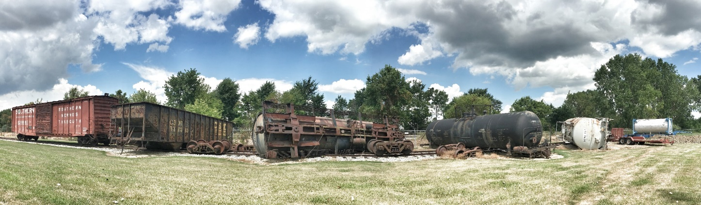
HMEP Grant Application
Part D: Budget Narrative Reminders
Every SF-424A line-item should have a corresponding explanation as to how it was calculated in the budget narrative. Submitting a well-written budget narrative results in a faster review!
Explain how the 20% matching contribution will be met in the budget narrative.
Attach the indirect cost rate agreement if claiming indirect costs.
Double check all computations.

Slide 53
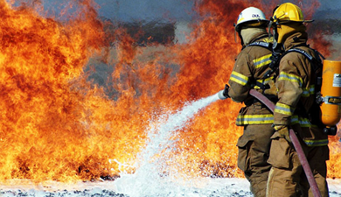
HMEP Grant Application
Part D: Budget Narrative Reminders
At least 75% of HMEP funds must be for programmatic activities.
Up to 25% of HMEP funds may be used for management and administration (“M&A”) for Tribal employees.

Slide 54
Notice of Funding Opportunity (NOFO)
The NOFO will provide the requirements for the application submission (where to submit, format, etc.).

Slide 55
Common Application Errors
Did I Do That?

Slide 56

Most Common Application Errors
Standard Forms
SF-424A – Budget Information
Section A Budget Summary column (a) incomplete
Mathematical errors
Failure to calculate budget items under the correct Object Class
Failure Enter Federal share only in Section B
Section C Non-Federal Resources incomplete

Slide 57
Most Common Application Errors
Standard Forms
SF-424 – Application for Federal Assistance
Authorized Representative’s misinformation
Missing, Incomplete, or Unsigned These Required Forms
SF-LLL – Disclosure of Lobbying Activities.
Standard Title VI/Non-Discrimination Assurances – Civil Rights Assurances
HMEP Application form not completed and submitted

Slide 58
Most Common Application Errors
Budget Narrative
SF-424A budget failure to align with the budget narrative
Lack of detailed explanation of how the agency will make its 20% match contribution
Incorrect object class categorization
Incorrect allocation of Indirect costs
Lack of indirect cost rate agreement or statement indicating the use of the 10% de Minimis rate

Slide 59
HMEP Grant Milestones
Mark Your Calendar!
Notes:
Shakira starts

Slide 60

HMEP Grant Milestones
Application Period begins: February 28, 2022
Application Due Date: April 15, 2022
Application Award Date No Later Than: 09/30/2022
Period of Performance: 10/01/2022 – 09/30/2023

Slide 61

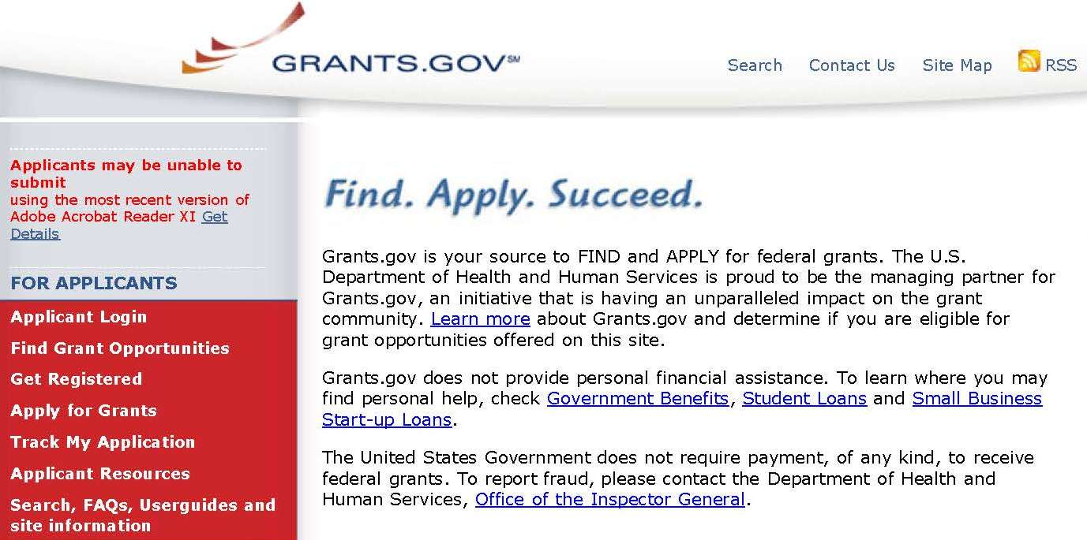
Invitation to Apply
PHMSA encourages federally recognized Tribes and Tribal Organizations to apply for the HMEP grant via www.grants.gov.

Slide 62

Invitation to Apply
Additional Requirements
Additionally, applicants must register with FedConnect for an account before submitting an application.
Your organization’s Marketing Partner ID number (MPIN), which can be retrieved from the System for Award Management (SAM), is required to create an account. https://www.sam.gov/SAM/
For instructions on how to register in FedConnect and how to use the portal, view the FedConnect: Ready, Set, Go! Tutorial under the Need Help? section on the FedConnect home page. https://www.fedconnect.net

Slide 63
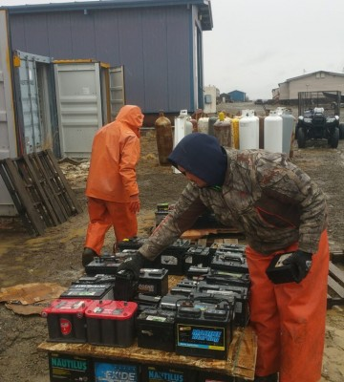
Other Hazmat Grant Programs
Open to Tribal Nonprofit Organizations
Hazmat Instructor Training Grant (HMIT) ($4M)– Trains hazmat employees on the hazmat regulations.
Community Safety Grant ($1M)– prepares communities to respond to hazmat accidents and incidents and supports the training of state and local enforcement personnel who are responsible for enforcing the safe transportation of hazmat.
Search by CFDA/Assistance Listing number and enter 20.703 to locate the grant opportunities.

Slide 64
Hazmat Grant Program Contact Information
General Grant Inquiries
HMEP.Grants@dot.gov
Website:
www.phmsa.dot.gov/hazmat/grants
Phone:
(202)366-1109

Slide 65
Questions?

