Slide 1


Emergency Preparedness Grant Program
Nonprofit Grantee Virtual Meeting
Pipeline & Hazardous Materials Safety Administration (PHMSA)
Wednesday
October 13, 2021
1:00 – 4:00 PM EST
Partnering with Nonprofit organizations working together to safeguard the American public against accidents and incidents involving the transport of hazardous materials

Slide 2

Today’s Agenda
U.S. DOT/PHMSA Update
  Bill Schoonover, OHMS Associate Administrator
Program/Grants Update
  Aaron Mitchell, Outreach and Grants
Keynote Presentation: Hazardous Materials Safety Regulations
  Shelby Geller, Standards and Rulemaking
  ** BREAK**
Hazardous Materials Roundtable Discussion
Preparing Performance and Financial Reporting for Maximum Program Impact
Closing Remarks

Slide 3
Opening Remarks
Bill Schoonover, Associate Administrator, Office of Hazardous Materials Safety

Slide 4
Grants Update
Aaron Mitchell, Director Outreach and Grants Office of Hazardous Materials Safety

Slide 5
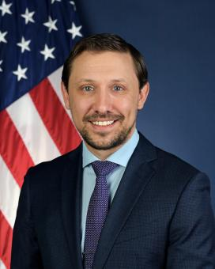
PHMSA Leadership
Mr. Tristan Brown
PHMSA, Acting Administrator

Slide 6

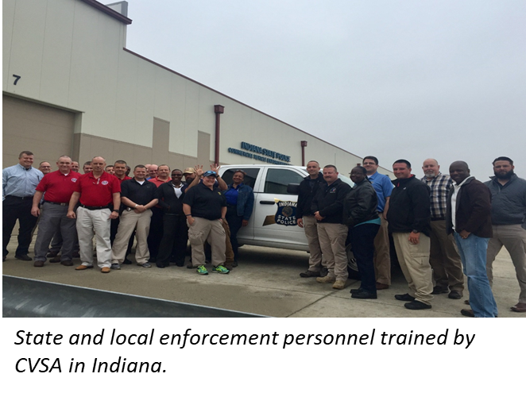
Hazmat Grants Update
COVID-19 Impacts
FY19-20 Grant Performance
FY 22 HM Grant Priorities

Slide 7
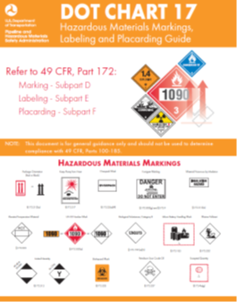

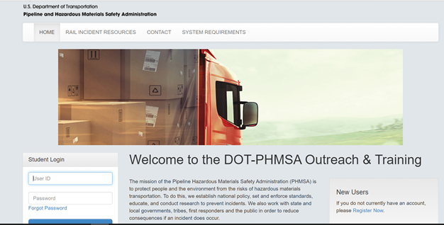
New HM Publications
2020 Emergency Response Guide (ERG)
DOT Chart 17
HM Online Training Modules 2.0
https://www.phmsa.dot.gov/training/hazmat/publications

Slide 8


Rulemaking Update
HM-264A LNG Suspension
HM-215 International Harmonization NPRM
HM-265 Modal Safety Advancement NPRM

Slide 9
Contact Info
15 Minute Break

Slide 10
Contact Info
Roundtable Discussion Topic 1:
Outreach Practices to Reach the Target Audience and Fill Training Courses

Slide 11
Contact Info
Roundtable Discussion Topic 2:
Redirecting Your Scope to Adapt to the Impact of Change

Slide 12
Reporting Overview
In 2006, the Federal Funding Accountability and Transparency Act (FFATA) set in motion a government-wide reporting procedure that has continued to evolve.
To comply with this Act, reporting information is located centrally via USAspending.gov.
It includes information reported by:
federal grant-making agencies
Prime awardees
Sub-awardees

Slide 13
Reporting Data
What kinds of data are federal award recipients expected to include in their reporting?
financial data - expenditures
compliance information to ensure the recipient is following federal regulations and project data highlighting progress
Grant-making agencies use this information to/for
  Gauge the success of the programs
  Initiatives
  Report to Congress

Slide 14
Progress Reporting Requirements
Reports should include:
Summary of activities and outputs during reporting period
Challenges faced and strategies implemented to mitigate those challenges
Updated timeline of activities projected to take place for the remainder of performance period
Outcome statements regarding the impact current grant performance period grant activities have had on protecting people and the environment from the risks of hazardous materials transportation

Slide 15
Contact Info
Questions?

