Slide 1
2021 Nonprofit Virtual Meeting:
Standards & Rulemaking Update
Shelby Geller
Pipeline and Hazardous Materials Safety Administration
Regulatory Specialist, Standards and Rulemaking Division
Office of Hazardous Materials Safety
October 2021

Slide 2

Outline
Purpose:
To provide an update on Standards & Rulemaking
Rulemaking Priorities for 2021
Regulatory Update
Completed Rulemakings
Current and Future Rulemakings
Petitions for Rulemaking
Special Permits
Letters of Interpretation

Slide 3
OHMS Rulemakings

Slide 4
Rulemaking Priorities for 2021
Goal to improve transportation safety through rules and legislative mandates.
Key rulemaking priorities:
  The HM-224I Final Rule to enhance the safe air transportation of lithium batteries.
  The HM-215P Final Rule to harmonize with newer international standards and improve the global transportation system by minimizing the regulatory burden.
  The HM-265 NPRM proposing to maintain or enhance the safe transportation of hazardous materials by rail, vessel, and highway.

Slide 5
Regulatory Update
Rule | Description | Rulemaking Status
HM-219C | Adopt Deregulatory Petitions (Final Rule) | Published November 2020
HM-260A | Editorial Corrections (Final Rule) | Published December 2020
HM-234 | DOT Specification Cylinders (Final Rule) | Published December 2020
HM-224I | Revised Lithium Battery Regulations (Final Rule) | In Progress
HM-241 | ASME Code Section XII (Final Rule) | In Progress
HM-215P | International Harmonization (Final Rule) | In Progress
HM-233G | Continued Special Permit Conversion (NPRM) | In Progress
HM-250A | Compatibility with IAEA Regulations (NPRM) | In Progress
HM-265 | Modal Safety Advancements (NPRM) | In Progress
HM-264A | Suspension of LNG by Rail (NPRM) | In Progress
HM-219D | Reduce Burden & Adopt Petitions (NPRM) | In Progress
HM-257A | Streamline Energetic Approvals (NPRM) | In Progress
HM-264B | Improve Safety of LNG | In Progress
HM-265A | Reg Reform Initiatives (ANPRM) | In Progress
HM-213E | Cargo Tank ID Numbers | TBD
HM-263 | FAST Act Real-Time Train Consist | TBD

Slide 6
Completed Rulemakings
HM-219C: Adopt Deregulatory Petitions Final Rule (November 25, 2020)
Adopts a number of petitions for rulemaking
HM-260A: Editorial Corrections Final Rule (December 21, 2020)
Makes editorial corrections to the HMR
HM-234: DOT Specification Cylinders Final Rule (December 28, 2020)
Amends requirements for the manufacture, use, and requalification of DOT-specification cylinders

Slide 7
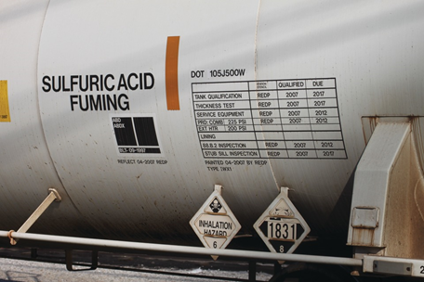
HM-219C: Adoption of Miscellaneous Petitions to Reduce Regulatory Burdens Final Rule
Overview:
  Published November 25, 2020.
  Responds to 24 petitions for rulemaking submitted between 2015 and 2018.
  Withdraws enforcement discretion regarding the phase-out of mobile refrigeration systems.
  Amendments include:​
    Update of APA Standard​
    Use of Pi-Marked Foreign Pressure Vessels​
    Incorporation by Reference Documents​
    Mobile Refrigeration Units​
    Phase-out of Poison-by-Inhalation (PIH) Rail Tank Cars​

Slide 8
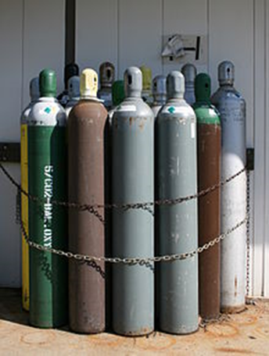
HM-234: DOT Specification Cylinders Final Rule
Overview:
  Published December 28, 2020.
  Responds to 20 petitions for rulemaking.
  Amendments include:
    Incorporation by reference and update to CGA publications
    Filling requirements for compressed and liquefied gases
    Use of salvage cylinders
    Clear manufacture and requalification requirements for cylinders

Slide 9

Current and Future Rulemakings
HM-224I: Enhanced Safety Provisions for Lithium Batteries Transported by Air
IFR published March 6, 2019; comment period closed May 6, 2019.
HM-241: ASME Code Section XII
Suppl. NPRM published April 29, 2016; comment period closed June 28, 2016.
Current
HM-215P: Harmonization with International Standards
NPRM published August 10, 2021; comment period closed October 12, 2021.
HM-265: Modal Safety Advancements – NPRM under development
HM-233G: Continued Special Permit Conversions – NPRM under development
HM-250A: Compatibility with IAEA Regulations – NPRM under development
Future
HM-219D: Reduce Burden & Adopt Petitions – NPRM under development
HM-257A: Streamline Energetic Approvals – NPRM under development
HM-264A: Suspension of LNG by Rail – NPRM under development
HM-264B: Improve Safety of LNG – NPRM under development
HM-265A: Reg Reform Initiatives – ANPRM under development

Slide 10
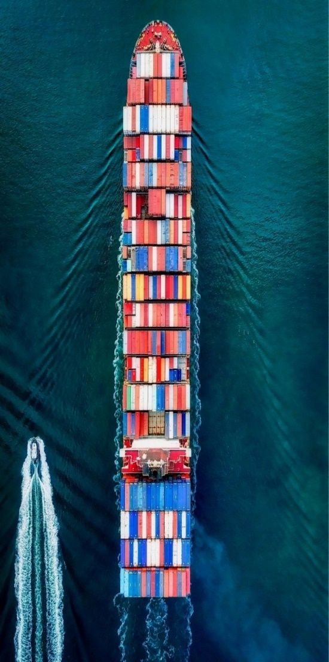
HM-215P: International Harmonization Final Rule
Overview:
  NPRM published August 10, 2021; Comment period closed October 12, 2021.
  Aligns with international standards that became effective on January 1, 2021, and facilitates the safe global trade of hazardous materials.
  Recently adopted amendments within international standards include:
    New classification for infectious waste of Category A
    Updates to ISO cylinder manufacturing and testing standards
    New entries to the organic peroxides table
    Expansion of existing options to transport large robust articles (i.e., refrigerating machines)
    Revise shipping paper requirements for lithium batteries (damaged / defective / recycling)

Slide 11

HM-265: Modal Safety Advancements NPRM
Overview:
  Under review within the Department.
  Proposes modal-specific (e.g., rail, highway, and vessel) amendments to maintain or increase safe transportation of hazardous materials.
  Includes consideration of actions identified by internal agency review and public comments.

Slide 12
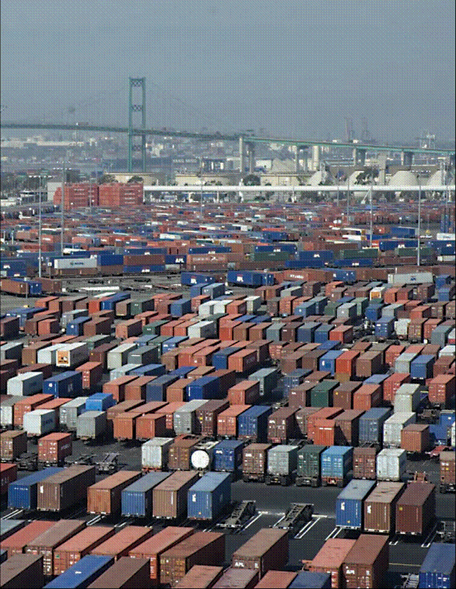
HM-233G: Conversion of Special Permits NPRM
Overview:
  Under review within the Department.
  Proposes to adopt provisions contained in certain widely-used or long-standing special permits that have an established safety record.
  Follows PHMSA analysis of active special permits, approvals, and related petitions.

Slide 13
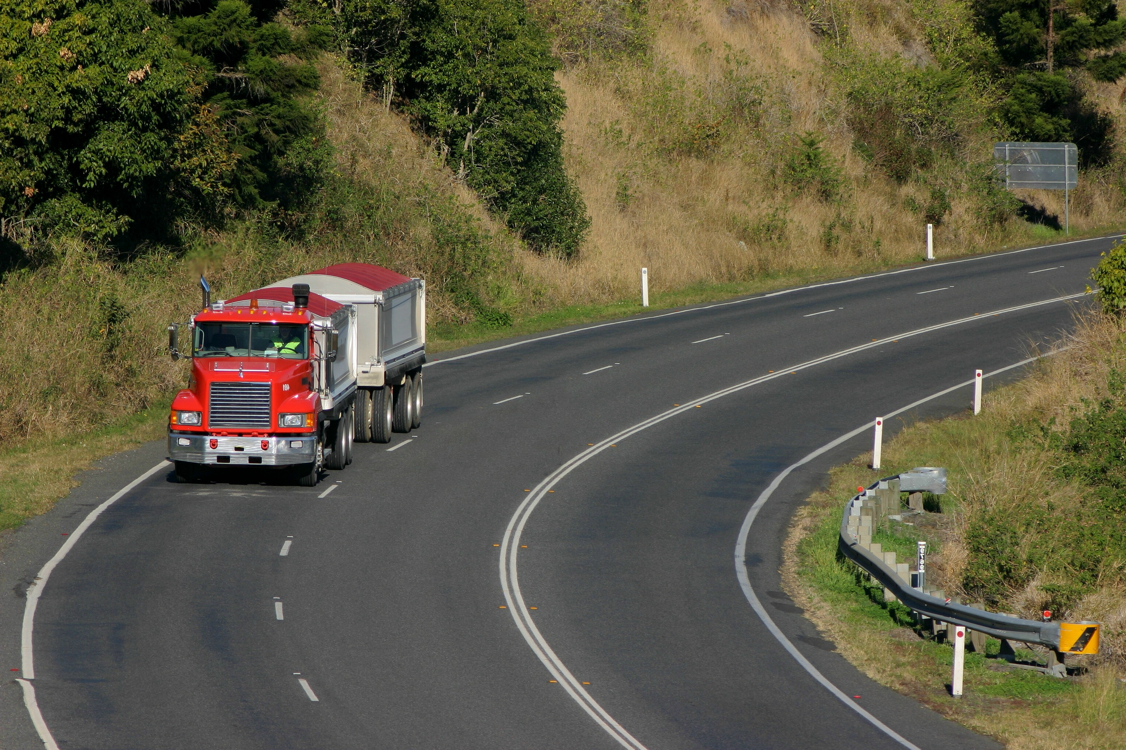
HM-219D: Adoption of Petitions NPRM
Overview:
  Under review within the Department.
  Proposes to address petitions for rulemaking submitted by hazardous materials transportation stakeholders.

Slide 14
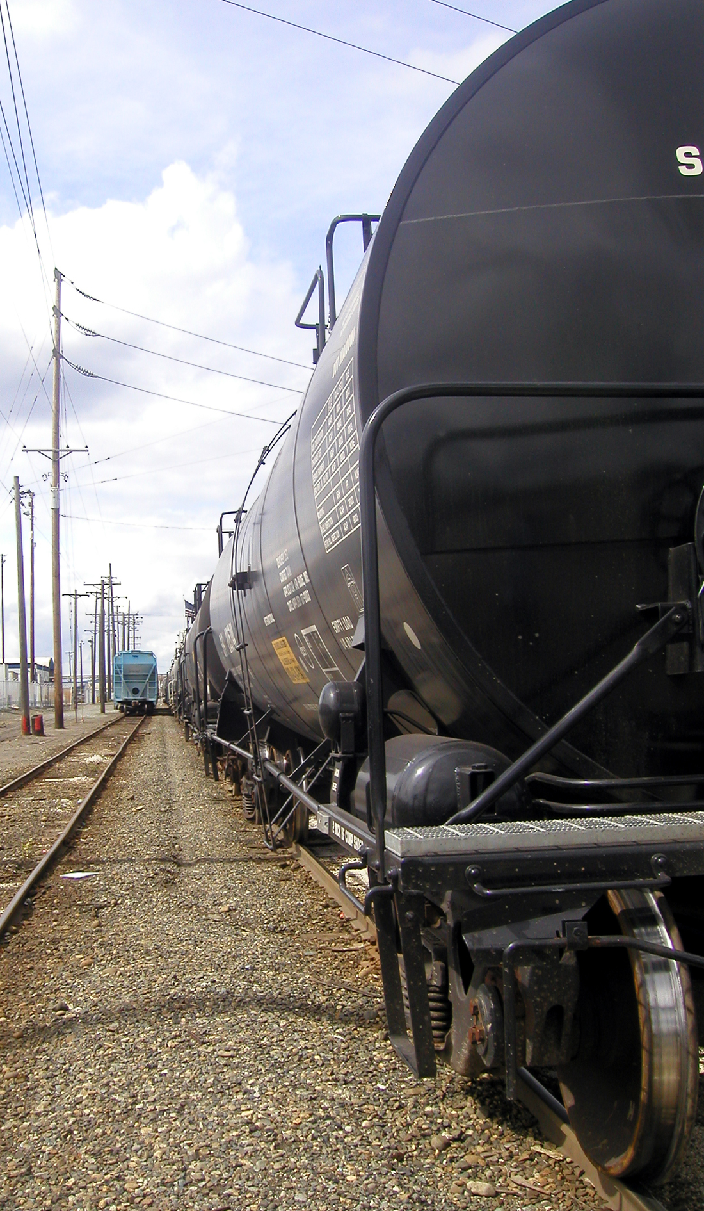
Updates to LNG by Rail Rulemaking
HM-264A: Suspension of LNG by Rail NPRM
  Under review in OMB/OIRA.
  Proposes to suspend authorization of LNG transportation by rail tank car pending completion of HM-264B.
HM-264B: Improve Safety of LNG NPRM
  Under development within the Department.
  Proposes to amend the requirements for the transportation of LNG in rail tank cars.
  Responds to (1) results of ongoing research efforts, (2) collaboration with FRA and external technical experts, and (3) EO 13990, which promotes public health and safety, the environment, and climate change mitigation.

Slide 15
Standards and Rulemaking Division

Slide 16

Petitions for Rulemaking
Incoming requests for petition must provide at a minimum the information as required in §106.100(a).
Petitions determined to be substantial are required to provide additional information as required in §106.100(b).
Petition process ensures proposals will not result in a decrease in safety or impose unsupported cost burdens.
Latest petitions rulemaking addressed 24 petitions from industry (HM-219C).

Slide 17
Special Permits
Authorize a person to conduct an activity that is not authorized under the HMR.
Allow for:
    Innovation and technical advancement
    Business development
    Response to emergencies and natural disasters
An application for a new special permit must be:
    Submitted in accordance with the requirements of §107.105.
    Evaluated to ensure it will achieve a level of safety equal to that of the HMR.

Slide 18

Letters of Interpretation
Improving Customer Service
Issuing Acknowledgement Letters
Streamlining Concurrence Process
Increasing Stakeholder Communication and Outreach
Working 100% Electronically Due to COVID-19
Improving Customer Service
Issuing Acknowledgement Letters
Streamlining Concurrence Process
Increasing Stakeholder Communication and Outreach
Working In a Fully Virtual Environment

Slide 19
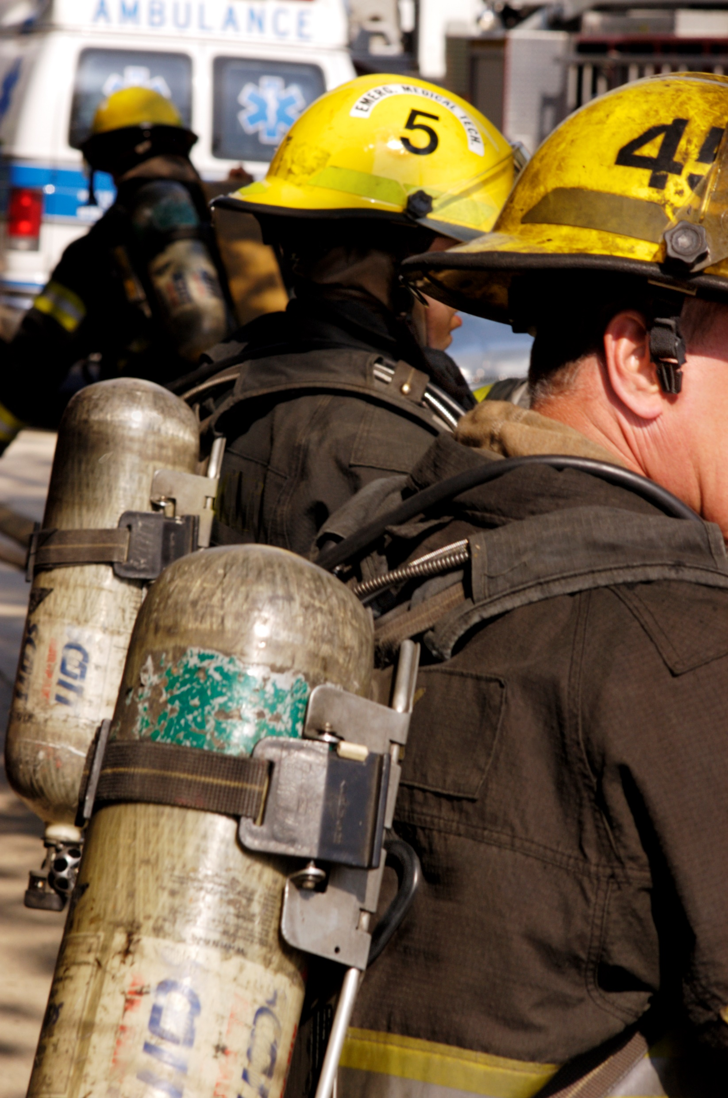
Hazardous Materials Information Center
Have a question about the HMR?
Receive live, one-on-one assistance Monday through Friday from 9 a.m. to 5 p.m EST:
1-800-HMR-4922
1-800-467-4922
202-366-4488
infocntr@dot.gov

Slide 20

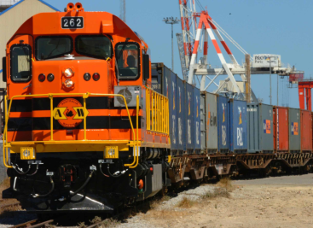
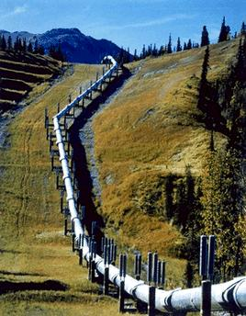
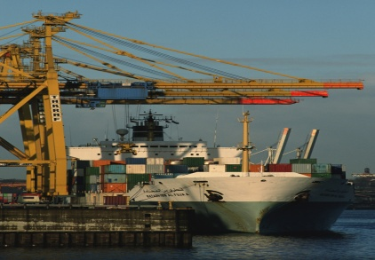
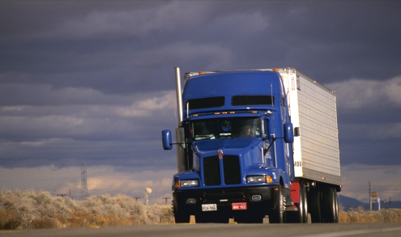
Thank you! Questions?

