Slide 1
Control Room Management
PHMSA’s CRM Initiative
Inspection Analytics
April 2021
Byron Coy PE
Sr. Technical Advisor
USDOT / PHMSA

Slide 2
Control Room Initiative Objective
Conduct Full Control Room Management Inspections at all Control Rooms under PHMSA Jurisdiction
Broaden internal CRM knowledgebase
Promote good cyber-hygiene to Operators

Slide 3
PHMSA-Jurisdicted Control Rooms
Pre-2020 Preliminary estimate of Control Rooms | 225
Pre-2020 Control Rooms without full CRM Inspections | ~ 55-120
2020 Estimate of Control Rooms | 255-320
2021 Current Estimate of Control Rooms | 280-345
Currently no direct reporting requirement for Control Rooms

Slide 4
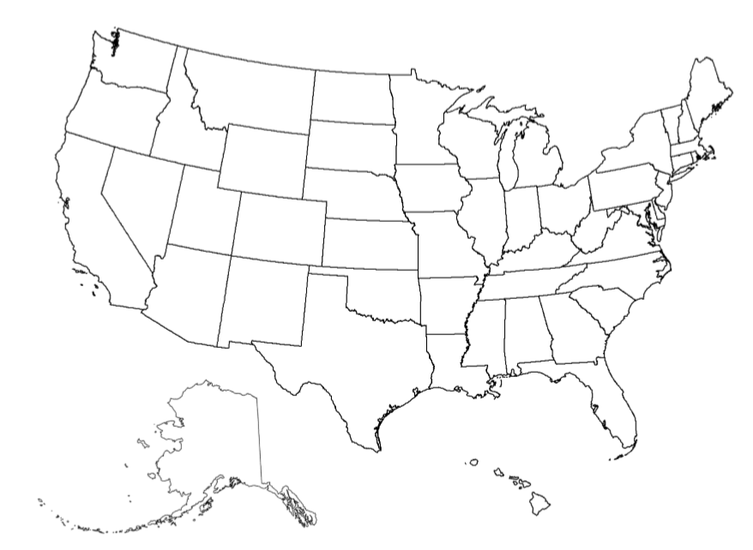
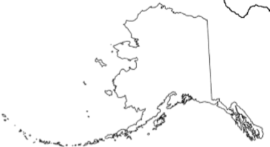


PHMSA-Jurisdicted Control Rooms
Alberta
4
2
2
Ontario
2
2
2
2
4
2
3
2
4
2
2
5
2
2
4
3
5
2
3
3
8
2
4
Num. of CR
5
2
1
2 – 4
5 – 9
10 – 20
>50
5
2
2
2
6
54
4
5
2
3
3
5

Slide 5
Identified Control Room Locations –
Federal Jurisdiction
States with highest number of identified control rooms
Number varies over time
  New CRs Identified
  Jurisdiction changes as pipeline segments are added/removed from CRs
  Acquisitions / Divestitures
  CRs move or consolidate locations
State / Province | Control Rooms Federal Jurisdiction
Texas | 76
Oklahoma | 16
California | 16
Louisiana | 14
Alaska | 10
Wyoming | 9
North Dakota | 8
Kansas | 8
Alberta, Canada | 6
Colorado | 6
Utah | 6

Slide 6
PHMSA CRM Full Inspections
Certain Aspects of Control Rooms are addressed in other types of Inspections

Slide 7
2020 Inspection Plan
Mix new with seasoned Inspectors
Inspect mid-size Operators in 1H2020
Inspect larger Operators in 2H2020
Inspect smaller Operators across the year
For TSA : Raise cyber-hygiene awareness

Slide 8
2020 CRM Inspection Program

Slide 9
2020 CRM Inspection Program –
Mostly “Virtual” Inspections
CY-2020 | Onsite Inspections | Virtual Inspections | Totals
Jan - Mar | 6 | 2 | 8
Apr - Sep | 0 | 37 | 37
Oct - Dec | 1 | 15 | 16
 | ------- | ------- | -------
2020 Total | 7 | 54 | 61

Slide 10
2020 CRM Inspections
Alberta
3
2
4
3
4
4
3
Num. of CRs Inspected
2
1
2 – 4
5 – 9
10 – 20
2

Slide 11
2020 Inspection Results
Overall results show approximately
9% Unsats and 10% Concerns
Wide Variation in Operator Performance
  Ranging from 1 – 50% Unsats
Improvement in results, for operators with previous full CRM inspections

Slide 12
2020 CRM Inspection Unsats
by Code Subparagraph
(a) General
(b) Roles & Responsibilities
(c) Adequate Information
(d) Fatigue Management
(e) Alarm Management
(f) Change Management
(g) Operating Experience
(h) Training
(i-j) Compliance Validation & Deviations

Slide 13
2020 CRM Inspection Unsats
by Code Subparagraph
(a) General
(b) Roles & Responsibilities
(c) Adequate Information
(d) Fatigue Management
(e) Alarm Management
(f) Change Management
(g) Operating Experience
(h) Training
(i-j) Compliance Validation & Deviations

Slide 14
Most Frequent Code Citations of
Most Frequent Subparagraph
CRM Inspection Unsats
Gas
Haz. Liquid
Code Citation | % of Total Unsats
192.631(h) - Training | 21%
192.631(e) – Alarm Management | 19%
192.631(c) – Adequate Info. | 19%
192.631(b) – Roles & Responsibilities | 16%
192.631(d) – Fatigue Management | 12%
Code Citation | % of Total Unsats
195.446(h) - Training | 32%
195.446(e) – Alarm Management | 17%
195.446(c) – Adequate Info. | 16%
195.446(b) – Roles & Responsibilities | 15%
195.446(j) – Compliance Validation & Deviations | 7%
195.446(d) - Fatigue Management | 7%

Slide 15
Most Frequent Code Citations
CRM Inspection Unsats
Gas
Liquid
Code Citation | Percent of Unsats
192.631(h)(6) Team Training | 11%
192.631(c)(2) Point-to-Point Verification | 11%
192.631(b)(5) Authority To Direct or Supersede | 9%
192.631(e)(4) Alarm Management Annual Review | 9%
192.631(e)(2) Alarm Mgt Monthly Identification of Points Affecting Safety | 9%
Code Citation | Percent of Unsats
195.446(h)(6) Team Training | 14%
195.446(b)(5) Authority to Direct or Supersede | 9%
195.446(e)(5) Alarm Management Annual Monitoring of Activity | 7%
195.446(c)(2) Point-to-Point Verification | 7%
195.446(j)(2) Documentation of Deviations | 6%

Slide 16
Single Most Cited Subsection
In 2020 CRM Inspections
“Team Training”
  192.631(h)(6) – 11% of Unsats in Natural Gas
  195.446(h)(6) – 14% of Unsats in Haz. Liquids

Slide 17
Most Common Issues for Unsats
Issues | Percent of Unsats
No Records or Documentation | 15%
Insufficient Documentation | 14%
Inadequate Process, but requirements being met in practice | 13%
No process | 11%
Inadequate Implementation | 5%
Not meeting required Intervals | 5%

Slide 18
2020 CRM Inspection Unsats
by Code Subparagraph
(a) General
(b) Roles & Responsibilities
(c) SCADA
(d) Fatigue Management
(e) Alarm Management
(f) Change Management
(g) Operating Experience
(h) Training
(i-j) Compliance Validation & Deviations

Slide 19
Breakdown of Average Unsats per Inspection (2020)
By Pipeline Type
By Control Room Pipeline Mileage

Slide 20
2021 Inspection Plan
Continue to grow CRM experience in staff
Inspect remaining large Operators
Mix in mid-size and small Operators
For TSA : Continue cyber-hygiene awareness & promote VADR
TSA – Transportation Security Administration of DHS
CISA – Cybersecurity and Infrastructure Security Agency
VADR – Validated Architecture Design Review

Slide 21
Inspection Progress : Natural Gas
12%
72%

Slide 22
Inspection Progress : Haz. Liquids
20%
50%

Slide 23
CRM Inspections
Expected Completions 2020 & 2021
Alberta
2
2
3
2
3
5
3
Num. of CRs 2020-2021
2
1
2 – 4
5 – 9
10 – 19
20 – 29
4
2
5
2
5
3
3
3
5
3
3
2
2

Slide 24
