Slide 1
SUBMITTING APLICATIONS IN THE COMPETENT AUTHORITY PORTAL
Select hyperlink: https://portal.phmsa.dot.gov/ and go through the screens.

Slide 2
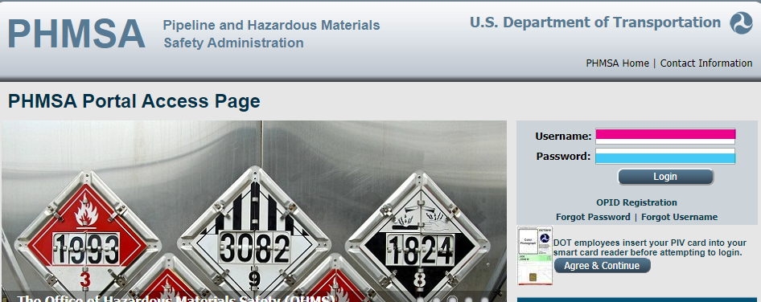
Login to the Portal using your Username and Password.

Slide 3
Read the Disclaimer. If you agree, click “Okay”

Slide 4
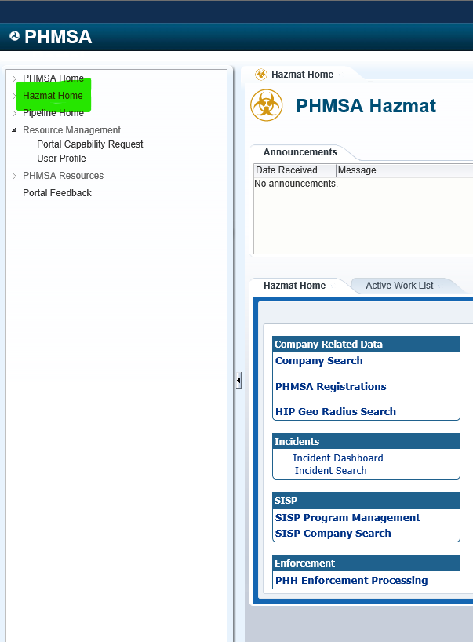
Left side of the page select: Hazmat Home

Slide 5
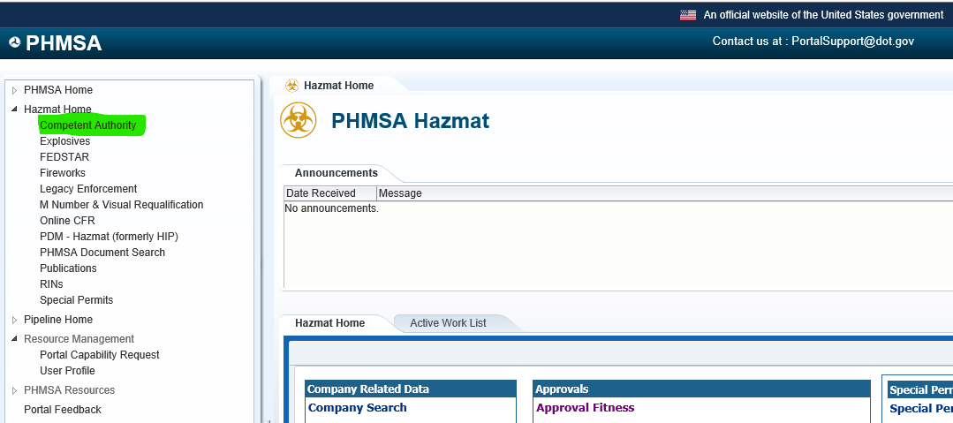
Under Hazmat Home select: Competent Authority

Slide 6
To the slight right side under “My Worklist” Click: Actions and a dropdown list will appear

Slide 7
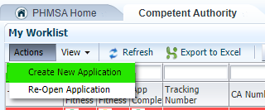
Select: Create New Application

Slide 8
The Portal want you to identify your Application Type. Click the dropdown list and select your Application Type.

Slide 9
After selecting your Application Type, click Continue.

Slide 10
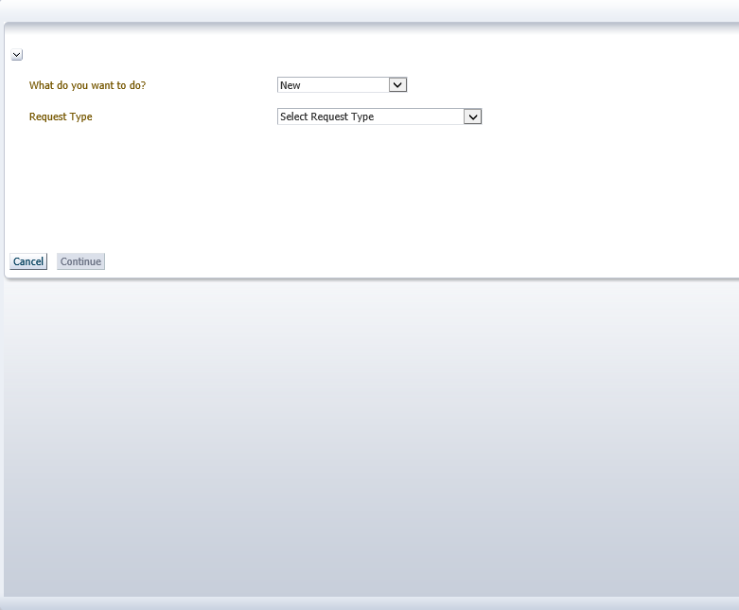
Next, select your Request Type

Slide 11
Selecting Request Type

Slide 12
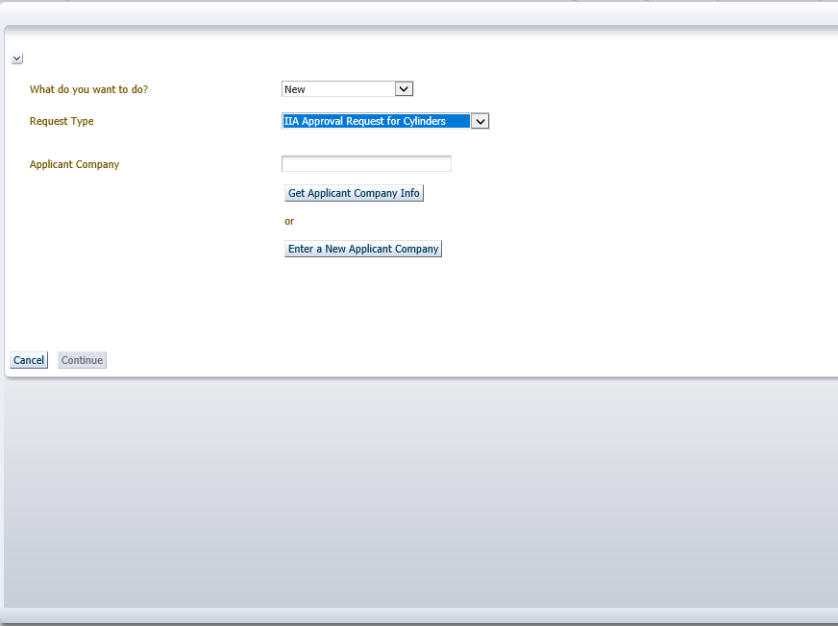
Next, enter your company name in “Get Applicant Company Info” if you have an approval. If you are a new applicant, select “Enter a New Applicant Company”.

Slide 13
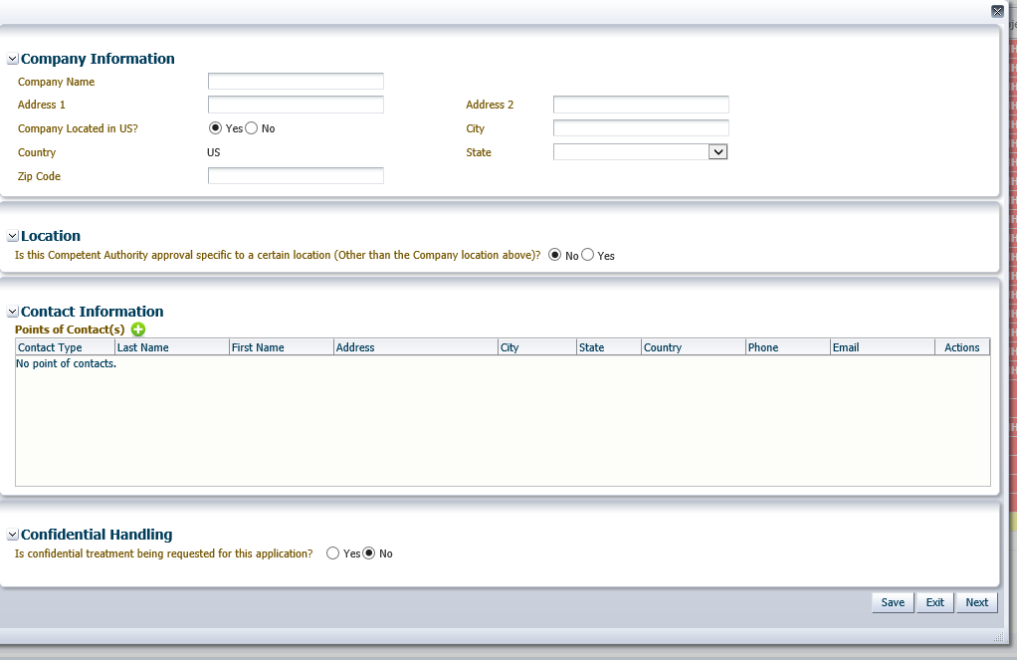
Complete the Company Information section.

Slide 14
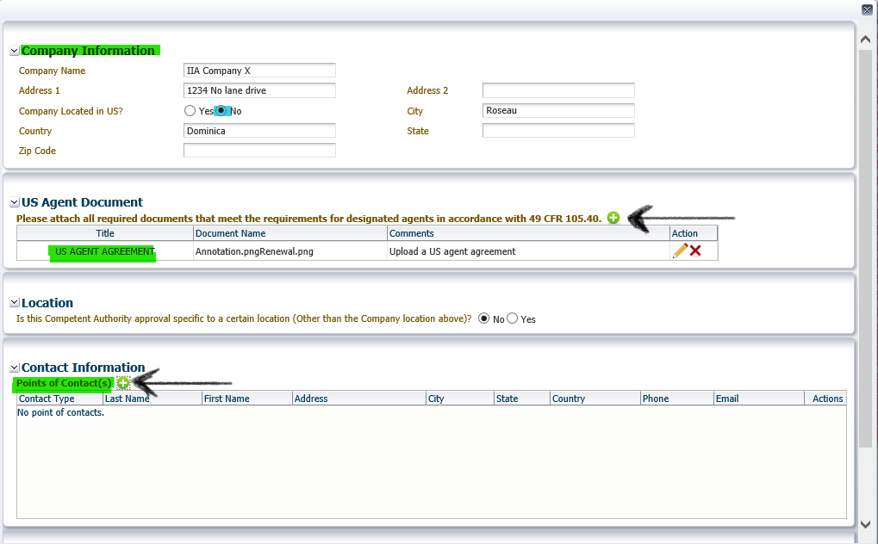
1st- select the green “+” if your company is located outside of the United States. 2nd – complete the Contact Information section by clicking the green “+”.

Slide 15
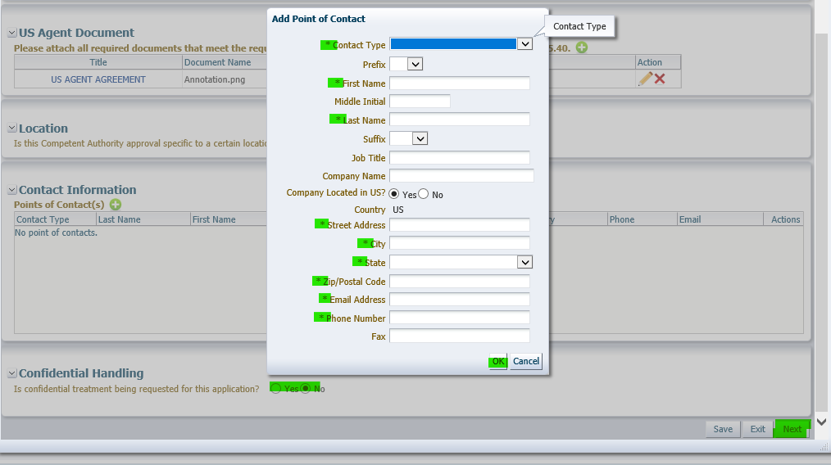
Enter your information for Point of Contact.

Slide 16
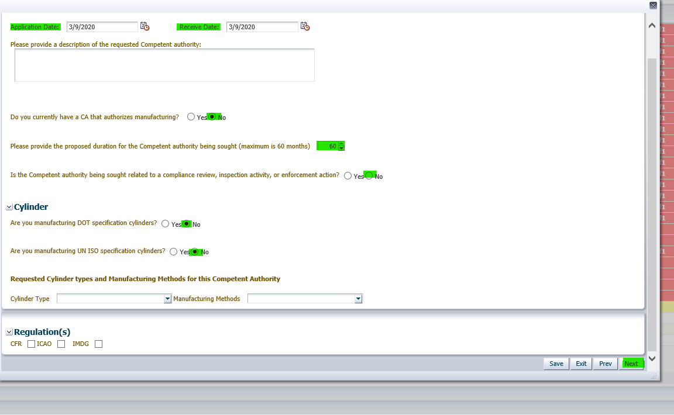
This page is asking for your submittal date and information relating to manufacturing cylinders.

Slide 17
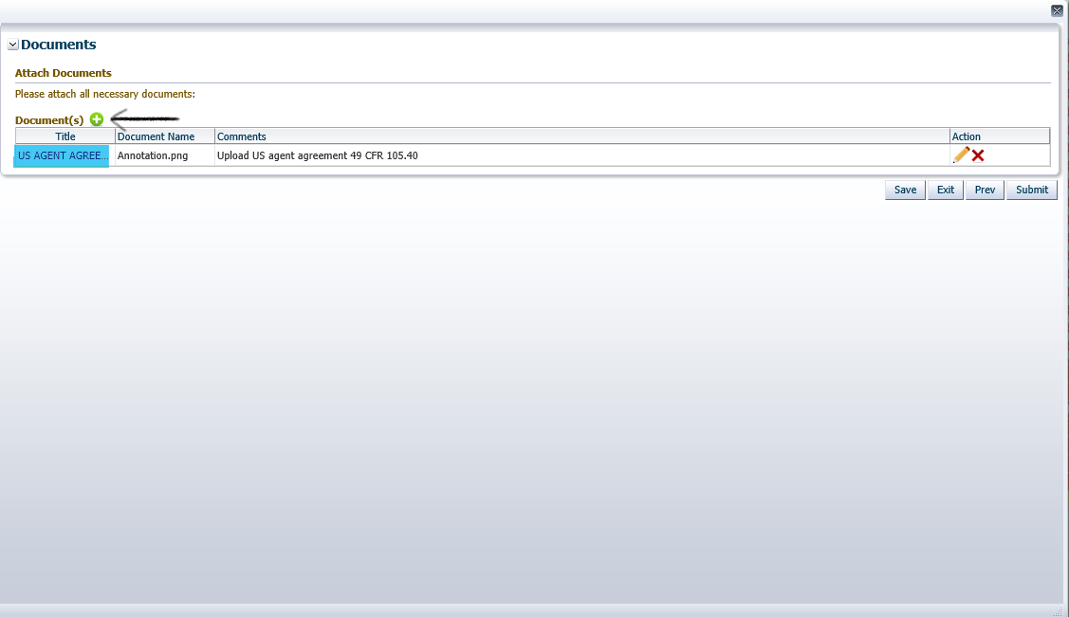
This section is for adding your documents. Select the green “+”.

Slide 18
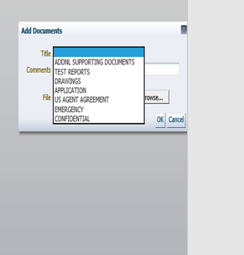
After selecting the green “+”, the Portal want you to select a title for your uploaded documents.

Slide 19
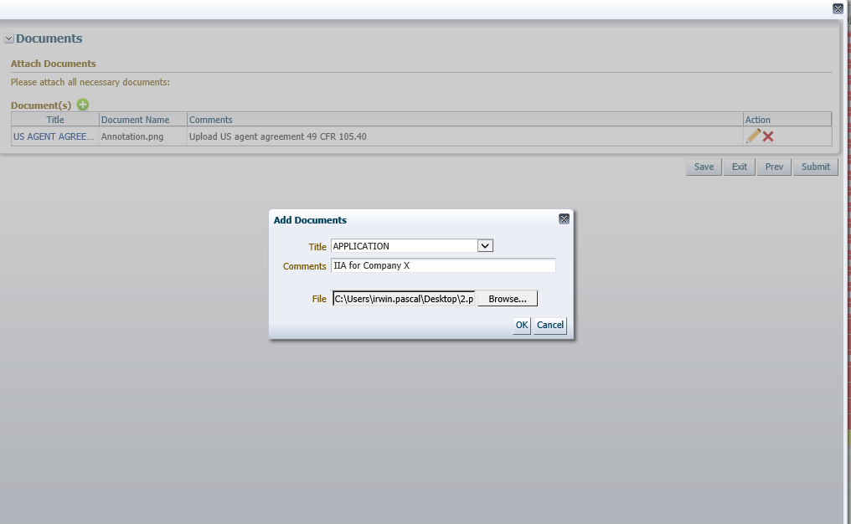
Click the Browse tab to upload your documents from the location you have saved them to previously.

Slide 20
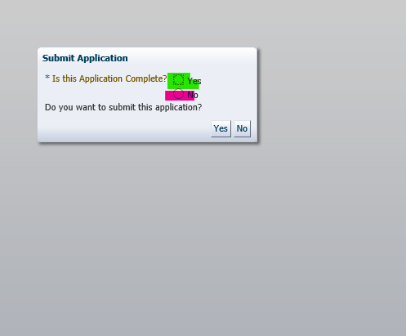
The Portal is asking if you are finish and ready to submit your application.

Slide 21
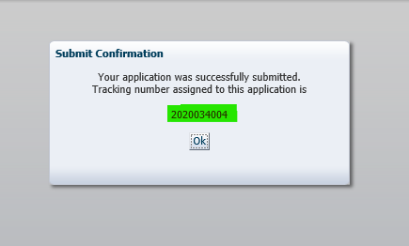
If yes was selected, you will see your specific Tracking Number for your application. Press “ok” – you have completed the process.

Slide 22
If “No” was selected, your application will go to Edit App until it is finalize.

Slide 23
Submitting Applications
‘Must have’ in any application.
Completed IIA application
(information required §§107.705, 107.803 of 49 CFR).
Modification / manufacturer: clearly state what is being sought, Letter of recommendation from IIA, comparison tables, review drawings for completeness and stamped with IIA stamp.

