Slide 1

Pipeline & Hazardous Materials Safety
Administration (PHMSA)
Hazardous Materials Emergency Preparedness (HMEP)
Grant Program Quarterly Webinar for States
July 8, 2020

Slide 2



FY2016 -2018 HMEP Closeout Process
Purpose and Introductions
Agenda
HMEP Grant & COVID-19 with other PHMSA Grants
Post-Award Management and Match/ Cost-Sharing
Overtime, Backfill & Stipends

Slide 3

Welcome
Purpose: To perform continued outreach and keep open lines of communication between PHMSA and its Grantees.
Objectives: For States to gain knowledge on updates to the HMEP Program and to increase effectiveness and ability to utilize funds. Agencies are enabled to virtually meet grantees that may have similar experiences, knowledge, and advice amongst each other.
3

Slide 4
PHMSA Hazmat Grants Team
Director
Aaron Mitchell
Chief
Shakira Mack
Senior Grants Management Specialist
Carla Sheppard
Grants Management Specialists
Andre White, Bonita Brown, Flor Valencia, Lisa Reichenbacher, Matthew Hufford, Suezett Edwards
Program Support
Rose Achieng – Business Analyst
Shannon Logan – Administrative Assistant
- 4 -

Slide 5
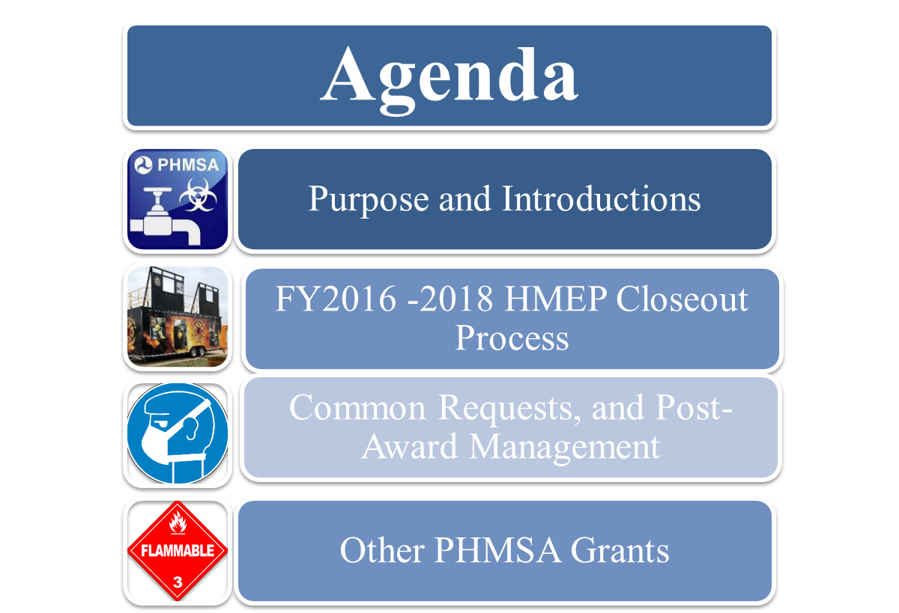

Slide 6
FY2016 -2018 HMEP Closeout Process
The HMEP Grant closeout process consists of:
Ensuring all required documentation and reporting have been submitted to the HMEP grant program. A list of official documentation is listed but not limited to the following:
Federal Financial Reports (FFRs):
Each Grantee is required to submit Semiannual, Annual, and Final FFRs. Each FFR is cumulative.
The Final FFR should capture the cumulative obligations and disbursements that have occurred from the initial grant award date through the end date of the performance period.
Performance Progress Reports (PPR):
Each Grantee is required to submit Semiannual, Annual, and Final PPRs.
The Final PPR is comprehensive report of the entire performance period. It should include all activities that were completed during the entire performance period.
Final SF-424A:
All Grantees must provide a final SF424A that reflects the combined total for all three years of funding.
6

Slide 7

Reporting Schedule
FY16- Semiannual FFR due April 30, 2017 for performance period: 10/1/2016 - 3/31/2017
FY16- Annual FFR & Progress Report due December 30, 2017 for performance period: 4/1/2017 - 9/30/2017
FY17- Semiannual FFR & Progress Report due April 30, 2018 for performance period: 10/1/2017 - 3/31/2018
FY17- Annual FFR & Progress Report due December 30, 2018 for performance period: 4/1/2018 - 9/30/2018
7

Slide 8

Reporting Schedule
FY18- Semiannual FFR & Progress Report due April 30, 2019 for performance period: 10/1/18 - 3/31/19
FY18- Annual FFR & Progress Report due December 30, 2019 for performance period: 4/1/19 - 9/30/19
FY19- Semiannual FFR & Progress Report due April 30, 2020 for performance period: 10/01/19 – 3/30/20
If no Extension: Final FFR & Progress Report were due on December 30, 2019
Extensions: Final Reports due 90 days after the end of the performance period ends.
8
Notes:
* If you had an extension until June 30, 2020; then your final reports are due no later than September 30, 2020.

Slide 9

Friendly Reminders
Any changes to HMEP staff or designated agency should be communicated with your Grant Specialist.
Activity Requests should be submitted in the grants portal and approved by PHMSA prior to conducting activity.
FFRs should be submitted to HMEP.grants@dot.gov and your Grant Specialist.
Progress Reports should be submitted via The PHMSA Grant Portal. (Please contact your Grant Specialist if you have any issues)
9

Slide 10
Frequent Topics for
Post-Award Grant Management
Post Award Changes
Match/Cost- Sharing

Slide 11
Making Changes to your Project Plan
https://hazmatgrants.phmsa.dot.gov/
Otherwise known as a Post-Award Adjustment, Activity Requests (ARs) can be submitted to the HMEP program when the following occurs:
Budget Revision (2 CFR 200.308)
Change in scope (2 CFR 200.308)
About the AR’s:
Common occurrence within the management of the HMEP Grant.
Allows for additional approval of activities.
Enables the program to provide detailed technical assistance.
Hot Tip
Don’t forget to double check the HMEP Expenditures Guide https://www.phmsa.dot.gov/sites/phmsa.dot.gov/files/docs/about-phmsa/grants/hazmat/2956/2019-hmep-expenditures-guide-032819.pdf
11

Slide 12

Match/Cost-Sharing
Non-Federal share of costs grantee is required to contribute to accomplish the purposes of the grant (2 CFR 200.306). Must be verifiable through grantee records and be maintained with the same level of effort as Federal funds (2 CFR § 400-475)
Required Matching of 20%:
States are not required to pass down the match requirement to sub grantees if they are able to fully cover the match.
Matching can be met in other ways, such as hours spent in training for the overall grant award.
Matching cannot be waived due to COVID:
The HMEP grant’s matching requirement is tied to federal statute so it cannot be waived.
12
Notes:
Match requirement citation 2 Per 48 U.S.C.1469a, the requirement to provide a 20% match for the Planning and Training (direct and indirect) costs of all activities covered under the grant award program with non-Federal funds is waived for “Insular Areas” which include the Virgin Islands, Guam, American Samoa, the Trust Territory of the Pacific Islands, and the Government of the Northern Mariana Islands in order to minimize the burden caused by the existing application and reporting procedures.

Slide 13
Additional Information on Matching
Cash/Hard Match:
Most common, easiest to track, and usually from general revenue, cash donations from non-federal third parties, or non-federal grants.
Soft/In-Kind Match:
Value of non-cash contributions
If a space is donated for a HMEP activity to be conducted you can use the expenses that it would have cost you to rent the space as a soft match.
Personnel, goods, and services, including direct and indirect costs
May be in the form of real property, equipment, supplies, services, and other expendable property
Match Tips:
Do not overmatch. However, if a subrecipient has provided over their required match you can apply that to the overall 20% requirement.
Match on the SF-425 (Financial Report) and SF-270 (invoice) shall include dollars as match is accumulated.
Match is not required to be met at each invoice request, but must be fulfilled by the final invoice request.
13

Slide 14


Slide 15
HMEP Grant and COVID-19
PHMSA will allow HMEP funds to be used to purchase items related to the COVID-19 pandemic in order facilitate a safe training environment.
Grantees must submit an Activity Request (AR) and receive prior approval before purchasing COVID-19 related supplies. Examples include, but are not limited to:
Items purchases must be used for HMEP planning or training activities and not for operational use.
Disposable Gloves | Hand Sanitizer
Disinfectant Spray | Disinfectant wipes
Soap | Paper towels
Masks | Sneeze guards
Disposable coveralls | Contactless Thermometers
15

Slide 16
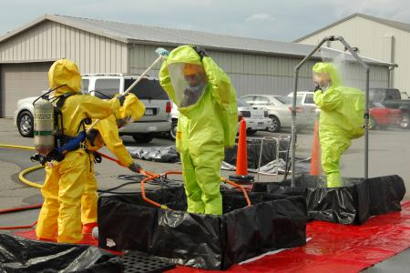
No-Cost Emergency Response Training for Flammable Liquid Incidents (ALERT Grant)
American Chemistry Council (TRANSCAER)
Erica Bernstein, ebernstein@chemtrec.com
703-741-5524, https://www.transcaer.com/training
The Center for Rural Development (CRD)
Julie Wilson, jwilson@centertech.com
606-677-6000, https://www.ruraltraining.org/
International Association of Fire Chiefs (IAFC)
Ashley Johnson, ajohnson@iafc.org
703-537-3981, https://www.iafc.org/learn-and-develop
16
Notes:
Assistance for Local Emergency Response Training (ALERT)

Slide 17

No-Cost “Whole Community” Training Opportunities
Helps communities to prepare for and respond to hazmat accidents and incidents and supports the training of state and local enforcement personnel who are responsible for enforcing the safe transportation of hazmat.
Commercial Vehicle Safety Alliance (CVSA)
Bill Reese, billr@cvsa.org, 301-830-6148, https://www.cvsa.org/eventpage/events/cohmed-conference/about-the-cohmed-program/
International Association of Fire Chiefs (IAFC)
Ashley Johnson, ajohnson@iafc.org, 703-537-3981, https://www.iafc.org/learn-and-develop
Sustainable Workplace Alliance (SWA)
David Casavant, david@sustainablewp.org, 863-676-4100, https://sustainablewp.org/
17

Slide 18
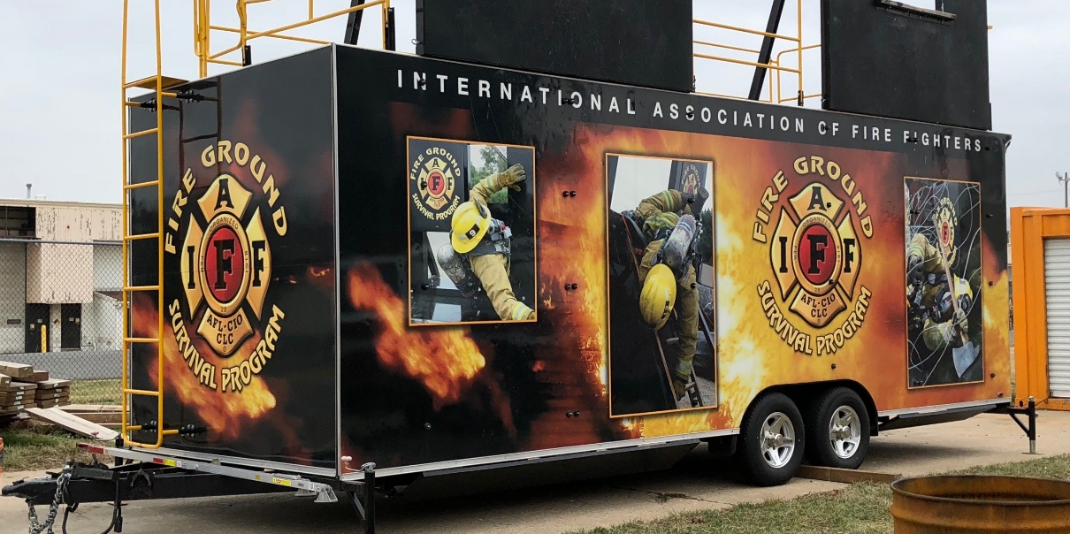
No-Cost Supplemental Training Opportunities for Emergency Responders (SPST Grant)
International Association of Fire Fighters (IAFF)
Elizabeth Del Re, edelre@iaff.org, 202-824-1534, https://www.iaff.org/
Offers in-person and online
virtual training options
18

Slide 19

No-Cost Hazmat Employee Training
(HMIT Grant)
Helps hazmat employees and instructors understand the Hazardous Materials Regulations and how to safely package and ship hazmat.
National Partnership for Environmental Technology Education
Kirk Laflin, klafin@maine.rr.com, 319-640-7283, https://nationalpete.org/
International Chemical Workers Union
John Morawetz, jmorawetz@ICWUC.org, 513-621-8882, https://www.icwuc.org/
Short Line Safety Institute (rail training)
Thomas Murta, tom.murta@shortlinesafety.org, 202-585-3446, https://www.shortlinesafety.org/
19

Slide 20
No-Cost Hazmat Employee Training
(HMIT Grant)
Helps hazmat employees and instructors understand the Hazardous Materials Regulations and how to safely package and ship hazmat.
Sustainable Workplace Alliance (SWA)
David Casavant, david@sustainablewp.org, 863-676-4100, https://sustainablewp.org/
Texas Engineering Extension Service
Taylor Hartmann, taylor.hartmann@teex.tamu.edu, 979-845-2281, https://teex.org/
20

Slide 21
Virtual and Web-based Training
PHMSA strongly encourages HMEP grant recipients to consider virtual and web-based training as social distancing efforts continue.
Virtual training is considered training taught by a live instructor.
Web-based training is considered online training that can be taken remotely at any time.
PHMSA currently has awareness and operations training available at no cost at the following website: https://dotnfa.vividlms.com/
21
Notes:
Software or training courses to enhance virtual and web-based training are eligible costs for the HMEP grant.

Slide 22

22

Slide 23

Overtime & Backfill Costs
PHMSA will now allow HMEP recipients to be reimbursed for Overtime & Backfill Costs
Overtime costs: Expenses limited to the additional costs which result from personnel working over and above 40 hours (or the amount of hours established by the state for fulltime employees) of weekly work time as a direct result of their performance of the PHMSA-approved activities. Overtime shall not exceed 1.5 times an individual’s hourly wage.
Backfill costs: Expenses are limited to overtime costs that result from personnel who are working overtime (as identified above) to perform the duties of other personnel who are temporarily assigned to PHMSA-approved activities outside their core responsibilities.
All costs must be related to an HMEP training activity.
Planning activities are not eligible.
23

Slide 24
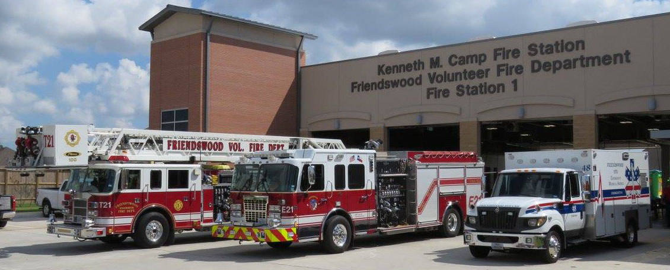
Nominal Volunteer Stipends
PHMSA will now allow HMEP recipients to be reimbursed for nominal volunteer stipends.
A stipend is nominal if it does not exceed 20 percent of what the fire department would otherwise pay a full-time firefighter to perform response services.
HMEP recipients should develop and submit to PHMSA a policy for the standardized stipend amount to be provided for participation in HMEP training and training-related exercises.
Prior-approval must be received before issuing stipends. All costs must be related to an HMEP training activity.
24
Notes:
Whether a stipend falls above or below the 20 percent threshold may be determined in one of two ways. Departments that maintain paid full-time firefighters on their payrolls may compare the stipend to the salary paid to a full-time firefighter who performs similar duties to determine whether the stipend is more or less than 20 percent of that salary. Departments that do not maintain full-time firefighters on their payrolls may make the determination based on a comparison to the salary paid to a full-time firefighter in a neighboring jurisdiction, elsewhere in the state, or ultimately the nation. They may also utilize data from the Department of Labor’s Bureau of Labor Statistics.

Slide 25

Overtime, Backfill & Stipends Recordkeeping Requirements
Grant recipients must retain a list of all individuals involved in these costs and their salary (individual trained and individual backfilling)
Grant recipients must provide PHMSA with an internal management plan to ensure adequate oversight for these costs prior to the activity occurring.
A training record must be maintained for all responders who receive overtime, backfill or stipends by name, county, training date(s) and the total amount paid to each individual volunteer for each individual training event.
25

Slide 26
Hazmat Grant Program
Contact Information
General Grant Inquiries: HMEP.Grants@dot.gov
  Website: www.phmsa.dot.gov/hazmat/grants
  General Phone Number: (202)366-1109
Chief: Shakira Mack, (202) 366-5090, Shakira.Mack@dot.gov
Team Lead: Carla Sheppard, (202) 366-2738, Carla.Sheppard@dot.gov

Slide 27

27

Slide 28
Q&A
1. Can volunteer stipends be used to backfill with volunteer firefighters?
No, volunteer stipends can only be used to provide compensation to volunteer firefighters that may have to take off work to attend HMEP training.
2. Would OT/Backfill apply to both instructors (if agency were to assign an instructor to teach on an OT basis?
No, overtime would only apply to those attending training. However, if there is a unique circumstance that you have please reach out to your grant specialist to discuss.
2B. What if the instructors are employees not consultants?
At this time the overtime is only permitted for those attending training. The OT/Backfill policy was created to address the issues that fire departments have covering shifts for those that attend the HMEP trainings.
28

Slide 29
Q&A
3. Do grantees need to include anticipated OT/Backfill costs for each LEPC in the HMEP application?
It would be ideal to include that information in your application if you have it, but it is not required. Just remember that if the OT/Backfill is not outlined in the approved application you will need to submit the request prior to incurring the OT/Backfill cost.
4. In reference to overtime, two of our fill-time employees that are coordinators/instructor for HMEP approved training has a 35-hour work week. How would you suggest handling the OT since your policy is anything over 40-hours?
At this time PHMSA HMEP grant program does not allow overtime for instructors to conduct the training. However, if there are unique circumstances that you would like PHMSA to consider we will review requests on a case by case basis.
In the cases in which a grantee has a standard work week hour of less than the 40 hour outlined in our OT/Backfill policy please include that information when submitting your request. We will work to update our policy to accommodate those that have less than a 40 hour work week.
29

Slide 30
Q&A
5. Is there guidance on unspent funds remaining at closeout of FY19-20 (year one) due to COVID restrictions?
Due to COVID-19 PHMSA will forego the offset for any unobligated FY19 funds. Grantees are able repurpose HMEP funds if needed and expend any unspent funds until the end of the performance period, September 29, 2022.
6. Will grantees be able to continue to spend year 1 (FY19) funding going into FY21 if we are unable to spend out year 1 allocation by 9/30/2020 due to COVID?
Yes, grantees are able to expend year 1 funding until the end of the performance period. There is no need to request an extension; the performance period for the FY19-21 grant is September 30, 2019 – September 29, 2022.
7. Could the volunteer being brought in for backfill be used as an in-kind match versus a stipend?
Yes, a grantee can use the time a volunteer fire fighter backfills for another fire fighter attending a HMEP training. However, a grantee cannot pay a stipend to a volunteer fire fighter that backfills a spot.
30

Slide 31
Q&A
8. Do courses on the grantee’s approved activities list need to be resubmitted to PHMSA for approval for training courses that have been reformatted to a virtual/webinar course?
No, grantees transitioning their approved HMEP training to virtual/webinars do not need to submit an activity request. However, if the cost increase is 10% or more you will need to notify your grant specialist.
9. If a sub-recipient opted to change an activity to shift money from one course to another that are both allowable per the Expenditure Guide, does PHMSA keep a breakdown of the current budget based on what is submitted through the portal?
When a grantee submits an activity request, PHMSA keeps a record of the request and our approval or rejection of the request. If the activity request requires a budget change (i.e. moving funds from travel object class to contractual) then the grantee is required to submit an updated budget (SF-424A) and the budget is added to the grantee’s official file to reflect the change in the budget.
31

Slide 32
Q&A
10. Due to COVID-19, we may have to extend the deadlines for Year-1 project. What will be the deadline for such extensions?
Any decision to extend a project will be up to the grantee. The performance period for the FY19-21 grant cycle is September 30, 2019 – September 29, 2022, as long as the extension is within the performance period no request for extensions will need to be submitted to PHMSA.
11. If the final SF-424A is different than the combined original SF-424A, will that have to be reconciled somehow?
The final SF-424A should be a combined total of all three years of funding. It should reflect all budget changes that were submitted and approved by PHMSA. If there are any changes to the budget that were not approved by PHMSA you should contact your grant specialist to reconcile before submitting the final reports and final SF-424A.
32

