Slide 1

Pipeline & Hazardous Materials Safety
Administration (PHMSA)
Hazardous Materials Emergency Preparedness (HMEP)
Grant Program Webinar for Tribes and Territories
July 1, 2020

Slide 2
Common Requests, and Post-Award Management
Purpose and Introductions
Agenda
Other PHMSA Grants
Extensions and Updated Expenditure Allowances

Slide 3

Welcome
Purpose: To perform continued outreach and keep open lines of communication between PHMSA and its grantees
Objectives: Tribes and Territories gain knowledge on updates to the HMEP Program to increase effectiveness and ability to utilize funds. Agencies are enabled to virtually meet grantees that may have similar experiences, knowledge, and advice amongst each other.
3

Slide 4
PHMSA Hazmat Grants Team
Director
Aaron Mitchell
Chief
Shakira Mack
Senior Grants Management Specialist
Carla Sheppard
Grants Management Specialists
Andre White, Bonita Brown, Flor Valencia, Lisa Reichenbacher, Matthew Hufford, Suezett Edwards
Program Support
Rose Achieng – Business Analyst
Shannon Logan – Administrative Assistant
- 4 -

Slide 5
Frequent Topics for
Post-Award Grant Management
Activity Requests
Cost Types
Cost Sharing

Slide 6
Making Changes to your Project Plan
https://hazmatgrants.phmsa.dot.gov/
Otherwise known as a Post-Award Adjustment, Activity Requests (ARs)can be submitted to the HMEP program when the following occurs:
Budget Revision (2 CFR 200.308)
Change in scope (2 CFR 200.308)
About the AR’s:
Common occurrence within the management of the HMEP Grant
Allows for additional approval of activities
Enables the program to provide detailed technical assistance
Hot Tip
Don’t forget to double check the HMEP Expenditures Guide https://www.phmsa.dot.gov/sites/phmsa.dot.gov/files/docs/about-phmsa/grants/hazmat/2956/2019-hmep-expenditures-guide-032819.pdf
6

Slide 7
Understanding Direct and Indirect Costs
Direct Costs (2 CFR, §200.413)
  Specific
  Identifiable
  Incurred to provide services or products for a grant award of activity
Indirect Costs (2 CFR, §200.414)
Can not be identified for a specific grant award, service, or activity of an organization, but are incurred as a result of multiple grant awards, services, or activities.
In general, Indirect Costs fall within two categories (2 CFR, §200.414)
  Facilities
  Administration
*It is very important that agencies clearly segregate direct and indirect costs in the accounting system and when computing the indirect cost rate.
7

Slide 8
Indirect Cost Rate Agreement (ICRA) Quick Tips
The HMEP Program accepts any current, active, and existing ICRA’s from another Federal agency. If an ICRA has never been certified, the 10% De Minimis Rate may be used
What is the De Minimis Rate?
10% of Modified Total Direct Costs (MTDC)
Must be used consistently across all federal awards
Does not apply to Territories
Reminder: As ICRA’s expire, don’t forget to submit your most up to date ICRA HMEP.Grants@dot.gov and your Grant Specialist.
8
Notes:
Territories have previously existing rates, therefore it does not apply

Slide 9

Match and Cost-Sharing
Non-Federal share of costs grantee is required to contribute to accomplish the purposes of the grant (2 CFR 200.306) Must be verifiable through grantee records and be maintained with the same level of effort as Federal funds (2 CFR § 400-475)
Grantees shall provide 20% match of funds and may use:
Cash or hard match (common for Tribes)
In-kind contributions (soft match)
A combination of In-Kind and Cash
Match does NOT include:
Federal funds from other programs
Funds used as match from another Federal program
9
Notes:
Match requirement citation 2 Per 48 U.S.C.1469a, the requirement to provide a 20% match for the Planning and Training (direct and indirect) costs of all activities covered under the grant award program with non-Federal funds is waived for “Insular Areas” which include the Virgin Islands, Guam, American Samoa, the Trust Territory of the Pacific Islands, and the Government of the Northern Mariana Islands in order to minimize the burden caused by the existing application and reporting procedures.

Slide 10
Cash and In-Kind Match
Cash: Most common, easiest to track, and usually from general revenue, donations from non-federal third parties, or non-federal grants.
In-Kind:
Value non-cash contributions
  Personnel, goods, and services, including direct and indirect costs
  May be in the form of real property, equipment, supplies, services, and other expendable property
Third party in-kind comes from other non-federal third parties and may also include those listed above
Match Tips:
Do not overmatch
Match on the SF-425 (Financial Report) and SF-270 (invoice) shall include dollars as match is accumulated
Match is not required to be met at each invoice request, but must be fulfilled by the final invoice request
10

Slide 11
Performance Period Extension Request
Submit an extension request as soon as you know you need more time, and at least 30 days prior to the end of your existing deadline.
Performance period extension requests shall be emailed to HMEP.grants@dot.gov
Extension Requests shall include the following:
  Duration and end date of the extension request.
    Grantees may request an extension up to a year. The proposed end date of the performance period must be identified in the request.
  Extension date must be sufficient to complete grant activities.
    For example, do not request a one month extension if remaining activities will take three months to complete.
11

Slide 12
Performance Period Extension Request
Justification for the extension. Grantees must provide a brief summary of the reason the extension is needed (e.g. delays in awarding subgrants, staff turnover, poor weather, state budget constraints, etc.).
Summary and timeline of extension activities. Grantees must submit a brief summary and timeline of activities that will take place during the extended performance period. There must be a sufficient plan in place to complete the grant activities during the requested extension period.
12

Slide 13
HMEP Grant and COVID-19
PHMSA will allow HMEP funds to be used to purchase items related to the COVID-19 pandemic in order facilitate a safe training environment.
Grantees must submit an Activity Request (AR) and receive approval prior to purchasing COVID-19 related supplies. Examples include, but are not limited to:
Items purchases must be used for HMEP planning or training activities and not for operational use.
Disposable Gloves | Hand Sanitizer
Disinfectant Spray | Disinfectant wipes
Soap | Paper towels
Masks | Sneeze guards
Disposable coveralls | Contactless Thermometers
13

Slide 14
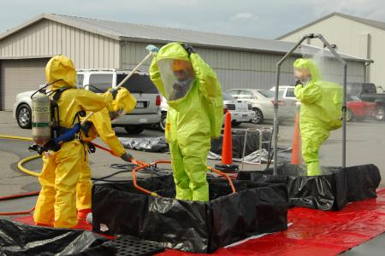
No-Cost Emergency Response Training for Flammable Liquid Incidents (ALERT Grant)
American Chemistry Council (TRANSCAER)
Erica Bernstein, ebernstein@chemtrec.com
703-741-5524, https://www.transcaer.com/training
The Center for Rural Development (CRD)
Julie Wilson, jwilson@centertech.com
606-677-6000, https://www.ruraltraining.org/
International Association of Fire Chiefs (IAFC)
Ashley Johnson, ajohnson@iafc.org
703-537-3981, https://www.iafc.org/learn-and-develop
14
Notes:
Assistance for Local Emergency Response Training (ALERT)

Slide 15

No-Cost “Whole Community” Training Opportunities
Helps communities to prepare for and respond to hazmat accidents and incidents and supports the training of state and local enforcement personnel who are responsible for enforcing the safe transportation of hazmat.
Commercial Vehicle Safety Alliance (CVSA)
Bill Reese, billr@cvsa.org, 301-830-6148, https://www.cvsa.org/eventpage/events/cohmed-conference/about-the-cohmed-program/
International Association of Fire Chiefs (IAFC)
Ashley Johnson, ajohnson@iafc.org, 703-537-3981, https://www.iafc.org/learn-and-develop
Sustainable Workplace Alliance (SWA)
David Casavant, david@sustainablewp.org, 863-676-4100, https://sustainablewp.org/
15

Slide 16
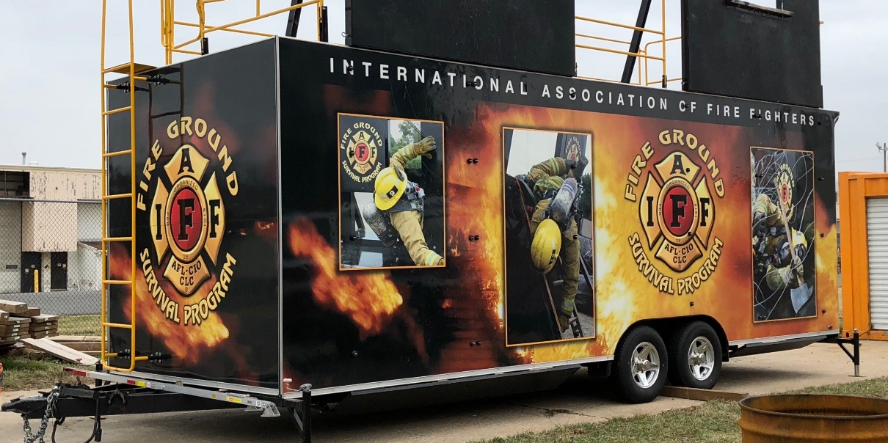
No-Cost Supplemental Training Opportunities for Emergency Responders (SPST Grant)
International Association of Fire Fighters (IAFF)
Elizabeth Del Re, edelre@iaff.org, 202-824-1534, https://www.iaff.org/
Offers in-person and online
virtual training options
16

Slide 17

No-Cost Hazmat Employee Training (HMIT Grant)
Helps hazmat employees and instructors understand the Hazardous Materials Regulations and how to safely package and ship hazmat.
National Partnership for Environmental Technology Education
Kirk Laflin, klafin@maine.rr.com, 319-640-7283, https://nationalpete.org/
International Chemical Workers Union
John Morawetz, jmorawetz@ICWUC.org, 513-621-8882, https://www.icwuc.org/
Short Line Safety Institute (rail training)
Thomas Murta, tom.murta@shortlinesafety.org, 202-585-3446, https://www.shortlinesafety.org/
17

Slide 18
No-Cost Hazmat Employee Training (HMIT Grant)
Helps hazmat employees and instructors understand the Hazardous Materials Regulations and how to safely package and ship hazmat.
Sustainable Workplace Alliance (SWA)
David Casavant, david@sustainablewp.org, 863-676-4100, https://sustainablewp.org/
Texas Engineering Extension Service
Taylor Hartmann, taylor.hartmann@teex.tamu.edu, 979-845-2281, https://teex.org/
18

Slide 19
Virtual and Web-based Training
PHMSA strongly encourages HMEP grant recipients to consider virtual and web-based training as social distancing efforts continue.
Virtual training is considered training taught by a live instructor.
Web-based training is considered online training that can be taken remotely at any time.
PHMSA currently has awareness and operations training available at no cost at the following website: https://dotnfa.vividlms.com/
19
Notes:
Software or training courses to enhance virtual and web-based training are eligible costs for the HMEP grant.

Slide 20
Overtime and Backfill Costs
PHMSA will now allow HMEP recipients to be reimbursed for Overtime and Backfill Costs
These costs must be related to an HMEP training activity.
Planning activities are not eligible.
Grant recipients must retain a list of all individuals involved in these costs and their salary (individual trained and individual backfilling)
Grant recipients must provide PHMSA with an internal management plan to ensure adequate oversight for these costs prior to the activity occurring.
Volunteer stipends will also be allowed provided that grant recipients provide PHMSA with documentation showing how the stipend amount was determined. Prior-approval must be received before issuing stipends.
20

Slide 21
Hazmat Grant Program
Contact Information
General Grant Inquiries: HMEP.Grants@dot.gov
  Website: www.phmsa.dot.gov/hazmat/grants
  General Phone Number: (202)366-1109
Chief: Shakira Mack, (202) 366-5090, Shakira.Mack@dot.gov
Team Lead: Carla Sheppard, (202) 366-2738, Carla.Sheppard@dot.gov

Slide 22

22

Slide 23
Q&A
1. Does PHMSA have a list of allowable COVID-19 items that can be purchased with HMEP funds?
No, currently we do not have a list of allowable COVID-19 items that can be purchased with HMEP fund; however as we receive request and approve COVID-19 purchases we will start compiling a list and share it with our grantees.
2. Can we purchase laptops to facilitate virtual trainings?
Yes, laptop purchases for HMEP approved activities are allowable. PHMSA will review each request to ensure that the costs per unit is reasonable.
3. Is internet subscription to facilitate the virtual trainings allowable cost to the HMEP grant?
Yes, internet subscription is an allowable cost to the HMEP grant program. However, PHMSA may not cover a 100% of the cost if the services will be used for more than conducting the approved HMEP activities.
23

Slide 24
Q&A
4. Does virtual training has to be a combination of hazmat transportation related and non-transportation related or can it be one or the other ?
No, trainings can be a combination or it can be only hazmat transportation related type of virtual trainings. HMEP does not allow trainings that does not have a component of the hazmat transportation related tie in. If a grantee is conducting a training that has a component of the hazmat transportation tie-in then PHMSA will cover a percentage of the cost based of how much of the training is HMEP related.
5. Are there significant differences between the states and tribes?
The biggest difference between the states and the tribes is performance period. Tribes are on a one year performance period, while the states are on a three year performance period. The one year performance period for tribes allow tribes that do not have an HMEP grant an opportunity to apply for the HMEP grant.
24

Slide 25
Q&A
5. If we are requesting an extension on an older grant performance period, do we also need to request an extension on the current grant performance period?
The territories are on a 3 year performance period with the states. All HMEP territories received an extension for their FY16-18 grant until September 30, 2020, so there is no need to submit an extension request at this time. For the FY19-21 grant cycle, the performance period does not end until September 29, 2022 so no extension is needed.
The tribes are on a 1 year performance period. Tribes can request an extension for any active grant cycle.
6. Can we have activities run concurrently using both the older and current grant?
Yes, you can use grant funds from two active grant cycle to fund an approved HMEP activity.
7. We had travel in our grant. Any advice?
Due to COVID-19 a grantees have suspended any travel that they had planned for the HMEP grant. Those funds that were allocated for travel can be repurposed for other things such as COVID-19 supplies for future HMEP trainings, or virtual platforms to conduct virtual trainings. If you are repurposing the funds remember that you must submit an activity request and receive approval prior to expending those funds for the new activity.
25

