Slide 1

DOT ERG isolation and downwind distances and other models
Tucson, AZ Disaster Response Scenario
John S. Morawetz
International Chemical Workers Union Council
Center for Worker Health & Safety Education
Cincinnati, Ohio
https://hsed.icwuc.org/
HMIT grant with UAW, AFSCME, AFGE and UFCW

Slide 2
ERG: Background on Table 1
Initial Isolation and Protective Action Distances
p. 293: “determine the downward distance to which persons may become incapacitated and unable to take protective action or may incur serious health effects”

Slide 3
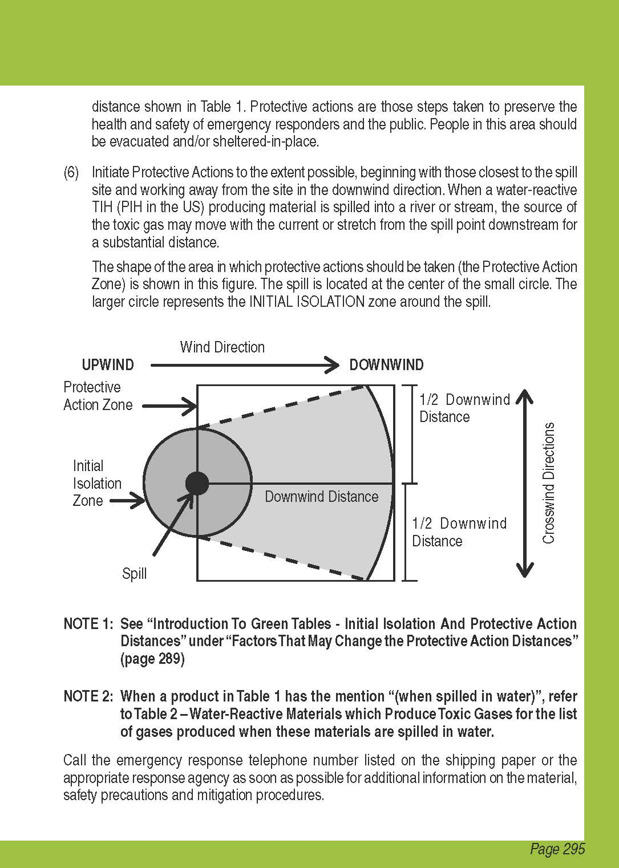
DOT ERG
Initial Isolation distances
Downwind distances

Slide 4
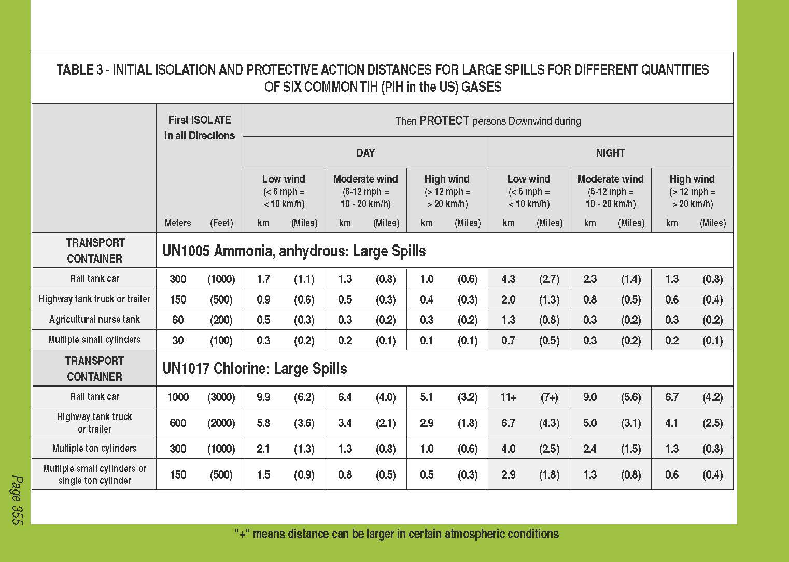
Table 3: Six common TIH (toxic by inhalation) Gases
Anhydrous Ammonia Chlorine Ethylene Oxide
Hydrogen Chloride Hydrogen Fluoride Sulfur Dioxide

Slide 5
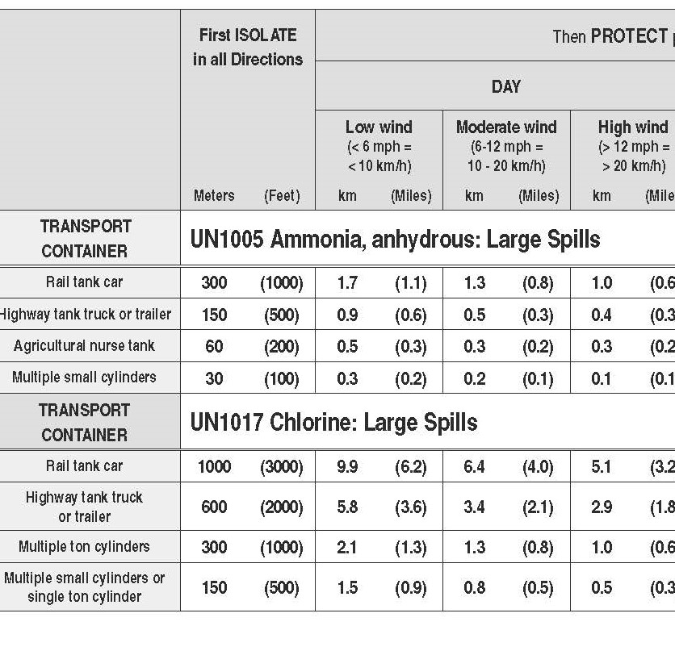
Chlorine – Rail tank car, Day
Isolate
1,000 meters (3,000 feet)
.62 mile
Protect Downwind
Moderate wind – 6 to 12 mph
4 miles

Slide 6
What happens in a release?
A footprint is formed
A release from one point source
Steady wind from one direction
Footprint that shows the furthest points the chemical reaches a given level (ppm)

Slide 7
What health effects happen?
There are a number of health outcomes that responders use to utilize the ERG to plan a response inside and outside the downwind distance
Will people have mild symptoms? Can they escape? Have serious health effects? Are their lives threatened?

Slide 8
Many models can show the three footprints (and health outcome areas) at same time
Impaired Escape
Death
Symptoms
No Symptoms

Slide 9
They can also show the change of concentration at any given point for the first hour
Impaired Escape

Slide 10
Scenario factors
Chlorine tanker car in a Tucson, Arizona rail yard
Full 90 ton car
1.5” hole at bottom of car
Wind at 7 mph from east
70º at 8 AM, October 3
ERG p. 293: “determine the downward distance to which persons may become incapacitated and unable to take protective action or may incur serious health effects”
Chlorine: 2 ppm for 60 minute exposure

Slide 11
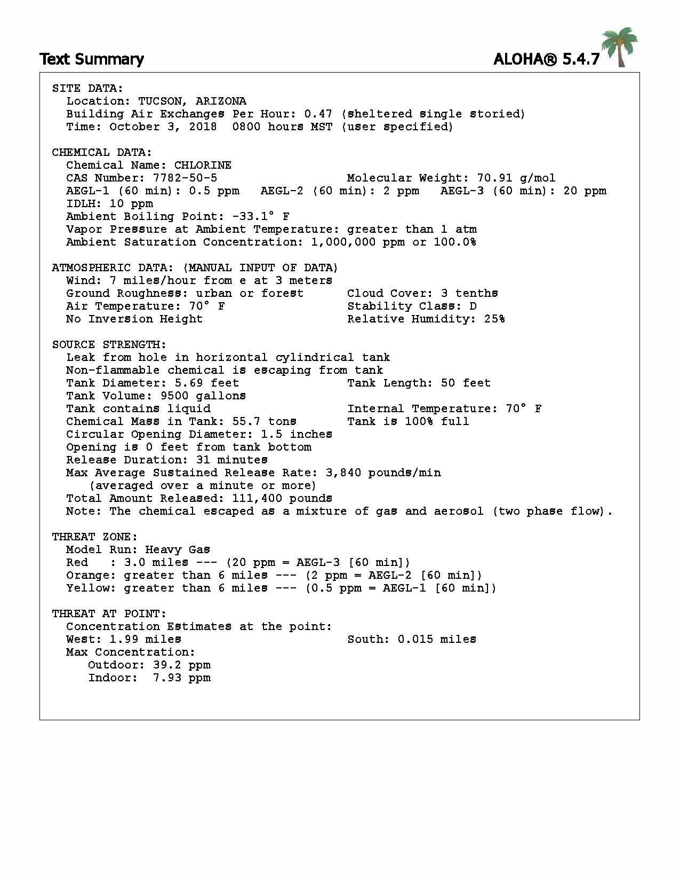
ALOHA Text Summary
Site Data
Chemical data
Atmospheric data
Source Strength
Threat zone
Threat at point

Slide 12
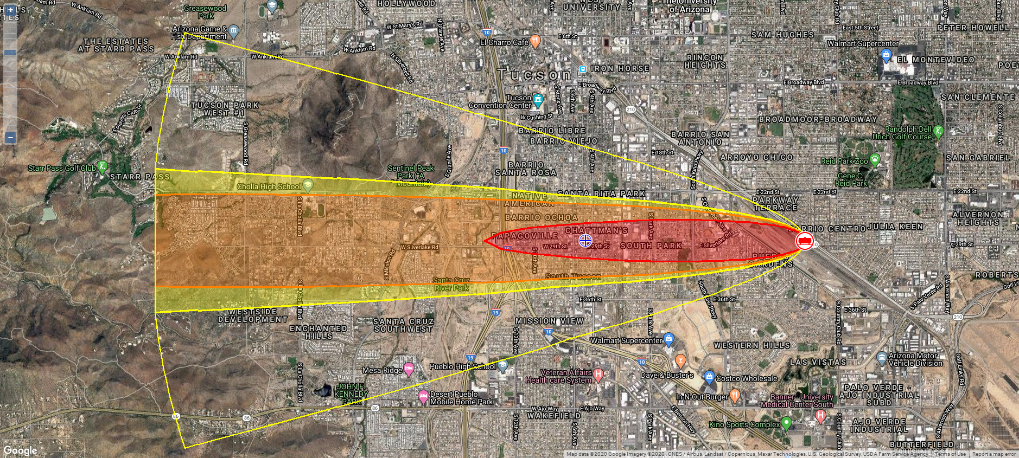
Initial plume with threat zone marked on MARPLOT map at 2 miles
Death

Slide 13
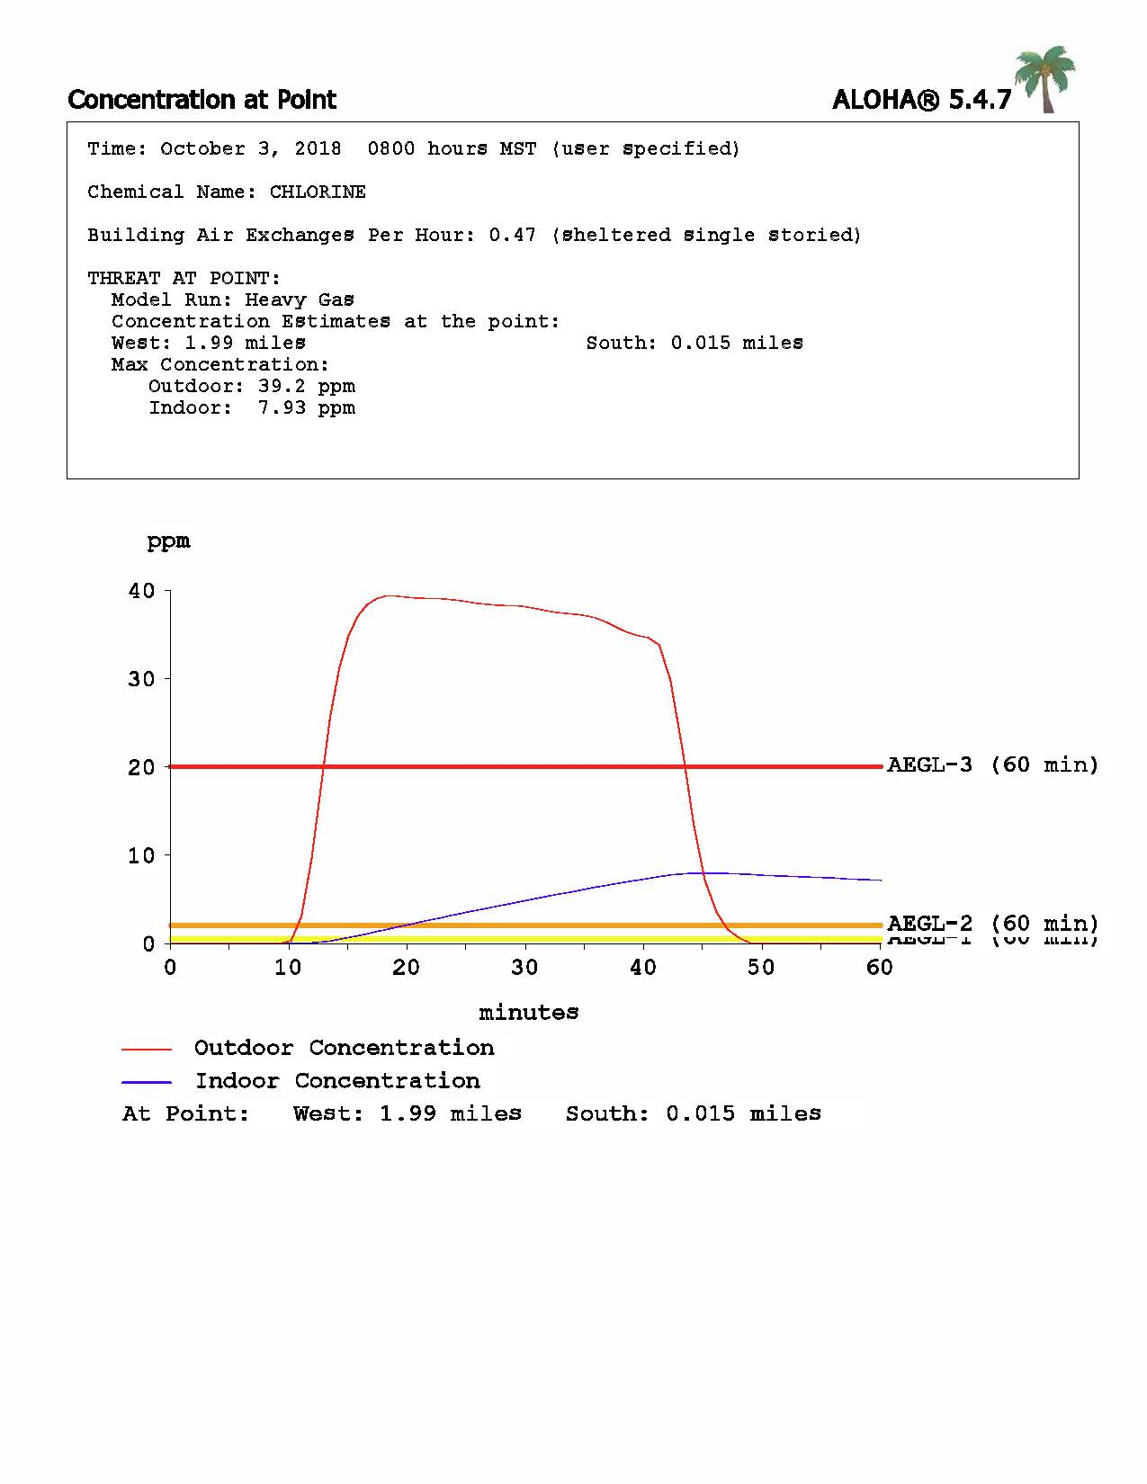
Concentration at 2 miles
Death 20 ppm

Slide 14
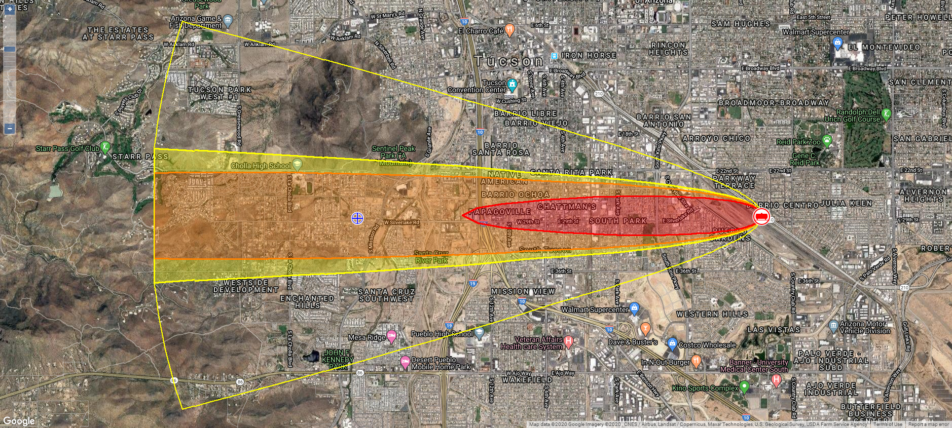
Threat zone marked on MARPLOT map at 4 miles
Impaired Escape

Slide 15
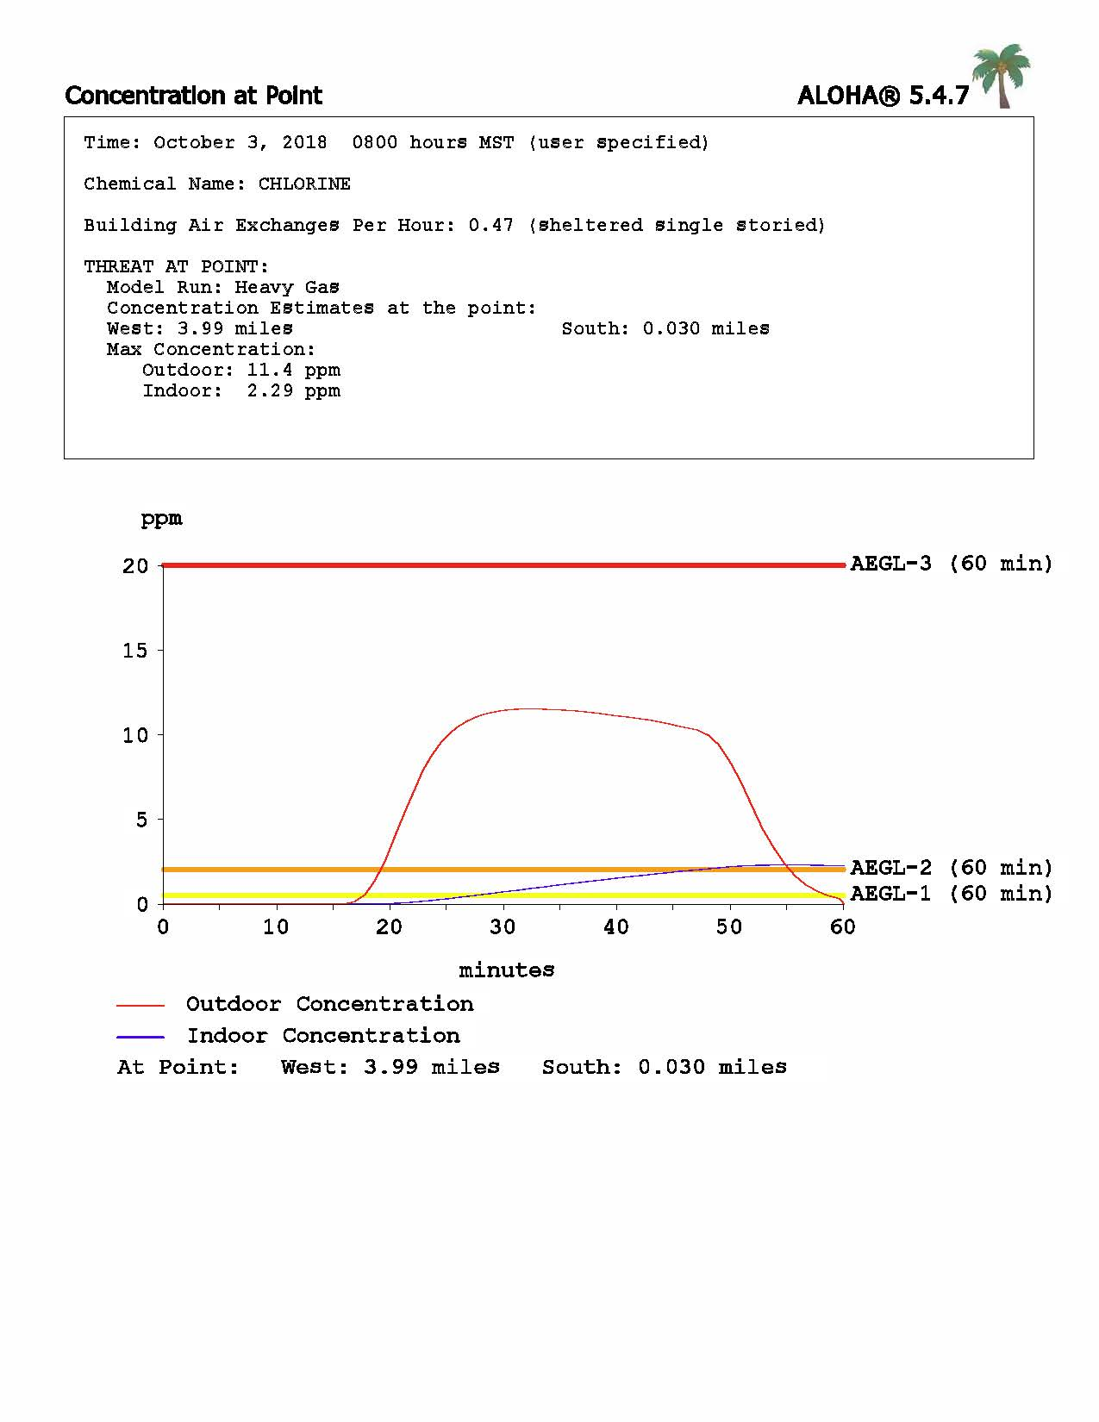
Concentration at 4 miles
Death
Ability to escape – 2 ppm

Slide 16
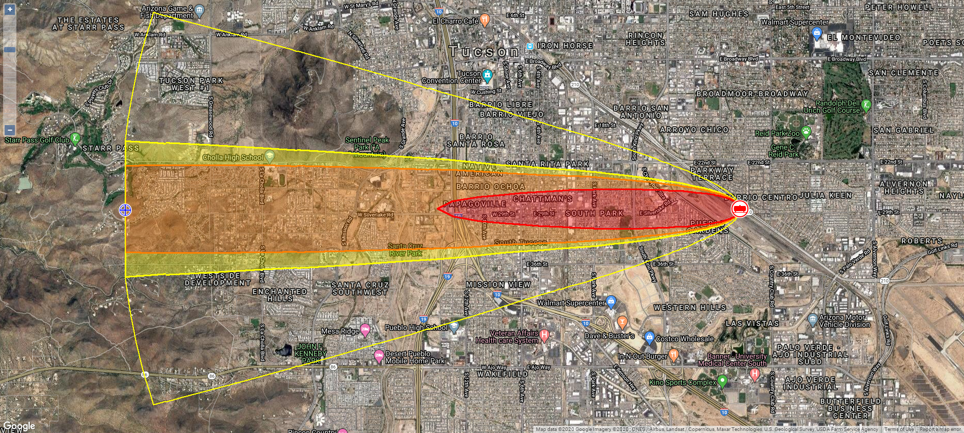
Threat zone marked on MARPLOT map at 6 miles
(limit of this program)
Symptoms
Impaired Escape
Symptoms

Slide 17
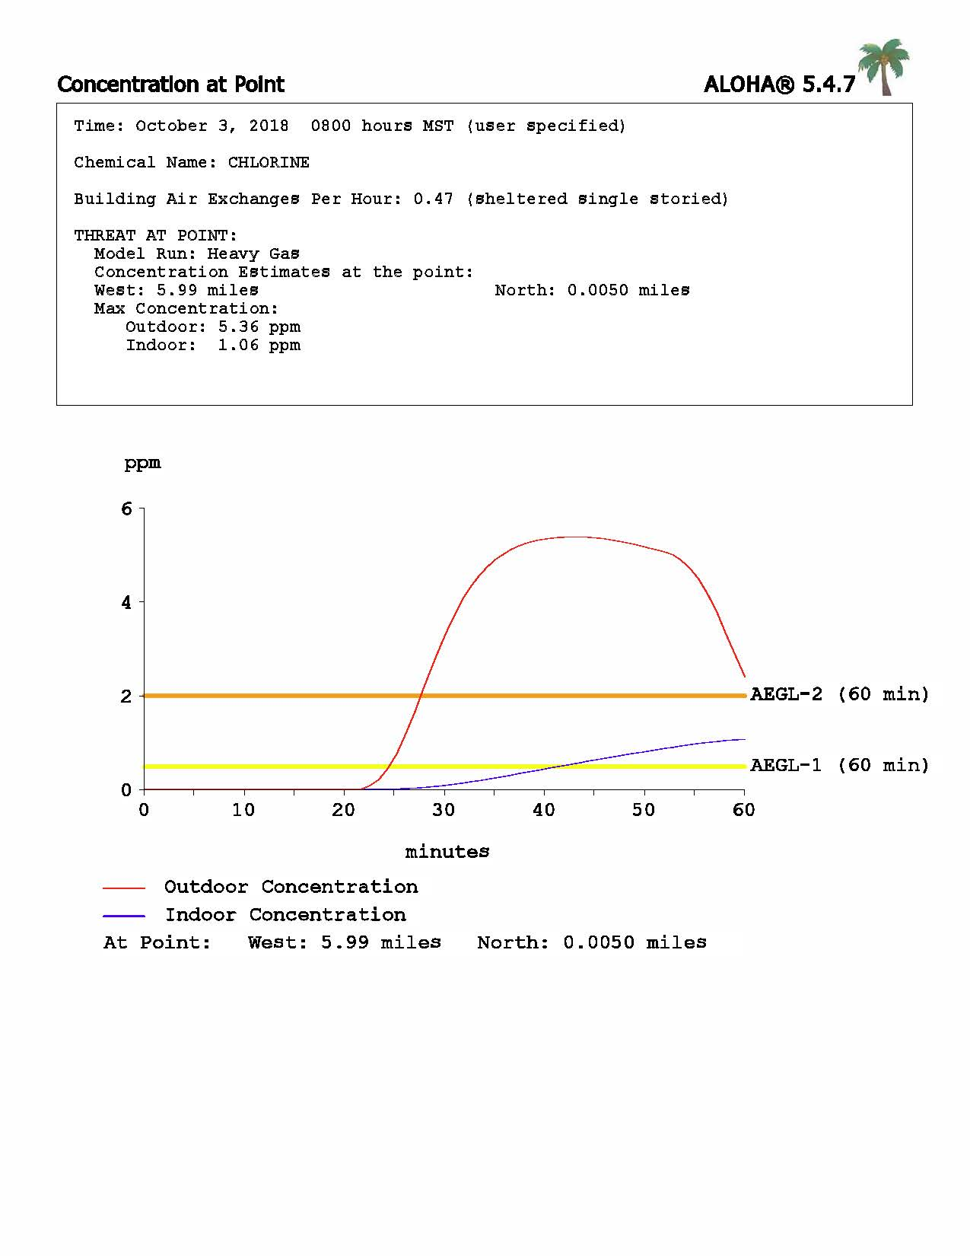
Concentration at 6 miles
Ability to escape

Slide 18
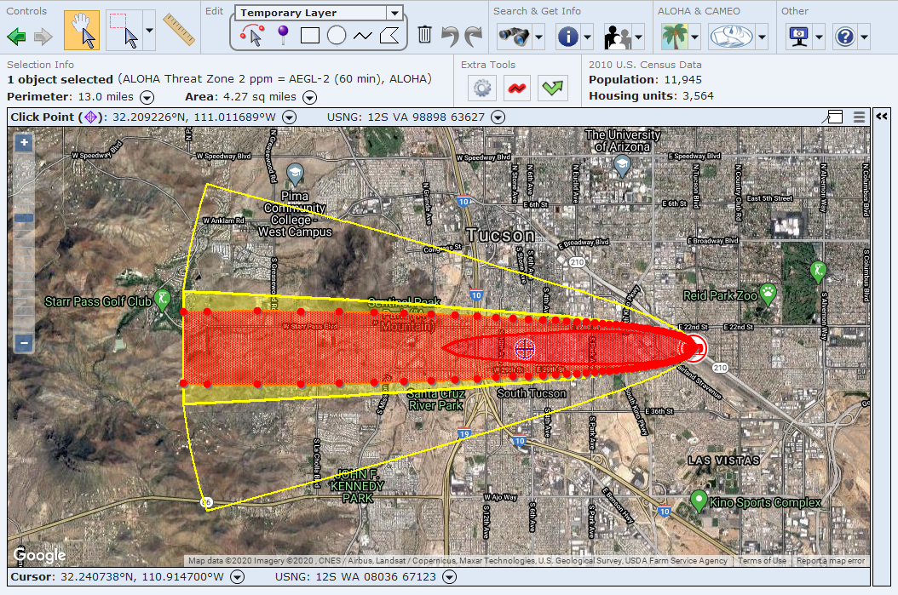
Impaired Escape/Death
Impaired Escape, serious health effects and death population: 4.27 sq. miles; 11,945 people: 3,564 housing units

Slide 19
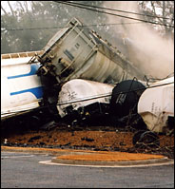
Chlorine Gas Still Lingers From South Carolina Train Wreck That Killed Eight
JENNIFER HOLLAND
Associated Press
January 6, 2005
GRANITEVILLE, S.C. (AP) -- Townspeople and nightshift workers at a textile mill heard the scrape of metal and a house-shaking boom. Then, in rolled a greenish-yellow fog that smelled powerfully like bleach, searing their eyes and lungs and making them cough and gasp.

Slide 20
