Slide 1

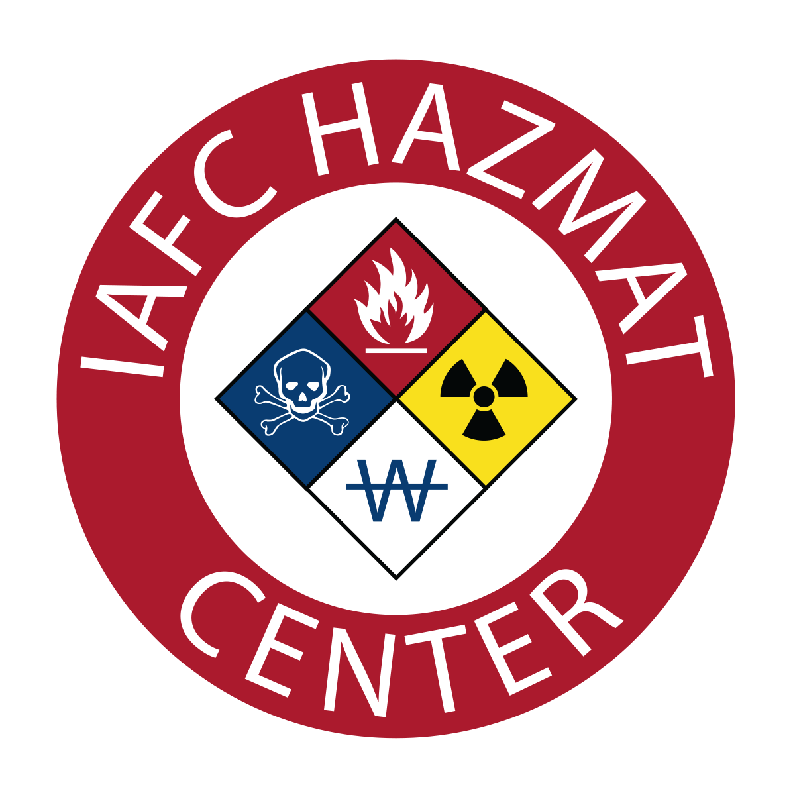
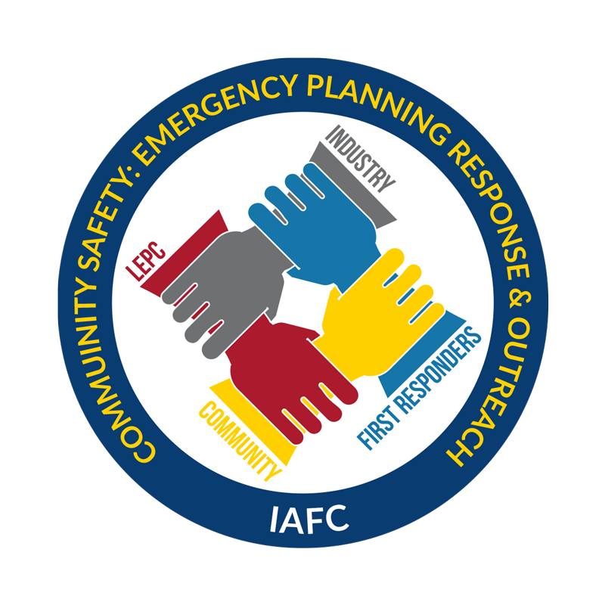
International Association of Fire Chiefs

Slide 2
IAFC – ALERT Grant
The IAFC represents the leadership of
firefighters and emergency responders worldwide. IAFC members are the world's leading experts in
firefighting, emergency medical services, terrorism response, hazardous response, natural disasters, search and rescue, and public safety legislation.
The Assistance for Local Emergency Response Training (ALERT) grant provides hazmat training for volunteer or remote emergency responders. The ALERT grant program focuses on emergency response activities involving the transportation of crude oil, ethanol and other flammable liquids by rail.

Slide 3
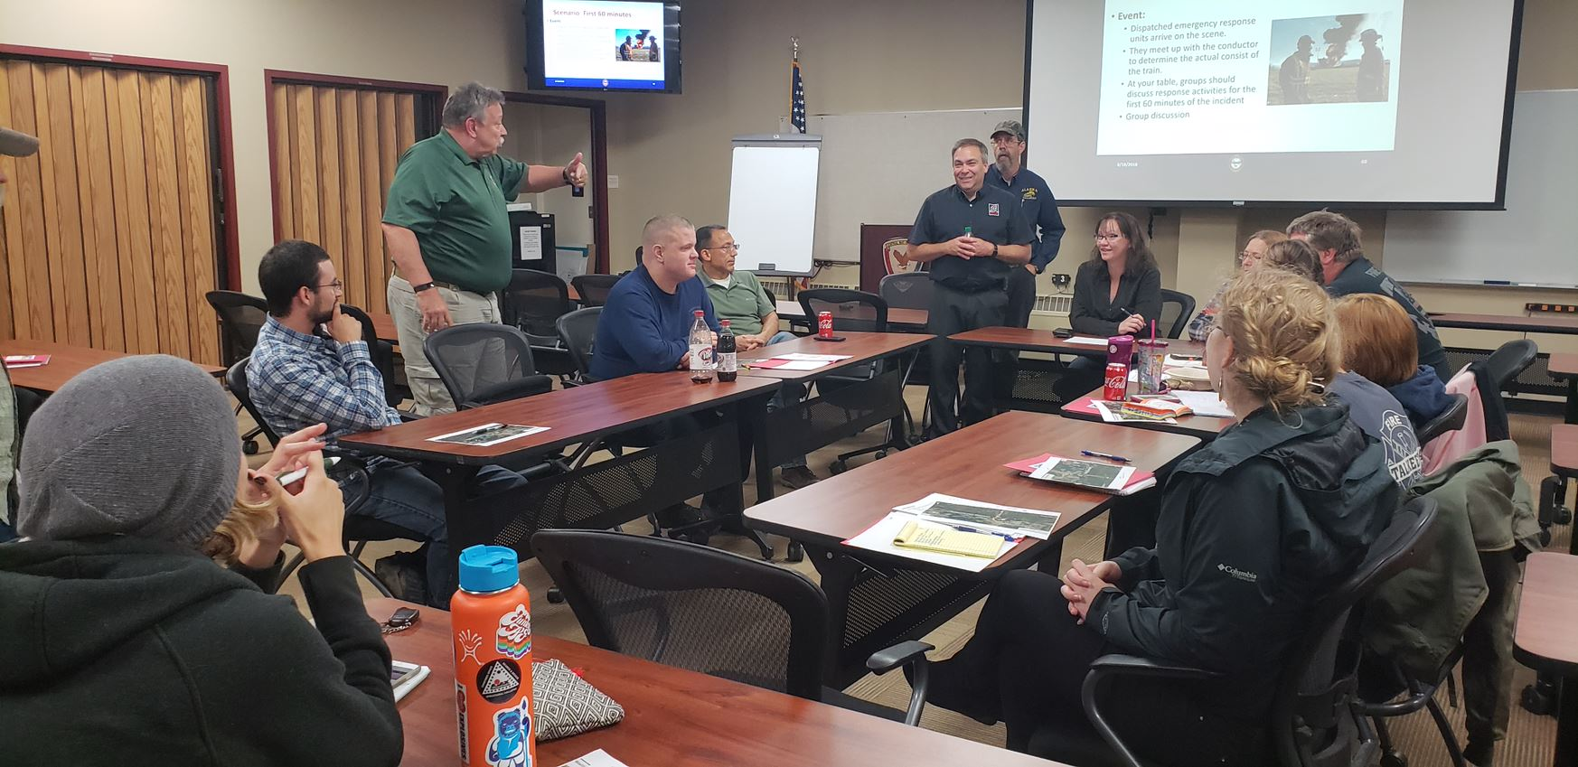
ALERT – Program Activities
Task I – Online Learning : Regional Rail Response
SLSI provided feedback on the curriculum for the short line areas.
The IAFC anticipates 1,000 new enrollments
Task II (A)– Instructor Led Trainings: Regional Rail Response
SLSI provided feedback on the curriculum for the short line areas.
Nine of the ten trainings scheduled from April – September.
The IAFC anticipates training 400 responders with 3,200 contact hours in 10 classes.
Task II (B) – HazMat Tabletop with Rail Scenario
Conducted with five (5) ILT- RRR.
The IAFC anticipates training 200 responders with 1,600 contact hours in 5 classes.
Task II (C) - Safety Train
Partnership with SLSI to provide three safety trains as part of the trainings.
“I'm a new volunteer firefighter, so my scope of knowledge is very limited. I learned a lot about how to stage for events like this. I especially liked the group exercises/table talk was an effective learning tool.” Girdwood, AK Participant

Slide 4
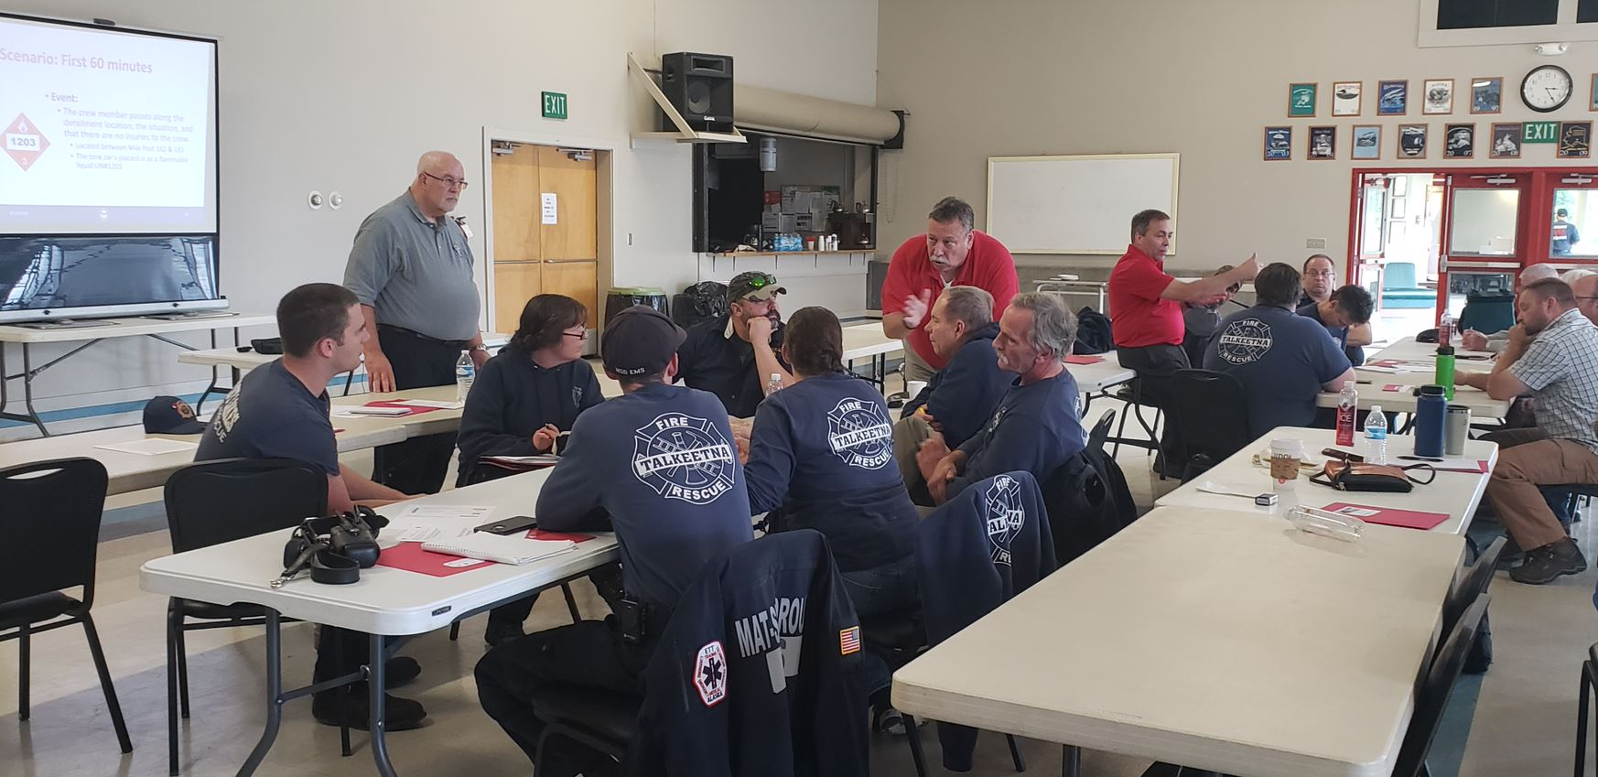
ALERT – Program Activities
Task III - Outreach with Promotion and Marketing of the AskRail Mobile Application
Shared on Hazmat FC social media sites, webpage and marketing materials for conferences and meetings.
Evaluations/Monitoring
Online analytics of RRR Online Participants
Online surveys of RRR Online Participants
Post surveys from RRR Instructor Led Participants
Web-based analytics of AskRail promotions and outreach
“Very open format. No questions were pushed off until the end. Instructors answered them at once. The tabletop at the end was a nice finish to tie everything in and give the opportunity to put information learned into practical application.” Pomona, NY Participant

Slide 5

Questions

Slide 6
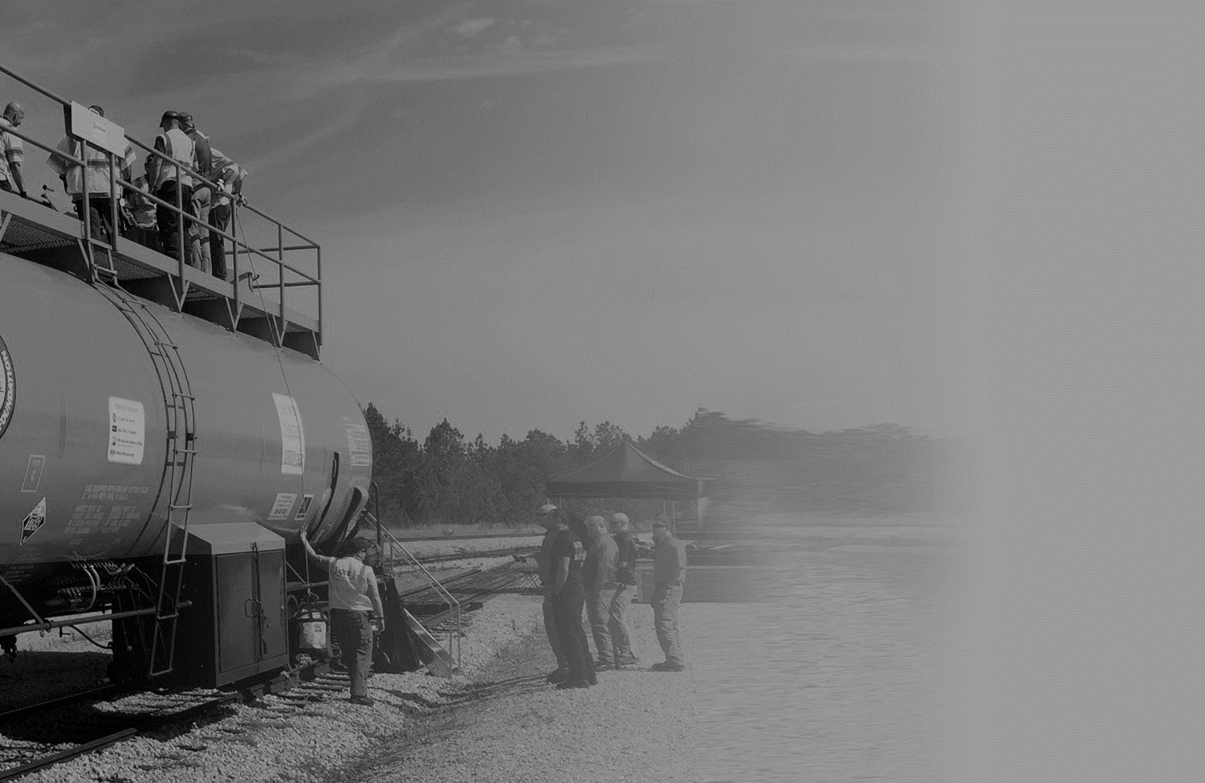












Slide 7
OUR SUCCESSES
40,626
trained in 2018
Thousands
trained each year
since 1986
100s
of FREE training
events offered
yearly
In Touch
TRANSCAER® today magazine & monthly eNewsletter
Training on anhydrous ammonia, chlorine, crude by rail, ethanol, steel drums, and highway & rail safety
Sponsored by 10
organizations
Partnerships with PHMSA, FRA, NVFC, IAFC
30 “Seconds Count - Are You Prepared?” videos with 7 more currently in development

Slide 8
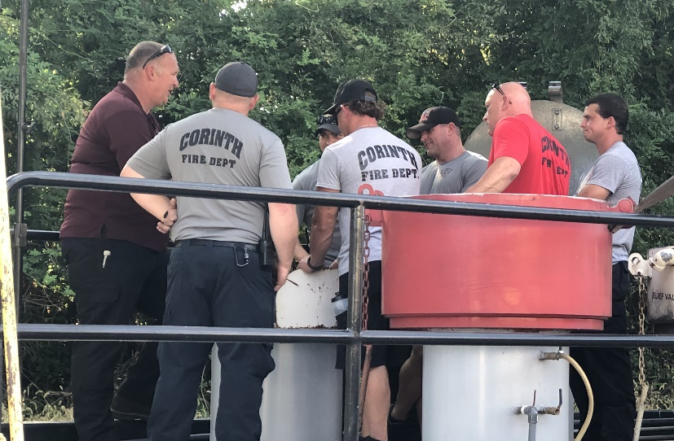
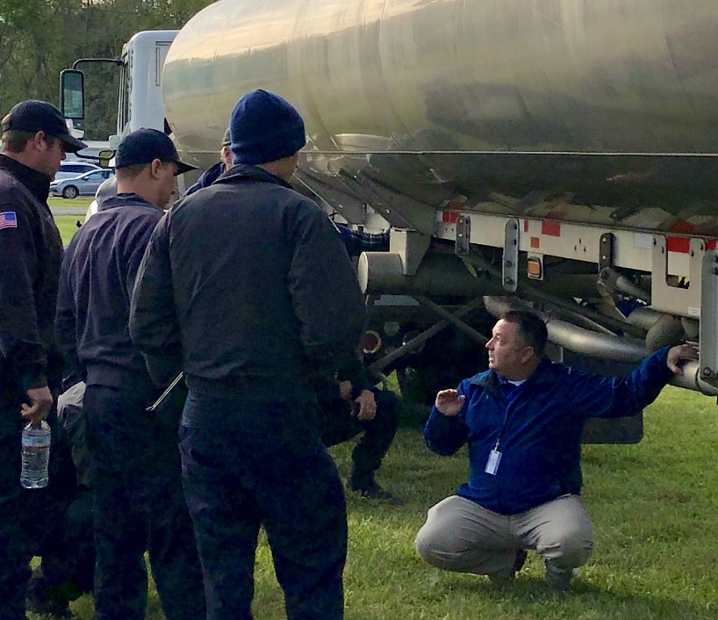
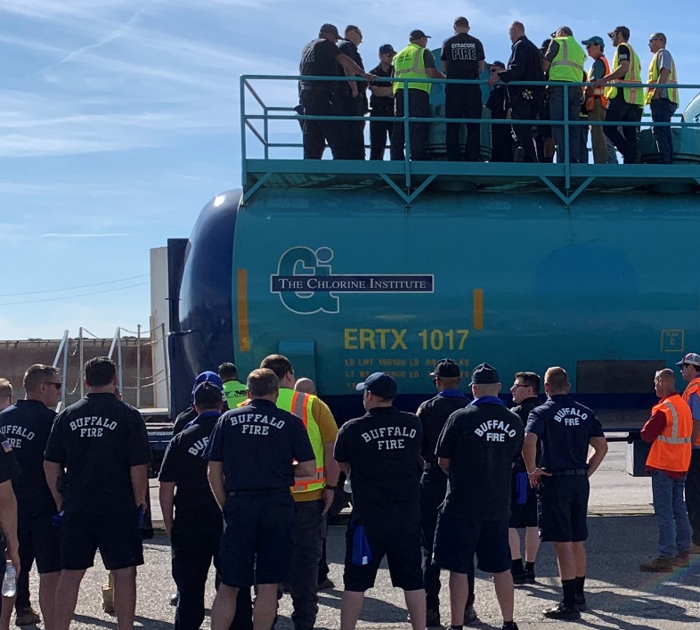
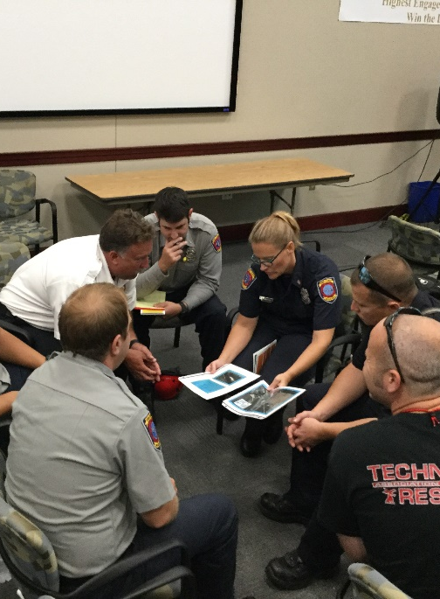
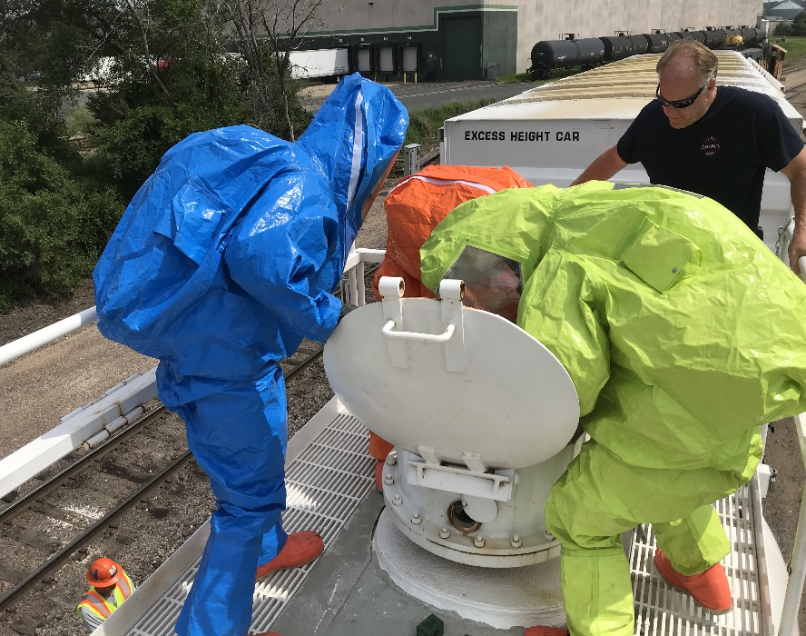
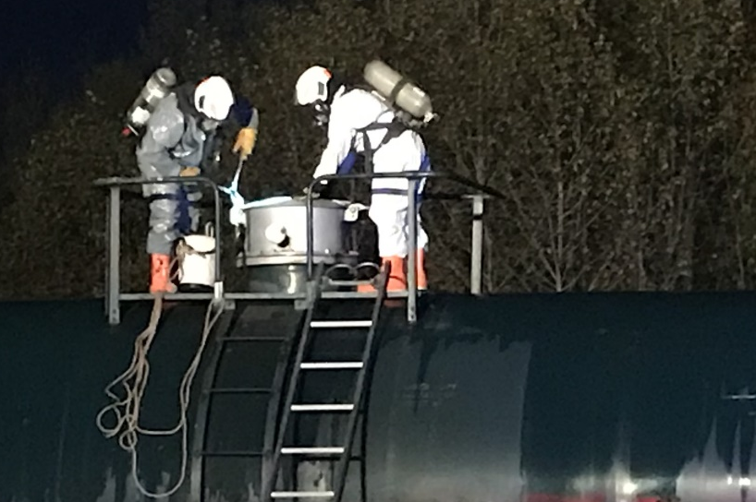
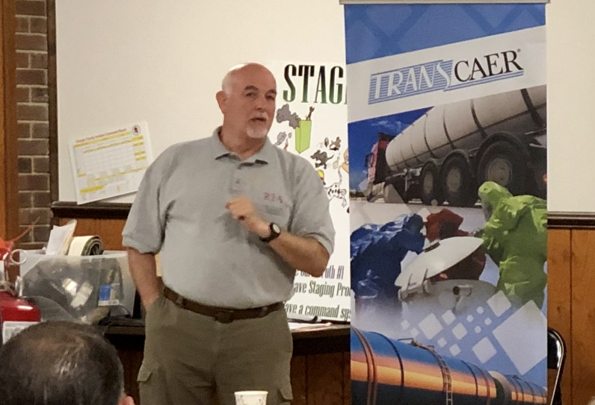
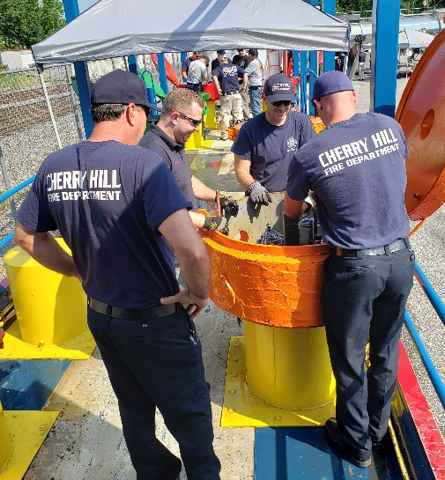
TRANSCAER® aims to reach out to a broad spectrum of stakeholders from responders, to government, to industry -- here are some of our OUTREACH & TRAINING efforts we made across North America throughout 2019.
Notes:
Top: Norfolk Southern Safety Train, Highway Cargo Tank Safety Training at the Joint Emergency Services Training Center in Zachary, Louisiana, Chlorine Institute Rail Safety and Hazmat Emergency Response Training Event (Buffalo, NY), Ammonia Safety Training in partnership with Anheuser-Busch in Williamsburg, VA Virginia Department of Emergency management, and Tanner Industries
Bottom Row: Railroad Emergency Response Training, BNSF, CN and CP in Minneapolis, MN, Minnesota Railroad Summit (BNSF/CP/UP/CN/CI/Emergency Response Contractors) Duluth, MN Nighttime rail car scenario , Ethanol & Steel Drum in Orange, VA, Dow Safety Train in New Jersey
Challenges: Avoiding duplication of trainings events (Best Practice: encourage partnerships between all sponsors), scheduling training events (Best Practice: Fire Chief/Training Officer – select best days and number of sessions), Low attendance rate even though training is free (still working on best practices for attendance – TRANSCAER is exploring CEUs and credit hours – available in some states not all),

Slide 9
TRANSCAER Training & Resources
Challenges | Best Practices
Avoiding duplication of training events | Encourage partnerships between all sponsors
Scheduling training events | Fire Chief/Training Officer – selects best days and number of sessions based on their training/rotation schedules
High no-show rates or low attendance for free training events | Still identifying best practices for attendance/no-show rates TRANSCAER is currently exploring CEUs/Refresher Hours (Available in some states & not a uniform application process) Issue certificates for all training events Some training Sponsors (ISDI & CI) present challenge coins for course completion
Distribution of training materials | Phasing out DVDs, purchasing USBs in 2020 (through ALERT Grant Funding), online options for 24/7 access

Slide 10

Questions

Slide 11


The Center for Rural Development

Slide 12
DOT ALERT Alliance
The Center for Rural Development (CRD)
      Principal Investigator
      501c(3) nonprofit organization established in 1996
      Mission: To provide leadership that stimulates innovative and sustainable economic development solutions
      ALERT awardee in both FY15 and FY17 for training Nationwide
  University of Findlay’s All Hazards Training Center (AHTC)
        Provides customized education, training, and information-transfer programs that focus on environmental, safety, health, security management, and emergency/disaster preparedness.
        A University of Findlay (Ohio) training center since 1989
        FY15 and FY17 ALERT awardee for 800 mile radius of Findlay, Ohio
        FY19 nationwide partnership – hubs in Ohio, Texas, and Utah

Slide 13
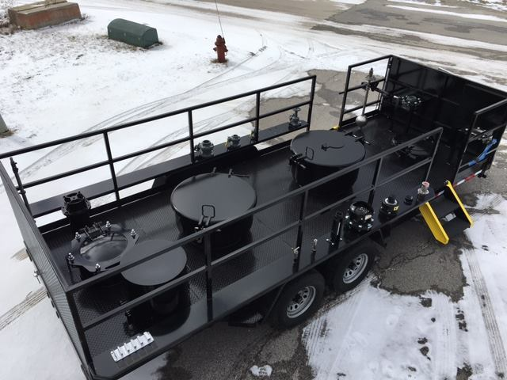
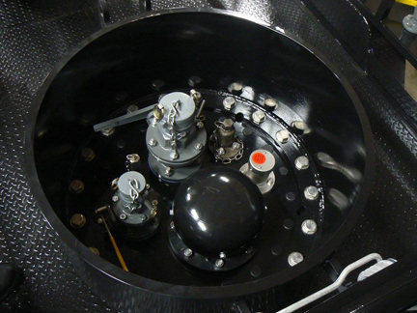
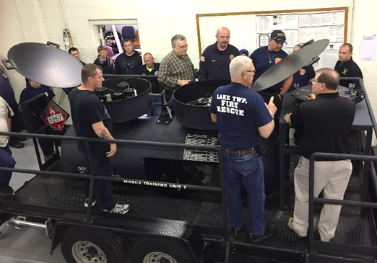
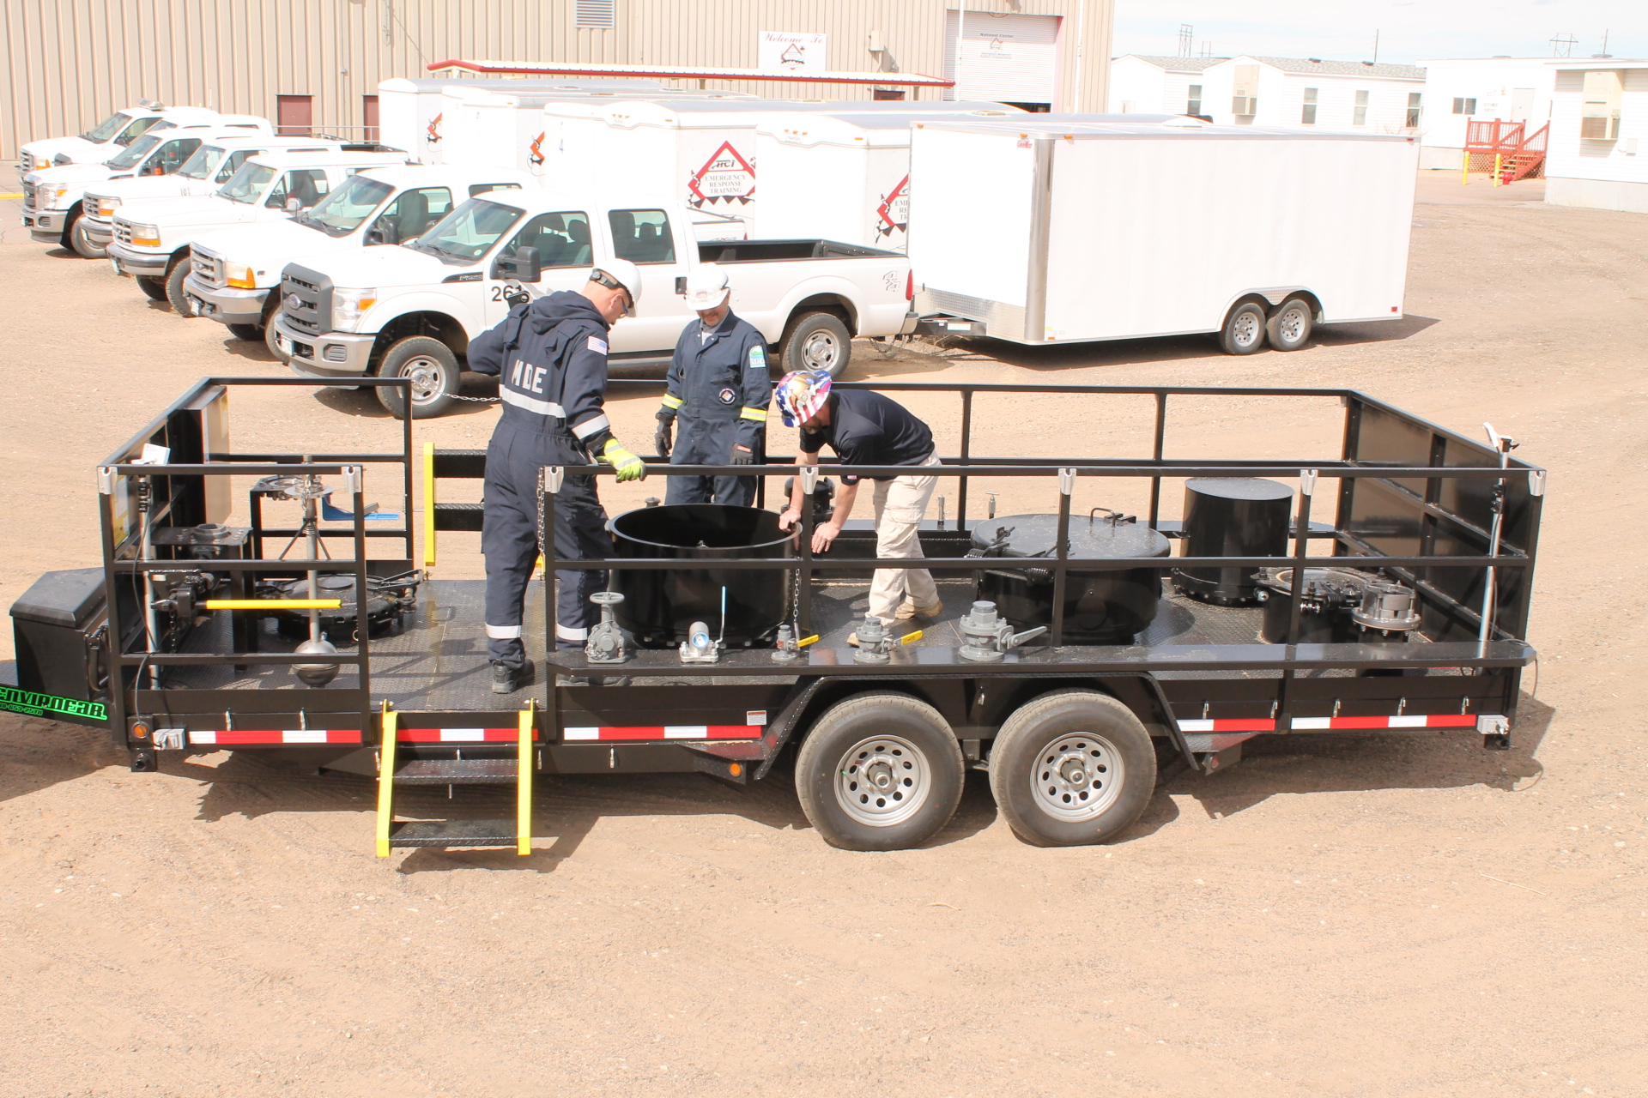
DOT PHMSA ALERT FY19 TRAINING PROGRAM
    Training for volunteer and remote responders related to rail transportation of crude oil, ethanol, and other flammable liquids
    8hr. scenario-based training
    Modules of Instruction
      Introduction and Overview
      Introduction to Rail Car Emergency Response
      Train Composition and Rail Car Design
      Hazardous Materials Recognition and Identification
      Characteristics of Chemicals and Toxicology
      Rail Tank Car Response
      Post Test and Course Evaluation
    FY19 ALERT Grant
      Awarded October 1, 2019
      Training deliveries started January, 2020

Slide 14
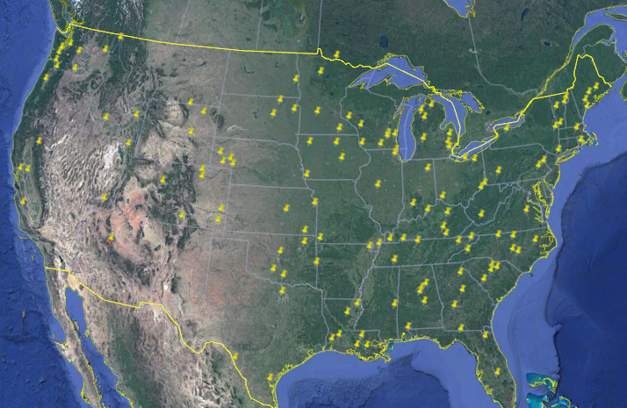
DOT PHMSA ALERT
Nationwide Delivery Statistics
FY 19 Statistics to Date
    90 Deliveries to Complete
      15 completed as of 3/2/20
      59 scheduled from 3/3/20 - 9/26/20
      39 pending to be scheduled
      113 total requests to date
FY 17 Completed Training
    Performance
      303 trained as of 3/2/20
      20 per delivery
      Pre Test Average: 72%
      Post Test Average: 97%
      % Improvement: 34%
    Evaluation Results To Date
      Average overall rating of course – 3.8/4.0
      Average overall rating of instructor – 3.9/4.0
      Objectives of course met – 3.8/4.0
      Course was relevant to my needs – 3.8/4.0
      Course materials – 3.9/4.0

Slide 15


Slide 16
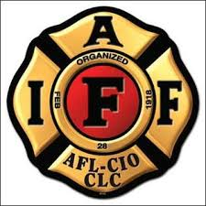
International Association of Fire Fighters (IAFF)

Slide 17
International Association of Fire Fighters (IAFF)
The IAFF is the driving force behind nearly every advance in the fire and emergency services in the 21st century.
Headquartered in Washington, DC, and Ottawa, Ontario, the IAFF represents more than 320,000 full-time professional fire fighters and paramedics in more than 3,500 affiliates.
IAFF members protect more than 85 percent of the population in communities throughout the United States and Canada.

Slide 18
IAFF Training
Training Deliveries
  Train-the-Trainer
  Supportive Teaching Sessions
  Director Deliveries
Training Programs
  Maintain/Update Curricula as needed (NFPA 472 – NFPA 1072)
Evaluation
  Instructors
  Program Compliance

Slide 19
Supplemental Public Sector Training Grant (SPST)
In 2018-2019…..
Students Trained – 936
Student Contact Hours – 30,104
Total Classes = 44
Train-the-Trainer – 2
Haz Mat Operations – 25
Haz Mat Technician – 12
Confined Space Operations – 2
Emergency Response to Terrorism – 3

Slide 20

International Association of Fire Fighters (IAFF)

