Slide 1
Packaging and Shipping
SARS-CoV-2
Specimens, Cultures, Isolates and
Waste

Slide 2
Classification of SARS-CoV-2
(COVID-19)
The Centers for Disease Control and Prevention (CDC) specifies in the “Interim Laboratory Biosafety Guidelines for Handling and Processing Specimens Associated with Coronavirus Disease 2019 (COVID-19)” :
Ship suspected and confirmed SARS-CoV-2 patient specimens, isolates, or cultures as UN 3373 Biological Substance, Category B;
  specimens should be in a sealed, decontaminated primary container
Handle laboratory waste from testing suspected or confirmed COVID-19 patient specimens as all other biohazardous waste in the laboratory. Currently, there is no evidence to suggest that this laboratory waste needs any additional packaging or disinfection procedures

Slide 3
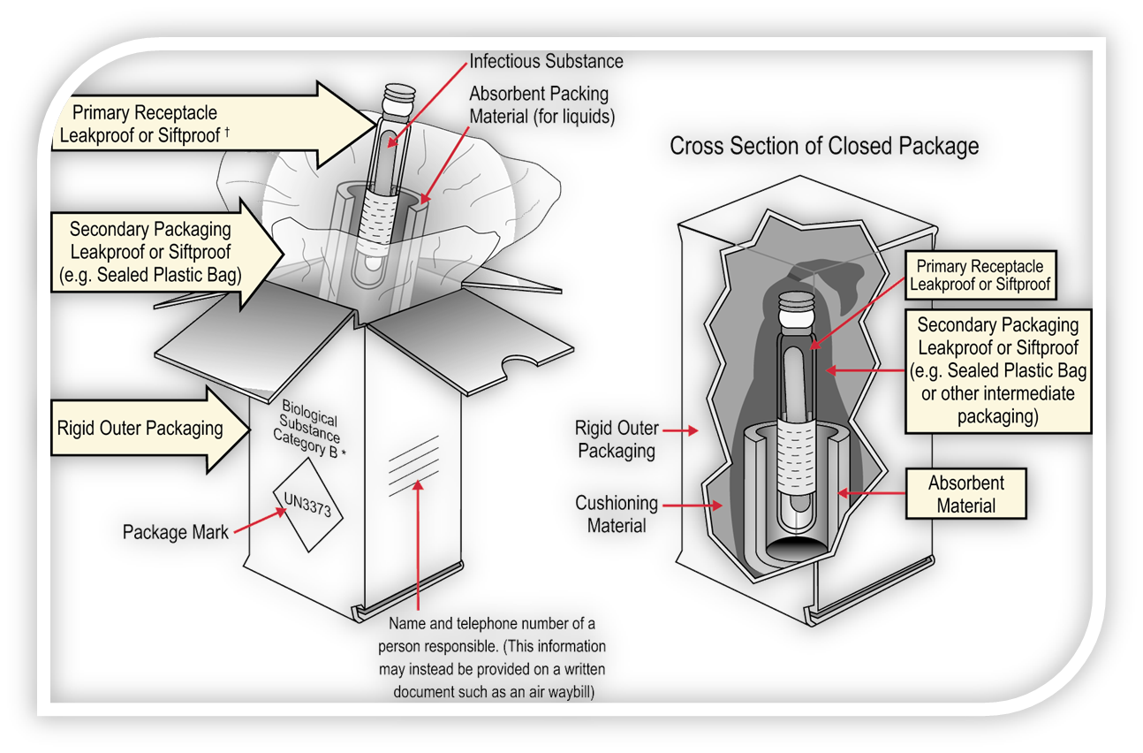
Packaging for Transportation
“UN3373 Biological Substance, Category B”
Triple Packaging “system”:
Primary receptacle, sealed and decontaminated;
Secondary packaging must contain sufficient absorbent (for liquids) and cushioning material to protect the primary receptacle;
Outer packaging filled and closed in accordance with manufacturer’s instructions.
49 CFR 173.199

Slide 4
Packaging for Transportation
“UN3373 Biological Substance, Category B”
Liquid Specimens:
Primary receptacle and secondary packaging must be leakproof;
Multiple fragile primary receptacles must be wrapped individually or must not make contact;
Secondary packaging must contain sufficient absorbent material to absorb entire contents of primary receptacles;
Primary receptacle or secondary packaging must meet 95kPa pressure differential for aircraft shipments.
49 CFR 173.199

Slide 5
Packaging for Transportation
“UN3373 Biological Substance, Category B”
Solid Specimens:
Primary receptacle and secondary packaging must be siftproof;
Multiple fragile primary receptacles must be wrapped individually or must not make contact;
If residual liquid present or solid material may become liquid during transportation, material must be transported as a liquid.
49 CFR 173.199

Slide 6

Hazard Communications for Transportation
“UN3373 Biological Substance, Category B”
Package marked with:
UN ID Number;
Proper Shipping Name;
Name/telephone of knowledgeable person.
  On package or Waybill
In case of Emergency:
Dr. Robby Keough, (321) 555-1212
49 CFR 173.199

Slide 7

Hazard Communications for Transportation
“UN3373 Biological Substance, Category B”
When outer package is placed in an overpack, such as a shippers envelope, package markings must be either clearly visible or reproduced on the outside of the overpack and marked “OVERPACK”.
In case of Emergency:
Dr. Robby Keough, (321) 555-1212
49 CFR 173.199

Slide 8
Training Requirements for
“UN3373 Biological Substance, Category B”
49 CFR 173.199(e) for training states in part, “Training. Each person who offers or transports a Category B infectious substance under the provisions of this section must know about the requirements of this section.”
This includes, but is not limited to:
  Manufacturer’s packaging instructions;
  Required hazards communications and markings;
  Solid vs. Liquid shipping requirements;
  Shipping with Dry Ice;
  Shipping via aircraft.
49 CFR 173.199

Slide 9
Definition
“UN3291, Regulated Medical Waste n.o.s., 6.2, II ”
“Regulated medical waste or clinical waste or (bio) medical waste means a waste or reusable material derived from the medical treatment of an animal or human, which includes diagnosis and immunization, or from biomedical research, which includes the production and testing of biological products. Regulated medical waste or clinical waste or (bio) medical waste containing a Category A infectious substance must be classed as an infectious substance, and assigned to UN2814 or UN2900, as appropriate.”
49 CFR 173.134(a)(5)

Slide 10
Exceptions for
“UN3291, Regulated Medical Waste n.o.s., 6.2, II ”
A regulated medical waste transported by a private or contract carrier is excepted from—
The requirement for an “INFECTIOUS SUBSTANCE” label if the outer packaging is marked with a “BIOHAZARD” marking in accordance with 29 CFR 1910.1030;
The specific packaging requirements of §173.197, if packaged in a rigid non-bulk packaging conforming to the general packaging requirements of §§173.24 and 173.24a and packaging requirements specified in 29 CFR 1910.1030, provided the material does not include a waste concentrated stock culture of an infectious substance. Sharps containers must be securely closed to prevent leaks or punctures.
49 CFR 173.134(c)

Slide 11
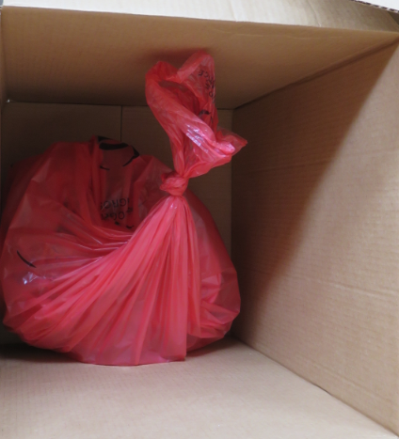
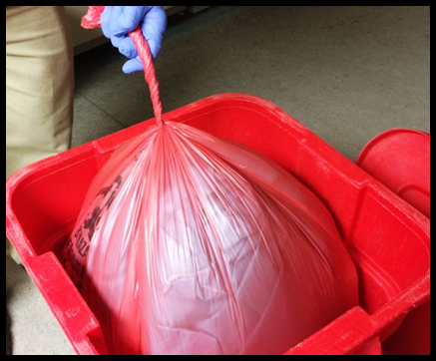
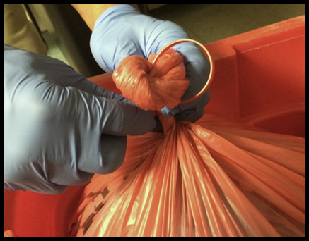
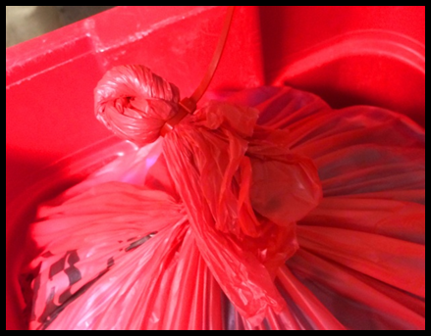
Common Industry Practice for Closure
“UN3291, Regulated Medical Waste n.o.s., 6.2, II”
Inner Packaging for solids:
No rips, tears or holes;
Minimum entrapped air;
Tied to prevent leakage;
  Do not use “overhand”/ Bunny Ears Knot
  Single knot or spin, gooseneck & tape
Bags placed in outer package
  Box, bin, rolling cart or large packaging
Single Knot
Gooseneck & Tape/Zip Tie

Slide 12
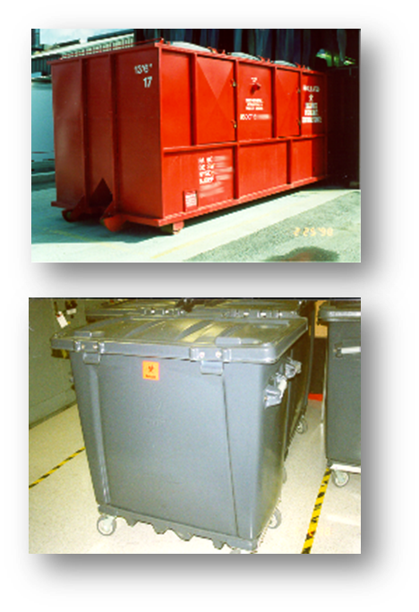
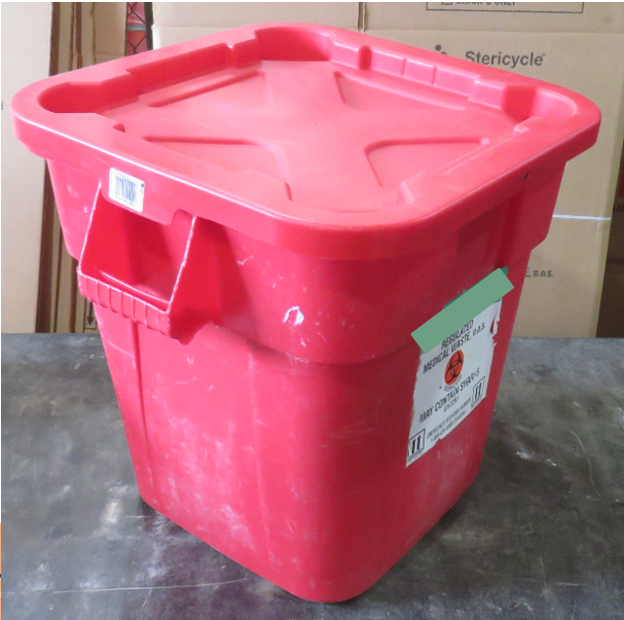
Packaging for Transportation
“UN3291, Regulated Medical Waste n.o.s., 6.2, II”
Outer Packaging:
Rigid Non-Bulk (<119 Gallons)
  When closed no leaks, residues, remains closed (49 CFR 173.24)
Bulk (>119 Gallons)
  Large Packagings and Non-Specification Bulk Packagings;
  Detailed requirements are found in 49 CFR 173.197(c)-(e)

Slide 13
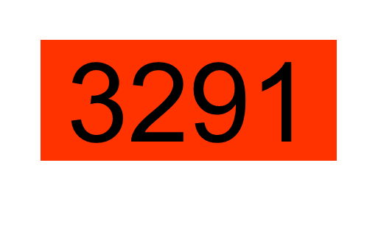
Hazard Communication for Transportation
“UN3291, Regulated Medical Waste n.o.s., 6.2, II ”
Package Marking:
UN ID Number;
Proper Shipping Name;
“BIOHAZARD” marking in accordance with 29 CFR 1910.1030;
Consignee's or consignor's name and address
UN3291
Regulated Medical Waste n.o.s.
§ 173.134(c)(d)
§ 172.302
Bulk Marking (can also be on plain white placard)

Slide 14
Hazard Communication for Transportation
“UN3291, Regulated Medical Waste n.o.s., 6.2, II ”
Shipping description in the correct order:
  Identification Number: “UN3291,”
  Proper Shipping Name: “Regulated Medical Waste n.o.s.,”
  Hazard Class/Division: “6.2,”
  Packing Group: “PGII” or “II” (Roman numeral)
  Total Quantity and Unit of Measure
  Number and Type of Package (Box, Cart, BOP, etc.)
  Shipper’s Certification with Signature
  Emergency Response Telephone Number
49 CFR 172.202

Slide 15
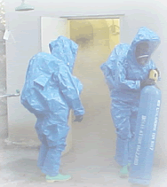
Emergency Information for Transportation
“UN3291, Regulated Medical Waste n.o.s., 6.2, II ”
Requirements for providing and maintaining emergency response telephone number identified in 172.604, Subpart G:
On shipping paper - Stands out.
Emergency Telephone number:
  Monitored at all times the hazardous material is in transportation. Immediate! No answering machines, No answering services or No beepers;
  Person who is either knowledgeable of emergency response and incident mitigation;
  Name of the person, or contract number or other unique identifier for the emergency number.
Photo: Lawrence Berkeley National Lab

Slide 16
Training Requirements for
“UN3291, Regulated Medical Waste n.o.s., 6.2, II ”
Federal hazmat transportation law 49 CFR, Part 172, Subpart H, requires training of all hazmat employees. Training must include:
  General Awareness / Familiarization
  Safety
  Function Specific
  Security Awareness
  In-depth Security Training (If Applicable)
Anyone shipping regulated medical waste must be “trained and tested”, with training records
49 CFR 172 Subpart H - Training

Slide 17

Hazardous Material Info-Center
1-800-HMR-4922
(1-800-467-4922)
E-mail: infocntr@dot.gov
HAZMAT.dot.gov
Hours of Operation: 9 am – 5 pm ET
Obtain answers to HMR questions
Request copies of Federal Register, special permits or training materials
Report HMR violations
Fax on Demand
Notes:
17
This hotline is attended during federal business hours, Monday to Friday. In off hours, you may leave a message and someone will return your call the next business day.

Slide 18

Stuart Streck
Investigator
Pipeline & Hazardous Materials Safety Administration
Office of Hazardous Materials Safety
Field Operations - Southern Region
230 Peachtree Street, N.W. Suite 2100
Atlanta, GA 30303
Stuart.Streck@dot.gov
(404) 832-1141

