Slide 1
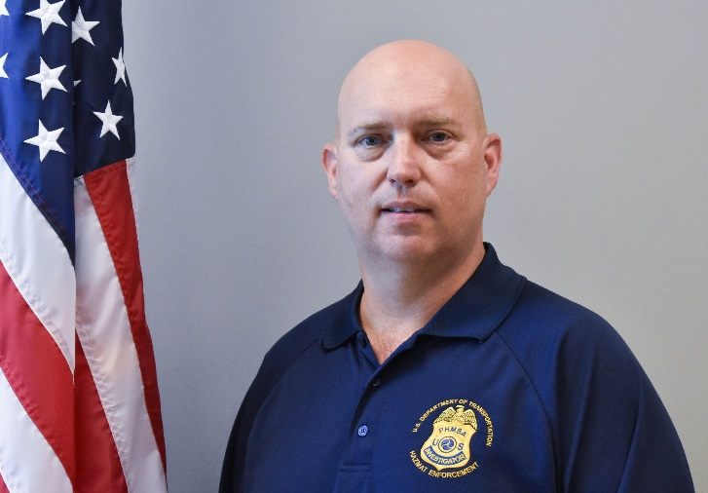
Field Services and Support Division
Norm Winningham
Director &
National Training and Qualification Branch Chief
“Integrity, Innovation, Service”
Notes:
Introduction:
Good morning/Afternoon….My Name is Norm Winningham and I am the Director of Field Services and Support Division and I also serve as the National Training and Qualification Branch Chief for the Office of Hazardous Materials Safety with PHMSA.
I have served the agency for 11 years as a Hazardous Materials Safety Assistance Team Member, Compliance Investigator & Instructor as well as a Branch Chief Supervisor and Divisional Director. My background in Hazardous Materials Safety started back in 1990 in the United States Coast Guard conducting inspections of international and domestic cargo leaving and entering the united states by vessels. I enjoyed it then and over the past 30 years I have become a proverbial HAZMAT Weirdo.

Slide 2
Field Services and Support Division
Missions Areas:
Packaging Program
Accident Investigations
Enforcement Standardization
Fitness
National Training and Qualification
“Integrity, Innovation, Service”
Notes:
Enough about me….Let me describe our Mission areas within our Division:
I am responsible for several National Programs that fall within the Packaging Program (which handles package testing related to compliance and validation of performance oriented packaging designs), Accident Investigations (which manages how we determine causes of HAZMAT incidents relative to packaging failures), Enforcement Standardization (Which produces our procedural guidance for how, when and where we conduct inspections), Fitness (which coordinates the determination of whether or not a company should receive certain approvals or special permits) as well as the National Training and Qualification Branch (which implements the agencies training and qualification program)
As you can see this division has a very expansive set of missions to accomplish.
I would like to focus mainly on the National Training and Qualification aspects of these missions and speak to you all about the importance of Hazardous Materials Transportation training….specifically focusing on SAFETY.

Slide 3
Training
SAFETY
“Integrity, Innovation, Service”
Notes:
Obviously from my background and current position, TRAINING is my thing. I have been in the field of technical training for about 18 years as a podium instructor. I have been a course manager, national program manager and I have built qualification programs and courses where there was nothing previously. So training is important to me to say the least.
QUESTION:
So….by a show of hands….how many grants involve the performance of training in the area of Hazardous Material Transportation Safety?
Likely a significant amount.
Regardless of how many of our stakeholders….. and in some cases our focused audience……as it relates to compliance…..it continues to be one of the highest written violations by our agency….whether it is no training, training that is not documented or in some indirect cases INADEQUATE Training.
Let me explain:
During my years of conducting Inspection and Investigations, it becomes quite obvious to me that people conduct jobs in a manner which is the easiest way possible to accomplish the job.
It is human nature to cut corners or not follow a particular procedure as intended. To include training requirements.
Our investigators are very good at their jobs and they know what questions to ask to ensure compliance. (I train them) Improper answers to critical questions tend to indicate poor training practices or corners being cut.
In the Hazardous Materials world cutting corners can be catastrophic if the personnel responsible for the safe transportation of hazardous materials are not performing activities in a Safe, efficient, productive, always improving with the goal of SAFETY in mind. The training is inadequate. If adequate training is not provided and hazmat transportation personnel are not performing activities as they should people can die.
So I define adequate training as: Training that ensures that performance of all responsibilities to ensure safety are carried out so that no one dies.
I was in the Coast Guard for over 20 years…..I joined to Save Lives…..and I serve PHMSA and the American Public to Save Lives. Folks, Adequate Training Save Lives!!!
So lets discuss the requirements…..

Slide 4
TRAINING Regulatory Requirements
Employers are Responsible
HAZMAT Employees
Trained and Tested
Systematic Approach
“Integrity, Innovation, Service”

Slide 5
Emphasis Areas
General Awareness/Familiarization
Function Specific
Safety Training
Security Awareness
“Integrity, Innovation, Service”

Slide 6
Resources
PHMSA.dot.gov
Norman.Winningham@dot.gov
405-686-2078 (ofc)
infoctr@dot.gov
“Integrity, Innovation, Service”

Slide 7
Objectives
Who we are and What we do
Emphasize importance of training
Provide summary of requirements
Provide you a resource for answers
“Integrity, Innovation, Service”

Slide 8
Questions, Comments or Concerns
“Integrity, Innovation, Service”

