Slide 1
Marc Nichols
Region Director, Western Region
Office of Hazardous Materials Safety

Slide 2
Office of Hazardous Materials Safety (OHMS) Field Operations and Enforcement
Ensures and promotes the safety, security and performance of the nation’s hazardous materials transportation system
Operational activities include:
  compliance inspections
  incident and accident investigations
  regulatory adequacy and fitness determinations
  outreach, education and training activities
  reporting feedback, information and intelligence from the oversight of hazmat shippers, carriers and manufactures, requalification, recondition, maintenance, and use of hazardous materials packaging

Slide 3
Hazardous Materials Safety Assistance Team (HMSAT)
PHMSA’s HMSAT is responsible for:
  improving hazmat transportation safety and security through increased communication and education
  conducting face-to-face outreach and compliance assistance to help businesses comply with the Hazardous Materials Regulations (HMR)
  providing compliance assistance to federal, state, and local governments
HMSAT members are assigned to each regional office
Notes:
HMSAT is charged with the planning and execution of outreach and engagement initiatives and activities. HMSAT acts as a conduit for trends in enforcement within their region to report out to O&E. Based on what they are seeing within their respective regions, they are responsible for recommending outreach and engagement activities and project plans if applicable.

Slide 4
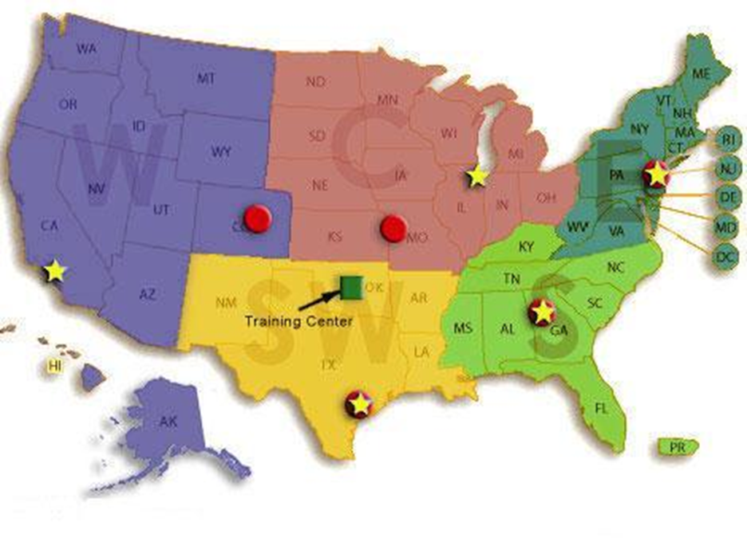
Office of Hazardous Materials Safety (OHMS) Regional Offices
Notes:
The HMSAT consists of at least one hazmat transportation specialist covering each region.

Slide 5
Outreach Activities
Regulatory information workshops
Multi-modal / multi-agency events
Conferences
Presentations
Conduct outreach campaigns
Answer questions by email, phone, and in person
(lots and lots of questions)
Notes:
HMSAT is responsible for the coordination and delivery of national and regional outreach and engagement activities that include, but are not limited to, HM workshops, conferences, webinars, stakeholder meetings, and promotion of outreach material and training resources to HM stakeholders.
Additionally, the HMSAT supports PHH-51 in the development and implementation of national outreach initiatives, standardization of messaging, and leading O&E program projects.

Slide 6
Assistance for Grantees
“Train the Trainer” program
  (PHMSA does NOT provide certification of training)
Review curriculums with the Grantee to ensure the proper information is provided in accordance with the HMR
Attend training sessions to ensure the correct information is being disseminated
Routine checks/updates to ensure the Grantee is performing all functions as required by the HMR

Slide 7
Backhaul Alaska
Backhaul Alaska coordinates the hauling of hazardous waste out of rural Alaskan communities.
PHMSA provided grants to Backhaul Alaska to assist their program and education on the transportation of hazardous materials.
http://backhaulalaska.org/

Slide 8
I’m in the back
http://www.atcemak.com/wp-content/uploads/2018/12/7_Backhaul-Alaska-Update-Simone-Sebalo.pdf

Slide 9
Backhaul Alaska and HMSAT
Provided hazmat workshops and train-the-trainer program
(training certifications were provided by employer)
Reviewed curriculum with Grantee to ensure the proper information was being provided
Attended training sessions
Performed routine checks/updates on the Grantee

Slide 10
Questions?
Marc Nichols
U.S. Department of Transportation
Pipeline and Hazardous Materials Safety Administration
Office of Hazardous Materials Safety
3401 Centre Lake Drive, Suite 550B
Ontario, CA 91761
Email: marc.nichols@dot.gov

