Slide 1

Hazardous Materials
Incident Reporting
PROGRAM
MANAGEMENT
REVIEW
Task 16
Period of Review
(JAN-MARCH)
5/26/2016
Presented by
Serita McKoy- Program Analyst
PHMSA – Office of Hazardous Materials Safety
Non Profit Grants Conference
March 10, 2017
DOT HQ

Slide 2


Agenda
Overview – PHMSA Vision and Mission
DOT 5800.1 Incident Report Overview
Uses of Information
Questions
Trends & Statistics

Slide 3
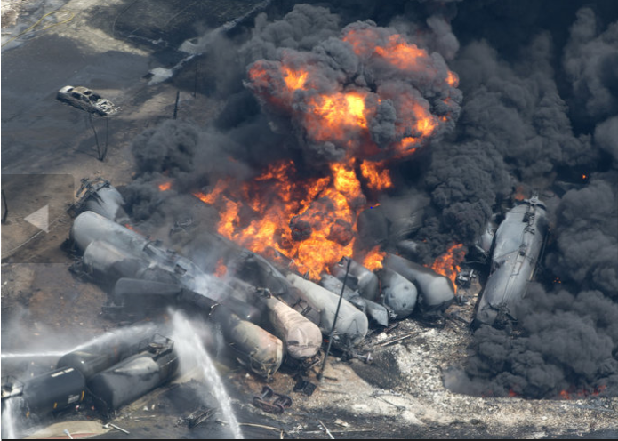
PHMSA Mission & Vision
PHMSA’s mission is to protect people and the environment by advancing the safe transportation of energy and other hazardous materials that are essential to our daily lives.
PHMSA’s vision is to become the most innovative transportation safety organization in the world

Slide 4

OHMS Key Priorities
Invest in Our People
Increase Communication
  Internal
  External
Position for Innovation
Foster Transparency
Improve Engagement
  Employees
  Partners
  Stakeholders

Slide 5
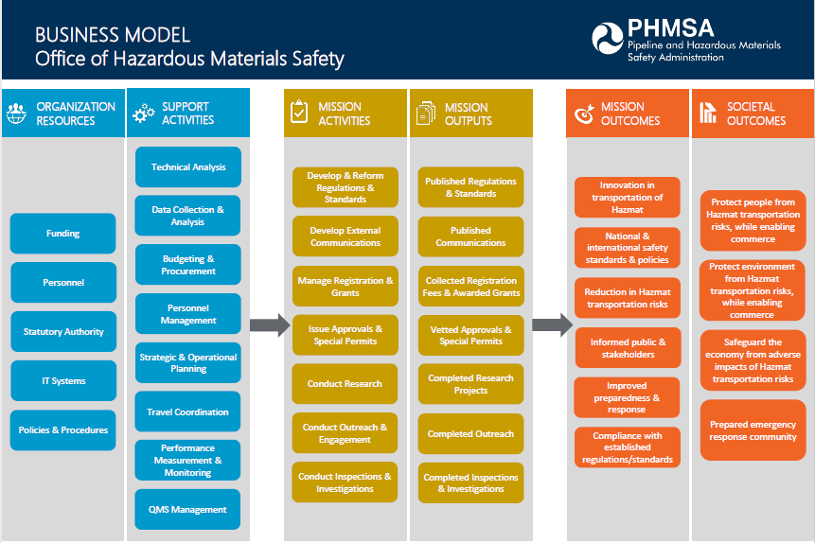

Slide 6

Incidents
“Think before you” ship!”

Slide 7
What is an Incident?
An unintentional release of a hazardous material or discharge of hazardous waste; a cargo tank with a capacity of 1,000 gallons or greater containing any hazardous material that suffers structural damage to the lading retention system; or an undeclared hazardous material.

Slide 8
When is a DOT 5800.1 Form required?
49 CFR Parts 171-180 requires certain types of incidents be reported.
Section 171.15 requires an immediate telephonic report be filed within 12 hours of certain hazmat incidents.
A person is killed
Injury requiring admittance to the hospital
Evacuation of general public for one hour or more
One or more major transportation arteries are closed for one hour or more
Operational flight plan is altered
Fire, breakage, spillage involving radioactive material
Fire, breakage, spillage involving an infectious substance
Release of marine pollutant in a quantity exceeding 450 liters for liquid or 400 kilograms for solids

Slide 9
When is a DOT 5800.1 Form required?
Section 171.16 requires that a 5800.1 report be submitted within 30 days of discovery of any of the following:
An incident that was reported under 171.15
An unintentional release of a hazardous material during transportation
Release of a hazardous waste
Undeclared shipment with no release is discovered
A Specification Cargo Tank 1,000 gallons or greater containing hazardous materials that received structural damage to the lading retention system and did not have a release.

Slide 10


What Data Do We Collect Via the 5800.1?
Who, What, Where, and When
Characteristics of the release:
  Material
  Packaging
  Hazard Communication
  Handling
Compliance and non-compliance
Consequences
Causation

Slide 11
Identify key hazards, risk factors and issues
Assess the risk associated with each factor and develop mitigation strategies
Monitor to ensure compliance, course correction and continuous improvement
Manage the risk through implementation of strategies and communication with stakeholders

Slide 12
Incident Statistics

Slide 13
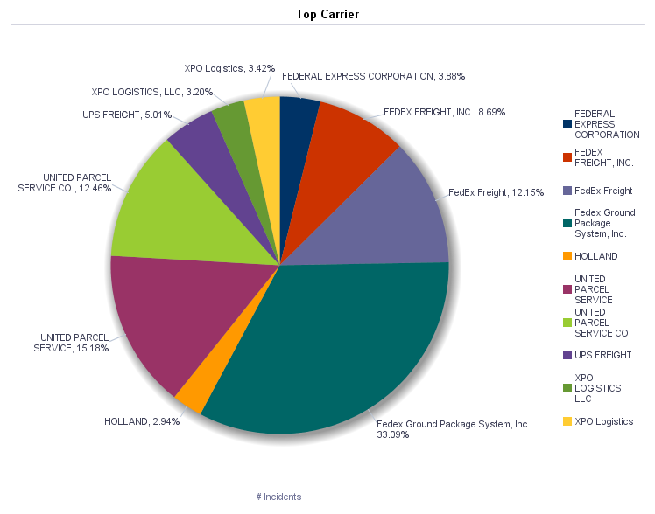

Slide 14
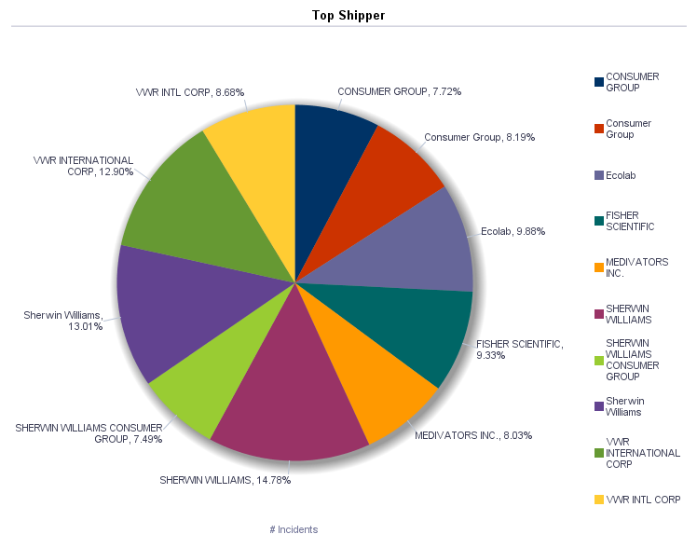

Slide 15
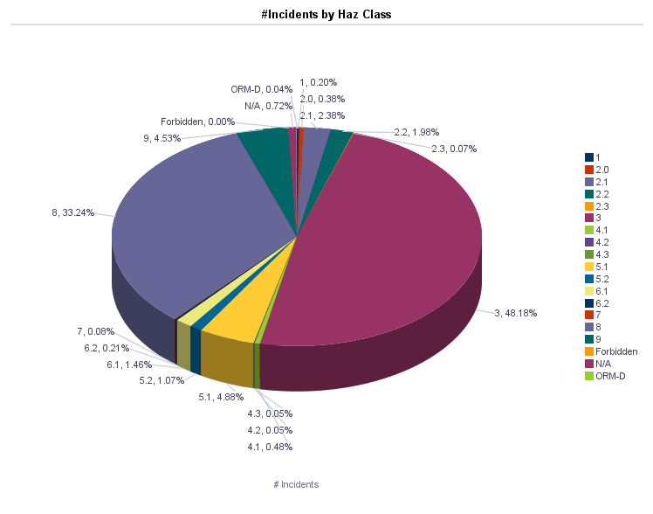

Slide 16
Incident Statistics

Slide 17
Incident Statistics

Slide 18
Incident Statistics

Slide 19
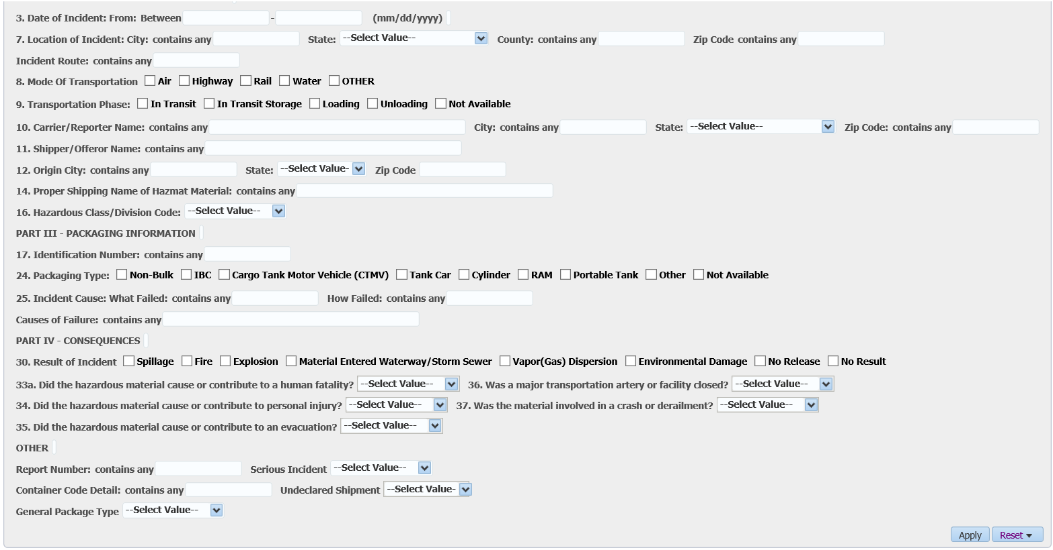
Trends and Statistics
If you are not searching for a specific incident, you may enter a date range to view a certain amount of months/years of data
Only select State if you are searching for information on one particular state
Select one or more modes if you want to filter your results to show incidents only for that mode.
*Note: To view all modes, leave this field blank.

Slide 20
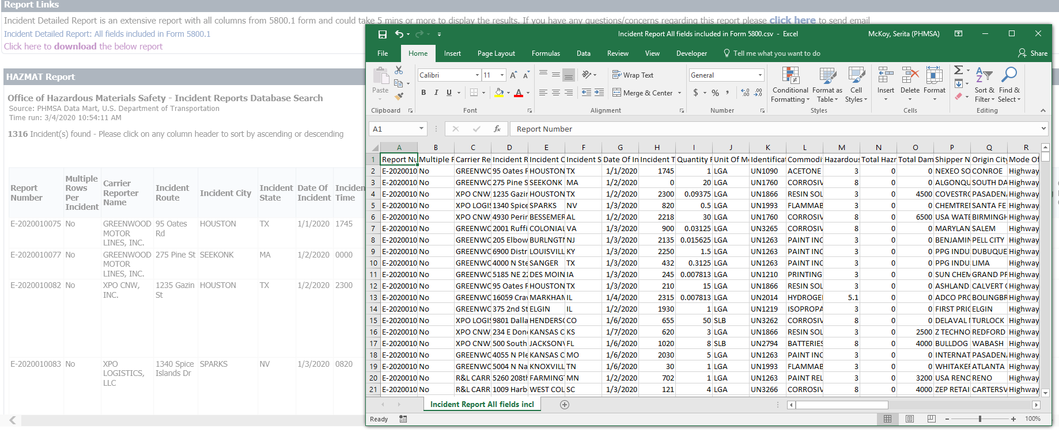
Trends and Statistics
You can export “all fields” or the “most requested fields”.
You can export “all fields” or the “most requested fields”.

Slide 21
Incident Report Statistics
Available Reports
Yearly Incident Summary Reports
Casualty Classification
Transportation Phase
Incidents by Results
Incidents Cause by Mode
Incident by Hazard Class
Incidents by Commodity Rank
Undeclared Incidents by State
Bulk Containers
Incidents by State
Serious Incidents Map
10 Year Incident Summary Reports
All Incidents
Accident/Derailment Incidents
RAM Incidents
Waste Incidents
Serious Incidents (Old definition)
Serious Incidents (Current definition)
Undeclared Incidents
Bulk Incidents
Non-Bulk Incidents

Slide 22
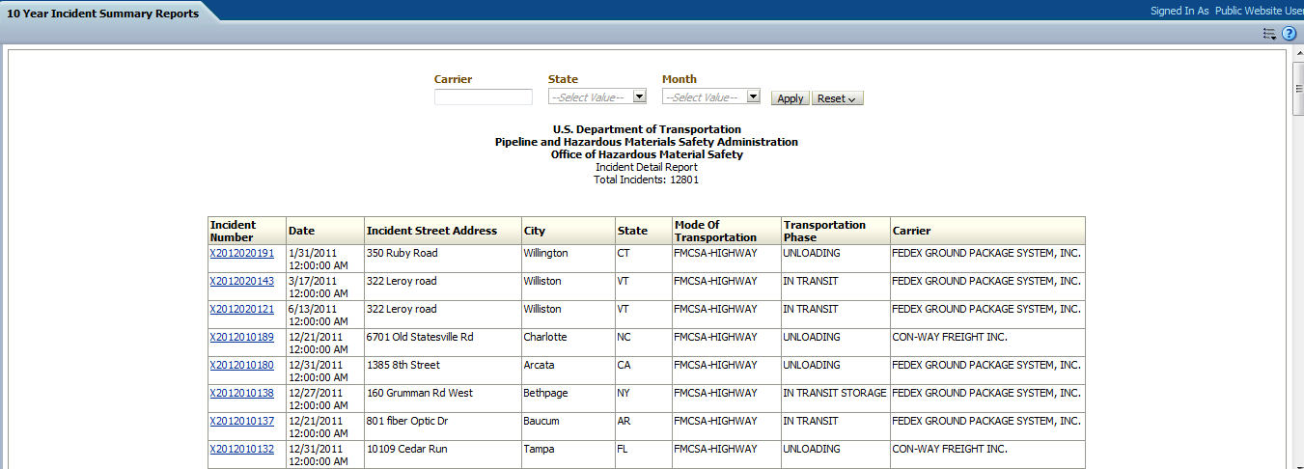
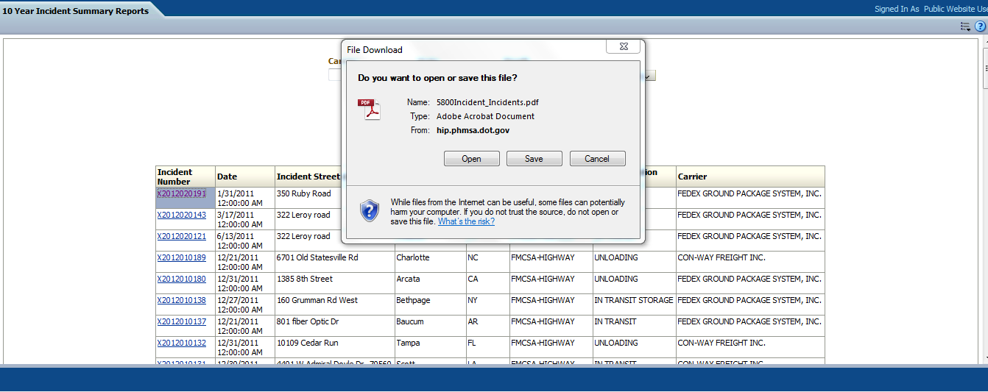
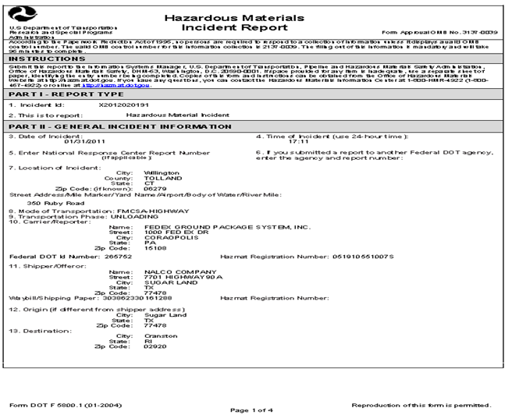
Incident Report Statistics

Slide 23
Incident Contact Information
Hazardous Materials Information Center
  800-647-4922
General Inquiries - Email
  PhmsaHAZMATICS@dot.gov

Slide 24

Questions

