Slide 1
Emergency Response
Guidebook 2020

Slide 2
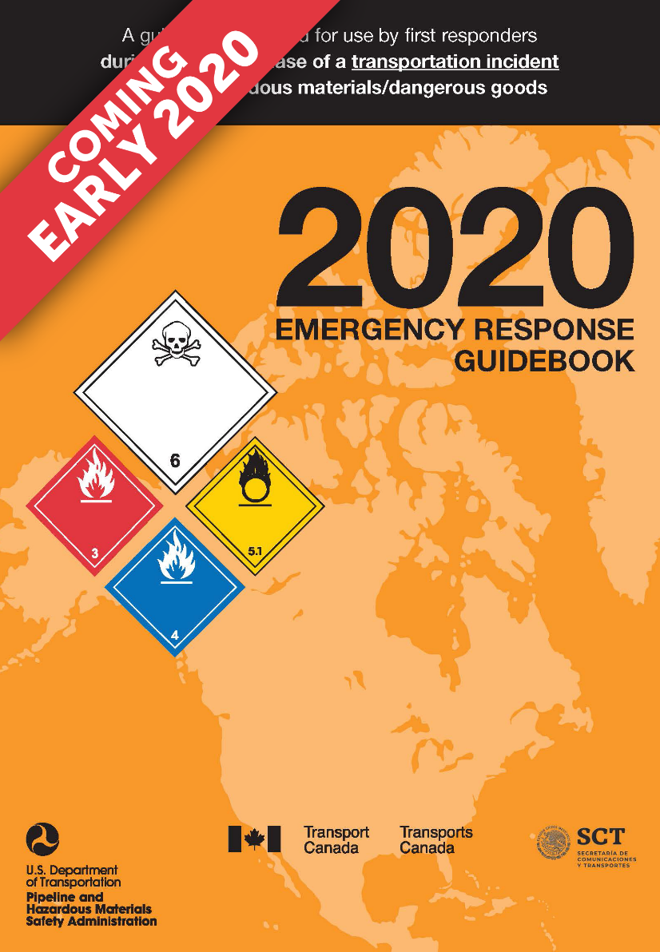
Tentative release:
May/June 2020
Print and mobile app
versions published in English, Spanish and
French
2

Slide 3
Summary of updates: White pages
Minor edits based on plain language review
Improved illustrations for railcar and road trailer identification charts
New additions:
  Lithium battery label and marking
  Decontamination section
  Heat Induced Tear basic information
  New terms in glossary section
3

Slide 4
Summary of updates: Yellow and Blue Pages
UN numbers for Chemical Warfare Agents
were removed
Removed and added UN numbers based
on UN and North American regulations
Reviewed polymerization hazards for certain materials
Re-evaluated guide assignment for some materials
4

Slide 5
Summary of updates: Orange pages
Created new How to use the orange guide pages section
Guide 121 Gases - inert was merged with Guide 120 Gases - inert (Including refrigerated liquids)
Added CAUTION sentences for specific materials
Comprehensive review of the sentences in the orange pages by FEMA/NFA
Distances in PUBLIC SAFETY section are now in EVACUATION section
5

Slide 6
Summary of updates: Green pages
Minor edits based on plain language review
Improved illustrations for railcar and road trailer identification charts
New additions:
  Lithium battery label and marking
  Decontamination section
  Heat Induced Tear basic information
  New terms in glossary section
6

