Slide 1
The Sustainable Workplace Alliance
Notes:
We operate out of Lake Wales, FL. We are happy to say that this is our 7th year receiving the HMIT grant. With this grant program we conduct a road show across the nation. For this year we have 76 training days in 18 different cities scheduled. Our challenge each year is how do we reach our target audience in areas where we are not known. We meet this challenge by conducting outreach at various industry conferences and present at local chapter meetings to get our program information out there. Last year we experimented with a new tactic, we thought that going to a city with one of our classes would build momentum for us to bring another class back a few weeks later and in some cities even bring a third class a few weeks after that. However, this model ended up being a huge challenge for us, our second and third classes were very low attendance. We had to step up our game and really work hard to fill these classes to meet our numbers.

Slide 2
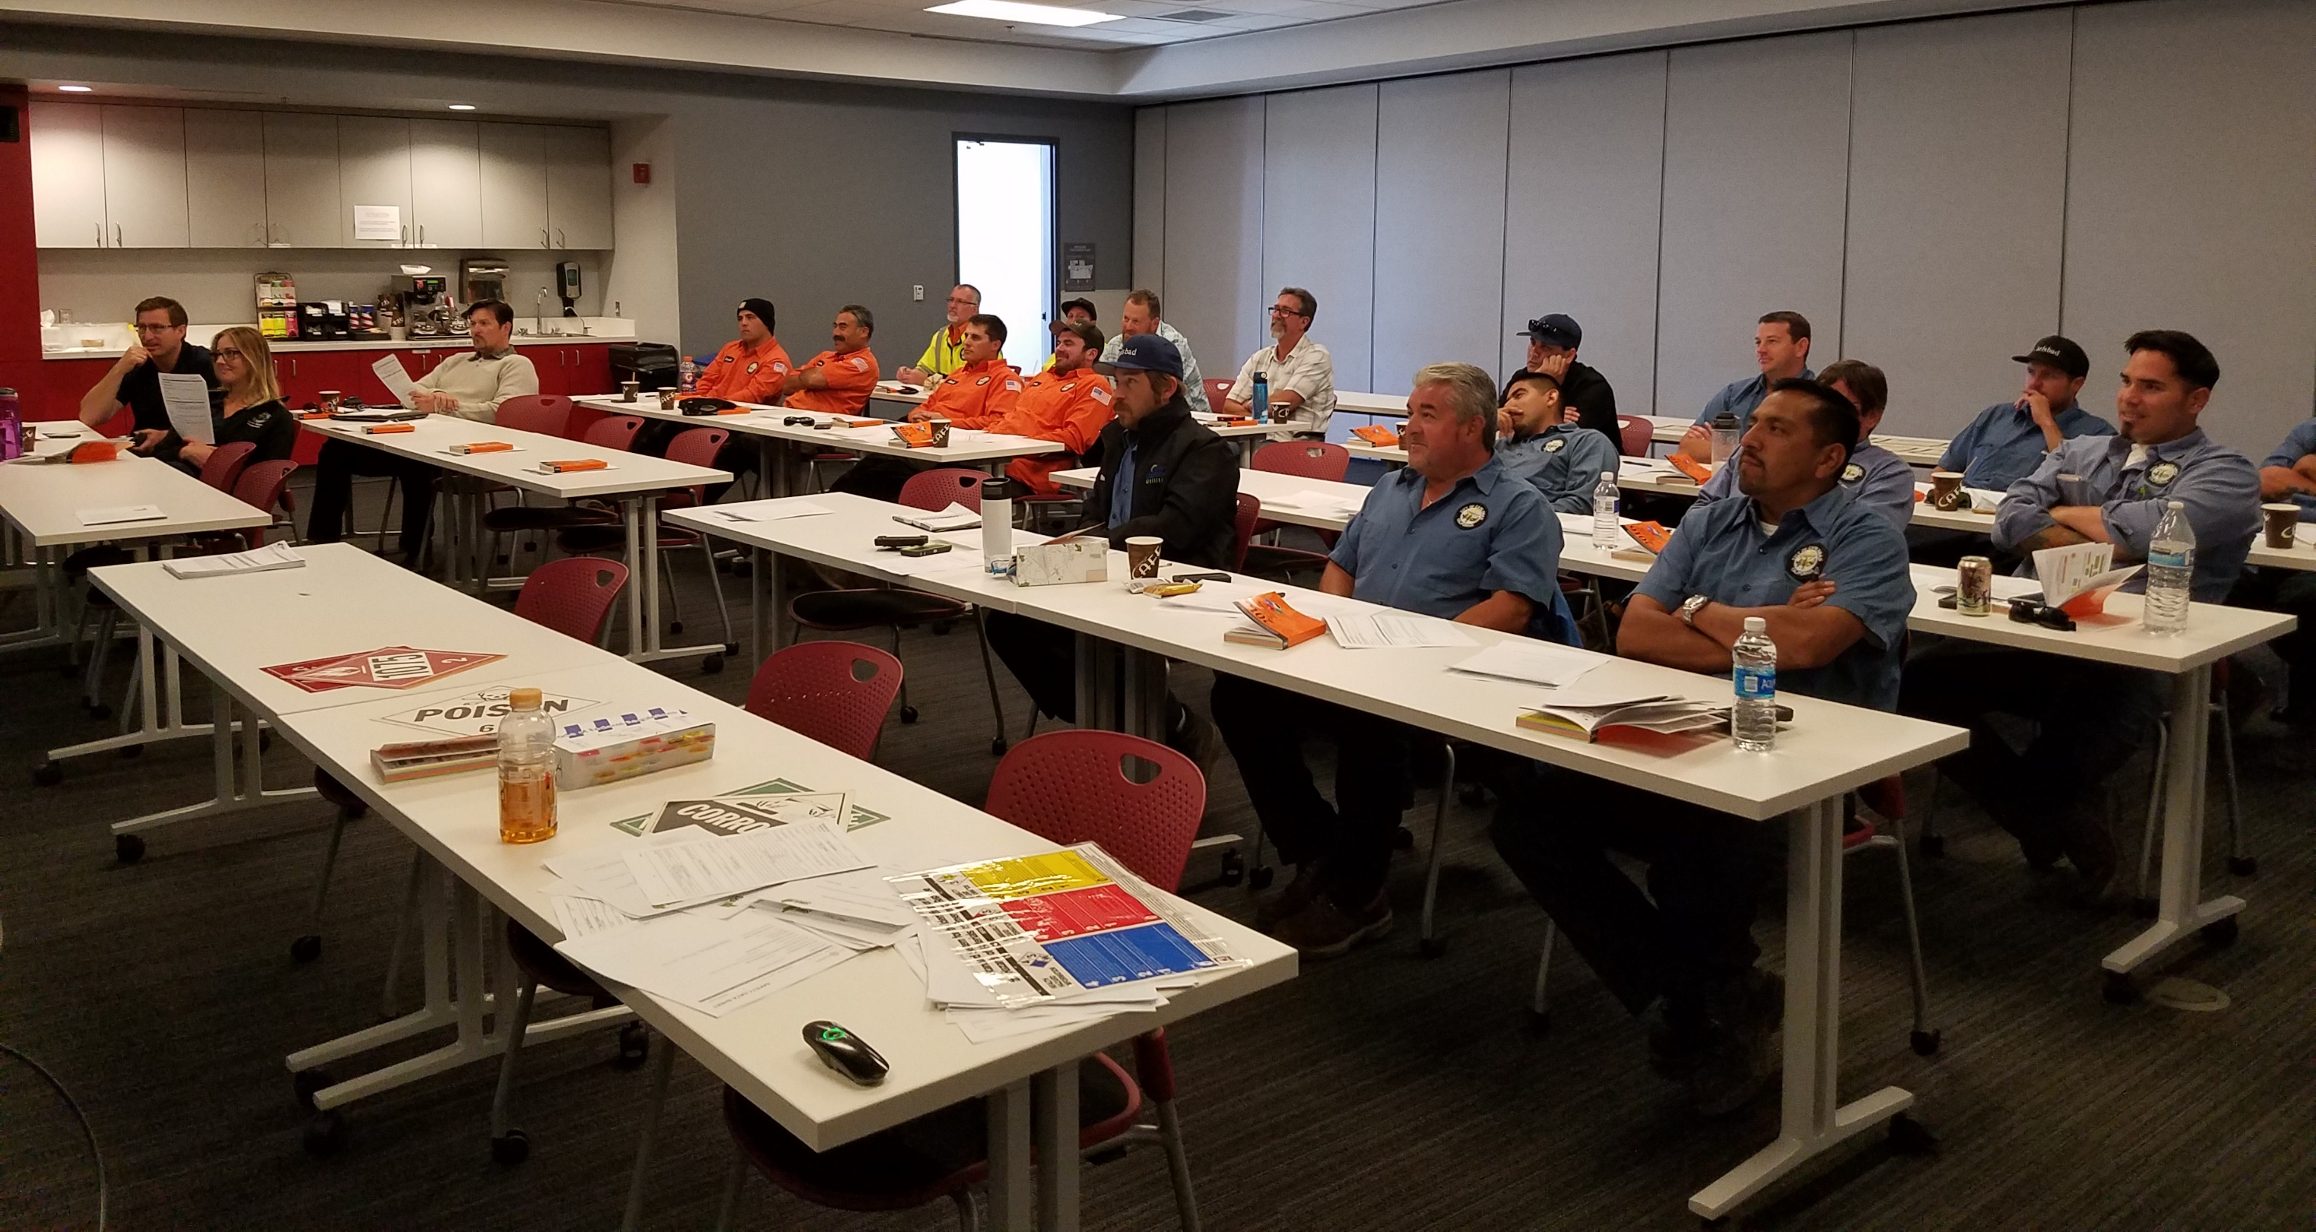
FY2019 Community Safety Grant
The Sustainable Workplace Alliance has been awarded
the Community Safety grant since it’s inception in 2016
Notes:
We’ve and has trained over 2,000 emergency responders, state agency personnel, community leaders, and the general public throughout the U.S. and its territories

Slide 3
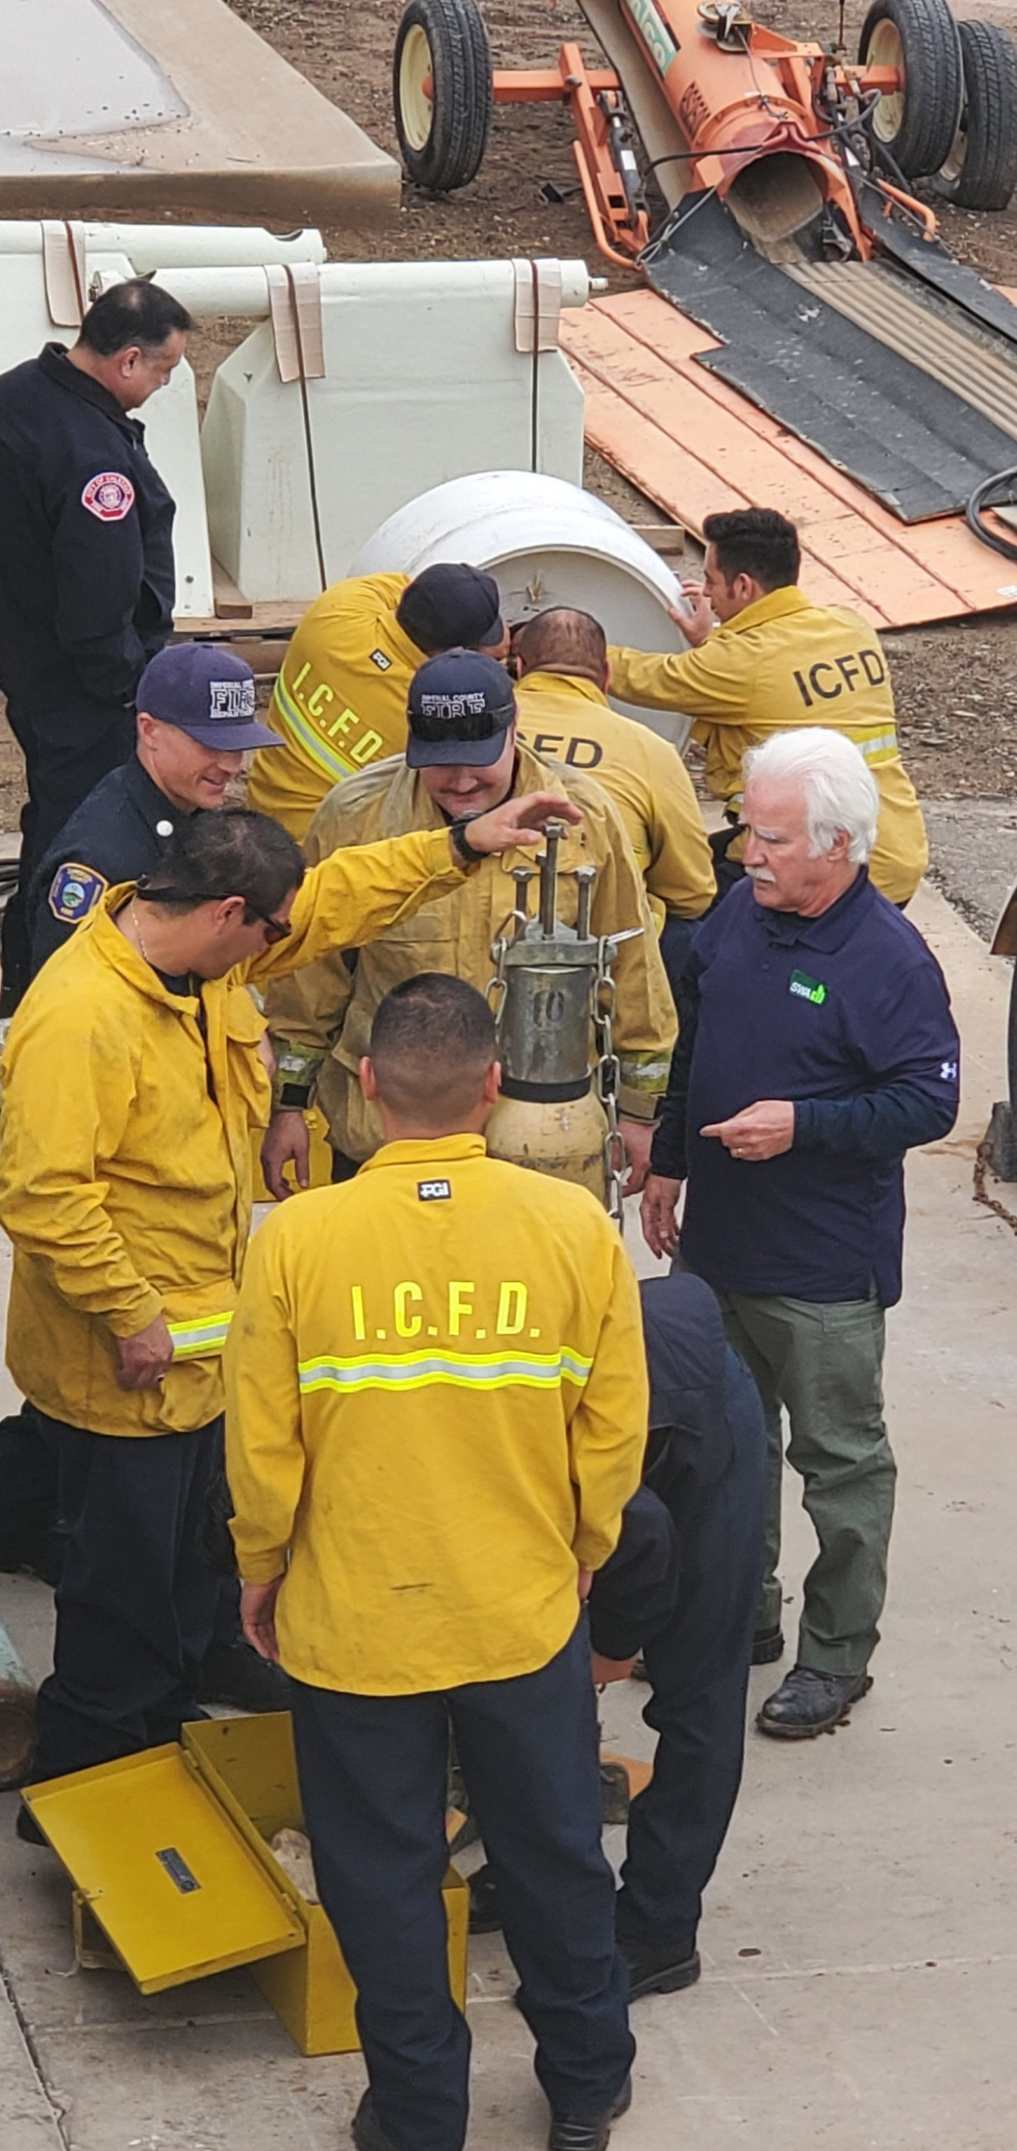
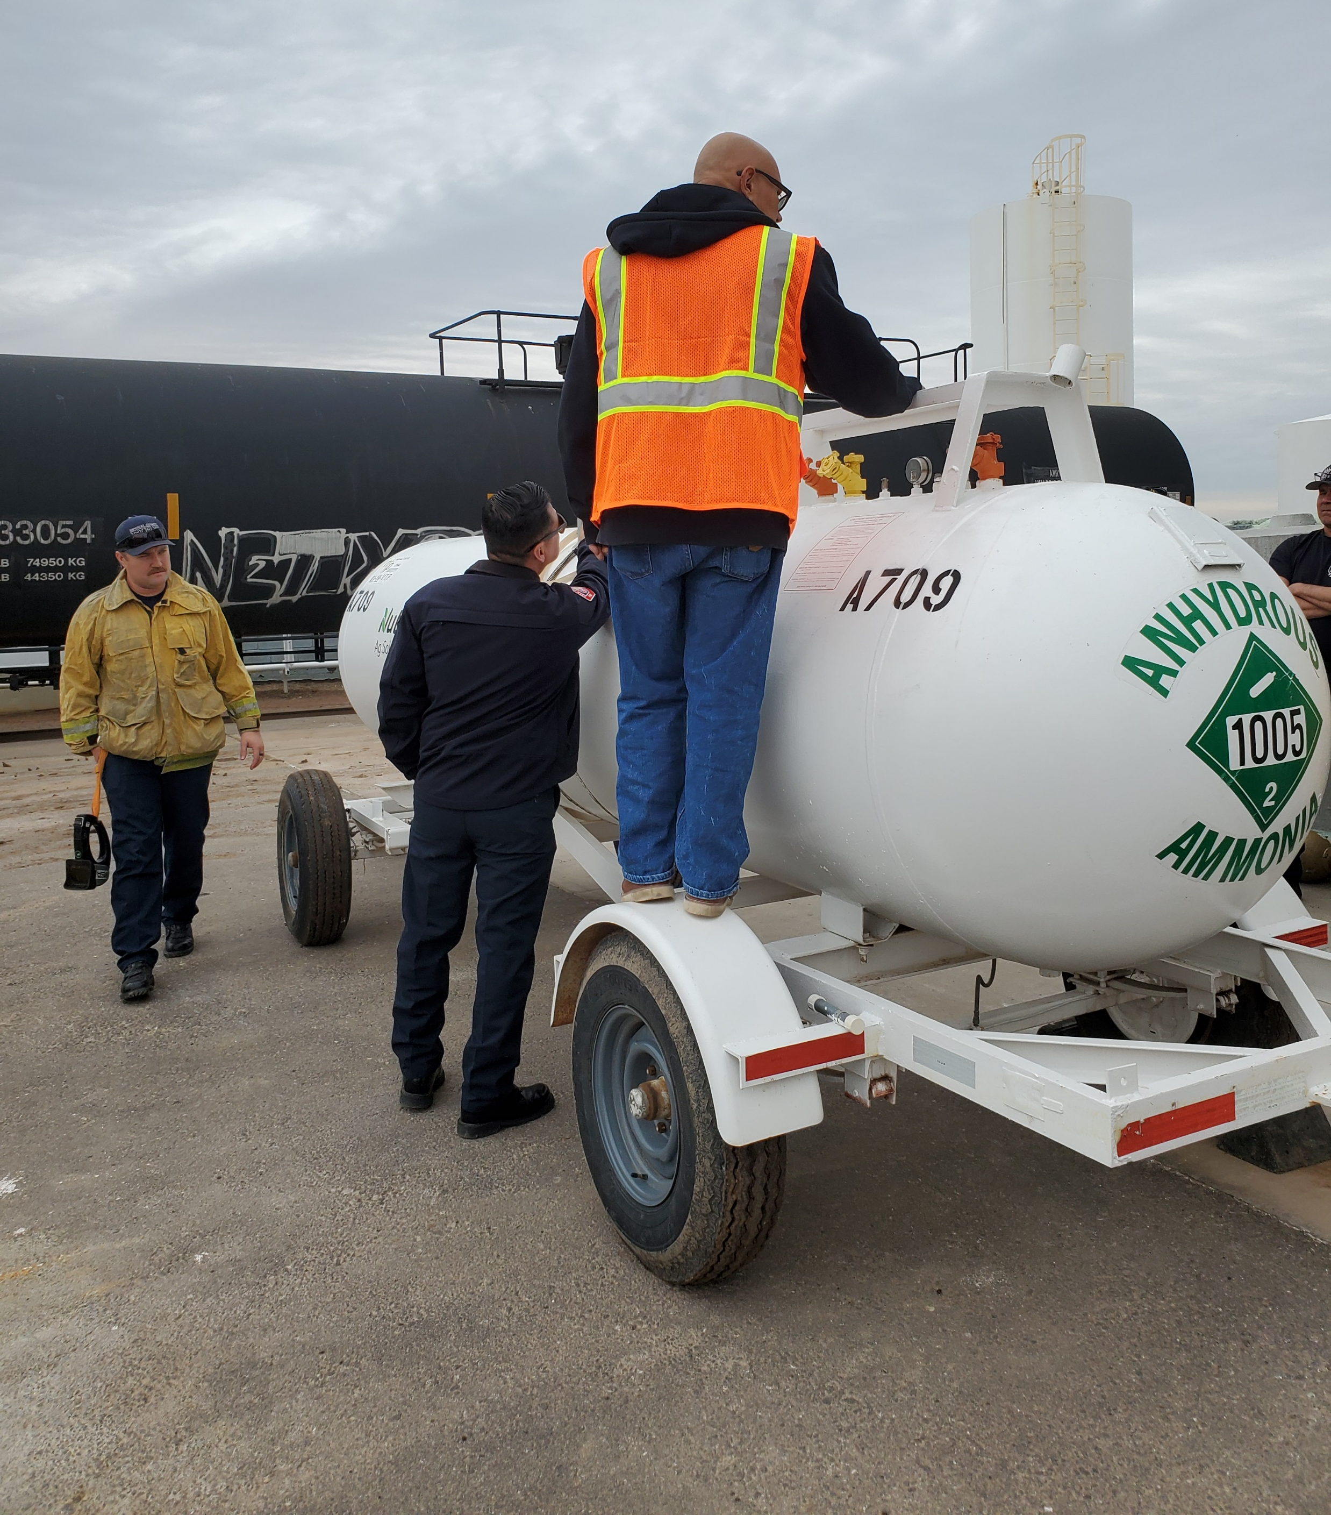
Customized, Hands-On Training
Our focus has been to help rural communities receive training that gets them out of the classroom and in the field
Notes:
Imperial Co is east of San Diego Co; S.D. Co +3 million according to 2010 Census – Imperial Co 174,000 population
Examples of training: “Regs & Response” How the 49CFR and ERG assist responders to a Hazmat Incident; “2020 ERG, How to ID HazMat & SDS Awareness” helpful for Code Enforcement agencies; “Railcar Identification and how to read a consist”; “Tactical Chemistry” Teaching inspectors how to ID unknown hazards through modern instrumentation.

Slide 4
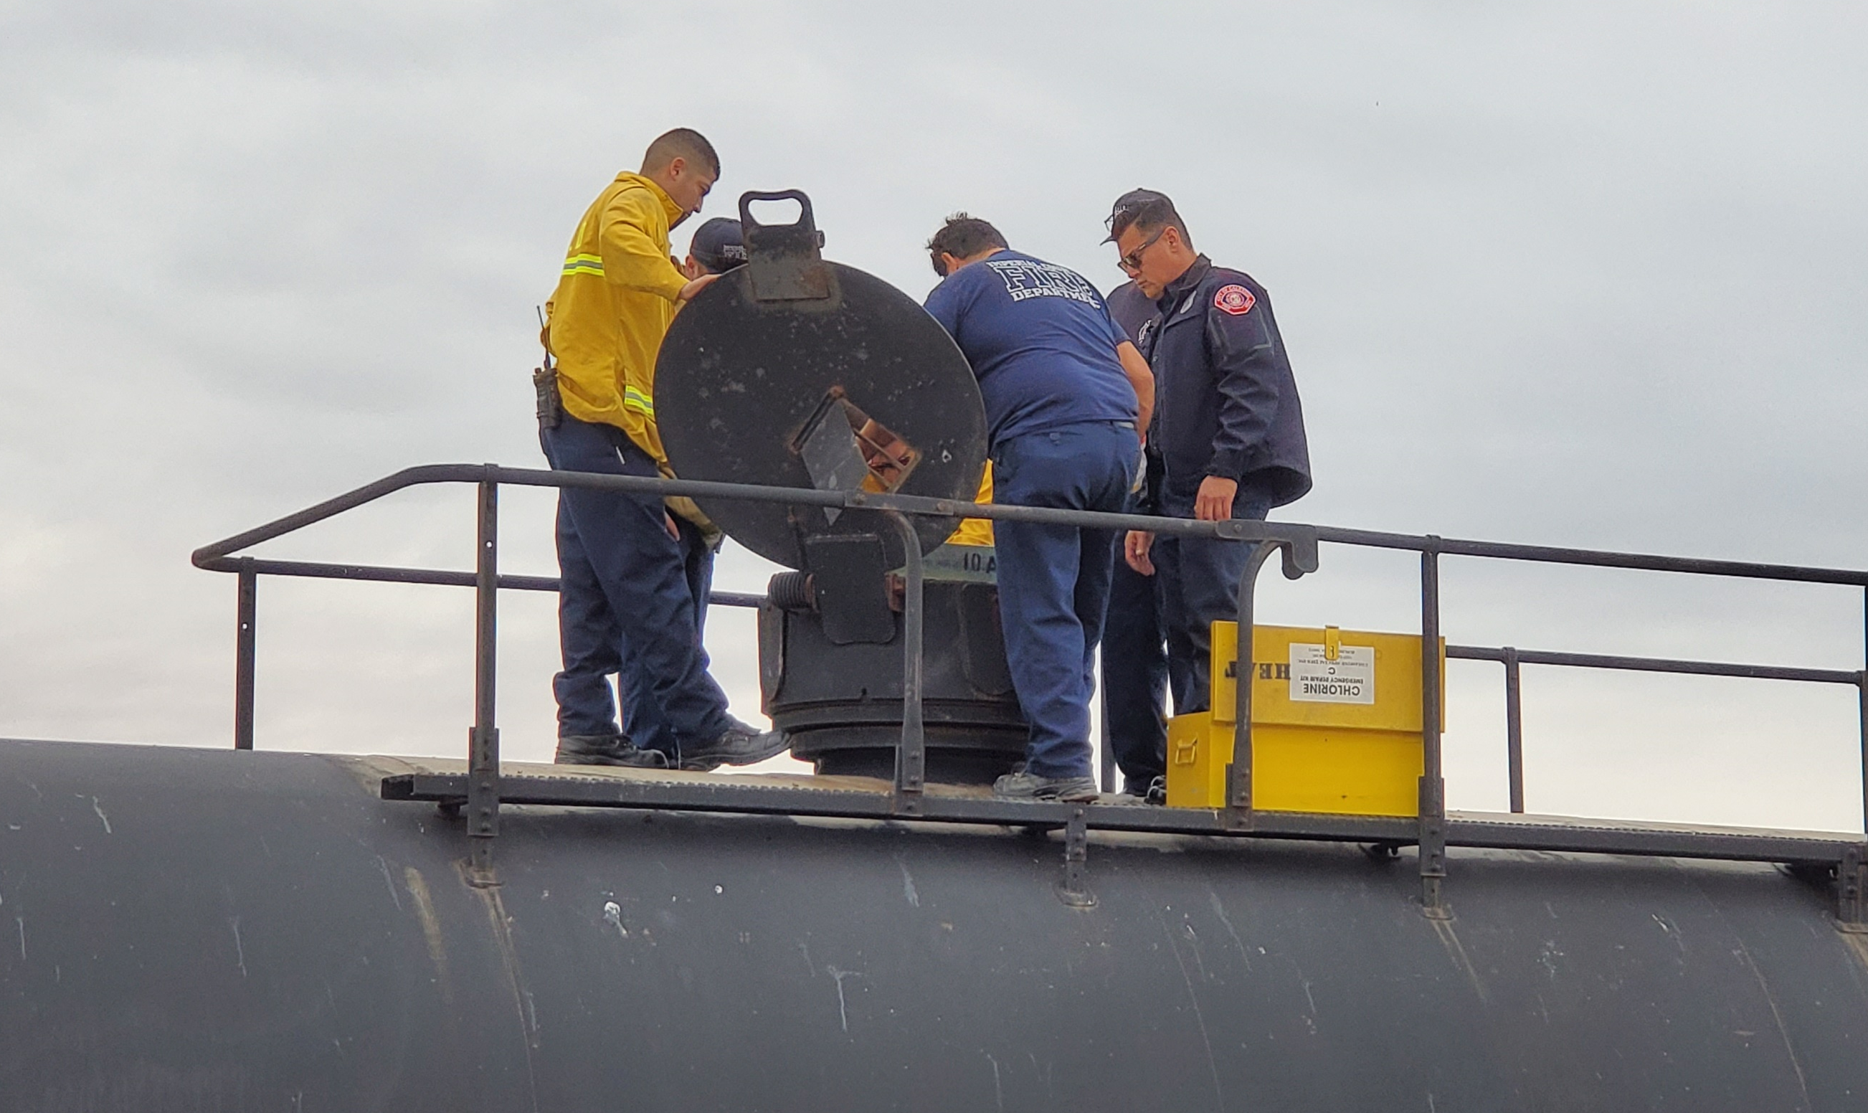
Rural communities and territories have a great need for training and support!
Notes:
HazMat routinely moves through areas that doesn’t produce or use them, as result, awareness, preparedness, and safe response in these communities is lacking.
Though CS we promote a “Whole Community” approach to hazmat transportation emergency preparation and response.
Whole Community – local residents, emergency management practitioners, organizational and community leaders, and governmental officials can collectively understand and assess the needs of their respective communities and determine the best ways to organize and strengthen their capacities and interests, resulting in increased security and resilience.

Slide 5

Notes:
Our HMIT classes our at the heart of our program. Last year we had a 1-day teaching techniques class then a separate 2-day HMIT class with a deep dive into the 49 CFR and Hazardous Materials table. This year we have expanded HMIT from 2 to 3 days and incorporated last years “Best Practices” class into it. So now at the same time they are learning how to navigate the 49 CFR they are also learning how to effectively pass that knowledge to their employees.
We have also added advanced HMIT 5-day classes which includes “teach backs” as well as a tour of a local shipping facility. For example in Miami, we are taking the class on a tour of Seaboard Marine at Port of Miami, or in Hawaii a tour of Young Brothers (an interisland shipping company in Oahu), San Juan we are planning a tour of Bacardi. I’m sure we can all agree that safety training is traditionally boring. We see in our classes how these hands-on opportunities make an impression on our students they won’t soon forget. They then get to take this new motivation and techniques back to train their employees and foster a safety-focused culture that all have bought in to.

Slide 6
Commercial Vehicle Safety Alliance

Slide 7
Commercial Vehicle Safety Alliance
Thanks to the PHMSA Community Safety Grant, CVSA has been able to offer 17 in-person courses to more than 600 individuals at different locations throughout the country.

Slide 8
Commercial Vehicle Safety Alliance
We’ve offered 12 webinars to nearly 3,000 registrants
Undeclared HM Shipments
PHMSA Interpretations
HM in the FMCSRs
HM Safety Permits and Adoption of Parts 385 and 179
PHMSA Special Permits
§173.5 Agricultural Operations
HM-218H Rulemaking Update
Canadian vs. U.S. Cargo Tank Regulations
Inspecting Cargo Tanks Transporting Cryogenic Hazardous Materials
Online Resources for the Hazardous Materials Inspector
Cargo Tank Testing Update
HM-215N Overview

Slide 9
Commercial Vehicle Safety Alliance
We have five virtual training sessions in our online learning management system
Class 3 Flammable and Combustible Materials
Hazmat Refresher Course 1
Hazmat Refresher Course 2
Hazmat Refresher Course 3
Radioactive Material Inspections for the Non-Level VI Inspector

Slide 10

Commercial Vehicle Safety Alliance
Questions

Slide 11

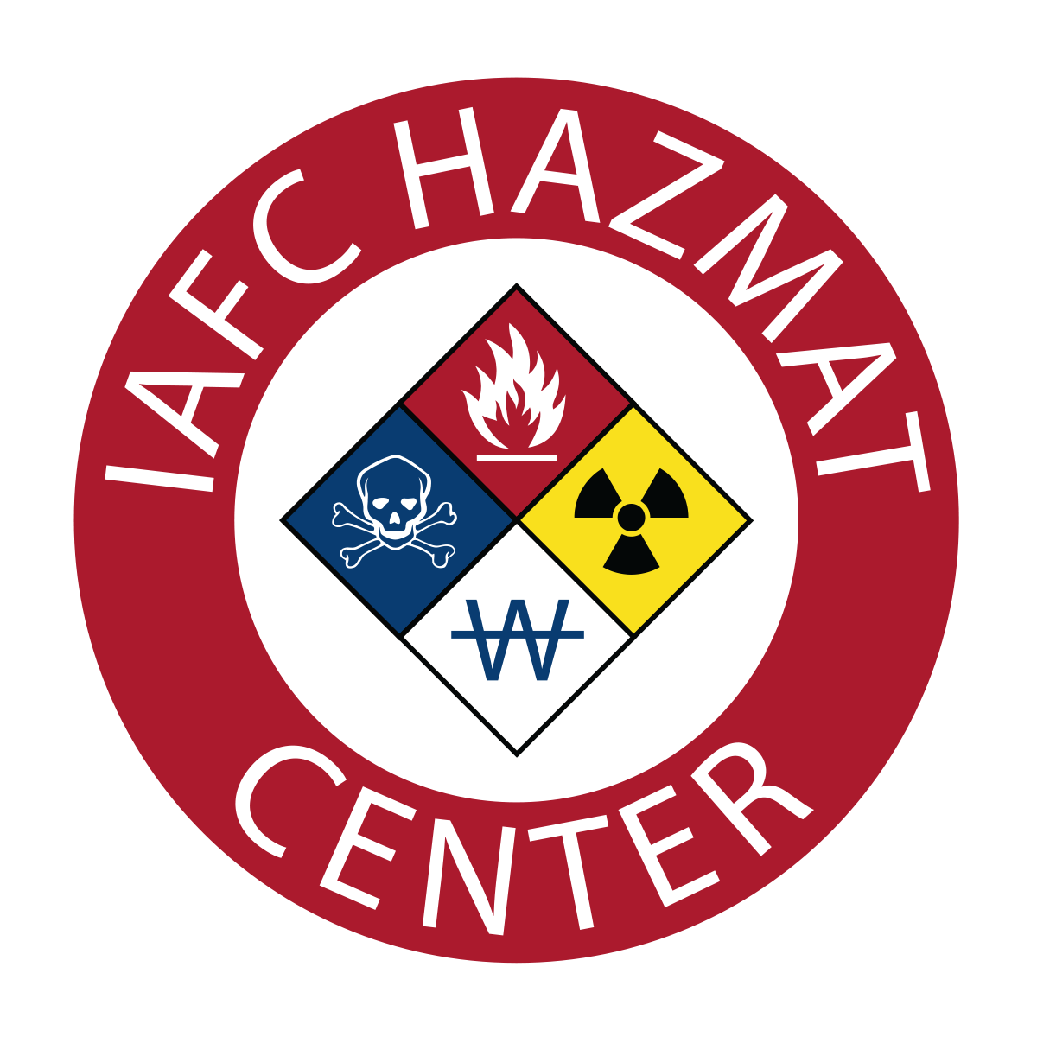
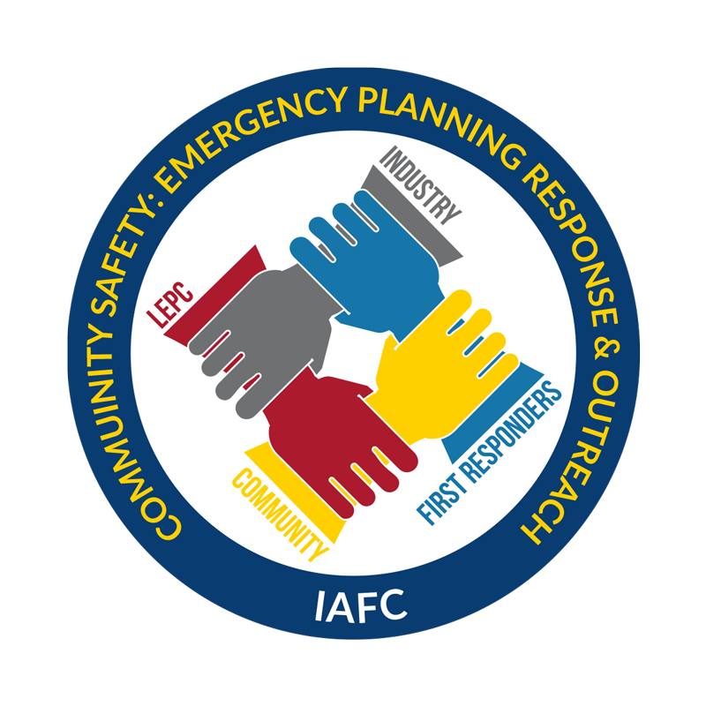
International Association of Fire Chiefs

Slide 12
IAFC – Community Safety Grant
The IAFC represents the leadership of
firefighters and emergency responders worldwide. IAFC members are the world's leading experts in
firefighting, emergency medical services, terrorism response, hazardous response, natural disasters, search and rescue, and public safety legislation.
The Community Safety-EPRO Grant is designed
to create community training, preparing for over the road, rail and pipeline HazMat incidents, especially in rural areas.

Slide 13
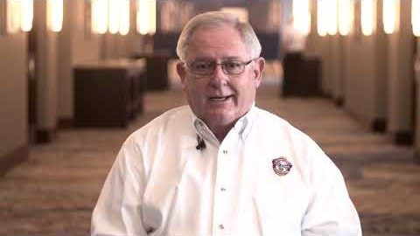
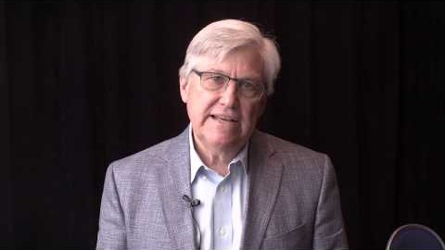
CSG – Program Activities
Task I – Collaborate and Expand the Technical Advisory Group
15 active members representing 10 LEPCs around the country
Meet once a month via conference call.
Task II – Resource Maintenance and Development
Maintained on the Hazmat Fusion Center Website
- LEPC 101 Series (Blog Posts, Videos, Resources)
- LEPC Spotlight
- Government Policy Updates
- Industry Updates
- Shared on IAFC Hazmat FC social media pages
Task III – Whole Communities Planning for Disasters Training
Two Pilots with Tim Gablehouse providing feedback
Eight scheduled between June 2020 – September 2020
Notes:
If allowed, show top video 2:30 minutes in length.
If allowed, show bottom video 1:40 minutes in length.

Slide 14
CSG – Program Activities
Task IV – Engage with LEPCs on the boarders of Canada and Mexico
Santé Fe, NM
Ontario, Canada
El Paso, TX
Tucson, AZ
Task V – National LEPC Survey
Survey Fire Service Communication with their LEPC
Tim Gablehouse and EPA to assist in dispersing the surveys
Evaluations/Monitoring
Tim Gablehouse pilot evaluations
Post surveys from Whole Communities Participants
Bi-monthly analytics of LEPC webpage visits
Qualitative and quantitative analysis of national survey

Slide 15

Questions

